Slide 2
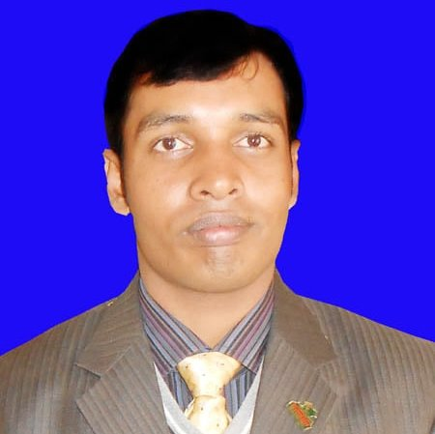
Class –Nine
UNIT-1, LESSON-1
Md. Akhtarul Islam
Assistant Teacher English
Boalia BLHigh School
Gomastapur, Chapainawabganj

Slide 3
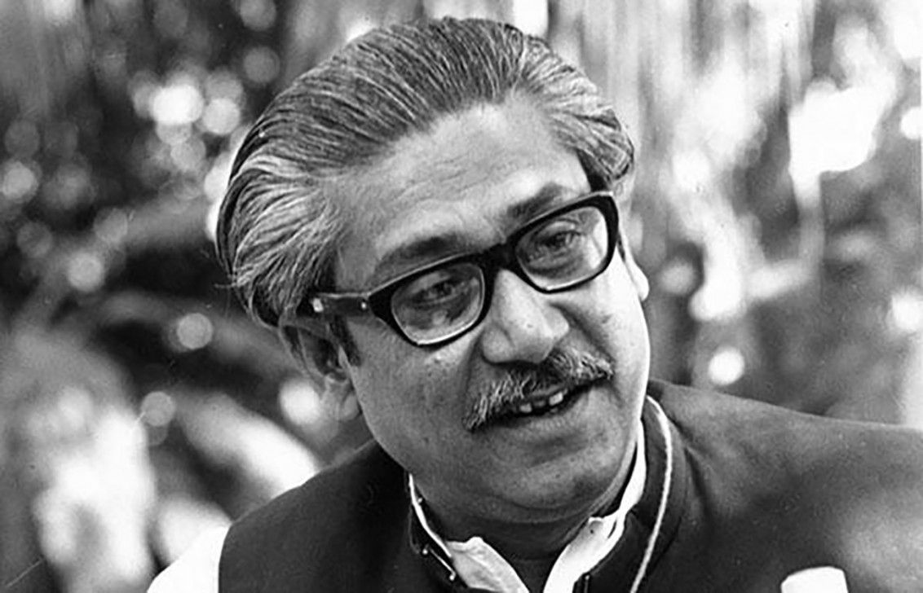
Do you know this person?

Slide 4
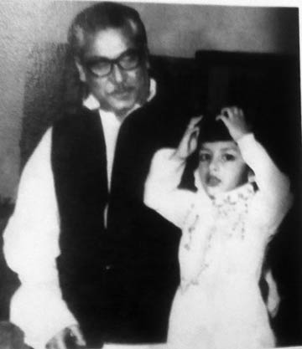
Just imagine
Notes:
The learners will be asked for guessing the pictures’ name .After that the phrase will be shown.

Slide 5
Today our lesson is ………….
Bangabandhu’s family in 1971

Slide 6
LEARNING OUTCOMES
By the end of the lesson the learners will be able to….
Read and understand text.
Narrate incident and event.
Participate in conversation.
Tell stories.
Notes:
This slide may be shown or not in the classroom.

Slide 7
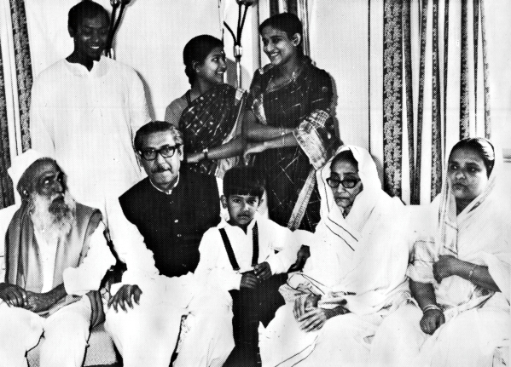
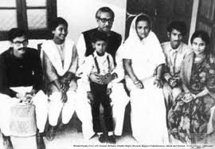
Who can you see in the pictures

Slide 8
Probable answer
We can see in the picture Bangabondhu Sheikh Mujib’s Family.

Slide 9
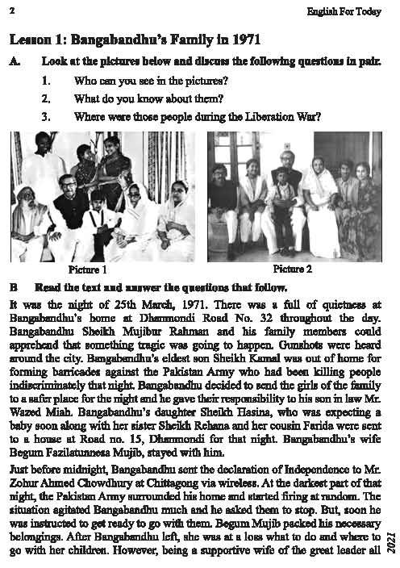
Now read the text in in B

Slide 10
List the Five ways of Pakistani Army Torture Bangabondhu’s Family.

Slide 11
Here is the Suggested List
Exhibition showcases torture by Pakistani army during 1971 war
Following launching of bush war against the Pakistan army after Bangabandhu Mujibur Rehman gave a clarion call for fight against Pakistani rulers, thousands of refugees entered into Tripura for shelter.
Tripura accommodated 16 lakh people, which was more than its own population that time. Tripura was also the war headquarters of the Bangladesh liberation war 1971.
"Pakistani Army massacred more than 30 lakh Bangladeshis and raped six lakh women during the liberation war which is an instance of barbaric acts by the Pakistani army and we are showcasing these facts to make aware about the history to the people, particularly the young generation," Mamun claimed.

Slide 12
Discuss the sufferings of the People in Liberation War

Slide 13
Match Your Answer
The genocide in Bangladesh began on 26 March 1971 with the launch of Operation Searchlight, as West Pakistan (now Pakistan) began a military crackdown on the Eastern wing (now Bangladesh) of the nation to suppress Bengali calls for self-determination. During the nine-month-long Bangladesh War for Liberation, members of the Pakistani military and supporting Islamist militias from Jamaat-e-Islami killed between 300,000 and 3,000,000 people and raped between 200,000 and 400,000 Bengali women, according to Bangladeshi and Indian sources, in a systematic campaign of genocidal rape. The actions against women were supported by Jamaat-e-Islami religious leaders, who declared that Bengali women were gonimoter maal (Bengali for "public property").As a result of the conflict, a further eight to ten million people, mostly Hindus, fled the country to seek refuge in neighbouring India. It is estimated that up to 30 million civilians were internally displacedout of 70 million. During the war, there was also ethnic violence between Bengalis and Urdu-speaking Biharis. Biharis faced reprisals from Bengali mobs and militias and from 1,000to 150,000 were killed.
There is an academic consensus that the events which took place during the Bangladesh Liberation War constituted a genocide. However, there are scholars who deny the killing was a genocide.

Slide 14
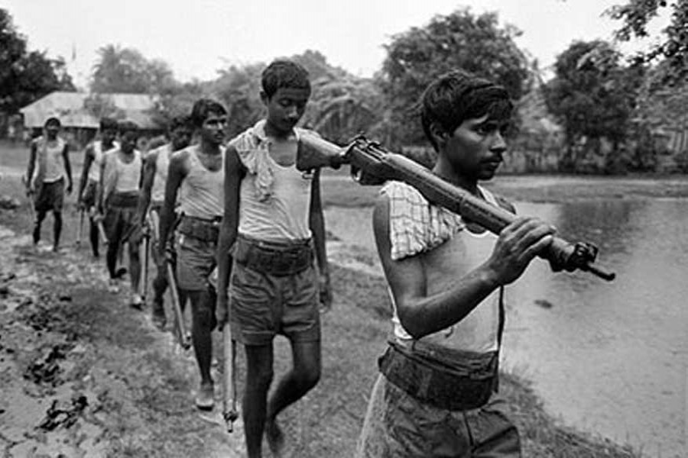
Home Work
Write a short paragraph on Liberation War

Slide 15
Thank You All

