Slide 1




Slide 2



Identity
Class: One
Subject: English
Alphabet. Lesson:4-6,
Unit : 2. Page : 5
Mohammod Abdul Hannan
Assistant teacher
Chunghor Govt. primary school
Kulaura, Moulvibazar.

Slide 3
Learning Outcomes
Students will be able to-
1.1.1 to become familiar with English sounds by listen to
common English word.
1.1.2 to say simple words.
1.2.1 to recognize and read the alphabet both small and
capital (non-cursive) letters.
3.1.2 write words using non-cursive small letters.

Slide 4

Lets See a Video

Slide 5
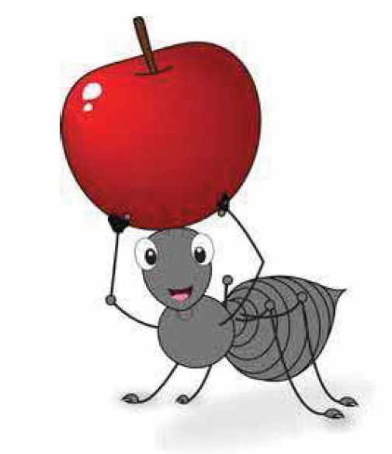
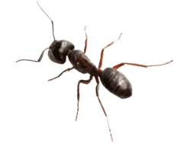
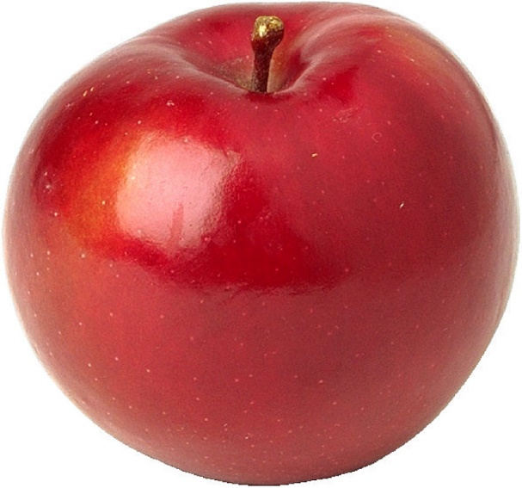
What can you see in this picture?
Ant
Apple

Slide 6
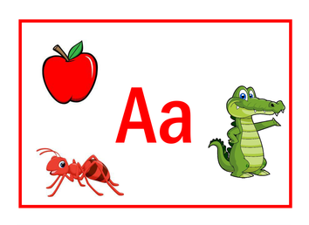
Lesson Declaration
Alphabet
A a

Slide 7
Input
Look, listen and say. Trace in the air.
A
Ant

Slide 8

Look, listen and say. Trace in the air.
A
Arm

Slide 9

Open at page 5

Slide 10

Loud reading by the teacher
WCW
Apple
A
a
apple
Ant
A
a
ant

Slide 11


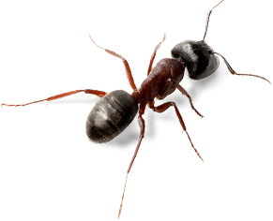

Practice
Match the pictures with the letters:
Group work
Apple
A

Slide 12
Practice
Match the pictures with the letters:
Group work
Apple
A

Slide 13


Say and read. Trace and write.
WCW
A
A
A

Slide 14

Evaluation
Look, Say and Write.
Look at the picture and fill in the gaps:
Ant
Apple

Slide 15


