Slide 1
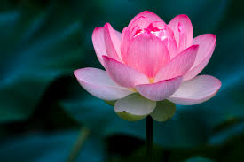
Welcome

Slide 2
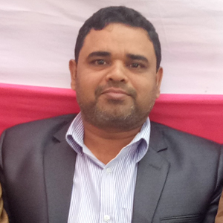
INTRODUCTION
Abdul Aziz
B.A(Hon’s), M.A(English
Assistant Teacher (English)
E-mail: azizabidpur@gmail.com
Mobile: 01921767310
Class –Nine
English 2nd Paper
Unit : 01
Topic: The Noun

Slide 3
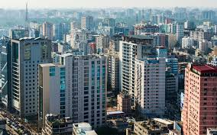
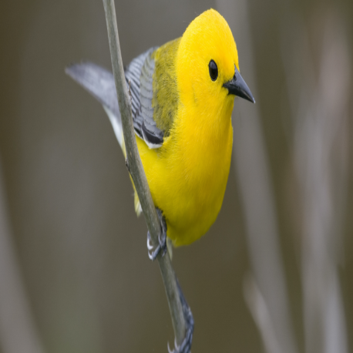
Look at the pictures
River
Dhaka city
A bird
A flower
Theses are all names.

Slide 4
So, our today’s topic is

Slide 5
Learning Outcomes
After the end of the lesson, students will be able to –
Talk about nouns
Describe the classifications of nous

Slide 6
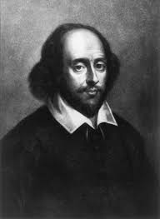
A. Read the following passage and notice the underlined words.
Shakespeare was born in 1564 at Stratford –upon-Avon in England. He was a poet, playwright and actor. He is widely known as the greatest writer in English and the world’s prominent dramatist. He enjoys his popularity even in the modern age for his plays and poems.
The bold and underlined words are nouns
The noun is a naming word. It may name a person,
place or thing.

Slide 7
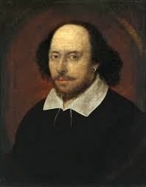
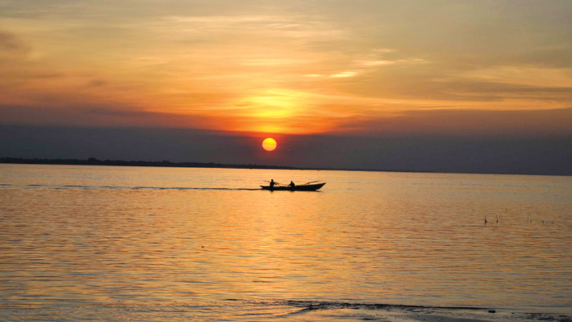
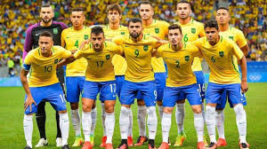
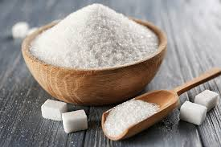
There are five kinds of nouns in English
Proper nouns
Common nouns
Collective nouns
Material nouns
Abstract nouns
A river
দয়া
Football team
Sugar

Slide 8
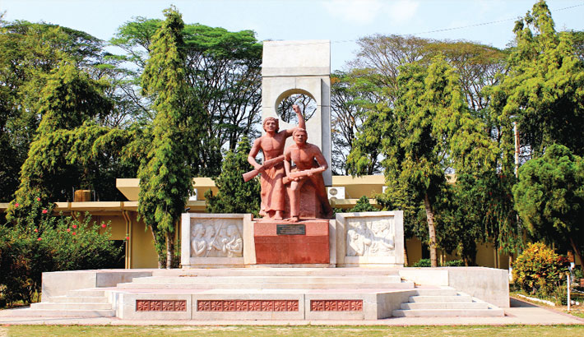
Proper Noun
Rajshahi is a divisional city in Bangladesh. It stands on the river Padma. My friend Alamgir lives in this city. He is a professor of History. I often visit his and discuss with him and he speaks good English
These bold and underlined words are proper nouns.
A proper nouns is the name of a particular person, place or thing. For example, “Rajshahi”
is the name of particular city and History is the name of a particular subject. A proper nouns
is usually starts with a capital letter.

Slide 9
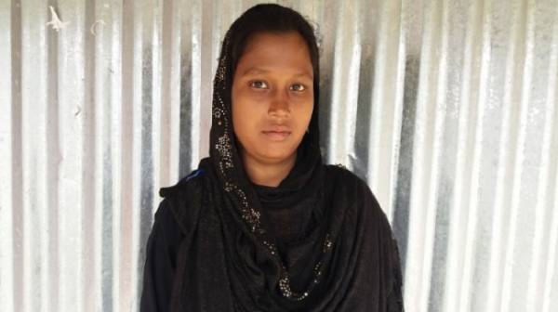
Common Noun
Nasima is a beautiful girl. She is a bright student too. She reads in a local College. She has many friends. She discusses her lessons with them. She attends classes regularly. Every teacher is fond of her.
The bold and underlined words are common nouns
A common noun refers to every person, place or thing of the same class or kind.
It does not refer to anything in particular. For example the noun ‘girl’ may mean
any girl in the world.

Slide 10
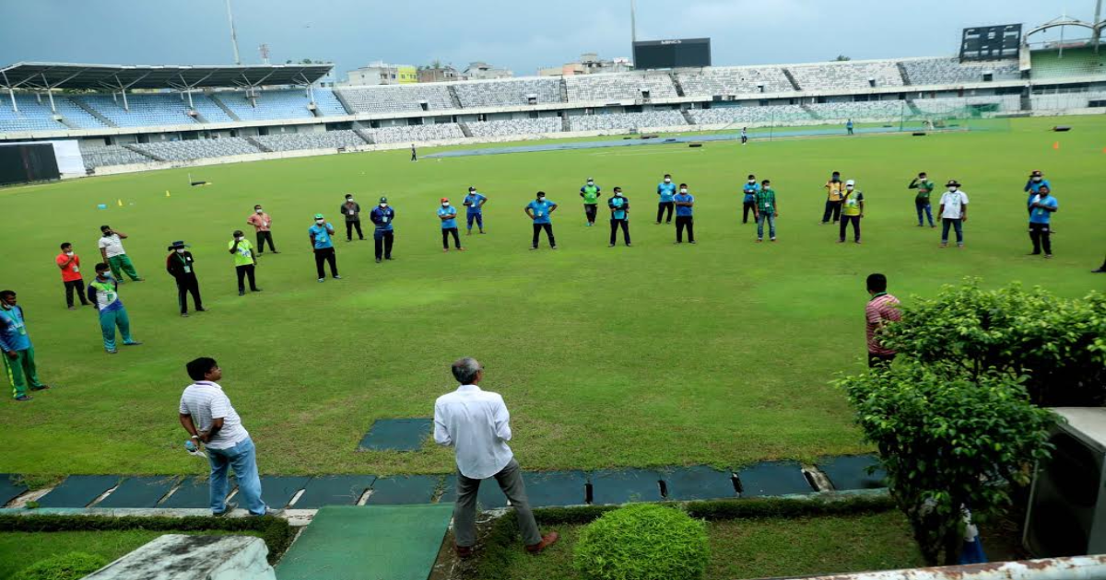
Collective noun
Salam comes of a big family. He has three brothers. His elder brother is a member of Parliament. His younger brother has recently joined the army. His other brother is a cricketer who plays for the national team.
The bold and underlined words are collective nouns
A collective noun is the name of a collection or group of people or things taken together. For example, an army is a group of soldiers and a team is a group of players.

Slide 11
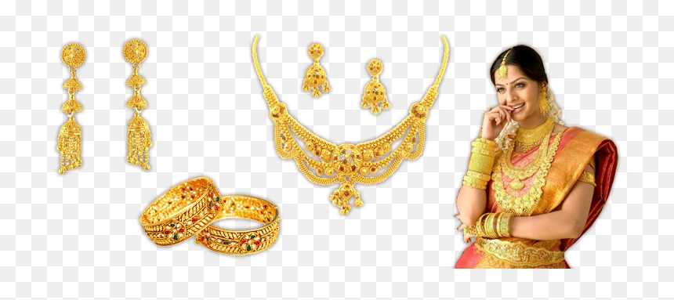
Material noun
Mrs. Rahman is now visiting a jewellary. She will buy some gold and silver. to make some jeweler. Next, she will also to to grecer’s. She needs to buy sugar, tea, milk and oil.
The bold and underlined words are material nouns.
A material noun names a thing that has weight but can not be
counted. it a kind of mass noun which is considered uncountable.
It refers to any material or substance. the substance may be solid,
liquid or gaseous. “Oxygen” is also a material noun.

Slide 12
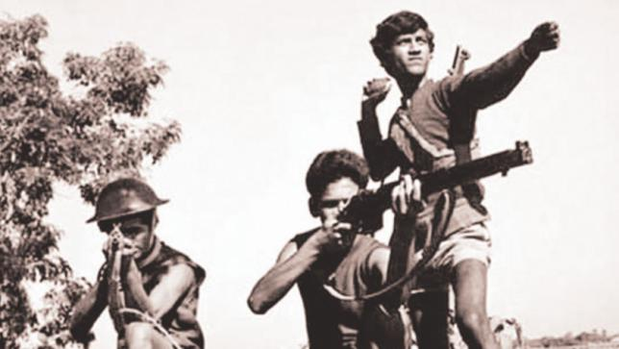
Abstract noun
Mr. Haque was a freedom fighter. He is known for his bravery. He is working for a private company now. Everybody loves him for his honesty and sincerity. He is an admirer of freedom and justice.
The bold and underlined words are abstract nouns.
An abstract noun is the name of a quality, state or concept. It has no
material form, shape or size

Slide 13
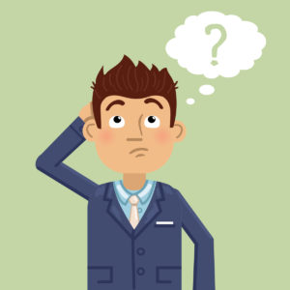
Evaluation
Think of some other abstract nouns and make a sentence with each other.

Slide 14
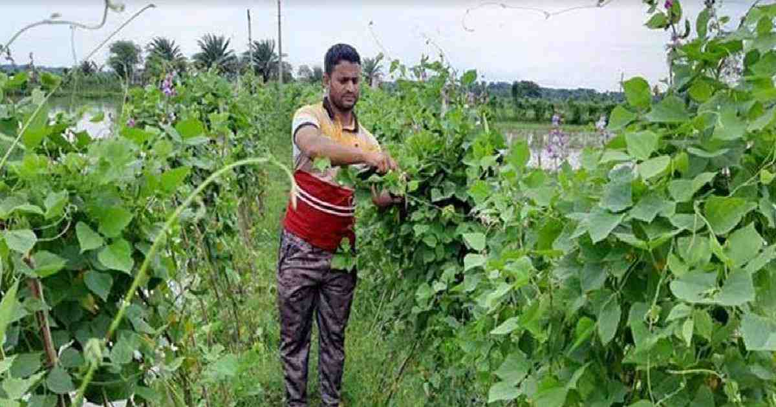
Home work
Identify the nouns in the following passage and say whether they are
Proper, Common, Collective, Material or Abstract nouns
Hasan is a rich farmer who lives in a village in the district of Sirajganj. He has a
lot of cultivable land. He grows rice, wheat and other crops. He has a herd of
cattle and other domestic animals. They provide him with milk and meat. Hasan
is a kind man. He has love and sympathy for the poor class of people.

