Slide 1
Welcome to English class

Slide 2
Md. Saifuddin khan
Lecturer in English
Hajee Goyes Uddin Mohila Fajil Madrasah
Bhangura , Pabna .
Contact Number: 01710449379
E-mail: skhan84bd@gmail.com
English 2nd paper.
Class : Nine and ten .
Part A:Grammar .

Slide 3
The eagle is more expert than any other bird in hunting.
The eagle is the most expert bird in hunting.

Slide 4
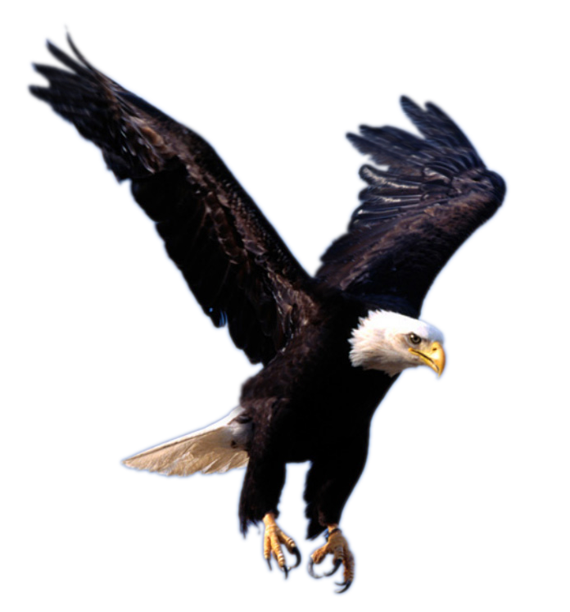
The eagle is more experienced than all other birds.
The eagle is the most experienced of all birds.
The eagle is one of the most experienced birds.
The eagle is more experienced than most other birds.

Slide 5
What is our today’s lesson?
Transformation of sentence
Comparative to Superlative

Slide 7
Learning outcomes
At the end of this lesson,ss will be able to—
identify the structure of changing comparative into superlative
change comparative to superlative.

Slide 8
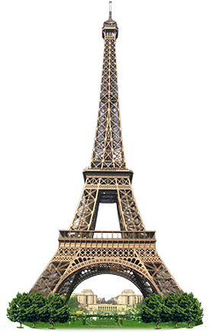
How to change Comparative (with ‘any other’) into superlative.
Eiffel tower is taller than any other tower.
Eiffel tower is the tallest tower.
Subject +verb +the + superlative form +extension.
It is longer than any other tower.
It is the longest tower.

Slide 9
This island is more beautiful than any other island.
This island is the most beautiful island.

Slide 10
Single work
This is more charming than any other scenery.

Slide 11
Pair work
Change the sentences into superlative.
Truth is better than any other thing.
It is more valuable than any other worldly wealth.
It is nicer than any other possession.
Character is more glorious than any other quality.
It is also better than any other abstract quality.
Notes:
.

Slide 12
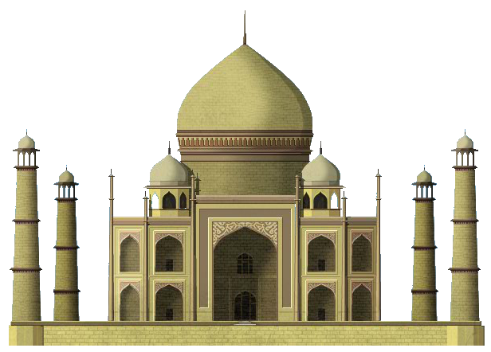
How to change Comparative (with ‘all other’ ) into superlative.
The Taj Mahal is more attractive than all other architectures.
The Taj Mahal is the most attractive of all architectures.

Slide 13
Group work
The parrot is nicer than all other birds.

Slide 14
How to change Comparative (with ‘most other’ ) into superlative.
Bermuda
Triangle
The Bermuda Triangle is more dangerous than most other devil’s seas.
The Bermuda Triangle is one of the most dangerous devil’s seas.

Slide 15
Evaluation
The dead sea is more exceptional than most other seas.

Slide 16
Home Work
Change the sentences into superlative degree
He is nobler than any other person.
Rubel is younger than all other boys in the class.
“Hamlet” is more popular than most other dramas.
Akbar was greater than all other kings of India.
Nasser Soomro is taller than most other men.

Slide 17
Thanks to all

