Slide 1
welcome

Slide 2
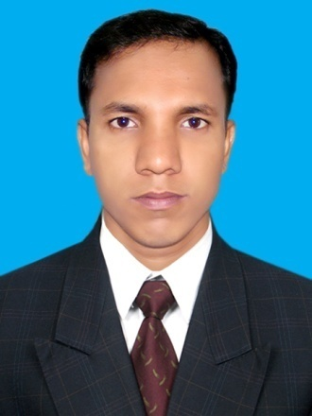
Presented By
Mohammad Azizul Hoque
Assistant Teacher
Alinapara Government Primary School.
Sherpur Sadar , Sherpur.

Slide 3
Lesson Identity
Subject : English
Class : 5
Topic: My Home District
Lesson Unit : My home…….the Town.
Date : 02.01.2021
Time: 40 Mins

Slide 4
Learning Outcomes
Listening:
1.3.1 Recognise which words in a sentence are stressed.
Speaking:
1.1.1 Say words, Phrases and sentences with propresonds and stress.
Reading:
1.5.1 Read words, phrases and sentences in the text with proper pronunciation, stress and intonation.

Slide 5
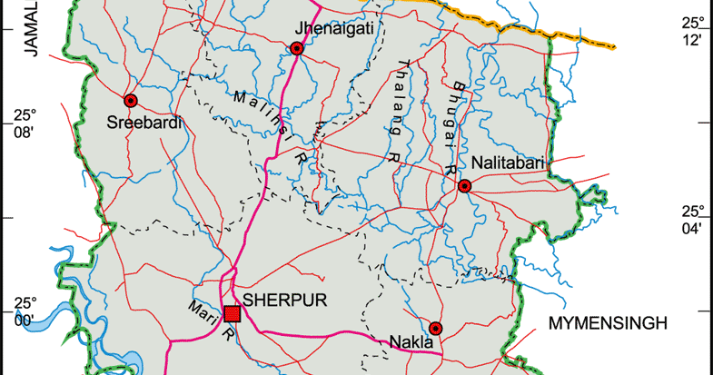
Lets see some pictures
Sherpur district

Slide 6
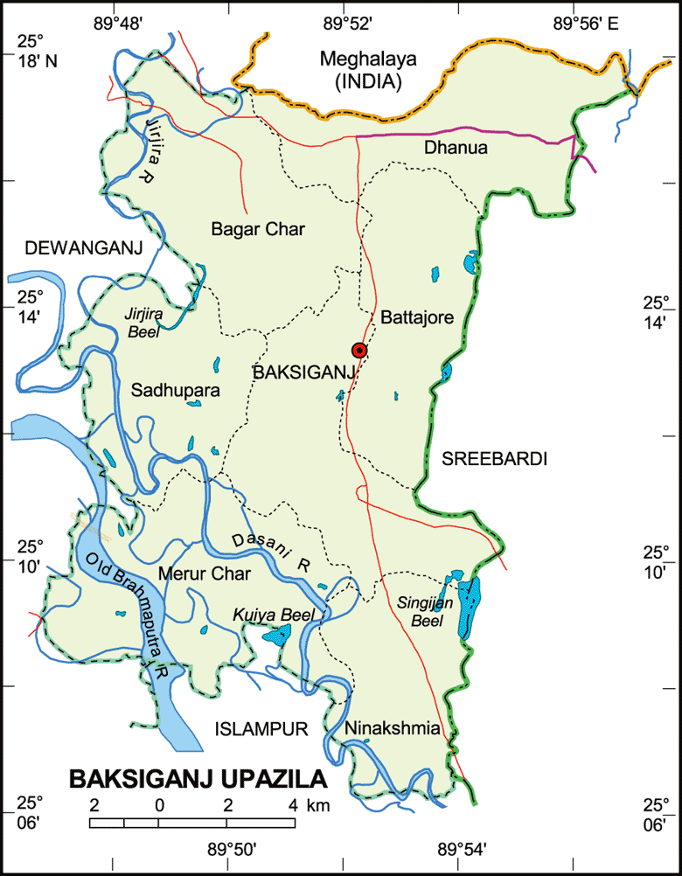
Upazila

Slide 7
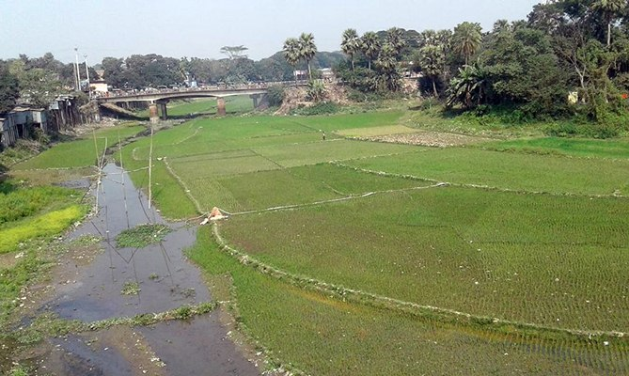
Narasunda River
What have you seen in the picture?

Slide 9
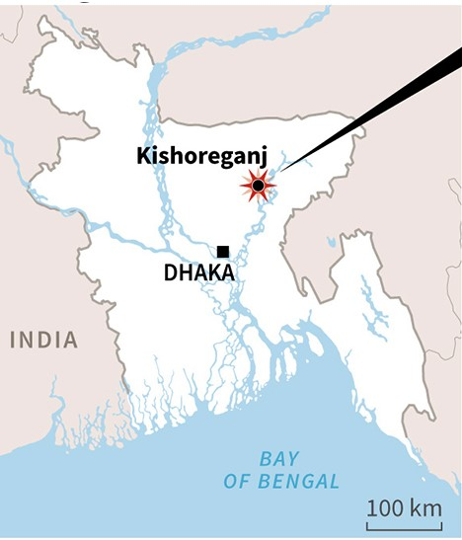
Lesson Declaration
My Home District

Slide 10
New words
Home = বাড়ি।
Union = পরিষদ।
District = জেলা।
Village = গ্রাম।
Name = নাম ।

Slide 11
One day one word
District = জেলা ।
District = There are sixty four districts in our Bangladesh.

Slide 12
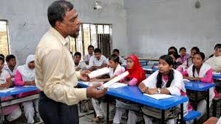
Teacher’s reading loudly

Slide 13
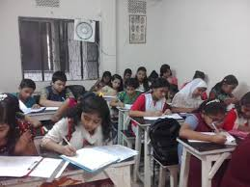
Now open at page 38
Students listen attentively

Slide 14
Group Work
Answer to the question.
Where does mamun live?
Which place are star mark?
How many upazila’s are there in Kishoreganj?
Where is narasunda river located?

Slide 15
Individual Work
My home District is……………………… .
Kishoregoanj district has ………… unions.
It is about …………kms fromDhaka.
The river……………. flows through the town.
145
Narasunda
108
Kishoreganj

Slide 16
Rearrange Words
Check your Answer
rveri
river
oinun
union
omec
come
twon
town
raea
area

Slide 17
Assesment
Whose home district are we reading about?
How many municipalities are there in kishoreganj?
How many upazila’s are there in kishoreganj?
We have learnt about the district Kishoreganj

Slide 18
Home Work
Write a five sentences about Kishoreganj?

Slide 19
Thank you All

