Slide 1
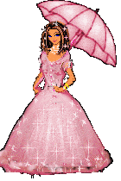
Good Morning

Slide 2
Introduction
Mohammed Hossain
Assistant teacher
Monipur gps
Shahrasti, Chandpur
hossainmd603@gmail.com
Class:Play
Subject:English
Time:45 mins

Slide 3
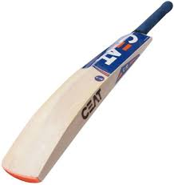
Look and Say
B
at

Slide 4
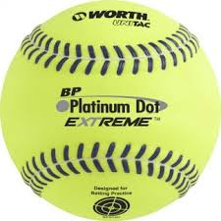
What they are called?
B
oll

Slide 5
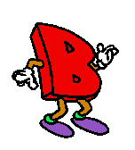
Look, Listen and Say

Slide 6
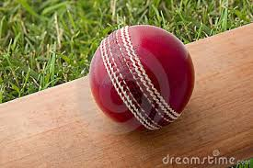
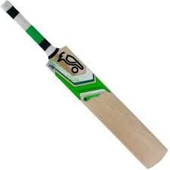
Look,listen and say
B

Slide 7
Lesson Declaration
B

Slide 8
Find The Letter
B

