Slide 1



Welcome

Slide 2

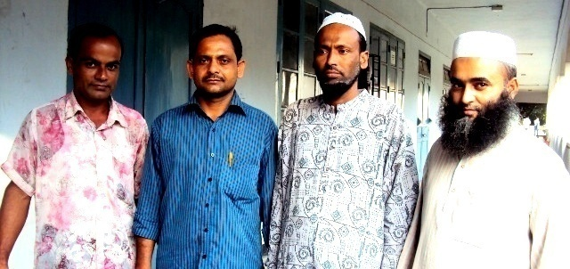
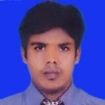

Teacher’s Information
Introduction
Anwarul Islam
Assistant Teacher (English)
Annada Govt. High School Brahmanbaria
Time: 40 Minutes
Contact # 01715456452
Email: anwarulislamratan@gmail.com
Md. Shamsul Alam
BA(Hons.)MA in English.
Assistant Teacher( English)
Nabodoy Girl’s High School
Shailkupa, Jhenaidah.
Phone:01917-452052,01722-922691
Email:shamsul101085@gmail.com

Slide 3
Subject
English 1st Paper
Class :Nine
Unit: Seven . Lesson: Six

Slide 4
Today’s Lesson
Love for humanity

Slide 5
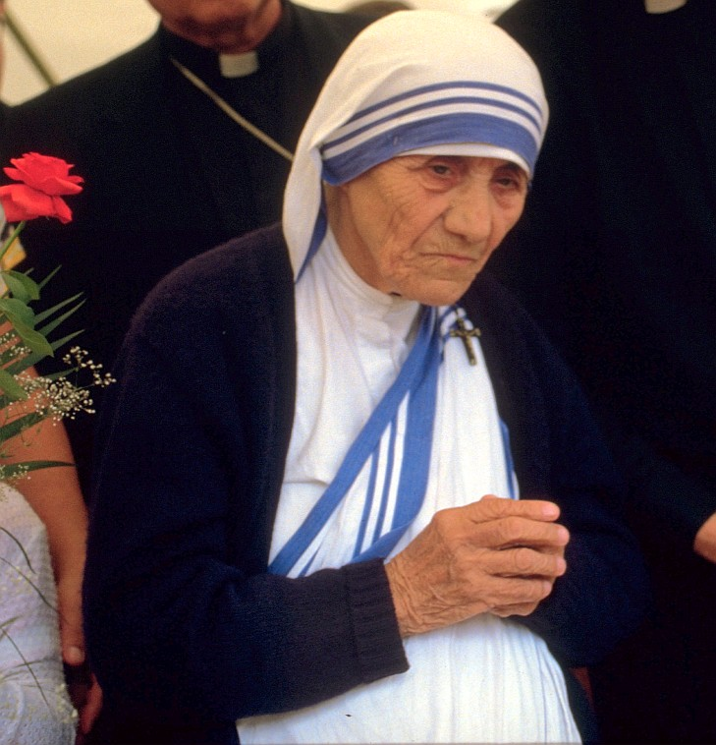
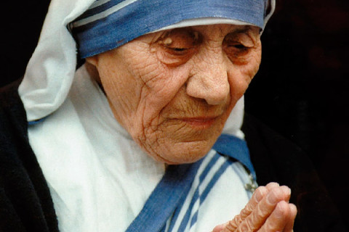
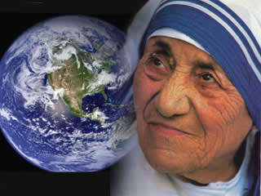
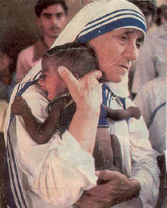
Mother Teresa

Slide 6
LEARNING OUTCOME
SS will be able to say some thing about famous persons.
SS will be encouraged to do good work.
SS will be able to read and understand texts through silent reading.

Slide 7
New vocabulary:
Destitute : extremely poor
Nun : a woman belonging to a female
religious community.
Divine : of or like God or god
Missionary : a person sent on a religious
mission
Charity : an organization set up to provide
help and raise money for those
in need

Slide 8
Survive : stay alive
Compassion : sympathy
Irrespective : regardless of
Creed : statement of religious belief , faith
Caste : Hindu social class
Saintly : very holy and good
Wrinkled : a slight line or fold

Slide 9
Individual Task
Read the passage silently and write whether the following statements are true or false. If false give the correct information.
1. Mother Teresa was moved to see the diseases that spread in the streets of Kolkata.
2. She opened a home for the orphans.
3. Nirmol Hridoy was founded so that the poor people who are dying can get love and care before death.
4 . She and her group brought in the dying people from the streets of Kolkata.
5. Mother Teresa said that humanity passes through charitable organization

Slide 10
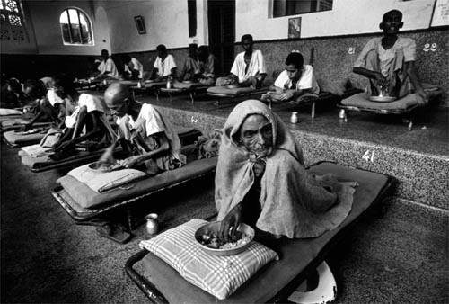
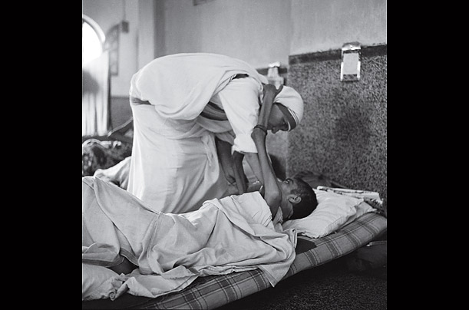
Let us see some pictures
Mother Teresa is serving the dying people in her home ‘Nirmol Hidoy’

Slide 11
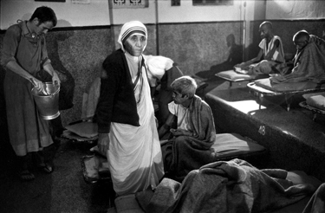
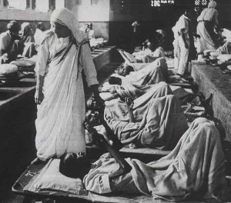
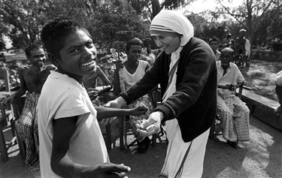
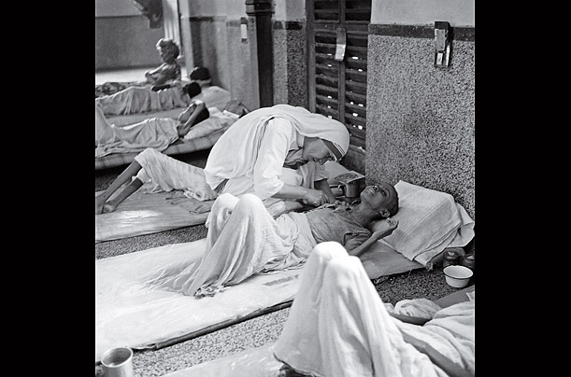
Mother Teresa’s Home For The Sick & Dying Destitute

Slide 12
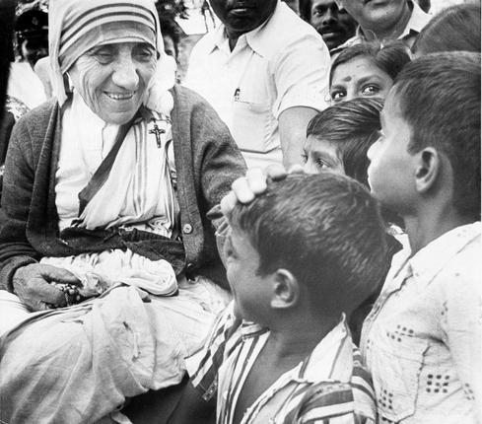
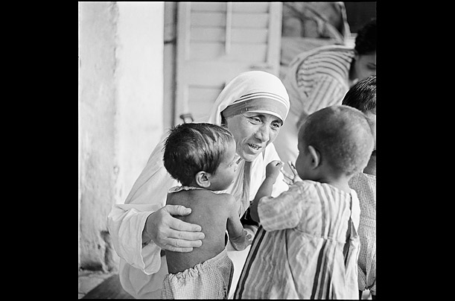
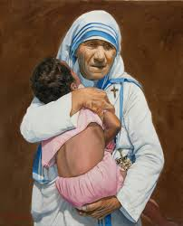
Mother Teresa with children

Slide 13
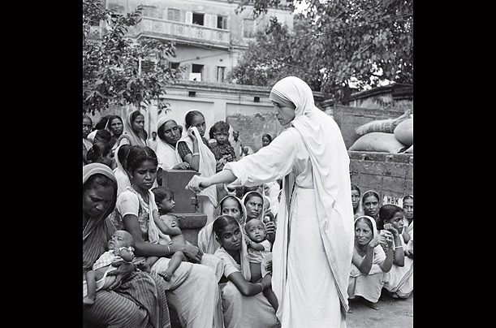
Mother Teresa with poor women

Slide 14
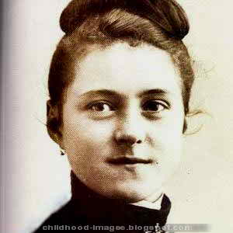
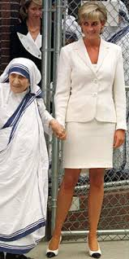
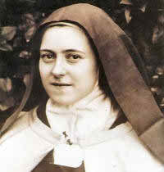
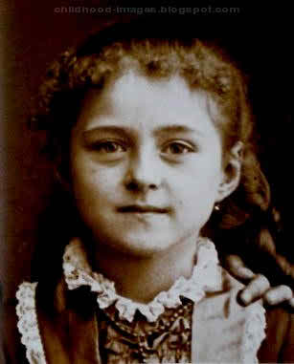
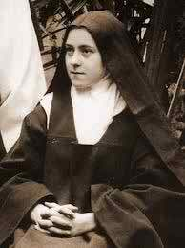
Some snaps of her early age
With Diana

Slide 15
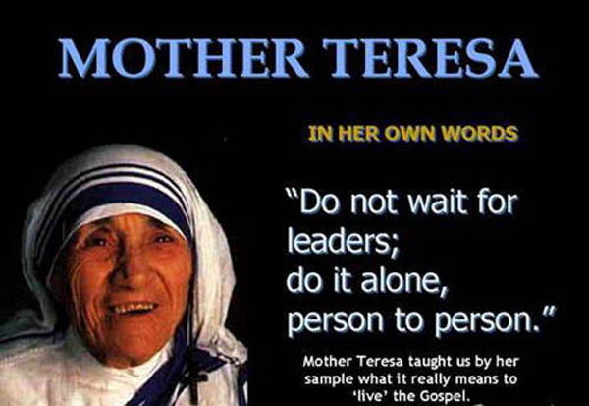
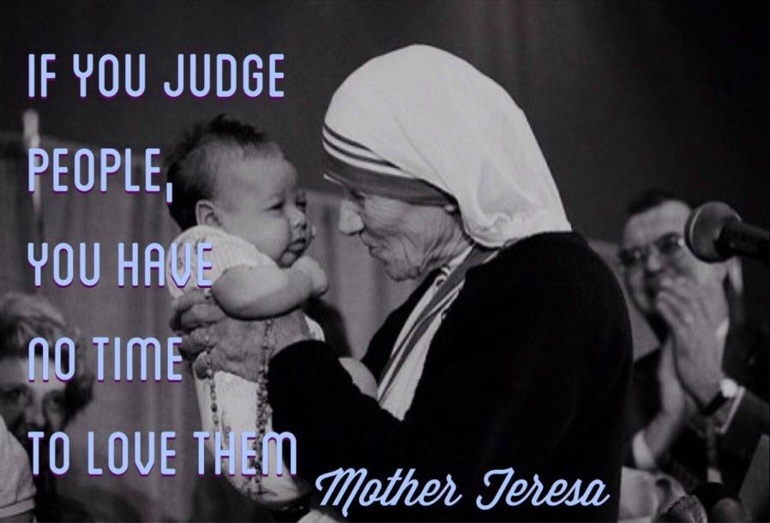
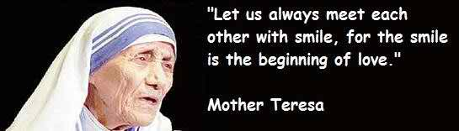
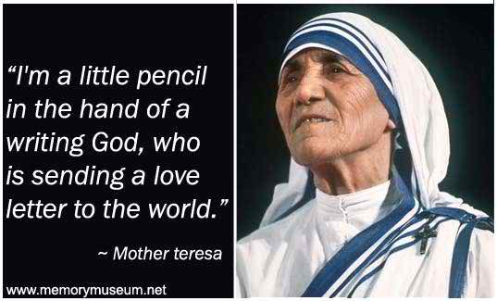
Some words of her own

Slide 16
Evaluation
Answer the following questions.
1. Why do you think mother Teresa won so many awards.
What does Nirmol Hridoy stand for?
Why do you think the home is named ‘Nirmol Hridoy’?
What are the things that we have learnt from Mother Teresa?

Slide 17
Home Work
Write an article on how you will help the helpless people?

Slide 18


