Slide 1


Welcome
To
online class

Slide 2


Teacher’s Information
Md. Shamsul Alam
BA(Hons.)MA in English.
Assistant Teacher( English)
Nabodoy Girl’s High School
Shailkupa, Jenaidah.
Phone:01917-452052,01722-922691
Email:shamsul101085@gmail.com

Slide 3
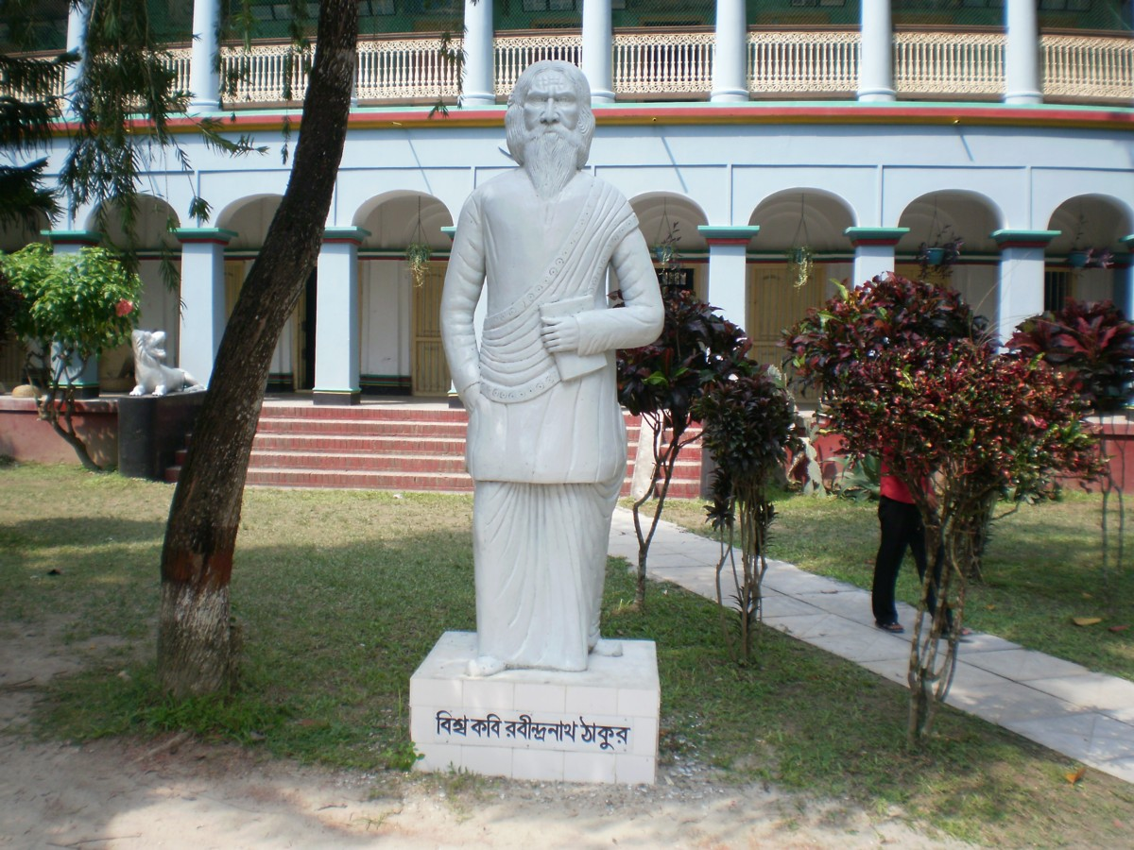
Robindranath Tagore

Slide 4
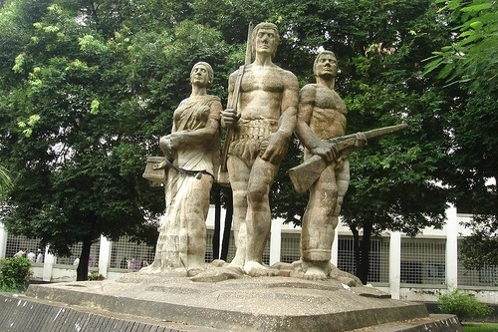
Aparajeo Bangla

Slide 5
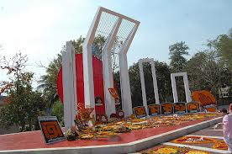
Shahid Minar

Slide 6
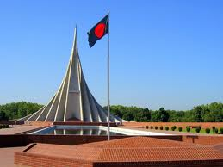
The National Memorial of Bd.

Slide 7
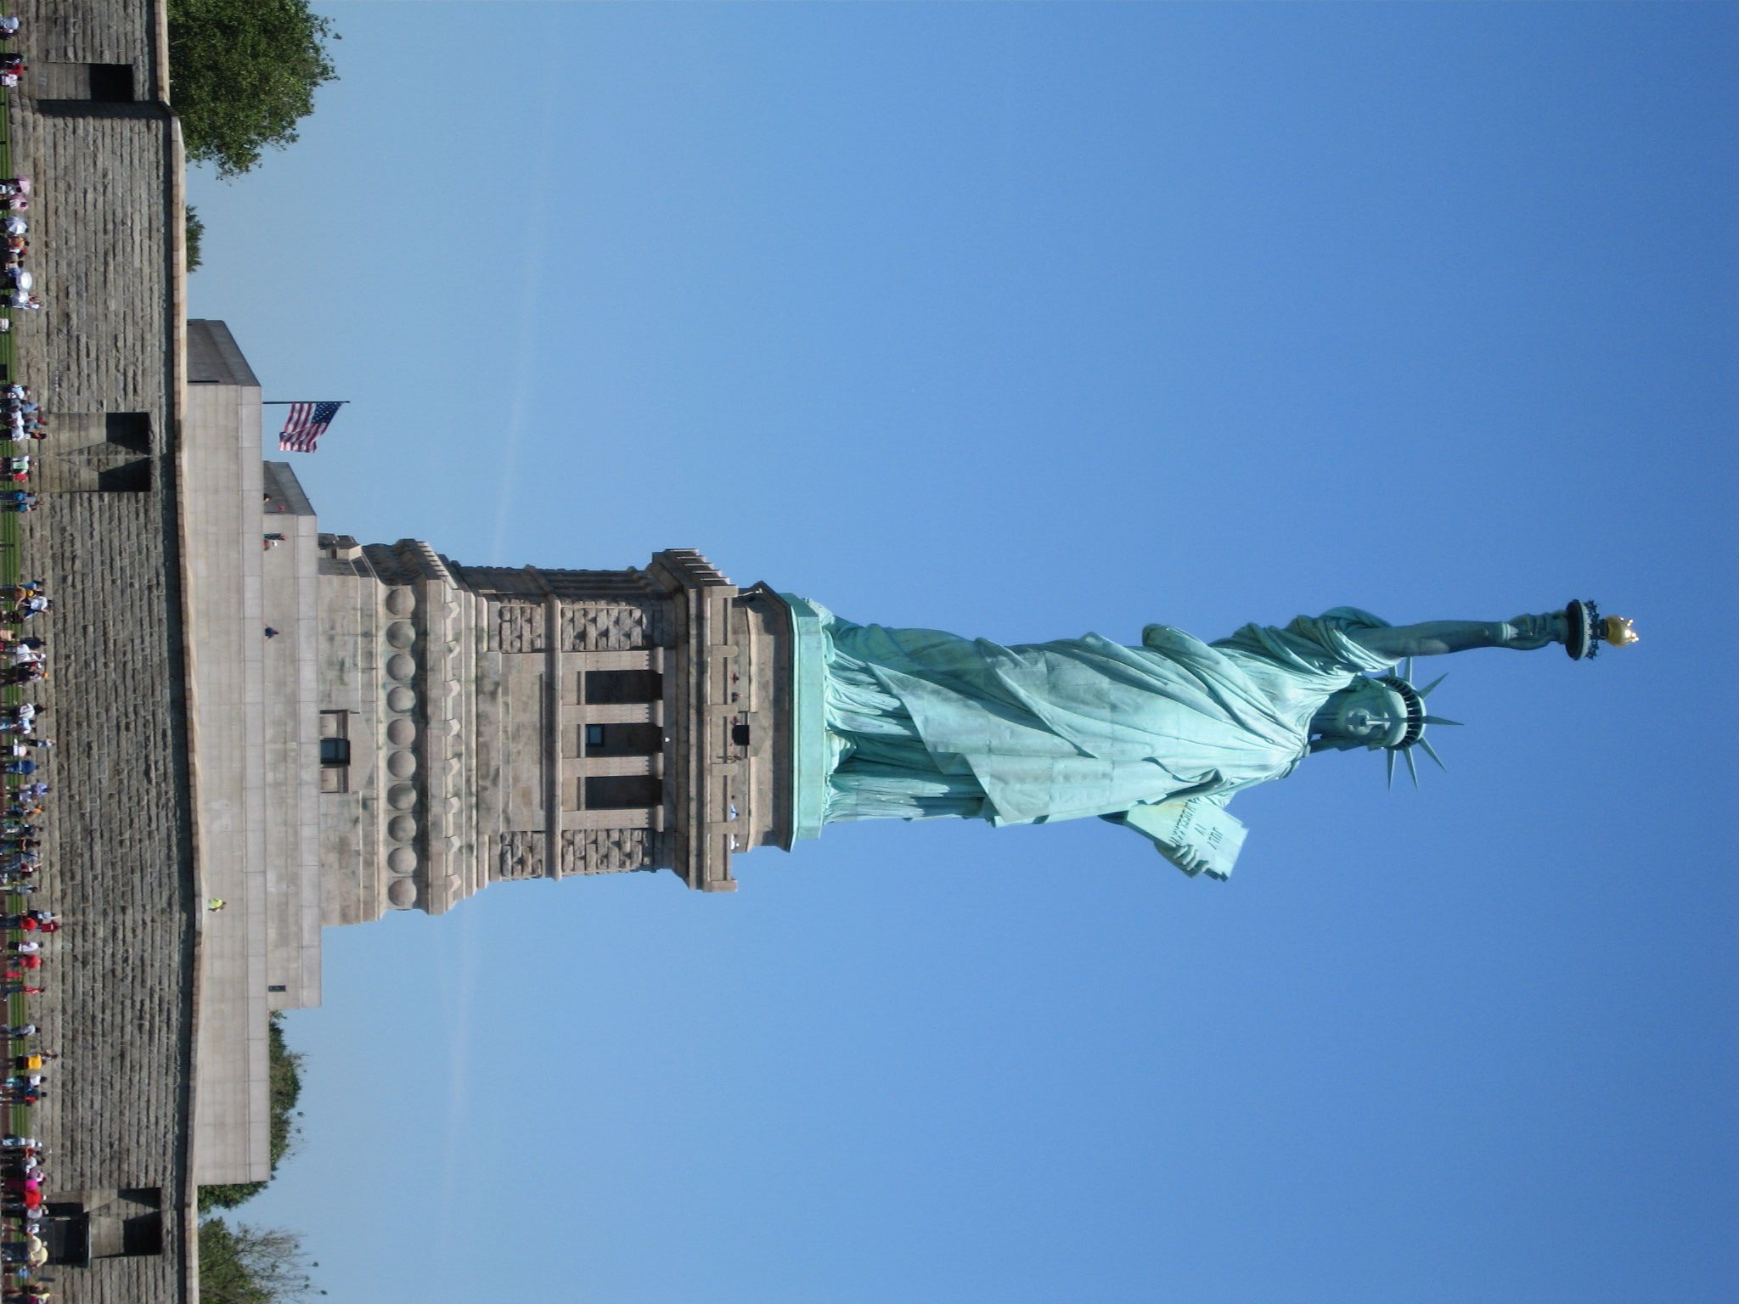
The Statue of Liberty

Slide 8
So, our today’s topic is ……………………….?
The Statue of Liberty
Unit-8, lesson-3

Slide 9
Objectives:
By the end of the lesson students will have
asked and answer questions about statues.
read a text on the Statue of Liberty.
answered questions.
Improved reading , speaking and writing skill.

Slide 10
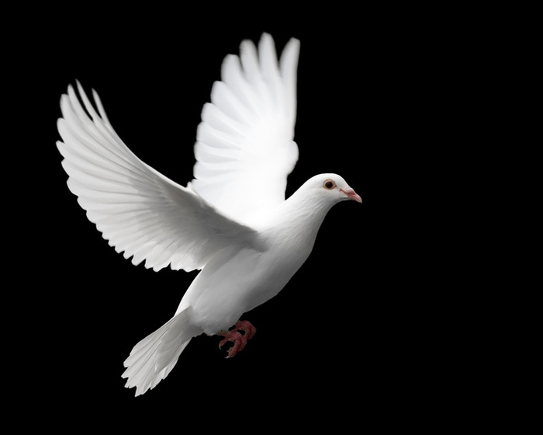
Vocabulary:
Symbolize:
Stand for /mean
Pigeon symbolises peace.

Slide 11

Aloft:
High up in the air
Our national flag is flying aloft.

Slide 12
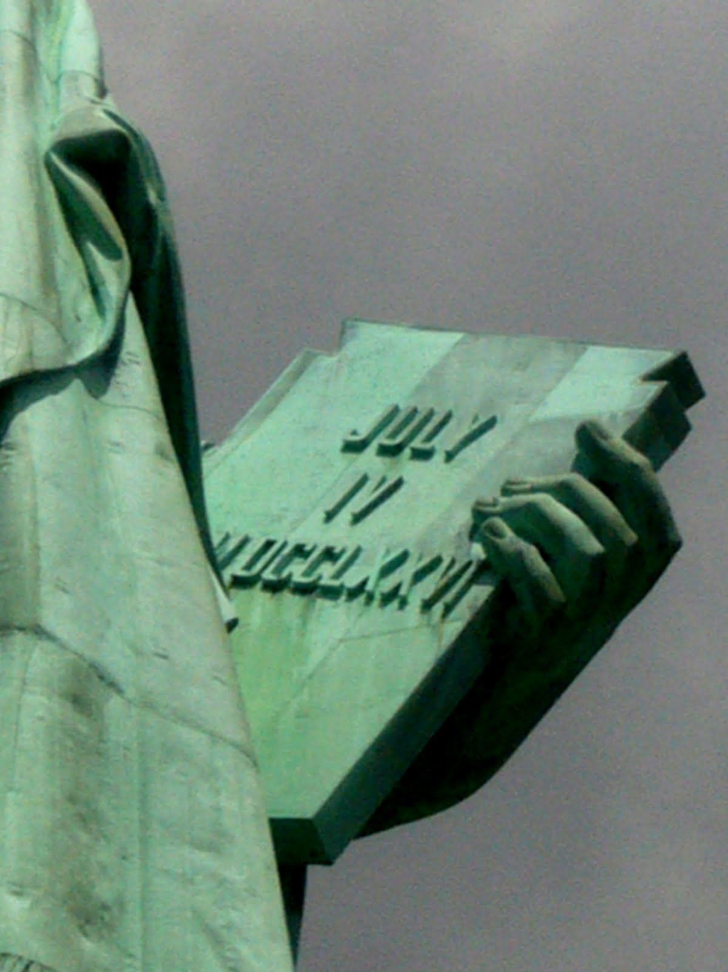
Inscribe:
Cut , print or write words on something.
The date of US independence is inscribed on the book.

Slide 13
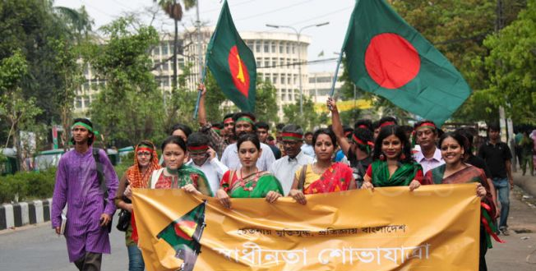
Commemorate:
to celebrate
People are holding a rally to commemorate our independence .

Slide 14
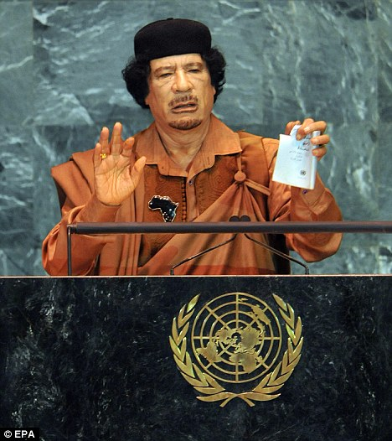
Overthrow:
Bring down /remove from power.
Gaddafi has been overthrown by US Army.

Slide 15
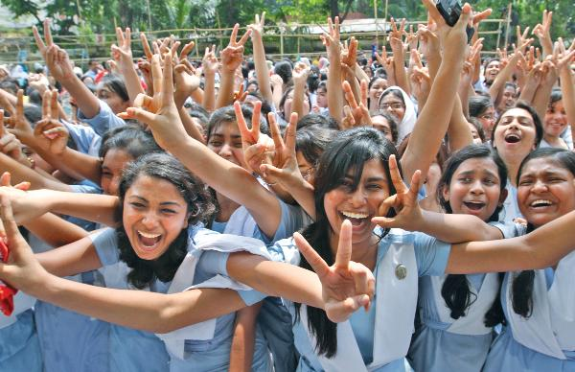
Gesture:
sign
The girls are showing the victory gesture.

Slide 16
Let’s enjoy a video

Slide 17
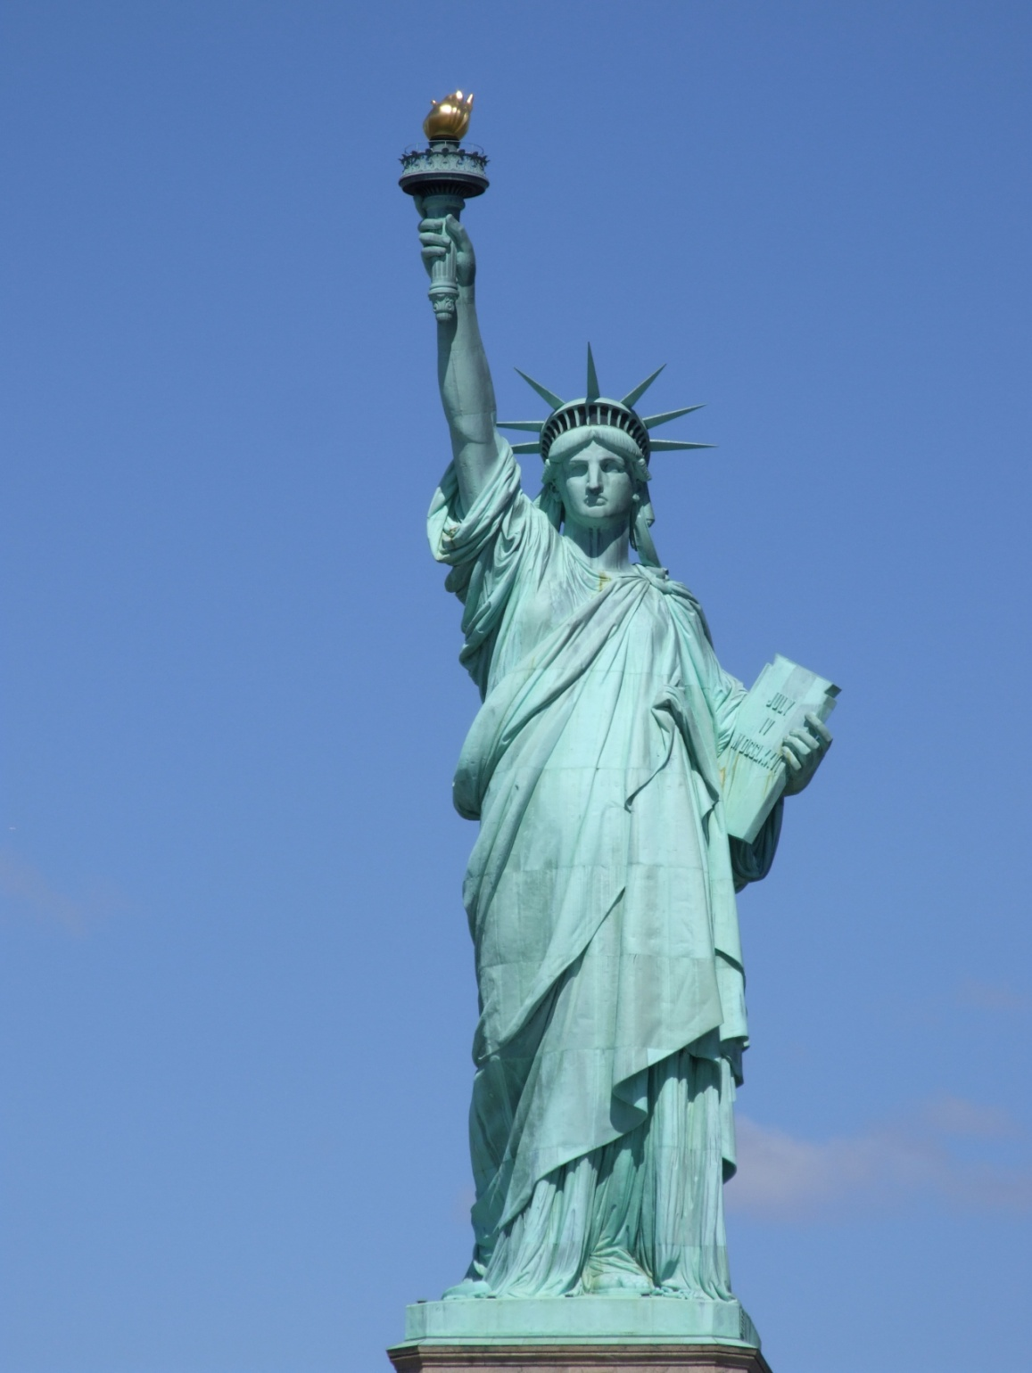
Read text &look at the statue to identify different parts.
Torch
Spiked crown
Book inscribed
July 4,1776
Flowing robs

Slide 18
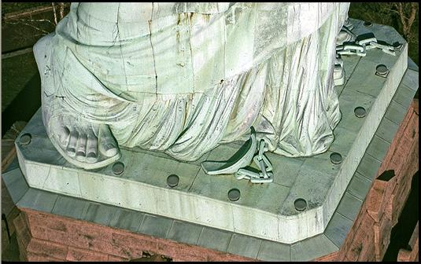
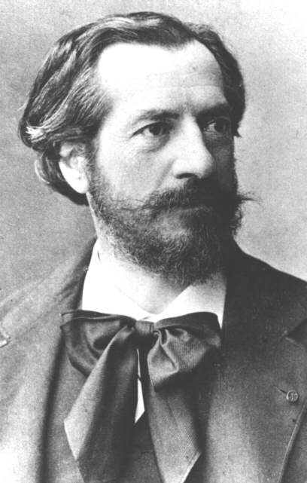
Broken chains, symbolising the overthrow of tyranny, lie at her feet
.
The statue was designed by the French Sculptor
Frederic Bartholdi and was given by France to the United States.
Frederic Bartholdi

Slide 19
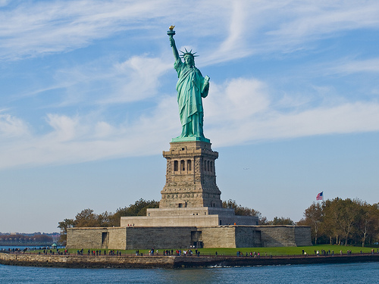
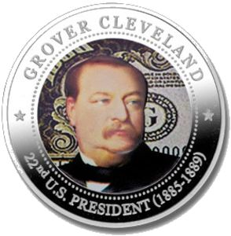
US donors financed the pedestal and installation of the monument.
Pedestal of the Statue
President Grover Cleveland dedicated the work on October 28, 1886.

Slide 20
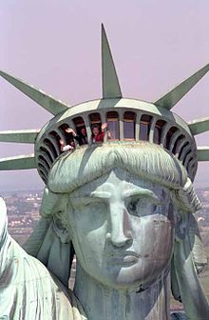
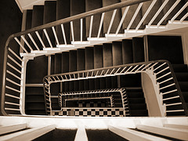
The head of the statue is reachable by staircase or emergency lift.

Slide 21
Measurement of the Statue of Liberty
The head from neck to diadem 28 feet
306 ft from torch tip to the pedestal
The
figure is 152 ft 2 in
The statue weighs 250 tons

Slide 22
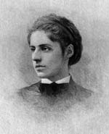
Pair Works:
Read the lines and discuss the following points with your partners.
Give me your tired, your poor
Your huddled masses yearning to breathe free,
The wretched refuse of your teeming shore.
Send these, the homeless, tempest-tossed to
me, I lift my lamp beside the golden door!
The New Colossus (1903)
Emma Lazarus
Who is saying these?
To whom are the lines said?
Do you think the lines express what the statue symbolises?

Slide 23

Evaluation:
What do the following things symbolise?
A light guiding to the way of US
Torch
Knowledge and learning
Book
Overthrow of tyranny
Broken chain
Freedom
Statue

Slide 24

Fill in the blanks with correct words from the box.
sculptor
flowing
liberty
aloft
designed
symbolizes
situated
harbour
inscribed
crown
glorious
shaky
The Statue of Liberty is a)________________ on Liberty Island in the b)______________ of New York. The statue symbolizes c)____________ in the form of a woman wearing d)______________robes and a spiked e)_____________. She holds a torch f)_____________ in her right hand and carries in her left hand a book g)____________ "July 4, 1776". Broken chains h)_________ the overthrow of tyranny. The statue was i)____________ by the French j)_________ Frederic Bartholdi .

Slide 25
Homework:
Write a paragraph on
“The Statue of Liberty”.

Slide 26

To be continue………

