Slide 1
WELCOME

Slide 2
INTRODUCTION
MD. AFSAR ALI
Assistant Teacher in English
MAJHIRA MODEL HIGH SCHOOL
SHAJAHANPUR, BOGURA
ENGLISH FOR TODAY
CLASS: NINE

Slide 3
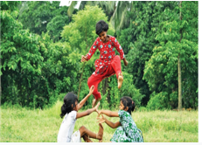
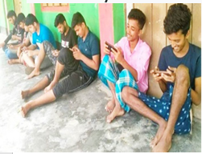
Look at the picture carefully. What can you see in the pictures?
Do you think, the pastime is changing in Bangladesh?
What is the difference between the pictures?

Slide 4
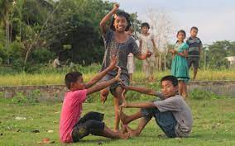
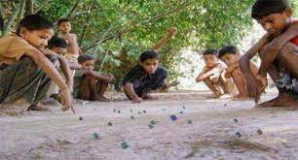
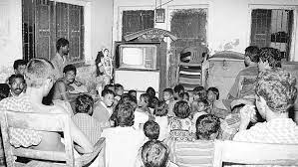
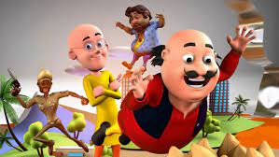
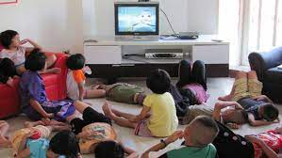
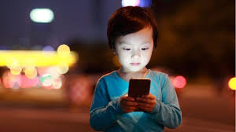
Look at the pictures carefully and guess what our today’s lesson is

Slide 5
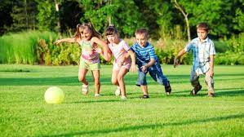
Yes, your answer is correct. Today we will learn
Change in pastimes in Bangladesh
Unit: 2 Lesson: 4

Slide 6
Learning outcomes
After this lesson the students will be able to-
read and understand the text
ask and answer the questions
choose the best answer

Slide 7
A. Tiya and Anusha decided to make a survey on students’ pastimes in their class. After the survey they presented their findings in a chart. Look at the chart and read how they explain their findings.
Item | For classes 9-10 | For classes 5-6
Playing games and sports | 22.3% | 9.2%
Watching television | 17.2% | 31.2%
Chatting with friends | 13.7% | 6.7%
Reading books or magazines' | 12.9% | 11.7%
Gardening | 10.7% | 6.1%
Attending social programs such as music, recitations or debates | 9.1% | 7.8%
Playing games on computers | 8.2% | 20.9%
Others | 5.9% | 6.4%

Slide 8
Let’s some key words
Word | English meaning | Synonym
Presentation | A speech or talk giving information about something | Demonstration
Equity | The act of being for equal | Neutrality
Contrast | A difference between two or more people or thing | Difference
Noteworthy | Deserving to be noticed | Noticeable
Priority | The most important | Precedence
Involve | To take part in something | Associate
Fascination | A very strong attraction | Attraction
Passion | A very strong feeling | Eagerness
Decline | To become less in number | Reduce
Opt for |  | Grant

Slide 9
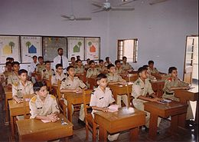
Tiya: Hello everyone! My name is Tiya. My friend, Anusha and I are going to do a presentation on Pastime Habits of Classes 9 and 10 students in our school. There are 120 students, 60 in class 9 and 60 in class 10. The classes have gender equity.

Slide 10
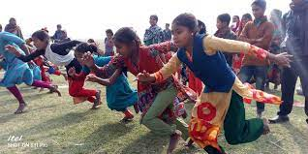
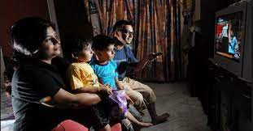
Each class has 30 male and 30 female students. The survey shows that 22.3 percent of students in classes 9-10 like games and sports as their most favourite pastime, which is the 4lh option given by classes 5-6 students. Watching television is the second choice (17.2%) by the first group in contrast to 31.2% of the second group.

Slide 11
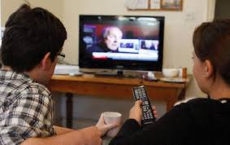
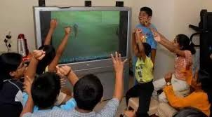
It is noteworthy that watching television is the first choice of the second group. A considerable number (13.7%) of 9-10 students like to chat with their friends and thus it becomes the third popular choice in the chart while this becomes one of the less important choices by the younger kids.

Slide 12
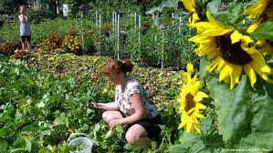
Only 6.7% of the kids take it as their first priority. It's interesting that both the groups like reading books. 12.9% of students of classes 9-10 take it as their favourite pastime. The number is 11.7% for Classes 5-6 students. Besides, gardening is voted (10.7% of students) to be the 5th preference by the grown up group though it is not that much liked by the younger group.

Slide 13
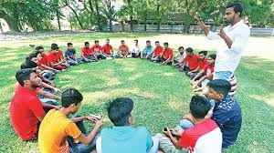
Only 6.1 % of the young kids are involved in it. This is interesting that though the higher number of students in classes 9-10 prefer attending social programs (9.1%) than students of classes 5-6 (7.8%), yet as a choice it is preferred by the latter group. It is the 5th choice for them while to the older group it is the 6th.

Slide 14
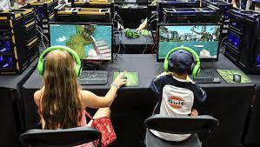
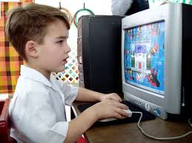
Young kids have greater fascination for playing games on the computers (20.9% like it as their first choice). The chart shows that as the kids grow up, they lose their passion for computer games. According to the chart the ratio declines to 8.2% from 20.9% when the kids are students of classes 9-10.

Slide 15
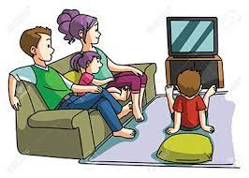
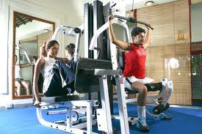
Finally, it can be said that the influence of television has impact on both the groups but the more students grow up, the more they opt for fields/ gym.

Slide 16
Answer the following questions
What are the gender policy of the surveyors?
Ans: The gender policy of the surveyors is equity since each class has 30 male and 30 female students.
2. What are the survey findings regarding watching television?
Ans: The survey findings regarding watching television are that watching television is the (17.2%)second choice by the first group in contrast to 31.2% of the second group and it is the first choice of the second group.
3. Which age group is more interested in socializing with others?
Ans: Students in class 9-10 are more interested in socializing with others.
4. According to the chart, how do the kids change their pastimes when they are grown up? What changes does the chart for 9-10 reflect ?
Ans: According to the chart when the kids are grown up, they reduce watching television, and lose interest in playing games on computers. As they grow up, they opt for fields/gym. The changes that the chart for 9-10 reflects are noteworthy. This group shows more interest in playing games and sports than in watching television. They lose passion for computer games. They also like to chat with friends more than before.

Slide 17
B. Work in groups. Make a chart on the pastimes of the students in your class and present it to your class.
Item | For classes 9-10
Doing games and sports | 25.5%
Watching television | 15.3%
Chatting with friends | 15.6%
Reading books or magazines' | 11.6%
Gardening | 6.7%
Attending social programs such as music, recitations or debates | 5.6%
Playing games on computers | 7.6%
Others | 3.5%

Slide 18
Choose the best answer
1. The word ‘findings’ means .............
a. doing result b. research result c. do something d. look for
2. The word ‘preference’ stands for ..............
a. disliking b. watching c. attraction d. inclination
3. The word ‘impact’ refers to ..................
a. effect b. interest c. impartial d. automatic
4. How many students are interested in watching television of class 9-10?
a. 17.2% b. 9.1% c. 17.2% d. 6.1%
5. What do 6.1% of class 5-6 students like to do?
playing games and computers b. watching television
c. gardening d. others

Slide 19
GOODBYE

