Slide 1
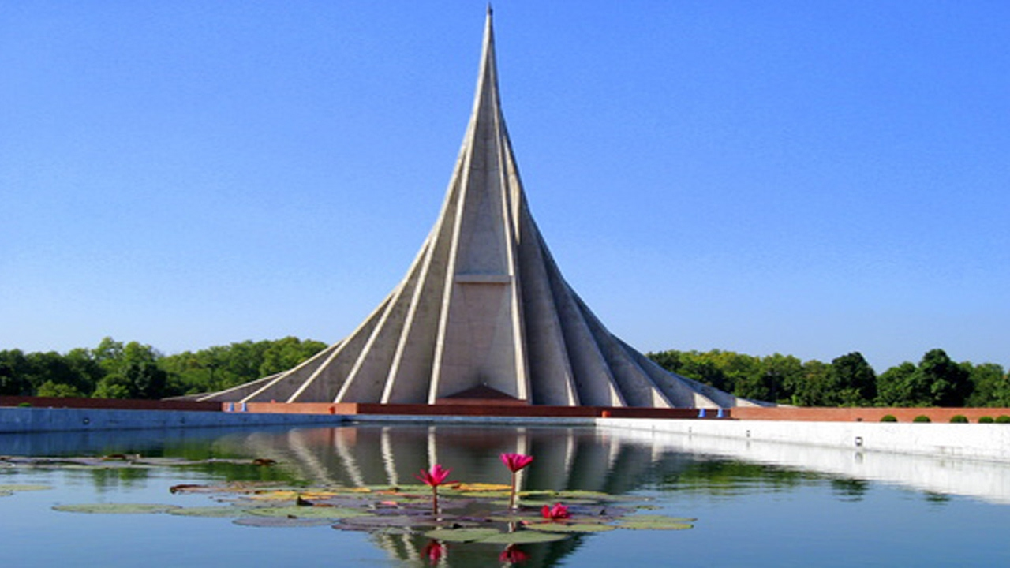
WELCOME

Slide 2
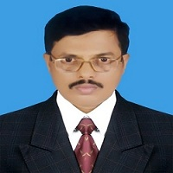
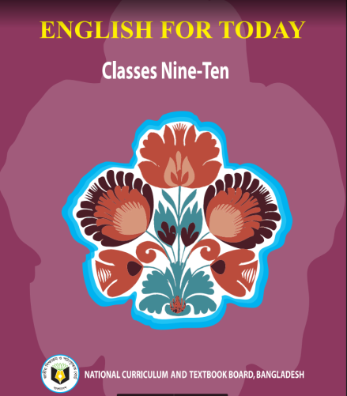
IDENTITY
Md. Saiful Islam Chowdhury
Senior Teacher
C. J. M High School,
Mohara, Chandgaon, Chittagong..
saifulcjm@gmail.com Mob: 01991945882
ENGLISH FOR TODAY
Class : Nine-Ten
Unit- Three , Lesson – Five

Slide 3
Look at the picture
1. What can you see in the picture?
1. In the picture we can see the National Memorial of Bangladesh.
2. Where is it ?
2. It is situated at saver .
3. Why was it built ?
3. It was built to commemorate the supreme sacrifice of the numerous martyrs of our country who laid down their lives for the sake of the liberation of our dearest motherland.

Slide 4
Today our lesson is
Independence Day
Events and festivals
UNIT: 03
LESSON: 05

Slide 5
Learning outcomes
After we have studied the lesson we will be able to ..
1.Talk about events and festivals;
2. Ask and answer questions and give opinions in a logical sequence;
3.Infer meaning from the context .

Slide 6
Read the text silently
26 March our Independence Day ,is the biggest state festival .The day is celebrated every year in the country with great enthusiasm and fervour. It is a national holy day .All office ,educational institution , shops factories remain closed on this day . The day begins with a 31 gun salute . Early in the morning the president and the prime Minister place floral wreaths at the national mausoleum at savar. Then other leaders, political parties diplomats, social and cultural organisations. educational institution and freedom fighters pay homage to the martyrs .people from all walks of life also go there with rallies and procession .There are many cultural programs throughout the day , highlighting the heroic struggle and sacrifice in 1971.In Bangabandhu National stadium , school children , scout and girl guides take part in various displays to entertain thousands of spctators . Educational institutions also organise their individual programmes. sports and tournaments are also organised on the day,including the exciting boat race in the river Buriganga . In the evening ,all major public buildings are illuminated with colourful lights.Bangla academy ,Bangladesh shipocala academy and others hold cultural function .similar function are also arranged in other place in the country.

Slide 7
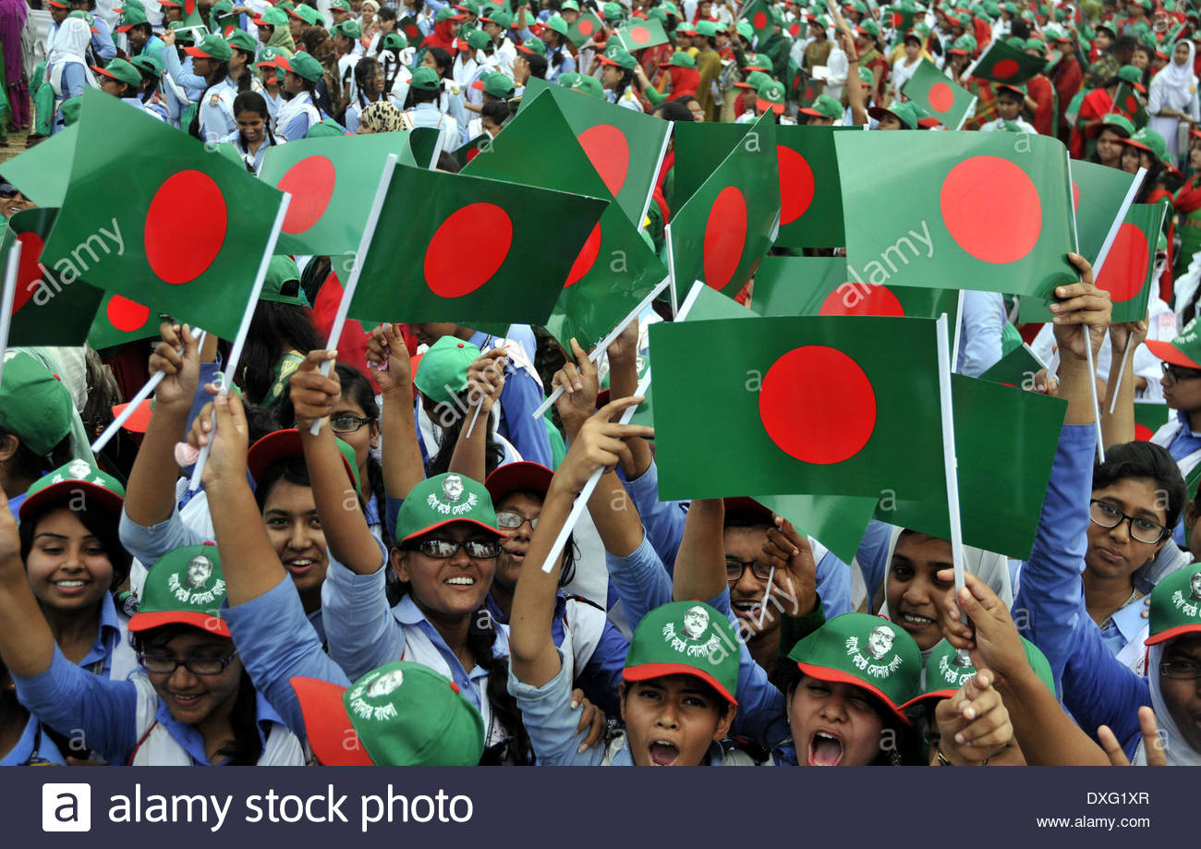
Key word
Enthusiasm
Meaning:
Excited
Our Independence Day is celebrated every year in the country with great Enthusiasm.

Slide 8
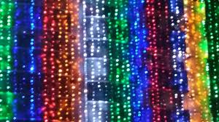
Key word
Illuminate
Meaning:
Light up
Buildings are illuminated with colourful lights in the evening.

Slide 9
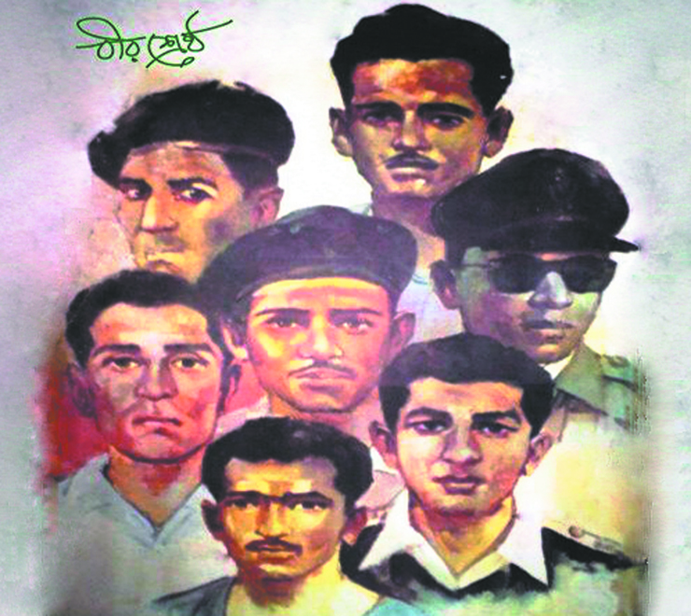
Key word
Martyr
Meaning:
Who sacrifice own life for a noble cause
They were martyrs to the cause of independence movement.

Slide 10
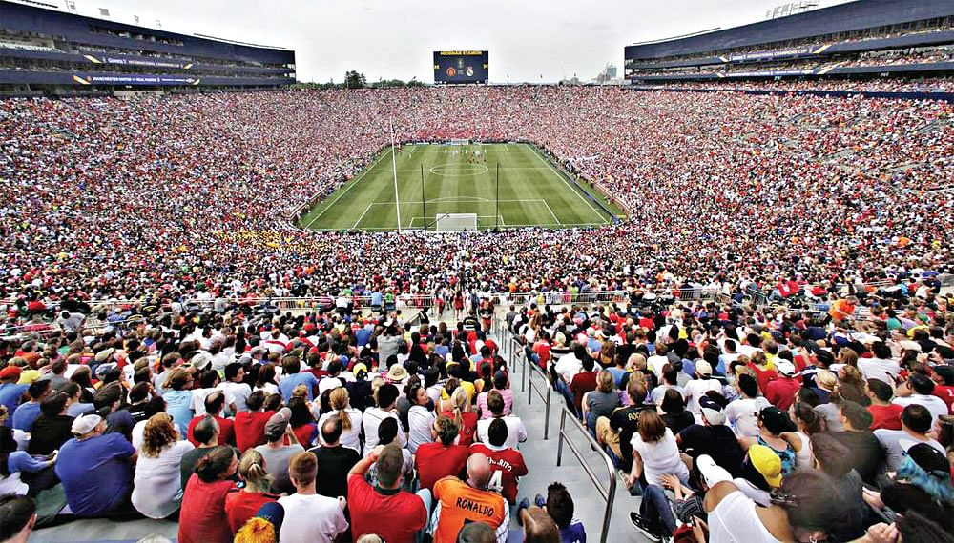
Key word
Spectator
Meaning:
Who watches an activity without taking part
The most popular spectator sport is football.

Slide 11
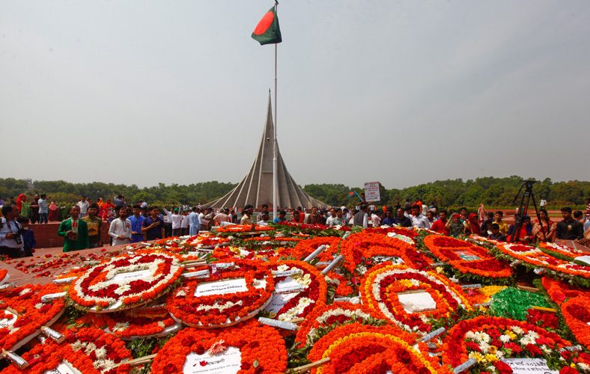
Key word
Wreath
Meaning:
Circular arrangement of flowers
We can pay homage to the martyrs by placing wreaths on the memorial.

Slide 12
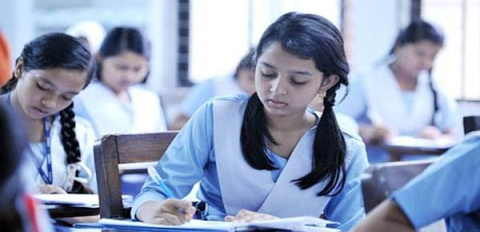
Match the words with their meanings
Words
Meanings
fervour
Acts of performing skill.
alike
To light up
spectator
In a similar way
displays
A strong feeling of excitement
illuminate
A person who is watching an event

Slide 13
Compare with your answer
Words
Meanings
fervour
A strong feeling of excitement
alike
In a similar way
spectator
A person who is watching an event
displays
Acts of performing skill.
illuminate
To light up

Slide 14
Choose the correct answer from the alternative.
Our biggest state festival is –
a) Independence Day
b) Shaheed Dibosh
C)Victory Day
d) Pahela Boishakh

Slide 15
Choose the correct answer from the alternative.
2.The celebration of Independence Day begins with-
Processions
b) Placing wreaths at the National Mausoleum
c) gun salute
d) Parade by defence forces

Slide 16
Choose the correct answer from the alternative.
3. The National Mausoleum is –
a) On Dhaka university cmpus
b) At Ramna Park
c) At Savar
d) Near Dhaka Medical College

Slide 17
Choose the correct answer from the alternative.
4.On Independence Day a National parade is held –
a) At the National parade Ground
b) In the streets
c) In the decorated vehicles
d) In Bangabandhu Stadium

Slide 18
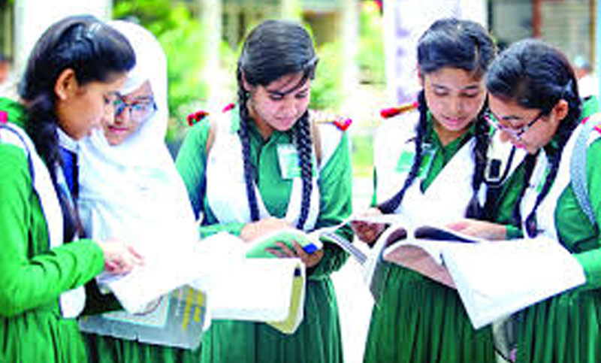
Read the passage attentively then discuss the following questions in group.
1.What is the biggest state festival in our country?
Group work
2.How does the day begin ?
3.How are public buildings illuminated?
4.Who place wreaths at the National Mausoleum on behalf of the Nation and when?
5.Where is the exciting boat race held on our Independence Day?

Slide 19
Compare with your answer
1. 26 March, our Independence Day, is the biggest state festival in our country.
2.The day begin with 31 gunshots.
3.The major public buildings are illuminated with colourful lights in the evening.
4.The President and the Prime Minister place wreaths at the National Mausoleum early in the morning on behalf of the Nation.
5. The exciting boat race is held in the river Buriganga on our Independence Day

Slide 20
Read the text and fill in each gap with a suitable word based on the information of the text.
red
liberation
sacrificed
celebrates
show
26 March is a (a)________ letter day for the people of Bangladesh. On this day, our (b) _____ War began. The heroic sons of our country (c) ______ their lives. SO, the whole nation (d) ____ the day every year to (e) ____ respect to the martyrs .

Slide 21
Evaluation
1.How does the country look on 26 march?
On 26 march the country looks festive.
2.Who hold rallies ?
People from all walks of life hold rallies.
3.What is the significance of 31 gunshots?
The significance of 31 gunshots is to show national respect to the Liberation War martyrs.

Slide 22
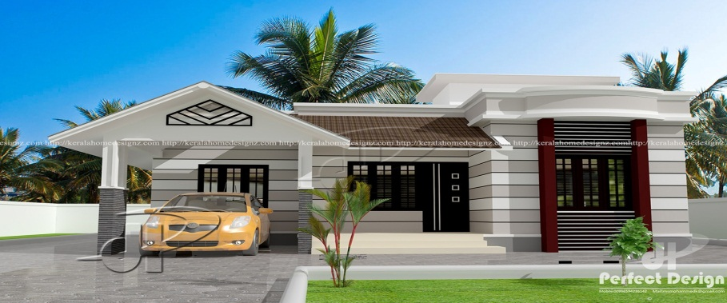
Home Work
Write in brief, how you have celebrated this year’s Independence Day at your school.

Slide 23
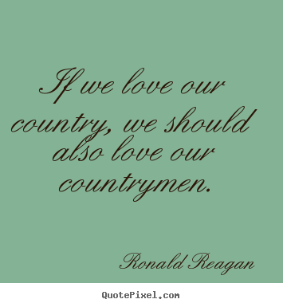
Thank you all

