Slide 1
Welcome to my multimedia classroom

Slide 2
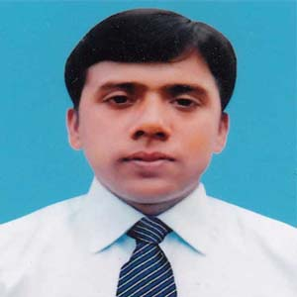
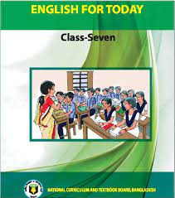
About me and Book
Md. Robiul Islam
Assistant Teacher English
Pioneer Girls’ High School, Khulna
Cell no. 01914223493

Slide 3
A. Talk about the picture .
What are they doing?
They are talking about Flora’s first day at school .

Slide 4
Today we are going to read about-
Unit - Three
What are friends for?
Lesson-2
Flora’s first day at school (1)

Slide 5
After we have studied this lesson, we will be able to -
Ask and answer questions.
Read and understand text.
Write short composition.

Slide 6
Recall
Remember
Verb
We will try to recall our past golden memory.
Antonym
Forget

Slide 7
Add
Join , Attach
Verb
Chlorine is added to the water to kill bacteria.
Antonyms
Remove, Subtract

Slide 8
Chat
Talk in a friendly and informal way.
Verb
She chatted to her mother on the phone every day.
Antonyms
Silence, Quiet

Slide 9
A. Talk about the picture and read the story.
Next week Farabi comes to visit Flora in her house. They are having a chat. “Can you remember your first day at school, Flora?” Farabi asks. “Oh, yes , I can,” Flora says. “I can recall exactly what happened . Would you like to hear it?” “I’d love to ,” says Farabi. “Please tell me.” “Okay,” says Flora. “It was 2006 . I was then 6 years old.” One day my mother said, “ Flora, you’re going to start your school tomorrow.” I was very excited . I couldn’t think of anything else. I was always thinking about the school, the teachers and the students of our school. I couldn’t even sleep well that night. The next morning my mother woke me up early in the morning. I had a bath and put on my best clothes. Then I had breakfast and started for the school with my mother. The school was not very far from our home. So we walked all the way.

Slide 10
B. Say whether the following statements are true or false. If false, give the correct answer.
1. Farabi and Flora are talking at school.
Correct answer: Farabi and Flora are talking at home.
2. Flora is talking about her school.
3. Flora first went to school at the age of 6.
4. Her mother dressed her in her best clothes.
5. Flora walked to school.
True
False
True
True
True

Slide 11
C. Fill in the blanks with suitable words.
Flora is a student . She is ------------------------ class 7. She can remember her --------------- day at school even today. She ---------------- to school in 2006. Her mother ----------------- her to school. The school was -------------- a long way from their house. ----------------- Flora walked to school -------------------- her mother.
reading
first
went
prepared
not
So
with

Slide 12
D. Match the words with their meanings.
Words | Meanings
Chat Recall Exactly Excited | precisely feeling happiness a friendly conversation remember
Chat
a friendly conversation
Recall
remember
Exactly
precisely
Excited
feeling happiness

Slide 13
E. Do you remember your first day at school? Write a short composition about it answering the questions below.
1. How old were you at that time?
2. What is the name of the school you went to?
3. What did you put on?
4. How did you feel before you started for the school?
5. Who did you go with?
Yes, I remember my first day at school. At that time I was 6 years old. The name of the school is Saint Joseph’s High School I went to. I put on formal dress of my school because my father managed this dress with in a very short time from tailors. I felt very excited before started for the school. I went to school with my father.

Slide 14
Grammatical Task
They are having a chat.
Present continuous Tense
Structure:
Subject +
Am/Is/Are+
Verb+
ing+
Object

Slide 15
Home work
Write a paragraph about your first day at school.

