Slide 1
Welcome To Multimedia Class
Nelufa Afrose Bithi

Slide 2
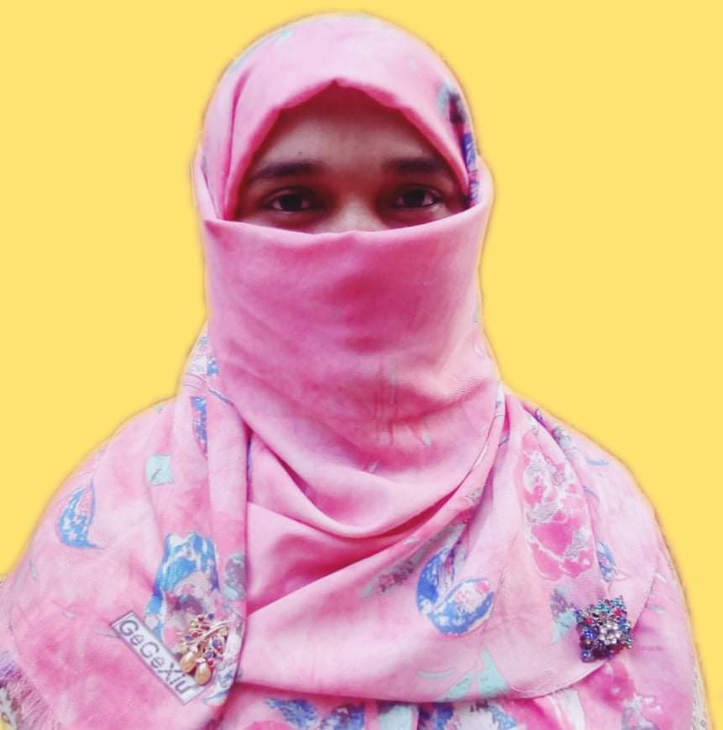
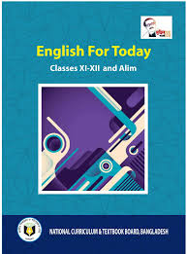
Identity
Mosammat Nelufa Afrose Bithi
Lecturer in English
Khilbaisa Rahmania Fazil Madrasah
Khailbaisa, Sadar , Lakshmipur
E-mail: nelufa.afrose@gmail.com
Class- Alim/ xi/xii
Subject- English For Today
(English 1st paper)
Nelufa Afrose Bithi

Slide 3
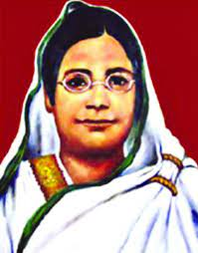
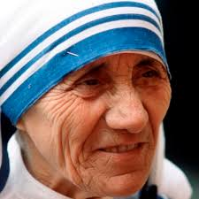
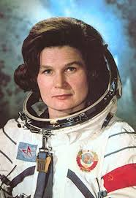
Watch some pictures -
Begum Rokeya
Mother Teresa
Valentina Tereshkova
Who are these women?
Why are they famous for ?
Who is an astronaut out of them ?
Nelufa Afrose Bithi

Slide 4
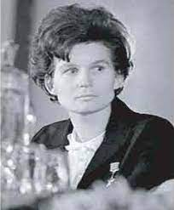
Our today’s topic is -
Two Women
“Valentina Tereshkova”
Unit-1:People and Institutions make History
Lesson-3: Two Women (Part-1)
Nelufa Afrose Bithi

Slide 5
Learning Outcomes
After finishing the lesson, the students will be able to -
* Learn new words from the text.
*Read the text with the teacher.
*Know the Biography of Valentina Tereshkova.
*Write down some questions on Valentina.
Nelufa Afrose Bithi

Slide 6
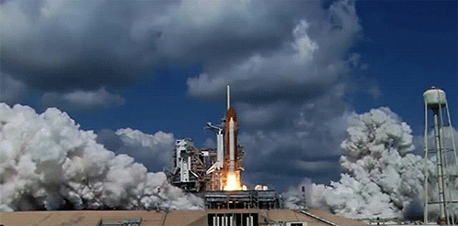
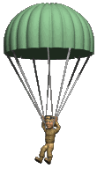
new words
Learn new words with pictures .
Space shuttle- A vehicle in which people travel to space and come back again.
Parachute- A large piece of thin cloth that opens out in the air to form an umbrella shape. It is attached to people or objects to make them fall slowly and safely when they are dropped from an aircraft.
Nelufa Afrose Bithi

Slide 7
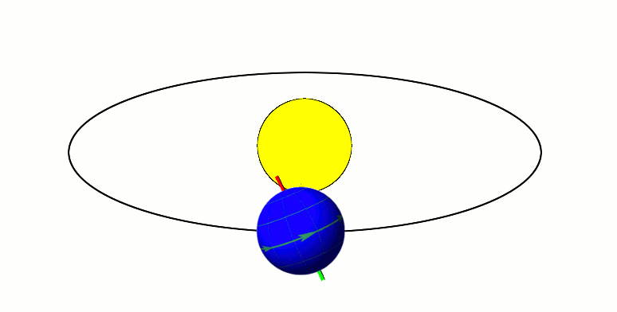
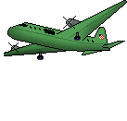
new words
Orbit- To follow a curved path around a planet.
Skydiving- a sport in which a person jumps from an aircraft and falls as long as possible before opening a parachute.
Nelufa Afrose Bithi

Slide 8
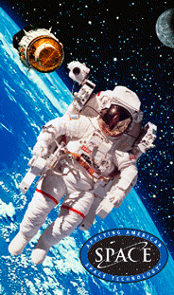
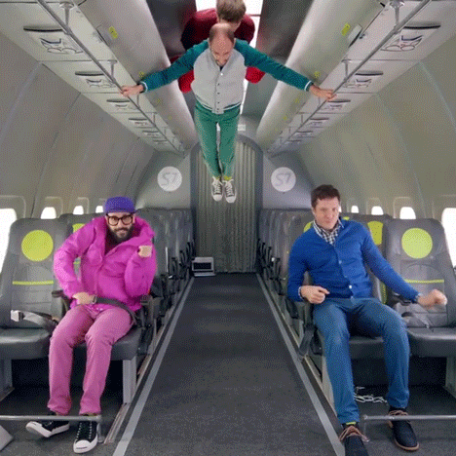
new words
Cosmonaut-An astronaut. A person who has been trained for travelling in space.
Weightless- the state of having no weight.
Nelufa Afrose Bithi

Slide 9
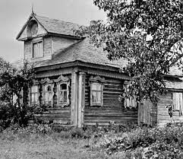
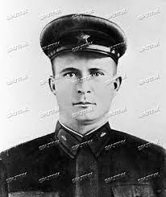
Text
Read the text with the teacher.
Valentina Tereshkova was born in the village Maslennikovo , Tutayevsky District, in Central Russia on March 06, 1937 .
Tereshkova's father was a tractor Driver & her mother worked in a textile plant .
Valentina’s father
Vladimir Tereshkova
Nelufa Afrose Bithi

Slide 10
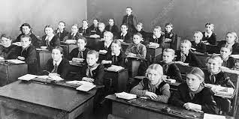
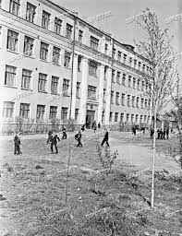
Text
Tereshkova began school in 1945 at the age of eight, but left school in 1953 and continued her education through distance learning.
Tereshkova’s School.
Nelufa Afrose Bithi

Slide 11
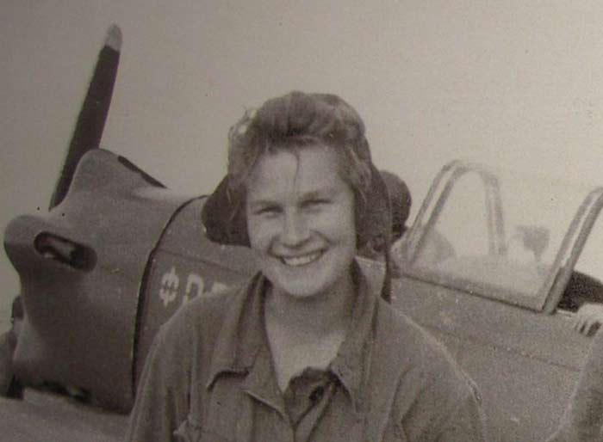
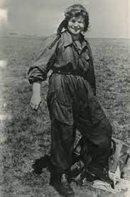
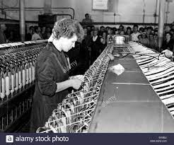
She became interested in parachuting from, a young age, and trained in skydiving at the local Aeroclub, making her first jump at age 22 on 21 May 1959.
Tereshkova at local Aeroclub
At that time she was employed as a textile worker in a local factory. It was her expertise in skydiving that led to her selection as a cosmonaut.
Textile plant where Tereshkova worked.
Nelufa Afrose Bithi

Slide 12
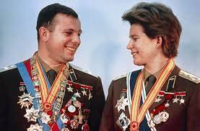
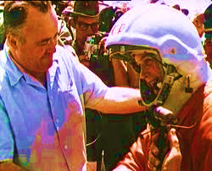
Text
After the flight of Yuri Gagarin (the first human being to travel to outer space in 1961), the Soviet Union decided to send a woman in space.
Yuri Gagarin & Tereshkova
On 16 February 1962, "proletaria" Valentina Tereshkova was selected for this project from among more than four hundred applicants.
Tereshkova selected.
Nelufa Afrose Bithi

Slide 13
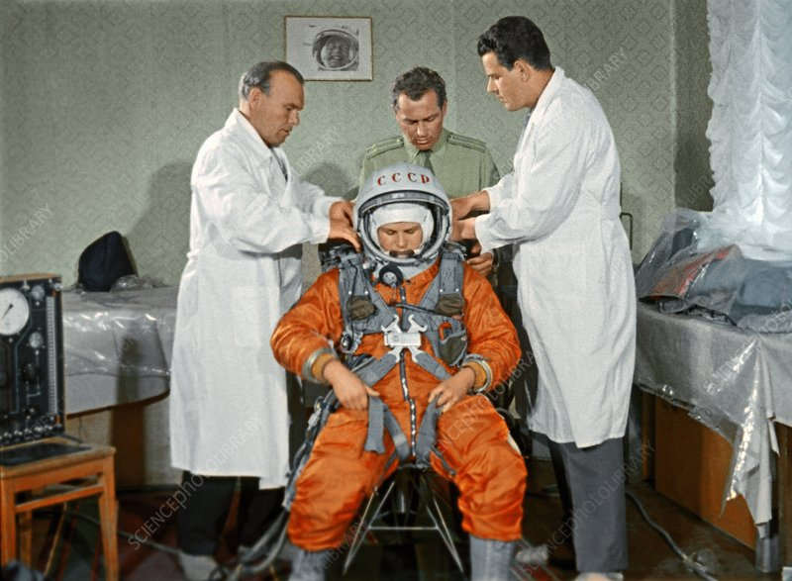
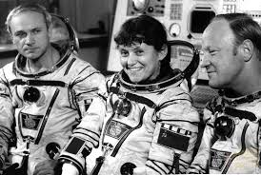
Text
Tereshkova had to undergo a series of training that included weightless flights, isolation tests, centrifuge tests, rocket theory, spacecraft engineering, 120 parachute jumps and pilot training in MiG-15UTI jet fighters.
On 16 June 1963 , Valentina & her back-up cosmonauts Solovyova were dressed in space-suits & taken to the space shuttle launch pad by a bus .
Nelufa Afrose Bithi

Slide 14
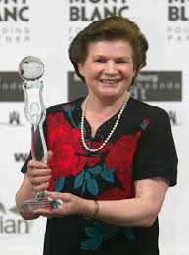
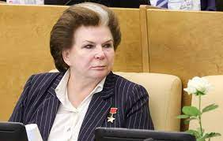
Text
In 1977 , Valentina earned a Doctorate in Engineering from Zhukov sky Air Force Academy.
Afterwards she turns to politics. During the Soviet regime she became one of the presidium members of the Supreme Soviet. Now this living legend is a member in the lower house of Russian legislature.
Nelufa Afrose Bithi

Slide 15
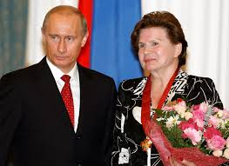
Text
On her 70th birthday when she was invited by the Russian Prime Minister Vladimir Putin, she expressed her desire to fly Mars.
Nelufa Afrose Bithi

Slide 16
Open the text book at page- 12
&
read the text silently.
Nelufa Afrose Bithi

Slide 17
Individual Work
Write five sentences on Valentina Tereshkova.
Nelufa Afrose Bithi

Slide 18
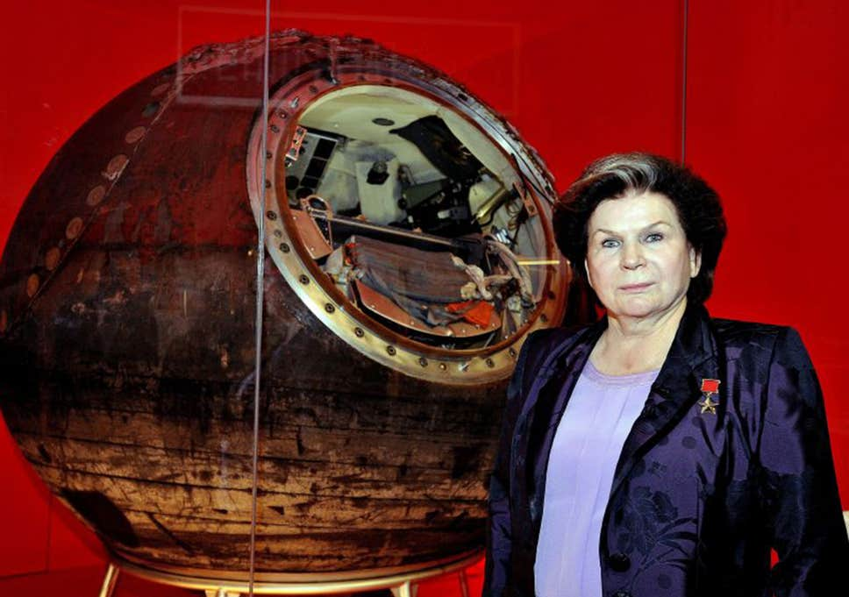
At a glance Biography of Valentina Tereshkova
Spent about 3 days in space.
Interested in parachuting. and skydiving.
Left school in 1953.
First jumped at 22, on 21 May 1959
Lunched Vostok-6 on 16 June 1963
Went to school at the age of eight in 1945.
Orbited the earth 48 times.
Continued education through distance learning.
Born in 6 March 1937.
Spacecraft engineering.
Pilot training.
Centrifuge tests.
Isolation tests.
Weightless flight.
Training-
Rocket theory.
Now a member in the Lower house of the Russian Legislature.
Became the presidium members of the Supreme Soviet after 1977.
Nelufa Afrose Bithi

Slide 19
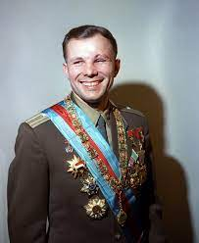
Some information related with the text.
Yuri Gagarin
Yuri Alekseyevich Gagarin was a Soviet pilot and cosmonaut. He was the first human to journey into outer space on 12 April 1961.
Nelufa Afrose Bithi

Slide 20
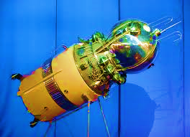
Vostok-5
Vostok-5: is a spacecraft of the Soviet Union that carried Valentina Tereshkova.
Nelufa Afrose Bithi

Slide 21
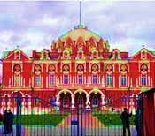
Zhukovsky Air Force Academy.
Zhukovsky Air Force Academy is a higher military educational institution for training Russian Air force. It is the world’s largest and oldest scientific school of aeronautics having been formed 23 November 1920.
Nelufa Afrose Bithi

Slide 22
Evaluation
1. When did she start her distance learning ? At the age of (a) 14 (b) 15 (c) 16 (d) 8
2. Valentina came of a ----- family . (a) aristocratic (b) working class (c) indigent (d) elite
3. MiG-15UTIis a / an ---- (a) Space project (b) aircraft (c) flying saucer (d) Projector
4. What does the word “undergo” in the passage refer to ? (a) collection (b) pick (c) nomination (d) medley
5. What is meant by “launch”--- .
(a) sending a spaceship into space (b) sending a launce into space
(c) launching weapons (d) launching boat
Nelufa Afrose Bithi

Slide 23
Group Work
Read the passage silently and fill the flow chat in group.
Make short notes in the each of the boxes in the flow chart showing information about Valentina Tereshkova.
Was born in 1937 in a village of Tutayvsky
Left school in 1953
educated through distance learning.
First jump in 1959.
In 1977 earned doctorate.
Went to school in 1945.
Nelufa Afrose Bithi

Slide 24
Home Work
Answer the following questions.
a. Give an account of Valentina Tereshkova’s early life.
b. Which trainings did Tereshkova have to take after joining the flight project?
c. What do you know about Vostok-5?
d. Who is Yuri Gagarin? Which country does he belong to?
e. What was Tereshkova’s first success? When did it happen?
Nelufa Afrose Bithi

Slide 25
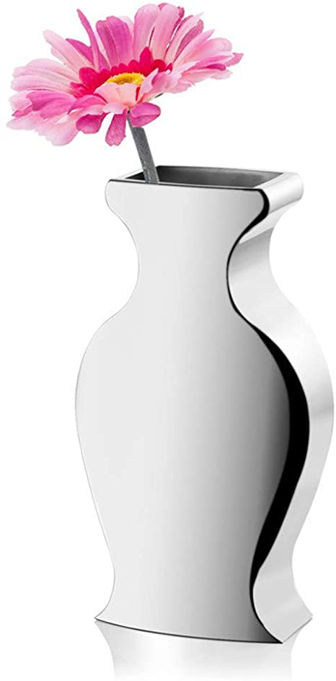
Thank you
Nelufa Afrose Bithi

