Slide 1
Good morning
ALL THE STUDENTS

Slide 2
IDENTITY
MD.Jahangir alam
Assistent Teacher
Vedvedi Govt.Primari School,
Rangamati, sadar.

Slide 3
LESSON IDENTITY
Class:1
Subject: English
Lesson : 4-5
Unit : 9,10,11 ( G.H.I Alphabet)
Time : 35 mn

Slide 4
Learning Outcomes:
Students will be able to -
1.1.1 –becomes familiar with English sound by listing to common English words.
1.1.1 – repeat after the teacher simple words and phrases.
1.1.2 – say simple words and phrases.
1.2.1 – recognize and read the alphabet both small and capital (non-cursive)
1.1.1-to practice letter shapes/ simple writing patterns etc.
1.2.1- write non-cursive capital letters small.

Slide 5
LOOK LISTEN AND SAY.
G
g
H
h
I
i

Slide 6
LOOK LISTEN AND SAY. TRACE IN THE AIR.
G
g
CAPITAL LETTER
SMALL LETTER

Slide 7
SAY AND READ. TRACE AND WRITE.
G
--------------------------------------------------------------------------------------------------------------------------------------------------------------------------------------------------------------------------------------------------------
-------------------------------------------------------------------------------------------------------------------------------------------------------------------------------------------
g

Slide 8
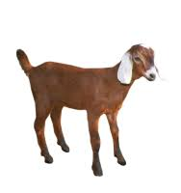
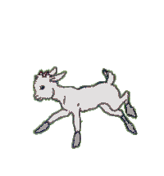
What is this ?
Goat

Slide 9
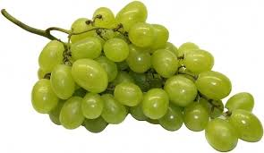
LOOK LISTEN AND SAY.
g
grape

Slide 10
LOOK LISTEN AND SAY.
G
GOAT
g
grape

Slide 11
LOOK LISTEN AND SAY. TRACE IN THE AIR.
H
h
CAPITAL LETTER
SMALL LETTER

Slide 12
SAY AND READ. TRACE AND WRITE.
H
--------------------------------------------------------------------------------------------------------------------------------------------------------------------------------------------------------------------------------------------------------
h
-------------------------------------------------------------------------------------------------------------------------------------------------------------------------------------------

Slide 13
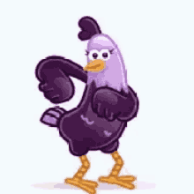
LOOK LISTEN AND SAY.
H
HEN

Slide 14
LOOK LISTEN AND SAY.
h
hut

Slide 15
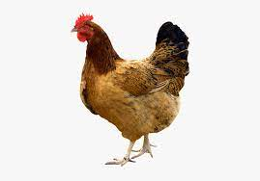
LOOK LISTEN AND SAY.
H
HUT
h
hen

Slide 16
LOOK LISTEN AND SAY. TRACE IN THE AIR.
I
i
CAPITAL LETTER
SMALL LETTER

Slide 17
SAY AND READ. TRACE AND WRITE.
I
--------------------------------------------------------------------------------------------------------------------------------------------------------------------------------------------------------------------------------------------------------
-------------------------------------------------------------------------------------------------------------------------------------------------------------------------------------------
i

Slide 18
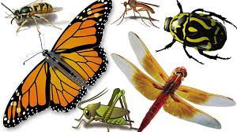
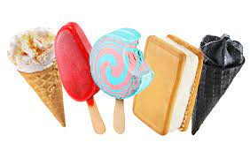
LOOK LISTEN AND SAY.
I
i
Insects
Ice cream

Slide 19
LOOK LISTEN AND SAY.
I
INSECTS
i
Ice cream

Slide 20
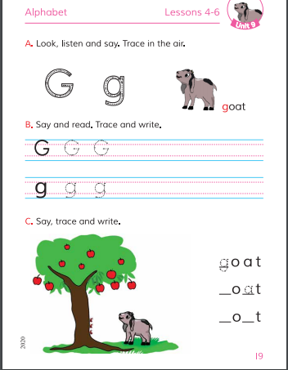
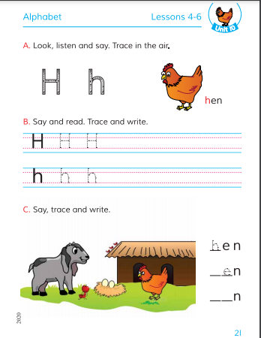
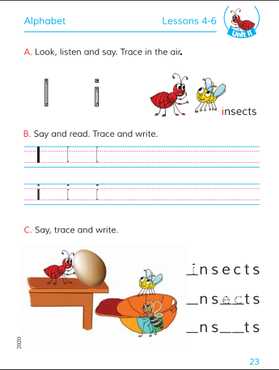
Open your Book at page-19,21,23.

Slide 21
Open your Book at page-19.

Slide 22
Open your Book at page-21.

Slide 23
Open your Book at page-23.

Slide 24
Write the missing letter.
a
__oag
gr__pe
G
u
h
H__t
__en
Ic __cream
e
__nsect
I

Slide 25
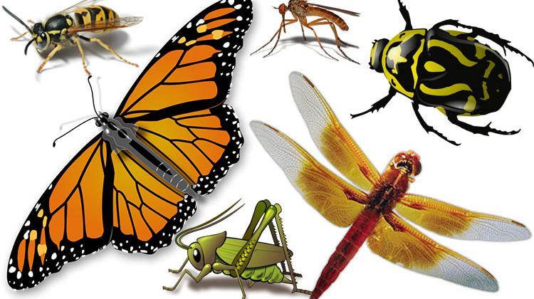
Match the letters with the pictures
G
H
I

Slide 26
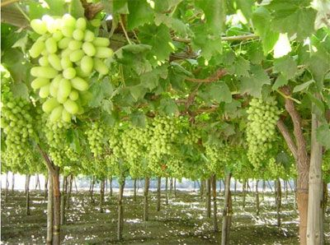
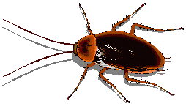
SAY AND WRITE THE FIRST LETTER.

Slide 27
Thanks
All
the
students

