Slide 1
Welcome

Slide 2
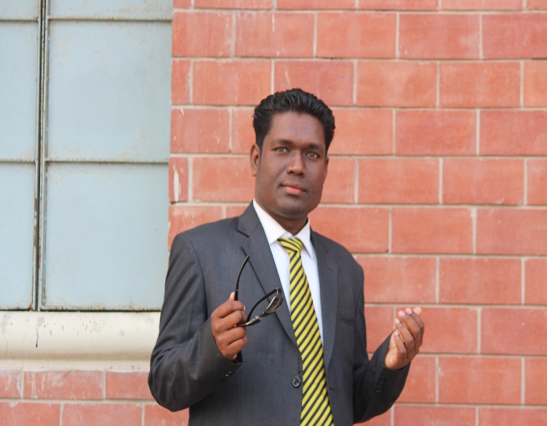
Introduction
Md. Gausul Haque B,A(hons)M,A (English) Assistant teacher Kalikapur Choukuni High school,koyra,Khulna. | Class-VIII English 1st Paper Time-50 minutes
Notes:
Details about the teacher.

Slide 3
Look at the Picture

Slide 4
Look at the picture

Slide 5
Look at the picture

Slide 6
Look at the picture

Slide 7
Look at the picture

Slide 8
Todays Lesson Plan
Pastimes

Slide 9
Learning outcomes:
Students will be able to
1.Narrate incidents and events in a logical
Sequence
2.They can learn about Pastimes.
3.Students can learn about new word meaning.
4. Students can learn about discussion.

Slide 10
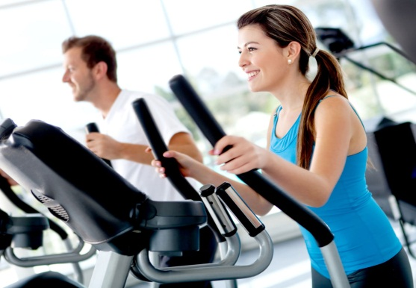
Vocabulary
Fishing
Playing
gym

Slide 11
Individual Work
Make a sentence by this word
Camera, Advanced,woundering, Gaming

Slide 12
Group Work
Write some advantages of Pastimes

Slide 13
Evaluation
1. Make a list of Tiya’s pastimes
2. What are her pastimes.
3. Five sentences about pastimes.

Slide 14
HOME WORK
Write a paragraph on Advatages of pastimes

Slide 15
Thank you

