Slide 2
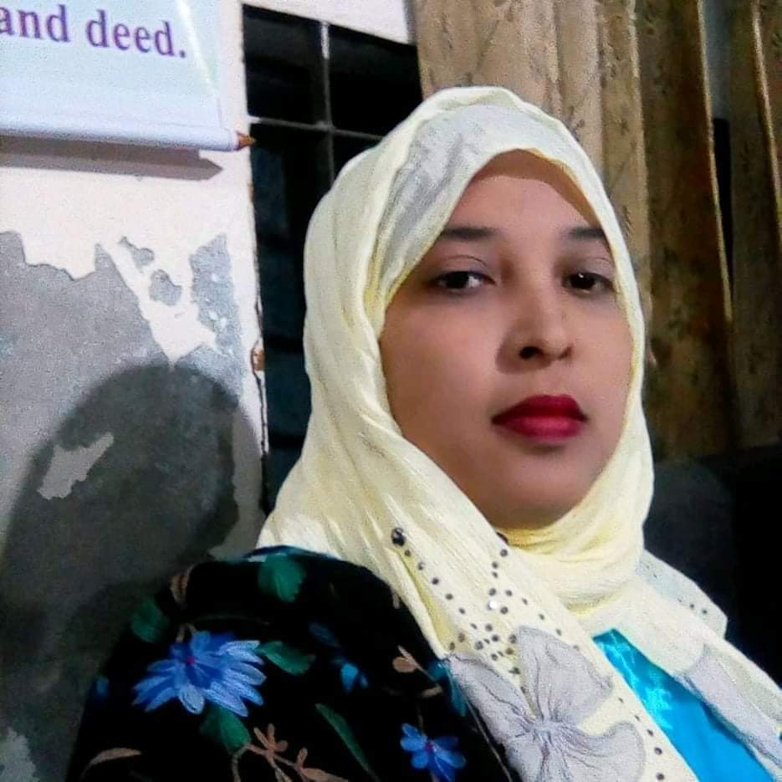
Identity
Mst.Forida Yeasmin
Assistant Teacher
Guthoil Model govt.Primary School
Nachoil, Chapainawabgonj
Email:foridapti1982@gmail.com
Class: Five
Sub:English For Today
Unit:8
Lesson: 5-6
Time: 35 Minute
Date: 12- 07- 2021

Slide 3
Let’s watch a video

Slide 4
Lesson Declaration
Write to me soon!
Unit: 8
Text: F
Lessons :5
Page:32

Slide 5
Learning Outcomes
By the end of the lesson students will be able to
Listening: 1.2.1 recognize which syllable in a word is stressed
Speaking: 1.1.1 say words, phrases and sentences with proper sounds and stress. 6.1.2 say what others are doing.
Reading: 1.5.1 read words, phrases and sentences in the text with proper pronunciation, stress and intonation.
.

Slide 6
Review the previous lesson
What should we do when we are sick?
What shouldn’t we do when we are sick?

Slide 7
Meaning of words
runny nose
সর্দি
headache
মাথা ব্যাথা

Slide 8
Stomach ache
পেটব্যাথা
chills
শরীর ঠান্ডা হয়ে যাওয়া

