Slide 1
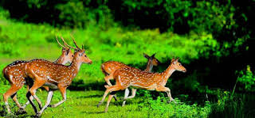
Welcome to our English class

Slide 2
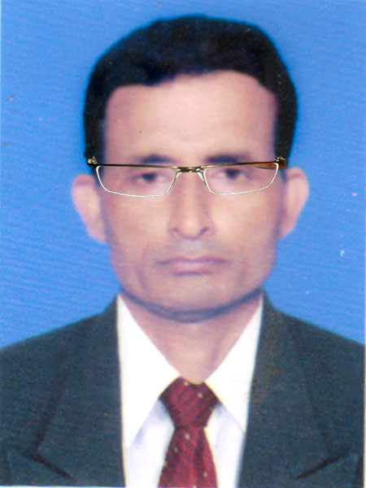
Identity
Manik Chandra Majumder
Senior Teacher (English)
Gazirhat High School
Senbag, Noakhali.
Mobile No: 01717155169
Email: manikmajumder01@gmail.com
Class : Nine-Ten
Subject : English 1st paper
Time : 50 Minutes
Date : 00/00/2021

Slide 3
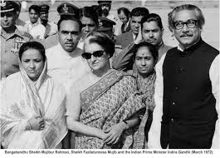
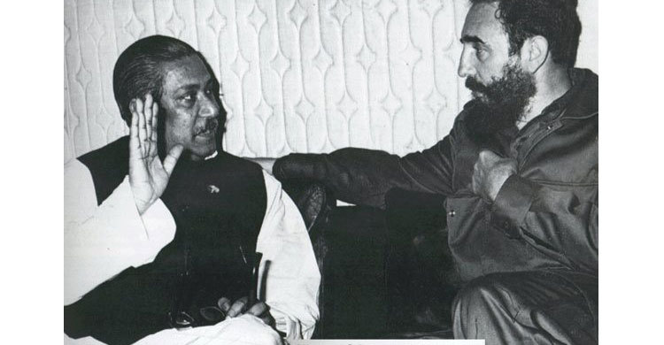
Look at the pictures below and discuss the following questions in pairs
Ans-1: In first picture we can see Bangabandhu Sheikh Mujibur Rahman, Begum Mujib and the then Prime Minister of India, Mrs Indira Gandhi and some other unknown people. In the second picture we can see Fidel Castro the then Prime Minister of Cuba.
Ans: 2. I think both Indira Gandhi and Fidel Castro were eminent leaders like Bangabandhu.
Q:2. How are they related to Bangabandhu?
Ans: 3. They had been a very friendly diplomatic relationship among them.
Q: 1 Who can you see in the picture?
Q: 3. What do you think are the relationship among them?

Slide 4
So, Dear students today we are going to talk a very important topic . Can you guess it?
Bangabandhu's relationship with other countries
Unit-1 , Lesson-4

Slide 5
Learning outcomes
After the end of this lesson, the students will be able to …
read and understand text
narrate incidents and events in a logical sequence
participate in conversation, discussion and debates
tell stories
After the end of this lesson, the students will be able to …
read and understand text
narrate incidents and events in a logical sequence
participate in conversation, discussion and debates
tell stories

Slide 6
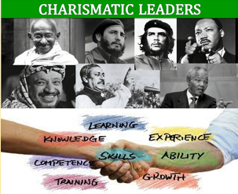
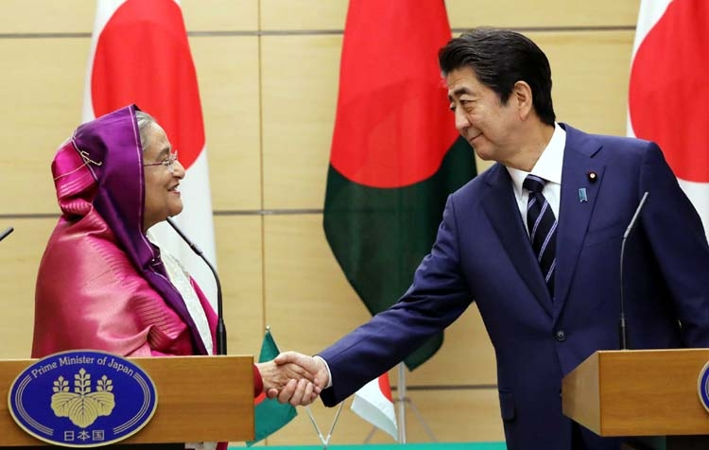
Vocabulary with sentence making
Meaning : Explanation, (make something easier to
understand)
Meaning : To make someone believe that
something is true , Prove
Meaning : Skill of managing international relations
Click box
Meaning : Influential, Inspiring, Fascinating
Meaning : Impact , Influence , Perception
Impression
Charismatic
Clarification
Convince
Malice
Diplomacy
Sentence: Bangabandhu had a strong personality to ask any clarification from any other leader of the world.
Sentence : He played an active role to convince the world leaders about sufferings of the people of Bangladesh and their right to be free.
Sentence : Our prime Minister has a long and distinguished career in diplomacy.
Sentence : He bears no malice toward anybody.
Sentence: The charismatic leadership of Bangabandhu inspired India to come forward to extend its support during the Liberation War.
Sentence: Bangabandhu made a great impression on the mind of world leaders .

Slide 7
Let’s read the text attentively
“I have nor seen the Himalayas. But, I have seen Sheikh Mujib. In Personality and in courage this man is the Himalayas. I have thus had the experience witnessing the Himalayas." - said Fidel Castro, the then Prime Minister of Cuba in 1973, when he first met Bangabandhu. Such was the impression Bangabandhu left on the ds of world leaders. He owned the position in the heart of people across the world by his selflessness, courage and greatness.
Any country has to determine its mode of dealing with other countries of the world. The constitution of Bangladesh of 1972 clearly reflects the philosophy, 'Friendship for all, malice to none.' Bangabandhu led new government decided to maintain friendly 'co-existence' with other countries based on this principle.

Slide 8
The charismatic leadership of Bangabandhu inspired India to come forward to extend its support during the Liberation War even in his absence. It played an active role to convince the world leaders about sufferings of the people of Bangladesh and their right to be free. Moreover, this country supported the freedom fighters with its army fighting the Pakistani occupation forces in a frontal war. Not only that, Bangabandhu was given a warm welcome at Palam Airport at Delhi by Mrs. Indira Gandhi on the occasion of his way back home from Pakistan jail via London. However, Bangabandhu's foresightedness, courage and mental strength were evident in his query to Indian Prime Minister when she would withdraw her army from Bangladesh. Mrs. Gandhi soon replied, "Any time when you wish". Noticeably, the great leader Bangabandhu had a strong personality to ask for any clarification from any other leader of the world!

Slide 9
Consequently very soon, before Bangabandhu's next birthday. the withdrawal was completed. Bangabandhu had an open mind to maintain good relationship with all countries irrespective of their capitalist, democratic or socialist ideologic. Ile left no stones unturned to make entry into different global organisations. During the period between 1972 and 1975. Bangladesh signed more than seventy treaties. agreements. memoranda and contracts with different countries of the world. Managing entry into OIC (Organisation of Islamic Cooperation) and attending its Conference at Lahore filled up a major gap in diplomacy of Bangladesh. It opened opportunities to explore all the possibilities of trade and other potentials with the Islamic world.

Slide 10
Bangabandhu charmed common people all over the world. His speech in different summits revealed that Bangladesh did not only think about its own self, it was also concerned about injustices prevailing in the rest of the world. Bangabandhu sent a medical team to Egypt and Syria for the treatment of the war victims of Arab-Israel war. He always used to say, "Today the world is divided into two parts — the oppressors and the oppressed. And I am with the oppressed." This kind of strong voice and wisdom made his position firm as a global leader. He was such a leader for whom the British Prime Minister Edward Heath broke all the protocols to welcome him at Claridge's Hotel on 8 January. 1972 while Bangabandhu was returning from Pakistani prison. His elegance was reflected in the voice of a renowned journalist, "The courage and charm that flowed from him made him a unique superman of these times."

Slide 11
Bangabandhu's philosophy of secular democracy honoured him with a firm position in the world. The period from 1972 to 1974 was actually a bright and busy era for Bangabandhu Government, when he visited many countries of Asia, Africa, Europe and Latin America. He made those visits to gain support from those countries and to promote friendly relationships with them. Consequently. wherever he went, he cast a very positive influence on the leaders of those countries. Among the world leaders who admired him were India's Prime Minister Mrs. Indira Gandhi. Palestinian leader Leader Yasser Arafat and Cuba's President Fidel Castro. His leadership, wisdom and personal relationship with world leaders made him a successful politician of international repute.

Slide 12
C. Work in groups. Ask and answer the following questions based on the text you have read at Section B. Then write the answers individually.
a. What did Fidel Castro compare Bangabandhu with? Why?
Ans: Fidel Castro compared Bangabandhu with the Himalayas. He admired him very much for his courage and strong personality. Castro compared him with the Himalayas as it is the symbol of firmness and undaunted spirit similar to the person of Bangabandhu.

Slide 13
b. What do you understand by ‘Friendship to all, malice to none.’
Ans: The statement ‘Friendship to all, malice to none.’ is the essential philosophy adopted by Bangabandhu regarding the relationship Bangaladesh would pursue with other countries after the Liberation War.

Slide 14
c. How did India help us during Liberation War?
Ans: India helped us in many ways during our our Libaration War. It made the world leaders aware of the sufferings of the Bangalees during the Libaration War and urged them to support their cause. It also extended its help by sending troops to join the Mukti Bahini in their fight against the Pakistan army.

Slide 15
d. Why did Bangabandhu try to join different alliances?
Ans: Bangabandhu try to join different alliances, because he knew that as a newly born country, Bangladesh would require economic and diplomatic support from them. He successfully signed more than 70 treaties, agreements, memoranda and contracts with different countries of the world. Moreover, he tried to join different alliances to explore all the possibilities of trade and other potentials with different countries.

Slide 16
e. What was the purpose of Bangabandhu’s visit to different countries?
Ans: Bangabandhu visited many countries of Asia, Africa, Europe and Latin America during the period of 1972 to 1974. His purpose was to strengthen relationship with other countries based on mutual support and to promote friendship.

Slide 17
D. Here are some words from the reading text. Find the opposite words and write on the blank spaces. You can take help of a dictionary. Then make meaningful sentence with each of those words.
Charismatic
evident
harmony
wisdom
capitalist
Given words | Opposite words | sentences
Charismatic
evident
harmony
wisdom
capitalist
ordinary
I think Bangabandhu was a Charismatic leader.
imperceptible
His extraordinary ability is evident in his writing.
People of different religions live in harmony in Bangladesh.
conflict
ignorance
The wisdom of Bangabandhu is known to all.
communist
Nowadays we are living in capitalist society.

Slide 18
E. Look at the third paragraph of the passage and identify the connecting /linking words. Observe how they have connected one sentence to another. Write the purposes of their use in the next chart. The first one is done for you.
Connecting or linking word | Place of use
For instance | to give example of what was said before.
Moreover | to add something to what had been said before
Not only that | to say that there is more.
However | to show contrast or concession with the previous statement
Noticeably | to indicate something in a way that is easily seen or noticed
Consequently | to indicate the result.

Slide 19
G. Group work
F. A successful man or woman has to maintain good relationship with others, for example, family members, friends, neighbours, etc. In groups discuss on ways of improving relationship with your neighbours.

Slide 20
Evaluation
Choose the best answer from the alternatives
Q : a)Who compared Bangabandhu with the Himalayas?
ii. Fidel Castro
Ans :
i. Indira Gandhi
ii. Fidel Castro
Ans :
iii. Mr. Bhutto
iv. Bangahandhu himself
Q : b) The constitution of Bangladesh was written in ----------.
Ans :
Ans :
i. 1971
iii. 1973
iv. 1972
ii. 1969
iv. 1972

Slide 21
Q : c) Bangladesh determined its mode of dealing with other countries according to which philosophy?
Ans :
Ans :
i. Friendship for all,malice to none
ii. Don't care anybody
i. Friendship for all,malice to none
iii. We are the best
iv. We know everything
Q : d) Which quality of Bangabandhu inspired India to extend its support during the Liberation War?
Ans :
Ans :
i. Courage
ii. Principle
iii. Charismatic Leadership
iv. Philosophy
iii. Charismatic Leadership

Slide 22
Q : e) When did Mrs. Gandhi withdraw the Indian army?
Ans :
ii. Before Bangabandhu's next birthday
Ans :
i. In 1975
ii. Before Bangabandhu's next birthday
iii. Two years later
iv. Never
Q : f) Where did Bangladesh attend the conference of OIC for the first time?
i. Lahore
Ans :
i. Lahore
ii. Delhi
iii. Dhaka
iv. Doha
Ans :
Q : g) How many treaties did Bangladesh sign between 1972 – 1975 ?
i. Fifty
iii. Seventy
iv. Eighty
Ans :
iii. Seventy
Ans :
ii. Sixty

Slide 23
Homework
Write a paragraph on ‘How to Maintain Good Relationship with Our Neighbours.’ Use linking words as needed.

Slide 24
Good bye

