Slide 2
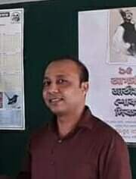
Teacher’s Identity
Satyajit goswami
Head Teacher
Betory GPS
Sadar,Moulvibazar.

Slide 3
Lesson Identity
Subject: English
Class : Five
Unit:10
Date:15.07.2021

Slide 4
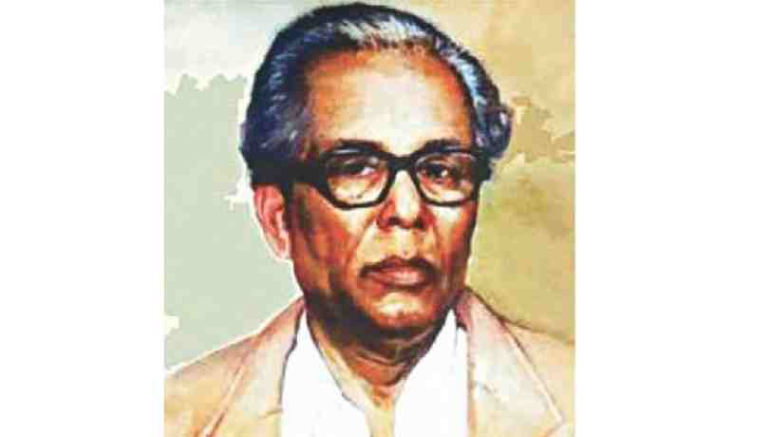
Who is this person?
Where does he come from?
Zainul Abedin
Kishoreganj

Slide 5
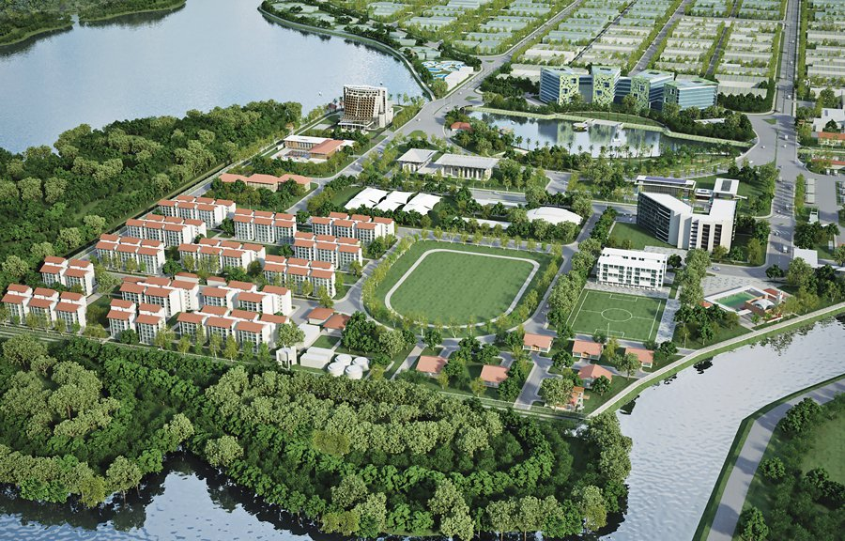
Our Today’s topic
is
My Home District
(My Home District …………………… Gurudayal College are in the town)

Slide 6
Learning outcomes
By the end of the lesson students will be able to……………….
Listening:1.1 recognize sound differences in the context of words.
Speaking: 1.1 say words, phrases and sentences with proper sounds ,stress and intonation.
Reading: 1.5 read words, phrases and sentences in the text with proper pronunciation, stress and intonation.
Writing: 3.1 write sentences using non-cursive and cursive capital and small letters.

Slide 7
Mamun’s home district is Kishoreganj. It is 145 kilometres from Dhaka.
It is a district headquarters. The district has 8 municipalities, 13 Upazilas, 108 unions and 1745 villages.
The name Kishoreganj comes from the name of an old landlord known as Brojakishore Pramanik or Nanda Kishore Pramanik.

Slide 8
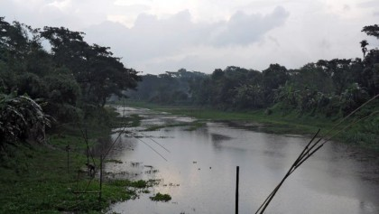
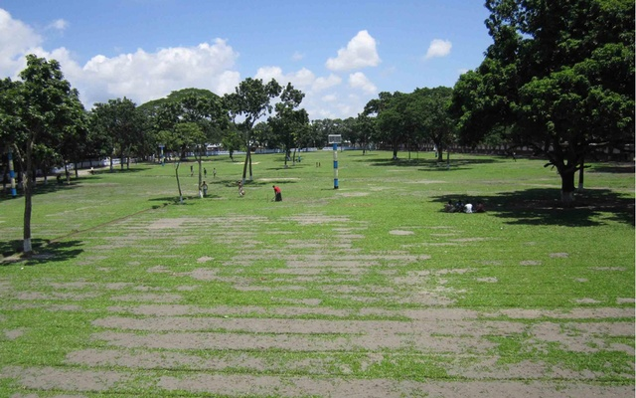
The area of Kishoreganj municipalities is about 10 square kilometres. The river Narasunda flows through the town.
Kishoreganj is a small town but there are many important places in and around it.
The largest Eid fairgrounds, called Solakia Eid ground and the well-known Government Gurudayal College are in the town.

Slide 9
New Words
Headquarter
Landlord
Municipality
Flow
Important
সদর
জমিদার
পৌরসভা
প্রবাহিত হওয়া
গুরুত্বপূর্ণ

Slide 10
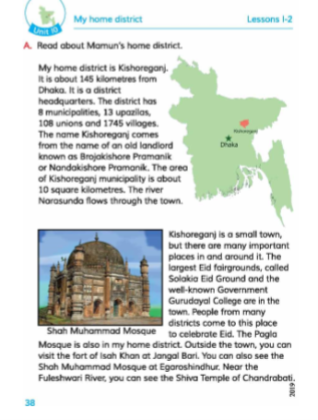
Open your book at page no 38 and read the text silently

Slide 11
Now read the text loudly one by one

Slide 12
Group Work
Ask and answer:
What`s is the name of Mamun`s home district?
Ans. Mamun`s Home district is Kishoreganj.
How far is it from Dhaka?
Ans. It is about 145 killomitrs from Dhaka.

Slide 13
Write true or false.
Kishoreganj is not a big town.
The largest Eid fairground is situated in Kishoreganj.
Kishoreganj is 150 kilometres from Dhaka.
There are few important places in Kishoreganj.
Individual work
True
True
False
False

Slide 14
Home Work
Write a short composition about Your Home District.

Slide 15
Thank you

