Slide 1

Welcome dear students.

Slide 2


Teacher’s Information
Md. Shamsul Alam
BA(Hons.)MA in English.
Assistant Teacher( English)
Nabodoy Girl’s High School
Shailkupa, Jenaidah.
Phone:01917-452052,01722-922691
Email:shamsul101085@gmail.com

Slide 3
Introduction of Lesson
English First Paper
Class: 9-10
Date: 16-07-2021
Time:45 minutes

Slide 4
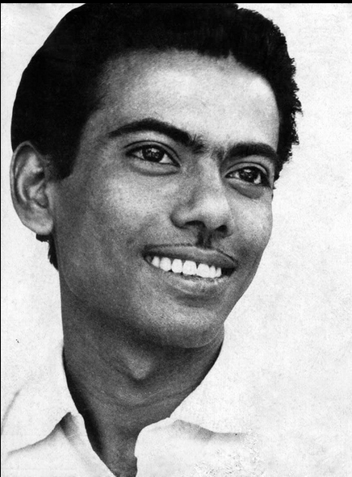
Look at the picture. He is a great son of our country.
Who is he?
Ans: He was a great film maker.
What do you know about him?
Ans: He contributed much to the Language Movement an Liberation War of Bangladesh.

Slide 5
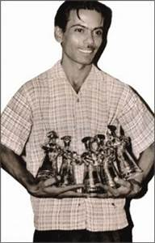
Look at the picture:
Can you tell his name now?
Answer: yes, he is Zahir Raihan.

Slide 6
Our today’s lesson is-
They had dreams 2
Unit 10, Lesson 4

Slide 7
Learning outcomes
After we have studied this lesson, we will be able to-
► listen for specific information
► participate in conversations and discussions
► understand and narrate problems
► take and give interviews
► complete a grid.

Slide 8


Slide 9
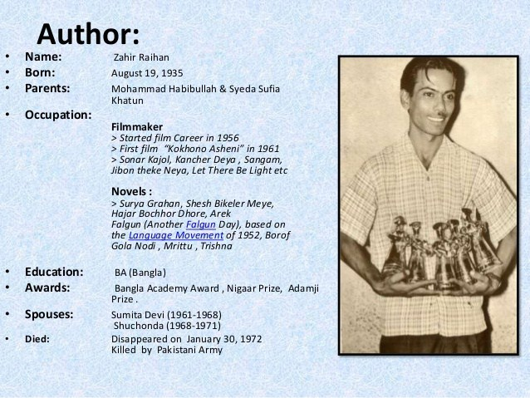

Slide 10
Key words and their meaning
Words
Meaning
Procession ▬ ▬ ▬
Prison ▬ ▬ ▬
Democratic ▬ ▬ ▬
Legendary ▬ ▬ ▬
Revolt ▬ ▬ ▬
Miniature ▬ ▬ ▬
Autocrat ▬ ▬ ▬
Conspiracy ▬ ▬ ▬
Critic ▬ ▬ ▬
Collaboration ▬ ▬ ▬
Genocide ▬ ▬ ▬
Inception ▬ ▬ ▬
A line of people or vehicles that move slowly for a specific purpose
Imprisonment/jail
Controlled by representatives who are elected by the citizens
Very famous an admired/celebrated
Refusal to accept someone’s authority,/revolution
Describing something which is a very small copy of an object
A ruler who has absolute power
A secret plan that made to do something harmful
Someone whose job is to give their opinion about opinion about something
A person who works with an enemy who has taken control of their country
The murder of a whole race or group of people
The start of an institution/beginning

Slide 11
Read the text
Zahir Raihan was one of the most talented film makers in Bangladesh. He was born on 19 August 1935 in the village Majupur in Feni district. He was an active worker of the Language Movement. He was one of the ten students to go out in a procession on 21 February 1952 despite a ban on such activities imposed by the authorities. As a result, he and many others were arrested and taken to prison. Raihan was also present at the historical meeting of Amtala on 21 February 1952. He also took part in the mass movement in 1969. In 1971, he joined the Liberation War.
All through his life, Zahir Raihan dreamt of a democratic society, a society that would ensure freedom of speech. He had many dreams about our film industry too. He made a legendary film ‘Jibon Theke Neya’ based on the Language Movement of 1952. It was a protest against the autocratic government then ruling our country. The family portrayed in that film symbolically represented East Pakistan. The family was ruled by

Slide 12
an autocrat who had to go to prison for her conspiracy. During the Liberation War in 1971, this film was shown outside Bangladesh. Celebrated film makers like Satyajit Ray, Mrinal Sen, and Ritwik Ghatak appreciated the film. Raihan gave all the money the film made to the Freedom Fighters' trust Besides, his great documentary on Pakistani atrocities, Stop Genocide, helped create world sentiment in favour of our liberation war.
On 30 December 1971, someone informed Raihan about an address somewhere at Mirpur where he might find his brother, the famous writer Shahidullah Kaiser, who had gone missing from 14 December 1971. Kaiser was captured and killed by the Pakistani army and the local collaborators during the last days of the war. Accordingly, Raihan left home to get his brother back but he never returned. Zahir Raihan’s dream was fulfilled. He could see the emergence of an independent Bangladesh though he did not get back his brother. And it's a pity that this dreamer could not live to see his dream come true. fulfilled. He could see the emergence of an independent Bangladesh though he did not get back his brother. And it's a pity that this dreamer could not live to see his dream come true.

Slide 13
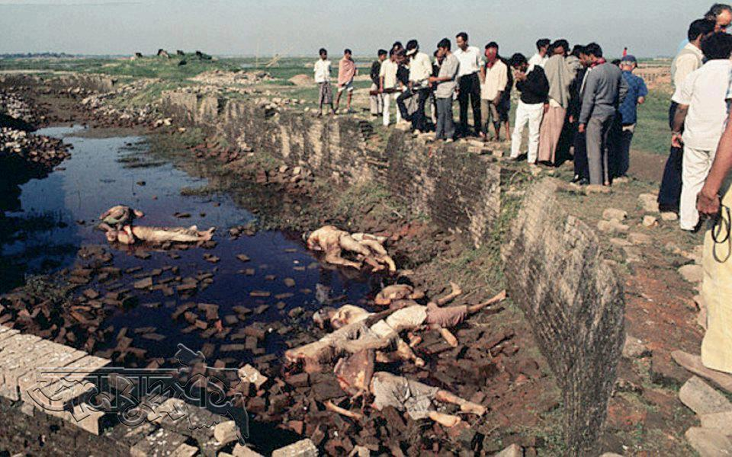
Martyred Intellectuals Memorial
Killing of intellectuals at Rayerbazar, Dhaka on the 14th December in 1971.

Slide 14
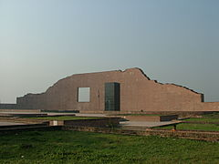
Martyred Intellectual Memorial, Rayerbazar, Dhaka

Slide 15
Use appropriate information from the text above to complete the grid.
Zahir Raihan
participated in | famous as | Best Documentary | movie based On language Movement | Missing Since | his dream
Use appropriate information from the text above to complete the grid.
The Liberation War, Language Movement
film maker
Stop Genocide
30 December, 1971
a democratic society
’Jibon Theke Neya’

Slide 16
Let’s watch a video-
How was the video? How much information have you got from it?

Slide 17
Read the following sentences and complete them.
1. Zahir Raihan is famous as……………………………………..
2. Raihan was imprisoned because……………………………………..
3. He participated in……………………………..and……………………………….
4. Jibon Theke Neya……………………………………..
5. He donated……………………………………..
6. He worked to organize…………………………………………………….by ………………………… his great documentary.
7. His disappearance is a great……………………………………..
Liberation War.
world sentiment against Pakistani atrocities
shock in the history of Bangladesh.
film maker.
He participated in the procession on 21 February, 1952.
Language Movement
The Language Movement of 1952.
money to the Freedom Fighters’ Trust.
Stop Genocide

Slide 18
Work in pairs. Discuss.
Why is Zahir Raihan considered a freedom fighter though he was a film maker?
Answer: It is because in 1971 he joined the Liberation War.
2. How does the title of the lesson fit the story of Zahir Raihan?
Answer: ‘A valiant freedom fighter Zahir Raihan’ fits to the story of Zahir Raihan.

Slide 19
Project:
Work in groups. Meet a valiant freedom fighter in your locality. Interview him/her. Then write a paragraph on him/her.

Slide 20
Thank You
So Much
Good bye

