Slide 1
Welcome
MS English Online Class

Slide 2
Madhu
Sudan Das.
BA (H), English,
MA (Double),
ELL & ELT; M.Ed.
Bakalia Adarsha Girls’
High School.
Introduction
Candidates
and
Nine-Ten

Slide 3
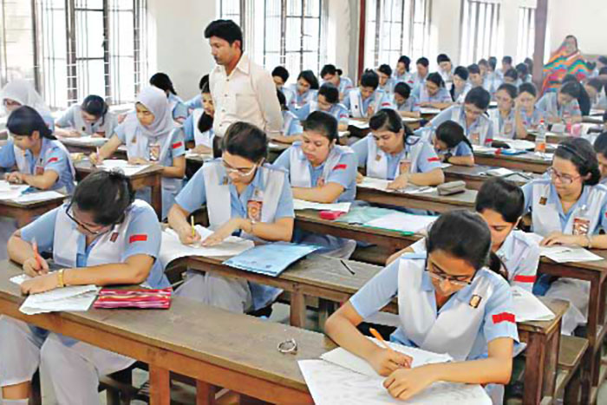
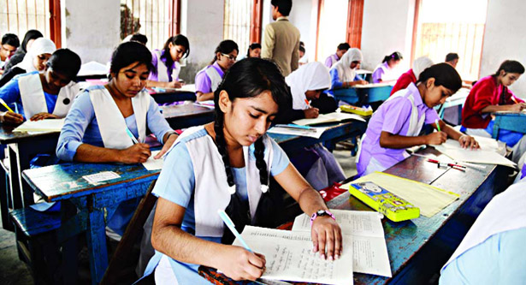
What are they doing?
What are they doing?
They are also appearing at SSC Exam.
They are appearing at SSC Exam.

Slide 4
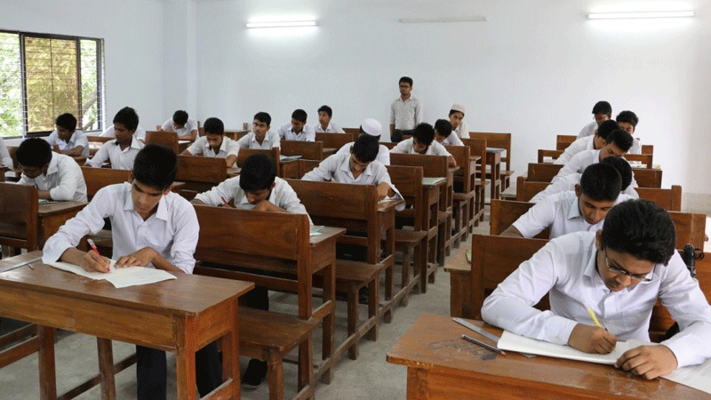
Today our topic is Questions items of SSC 2021

Slide 5
Learning outcomes:
After completing the lesson we will be able to:
Make Tag questions
Use right form of verbs
Make sentences using parts
Fill the blanks without words
Use Capitals and Punctuation Marks
Fill the blanks with suitable words
Speak about pictures and events
Fill the blanks with words from the box

Slide 6
Look at the pictures
They are going to school.
Class suspended
School closed.

Slide 7
1. Fill in the blanks with the words from the box. You may need to change the forms of some words. You may need to use one word more than once.
0.5×10=5
and
due
country
losses
reopening
all
until
regarding
After
announced
The Directorate of Secondary (a)______ Higher Education (DSHE) has suspended (b)_____ of the assignments for the students of Class-VI to Class-IX (c)______ to worsening situation of Covid-19 across the (d)________, reports UNB. A circular was issued on Friday (e)___________the matter. The order will remain in force (f) _____ further notice, said the handout. (g)_____ a year and half of closure due to the pandemic and significant academic (h)______, the government on 27 June (i)____________that all schools and colleges would be (j)__________ on 1 August.

Slide 8
What do you see in the picture?
No Activities of a classroom.
Activities of a classroom.

Slide 9
Pair work
2. Fill in the blanks with suitable words
1×5=5
The government has extended (a)----- ongoing closure of all the educational institutions (b)------- Bangladesh once again until 31 July (c)------the coronavirus situation keeps worsening (d)----- the country, reports UNB. The decision has been taken considering (e)----- overall Covid-19 situation, imposition of lockdown and safety (f)----- teachers, students and staff. On 26 May, the government had decided (g)----- reopen the educational institutions, particularly primary, secondary (h)------higher secondary ones, in the country on 13 June depending on the Covid situation. But the situation keeps worsening in the country, (i)-------- in bordering districts. The decision has been taken as per the directives of the national technical advisory committee formed (j)------ fight Covid-19 in the country.
Madhu Sudan Das. BA (Hon’s), English; MA (Double); ELL & ELT, M.Ed.
a. the
b. of
c. as
d. in
e. the
f. of
g. to
h. and
i. particularly
j. to

Slide 10
Online seminar
Overcoming the learning gap during the pandemic
The Friedrich Naumann Foundation for Freedom (FNF South Asia)

Slide 11
3.Make six sentences using parts of sentences from each column of the table.
1×6=6
The prosperity | is, the more intellectuals | on its education system.
The more efficient the system | of a nation depends | an online seminar programme.
All educational institutions | the schools, entrepreneurs and the | of the young generation.
The Friedrich Naumann Foundation | how to overcome the learning gap | are produced in the country.
This programme discussed | stayed shut for the welfare | students faced during the pandemic.
What roles | for Freedom organized | government can play in doing so.
Answer:
a. The prosperity of a nation depends on its education system..
b. The more efficient the system is, the more intellectuals are produced in the country.
c. All educational institutions stayed shut for the welfare of the young generation.
d. The Friedrich Naumann Foundation for Freedom organized an online seminar programme.
e. This programme discussed how to overcome the learning gap students faced during the pandemic.
f. What roles the schools, entrepreneurs and the government can play in doing so.

Slide 12
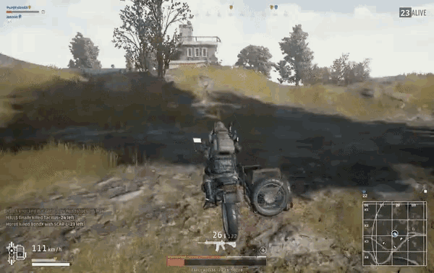
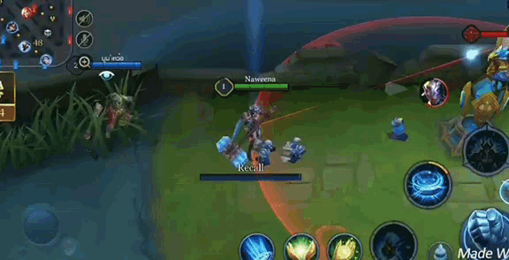
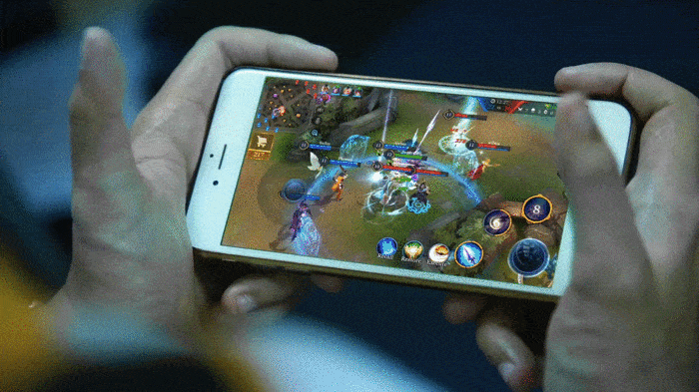
Look at the picture
Playing online game over mobile.
Playing online game over mobile.
Its also another online game using mobile/laptop.

Slide 13
4. Use right form of verbs
1×10=10
spend
agree
play
vandalize
worry
take
begin
impair
hesitate
list
be
The educational institutions closed. Many children, teenagers and young people spend their time (a) --- games. Game addiction has been (b) --- as a disease by the World Health Organization. Jisan, 18 years old teenager (c)--- most of the day playing online games. In the (d) ---, his parents (e) --- the matter as normal. But it (f) --- seen that when he could not play the game, he started (g) --- the house. Sometimes he not (h) --- to hurt his parents. His parents took him to a clinical psychologist. Many families in the country (i) ---. Many teenagers now spend a large part of the day playing games on their cell phones or computers. As a result their studies are being (j) ---.
Madhu Sudan Das. BA (Hon’s), English; MA (Double); ELL & ELT, M.Ed.
a. playing
b. listed
c. spends
d. beginning
e. took
f. was
g. vandalizing
h. does not hesitate
i. worried
j. impaired

Slide 14
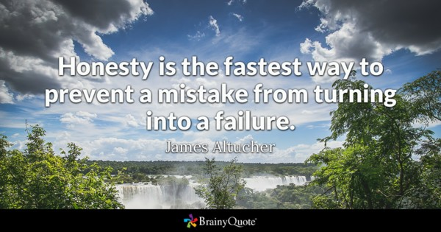
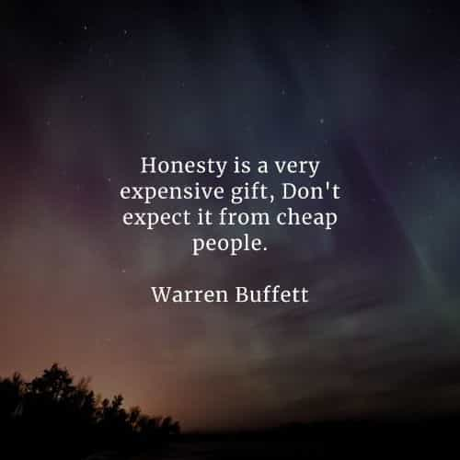
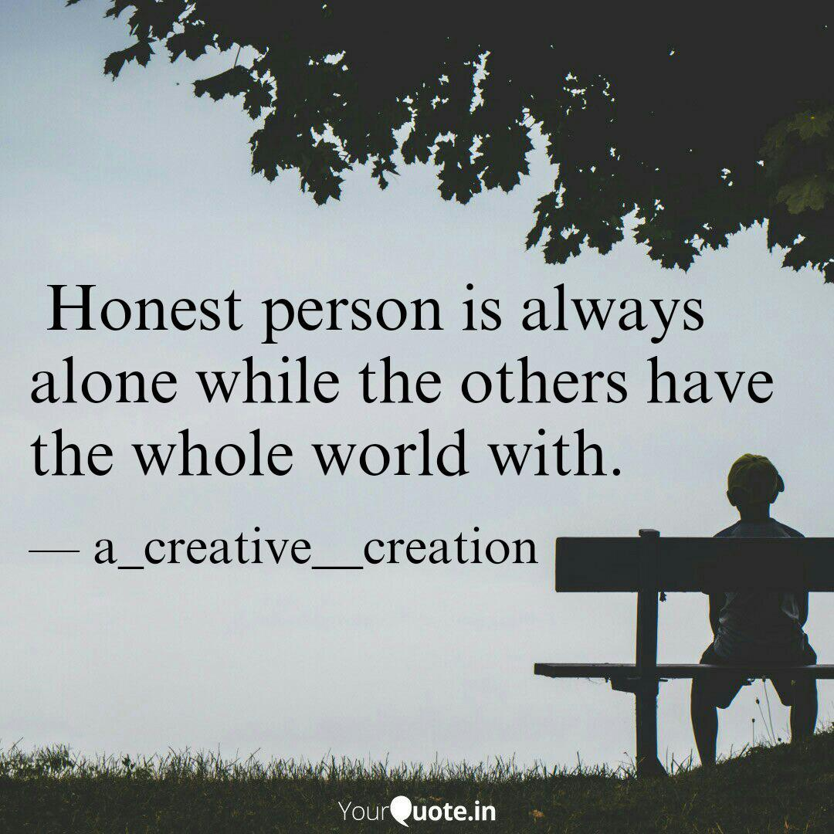
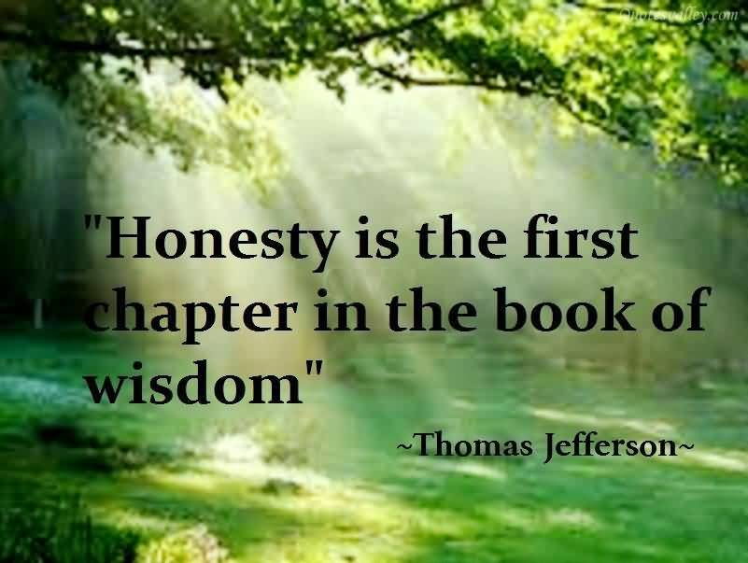
Read the quotes

Slide 15
5. Change the sentences as directed
1×10 = 10
a. Honesty is one of the most important virtues. (Comparative)
A: Honesty is more important than most other virtues.
b. Nowadays many people cultivate honesty. (Passive)
A: Nowadays honesty is cultivated by many people.
c. Everybody loves an honest man. (Negative)
A: There is nobody but loves an honest man.
d. How important honesty is! (Assertive)
A: Honesty is very important.
e. No virtue is as important as honesty. (Superlative)
A: Honesty is the most important virtue.
Madhu Sudan Das. BA (Hon’s), English; MA (Double); ELL & ELT, M.Ed.

Slide 16
f. Honesty is the best of all virtues. (Positive)
A: No other virtue is as good as honesty.
g. We like honest people for their integrity and morality. (Passive)
A: Honest people are liked by us for their integrity and morality.
h. Honesty is more worthy than all other qualities. (Superlative)
A: Honesty is the most worthy of all qualities.
i. Honesty should be cultivated widely. (Active)
A: We should cultivate honesty widely.
j. Govt. should take necessary steps to encourage honest people.(Passive)
A: Necessary steps should be taken by the govt. to encourage honest
people.
Madhu Sudan Das. BA (Hon’s), English; MA (Double); ELL & ELT, M.Ed.

Slide 17
Look at the picture.
Md. Maruf Hasan

Slide 18
Individual work
6. Use suffix or prefix or both:
0.5×14=7
Read the text
For the first time ever, Bangladesh has (a)―(bag) a gold medal in the Asian Pacific (b) ― (Math) Olympiad (APMO). The result was (c) ― (publish) on 29 June, reports UNB. Md. Maruf Hasan, a student of (d) ― (Govern) Anandamohan College, Mymensingh, won the gold medal for Bangladesh in this year’s (e) ― (compete). He won silver and bronze medals in 2019 and 2020, (f) ― (respective). Besides Maruf, Nuzhat Ahmed of Viqarunnisa Noon School (g) ― (an) College and Adnan Sadiq of Notre Dame College won a bronze each, while six members of the Bangladesh (h) ― (am) have been awarded special honours. In this year’s competition, a total of 344 students (i) ― (participate) from 37 countries. With a total score of 96, Bangladesh (j) ― (end) up 21st with one gold and two bronze. Bangladesh Mathematical Olympiad Committee (BDMO) (k) ― (announce) the local edition of the mathematical Olympiad in March this year. It was held at the Monem Business District Building in Karwan Bazar, Dhaka. The APMO is held annually. Each (l) ― (participate) country has a (m) ― (represent) in charge of organizing the APMO locally. A central committee selects a paper with five questions to be solved in four hours, sends (n) ― (mark) schemes and determines award winners.
a. bagged
b. Mathematical
c. published
d. Government
e. competition
f. respectively
g. and
h. team
i. participated
j. ended
k. announced
l. participating
n. marking
m. representative
Madhu Sudan Das. BA (Hon’s), English; MA (Double); ELL & ELT, M.Ed.

Slide 19
7. Make Question tag
1×7=7
1. One can do almost nothing without money, ________ ?
can they
2. “Courtesy costs nothing”- all should know the maxim, ___________?
shouldn’t all
3. Pandemic situation, ______?
isn’t it
4. There is scarcity of oxygen, __________ ?
isn’t there
5. Long live our Prime Minister, __________ ?
mayn’t she
6. That we love our country is known to all, ______ ?
isn’t it
7. Neither of the girls was present, _________?
were they
8. Kamal and not his friend took vaccine, _________?
didn’t he
9. The elite get treatment, _________?
don’t they
10. The poor has less opportunity of treatment, _________?
do they
Madhu Sudan Das. BA (Hon’s), English; MA (Double); ELL & ELT, M.Ed.

Slide 20
8. Use capitals and punctuation marks:
0.5×10=10
regarding the demand for opening educational institutions in the corona transition the leader of parliament and prime minister sheikh hasina said we can talk about opening schools colleges and universities but it is also necessary to think a little learn to read for this i will knowingly push the children to the brink of death or not
Regarding the demand for opening educational institutions in the Corona
transition, the Leader of Parliament and Prime Minister Sheikh Hasina said,
“We can talk about opening schools, colleges and universities. But it is also
necessary to think a little, learn to read, for this I will knowingly push the
children to the brink of death or not.”

