Slide 1
My dear students, you are-
Welcome

Slide 2
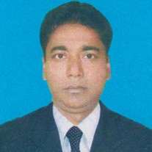
Introduction.
English For Today
Class –Nine
Time - 45 mins.
Md. Monirul Islam
Assistant Teacher (English)
Azimnagor Com.K.School & college.
monir19077@gmail.com
01761714820

Slide 3
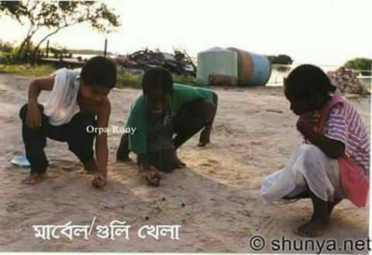
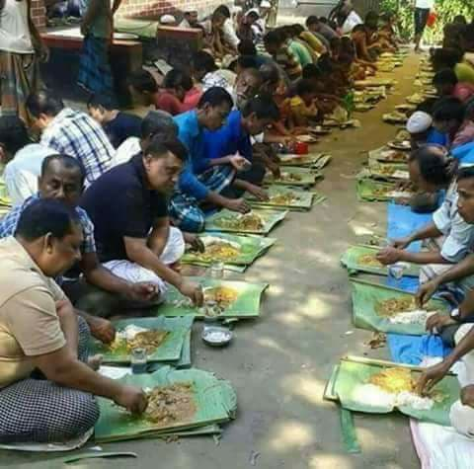
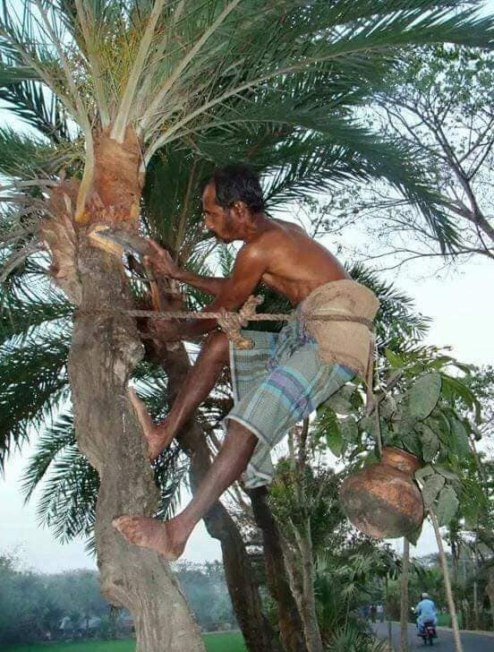
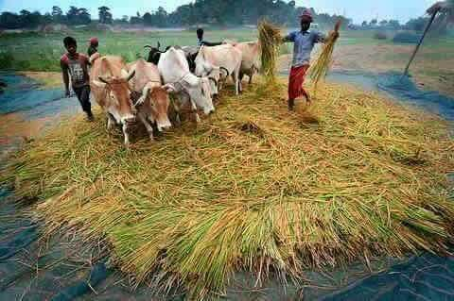
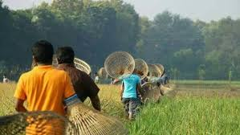
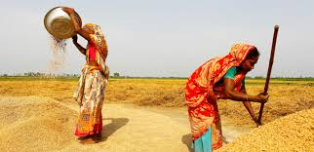
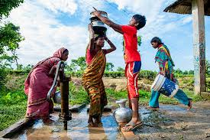
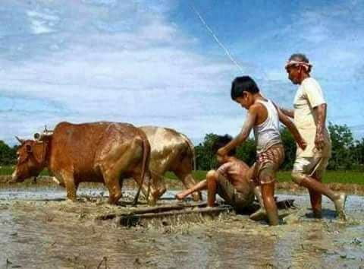
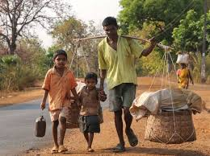
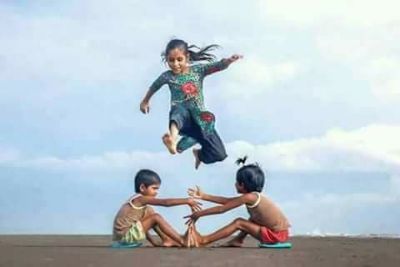
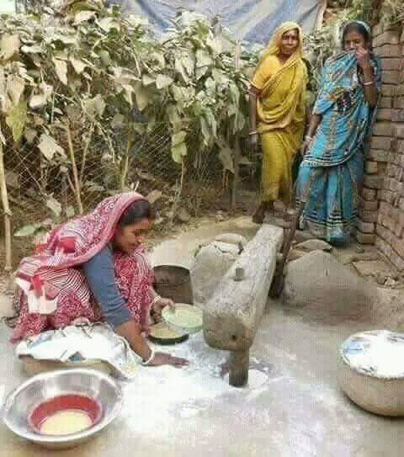
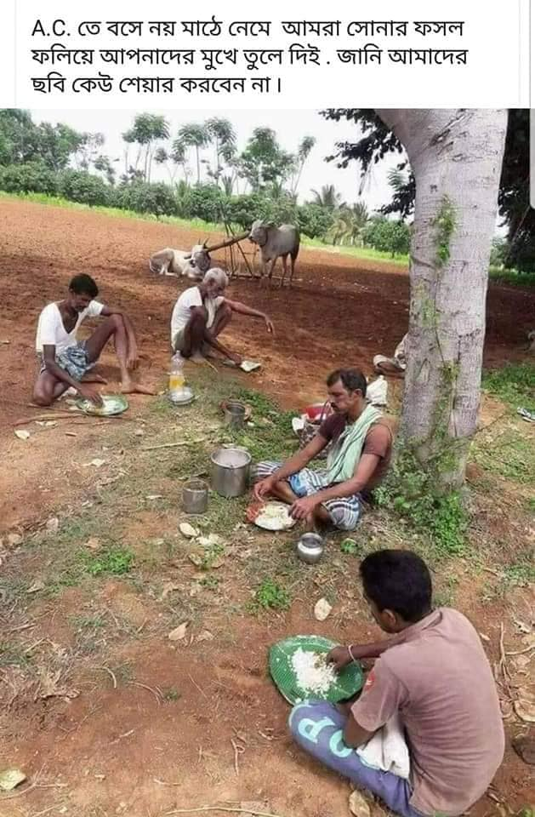
Let’s see some more pictures.
Are these pictures urban or rural ?
What do you see in the pictures?
Take a good look at the pictures.

Slide 4
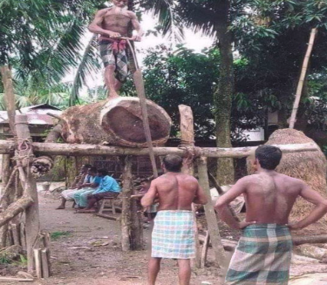
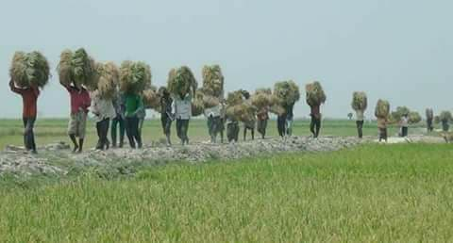
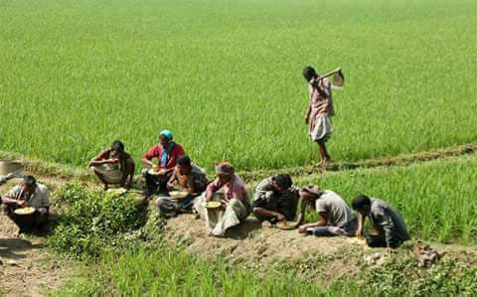
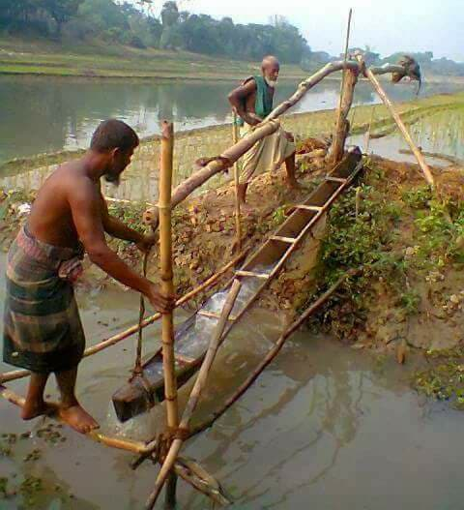
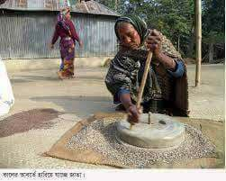
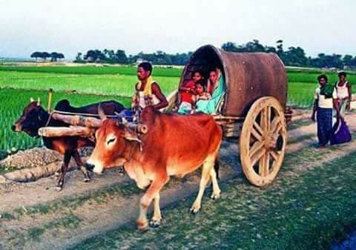
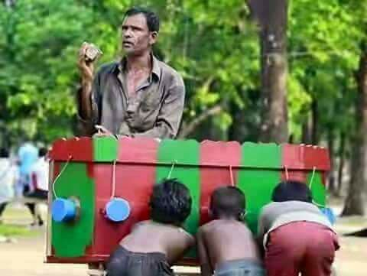
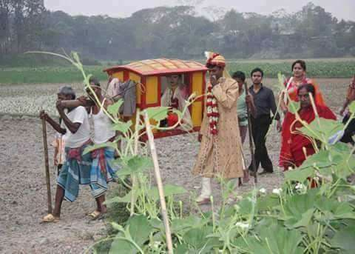
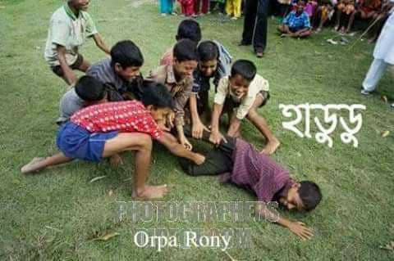
Dear students, let’s enjoy a video about village life.
Village

Slide 5
So, today we’ll read about-
Paragraph / Composition
writing.

Slide 6
Learning outcomes .
At the end of the lesson, students will be able to –
define about Village life ;
write a story about Village life ;
ask and answer question .

Slide 7
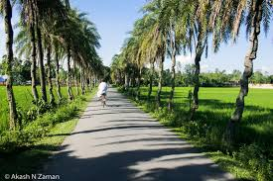
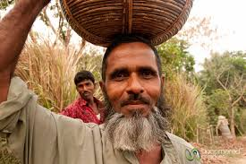
Village life is quite natural.
Villagers lead very simple and easy life.

Slide 8
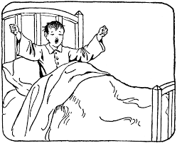
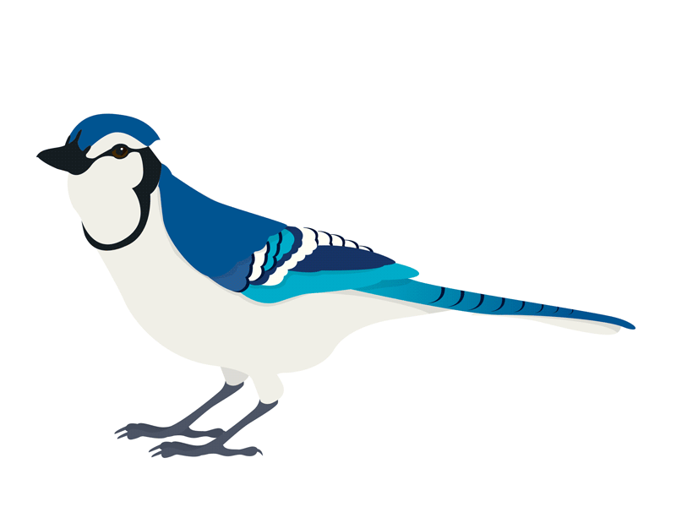
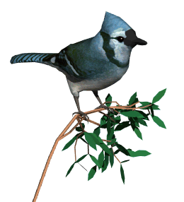
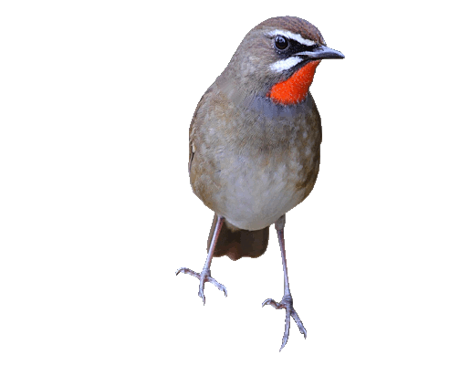
The villagers wake from bed in the morning hearing the melodious song of bird.

Slide 9
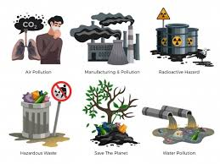
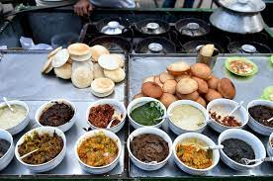
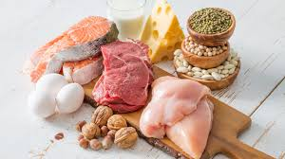
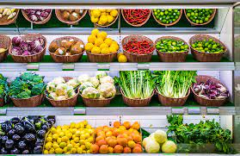
They eat fresh..
In the villages, people live in a pollution free environment.
Winter cake
Food
Vegetable

Slide 10
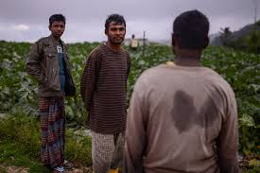
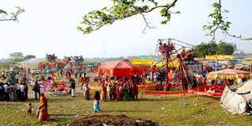
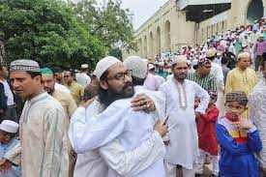
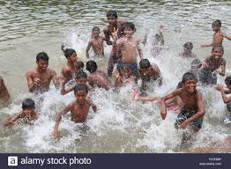
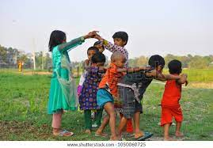
They enjoy different occasions and festival.
They move freely in the field.
Take a bath and swim in the pond or in the river.
Children in the villages play freely in the open air.

Slide 11
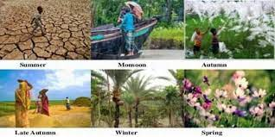
The village people can enjoy the different beauties of different seasons.

Slide 12
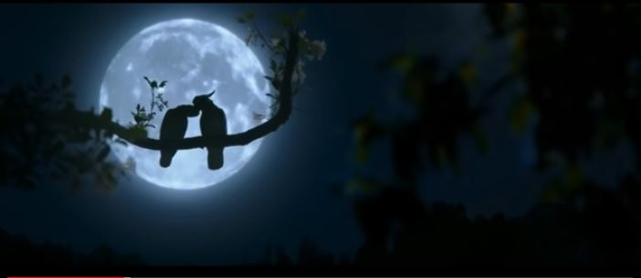
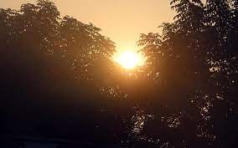
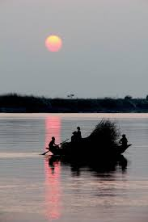
The village people can enjoy..
The sun rise
The sun set
Moonlit night

Slide 13
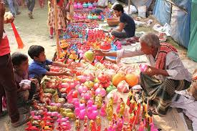
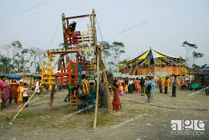
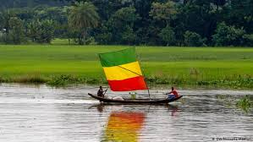
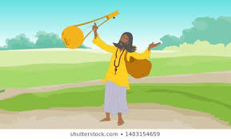
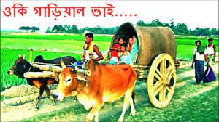
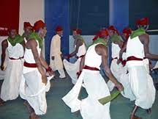
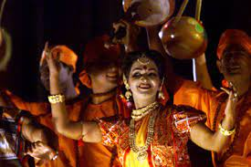
The village people can also enjoy..
Sharee gan
Baul songs
bhawaia songs
Village fair
Zaree gan

Slide 14
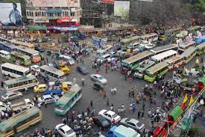
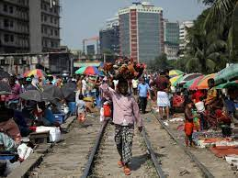
They do not feel life to be so hard and complicated as the city people feel.

Slide 15
Most of the villagers are underdeveloped.
They cannot enjpy modern facilities.

Slide 16
Yet
The villagers live happiness.
The villagers live simple.
The villagers live peace.

Slide 17
*Evaluation*
Answer a following questions:
How is village life ?
b. How do the village people live ?
c. How is the life of the villagers ?
d. How do the village people enjoy themselves ?

Slide 18
*Home work*
Write a paragraph about ‘Village life’ with your own word.

Slide 19
Thank you very much.

