Slide 1
Good morning students

Slide 3
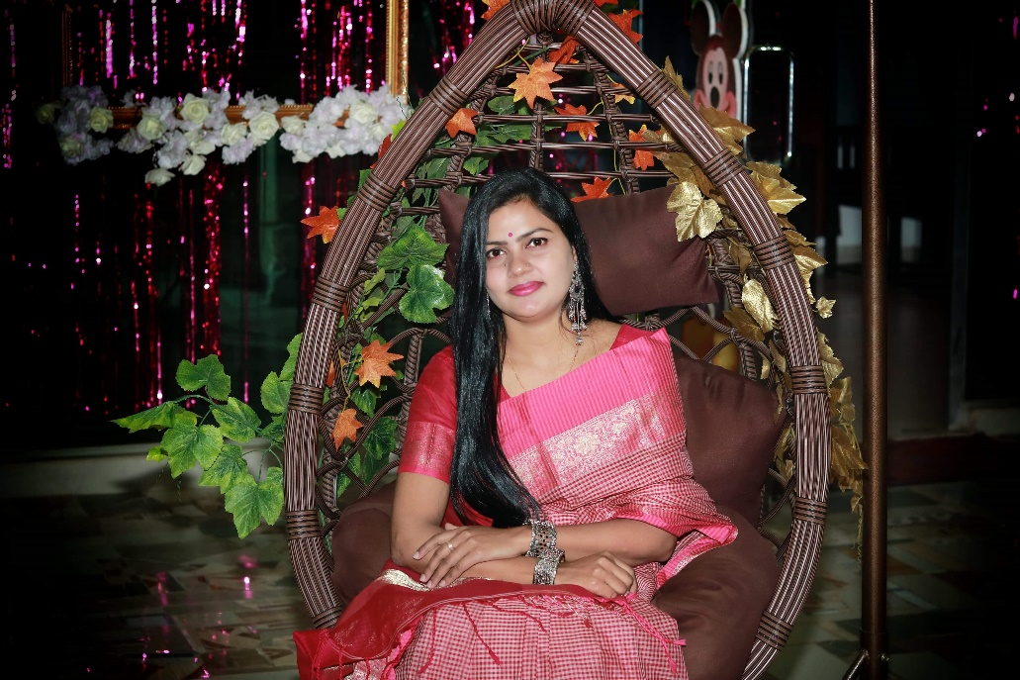
Teacher’s Identity
Maleka Mokerrama Moly
Assistant teacher
Dhondogaon Government Primary School
Thakurgaon sadar,Thakurgaon.

Slide 4
Lesson’s identity
Class :Two
Subject : English
Unit : 26
Lessons : 4-6
Activity :B
Time:50 minutes

Slide 5
Learning outcomes
By the end of the lesson student will be able to-
Listening:
1.1.1 become familiar with English sounds by listening to common English words.
Speaking:
1.1.1: repeat after the teacher simple words and phrases with proper sounds and stress.
1.1.2 say simple words and phrases with proper sounds and stress.

Slide 6
Let’s sing a song with the audio device.

Slide 7
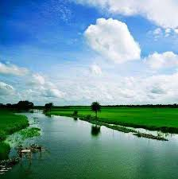
In the morning, what do you do?

Slide 8
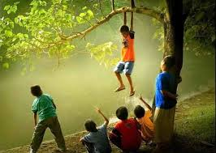
In the afternoon, what do you do?

Slide 9
In the evening, what do you do?

Slide 10
At night what do you do?

Slide 11
Today’s lesson is-
In the/at…

Slide 12
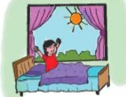
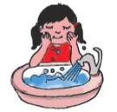
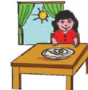
Dear students, let’s see what do we do in the morning .
Get up/wake up
Have breakfast
Wash face
Go to school

Slide 13
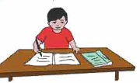
Dear students ,lets’s see what do we do in the afternoon.
Do homework
Play with friends

Slide 14
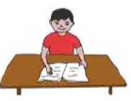
Dear students ,lets’s see what do we do in the evening.
Read book

Slide 15
Dear students ,lets’s see what do we do at night.
Brush my teeth
Go to bed

Slide 16
My dear students,now listen to me very carefully and say with me.
In the
I get up in the morning.
I brush my teeth in the morning.
I play in the afternoon.
I read in the evening.

Slide 17
At….
I brush my teeth at night.
I go to bed at night

Slide 18
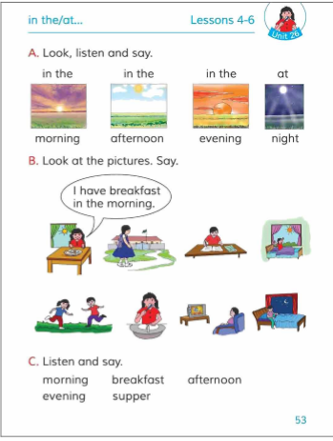
Practice in pair.
Now open your book at page 53.

Slide 19
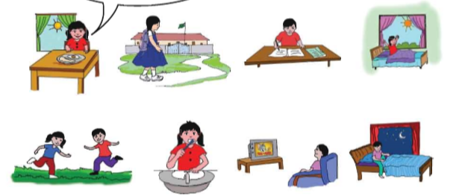
SGW
Dear students sit in group and discuss about the picture what time and what activity is doing.

Slide 20
Checking learning
Dear student ,look at the picture and answer the following question.
When do you get up?

Slide 21
When do you play?
When do you read book?

Slide 22
When do you go to bed?
When do you have breakfast?

