Slide 1
WELCOME
WELLCOME

Slide 2
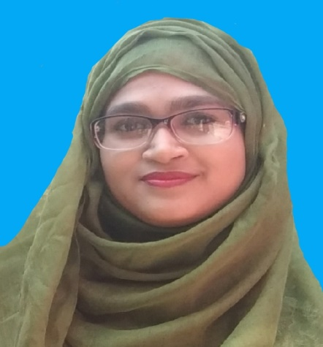
INTRODUCE
UMME SARMIN
ASSISTANT TEACHER
CORDICREE GOVT. PRIMARY SCHOOL
MULADI, BARISHAL

Slide 3
LESSON
CLASS: 1
SUBJECT: ENGLISH
UNIT: 10
LESSON: 1-3

Slide 4
LEARNING OUTCOMES
Student will be able to-
Listening:
1.1.1. beacome familiar with English sounds by listening to common English word.
4.1.1. enjoy the rhythm and music of simple rhymes.
Speaking:
1.1.1. repeat words, phrases and sentences after the teachers with proper sounds and stress.
1.1.2. say words, phrases and sentences with proper sound and stress.
4.1.1. repeat rhymes after the teacher.
4.1.2. recite rhymes individually.

Slide 5
CREATING EMOTION
LET’S ENJOY A SONG

Slide 6
LOOK AT THESE PICTURE
Right
Left

Slide 7
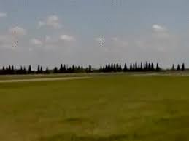
LOOK AT THESE PICTURE
Ground
Sky

Slide 8
LOOK AT THE PICTURE
Bird

Slide 9
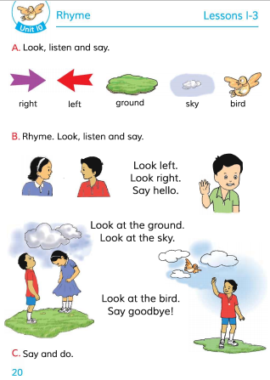
POEN YOUR BOOK
Page no-20

Slide 10
SAY WITH ME

Slide 11
LOOK AND LISTEN ATTENTIVELY

Slide 12
SAY WITH ME

Slide 13
SAY AND DO

Slide 14
HOMEWORK
Part of today’s lesson will be read well at home.

Slide 15
GOODBYE

