Slide 1
Identity
Class:9-10
Unit: One
Lesson: Two
Mst. Arifa Khatun
Assistant Teacher (English)
Chand Sultana Secondary Girls’
School, Kushtia Sadar, Kushtia
Email: arifakch87@gmail.com
Mobile: 01936601076

Slide 2
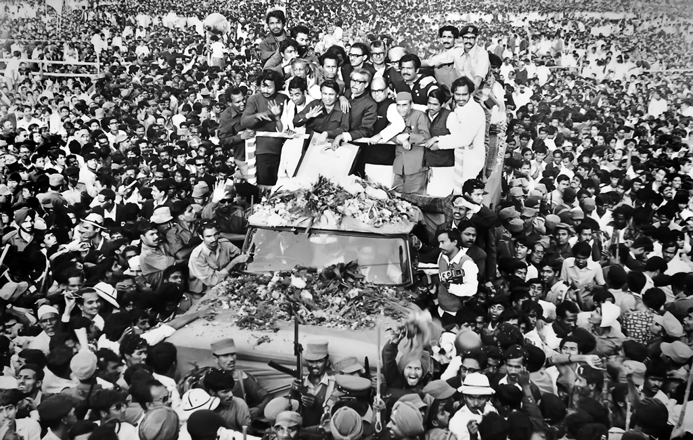
Lesson 2: The Tale of Homecoming
Bangabandhu’s Homecoming on 10 January, 1972.

Slide 3
A Work in pairs to discuss the following questions.
1. What do you see in the picture?
Answer
I can see in the picture of Bangabandhu’s homecoming after the independence of our country.
2. Who do you identify in the picture?
Answer
I can identify Bangabandhu Sheikh Mujibur Rahman on the open truck in the middle of the picture.

Slide 4
3. Do you find any connection between the picture and the title of the lesson? How?
Answer
Yes, I find an important connection between the picture and the title of the lesson. This picture refers that how Bangabandhu had received by the loving people of our country.

Slide 5
C. Work in pairs. Write on the blank spaces how you would express these words/phrases in your own language and then make sentences with them.
declaration of independence
capital punishment
(to) await breathlessly
(to) make their way satisfaction emotional affairs immense
Touch poetic unbounded joy genocide

Slide 6
Answer
1. Declaration of Independence = Announcing of an Independent Nation
Make Sentence = Bangabandhu was arrested by the Pakistani Army after his declaration of our independence
2. Capital Punishment = The Death Penalty
Make Sentence = Bangabandhu was imprisoned in Pakistan for capital punishment.

Slide 7
(to) Await Breathlessly = Waiting impatiently
Make Sentence = People were awaiting breathlessly to see Bangabandhu’s homecoming.
4. (to) make their way satisfaction = move towards a place
Make Sentence = We made our way to the school.
5. Emotional affairs = emotional closeness
Make Sentence= They have an emotional affairs with their friends.

Slide 8
Immense = huge
Make Sentence = It gives me an immense pleasure.
Touch poetic = The ability of poetic
Make Sentence = His return to home was a touch poetic because of his ling absence.

Slide 9
8. Unbounded joy = happiness
Make Sentence = He expressed the unbounded joy to see her success.
9. Genocide = massacre
Make Sentence = The Pakistani Army was responsible for this genocide crimes.

Slide 10
D Talk about the questions.
1. What made Bangabandhu so bold while in the prison?
Answer
Nothing could stop the Bangalees to gain independence that made Bangabandhu so bold while in the prison.
2. How did time change in Bangabandhu’s life within the nine months in a Pakistani prison?
Answer
Bangabandhu was brought to Pakistan as a prisoner , nine months earlier with little hope to return . When Bangladesh got independence, he was free to come back home and this time changed in Bangabandhu’s life within the nine months in a Pakistani prison.

Slide 11
3. How did London welcome Bangabandhu?
Answer
London welcomed Bangabandhu in several ways. Such as- His arrival was made headlines on the BBC and other media, journalists, the general public, British officials and politicians and Bangalee residents show respect to him.
4. Do you agree with the statement that Bangabandhu was excited as well as relieved from long anxiety in London? Why/Why not?
Answer
Yes, I agree with the statement that Bangabandhu was excited as well as relieved from long anxiety in London, because he called Dhaka and for the first time spoke to his family and Tajuddin Ahmad after his arrest by the Pakistan Army in March 1971.

Slide 12
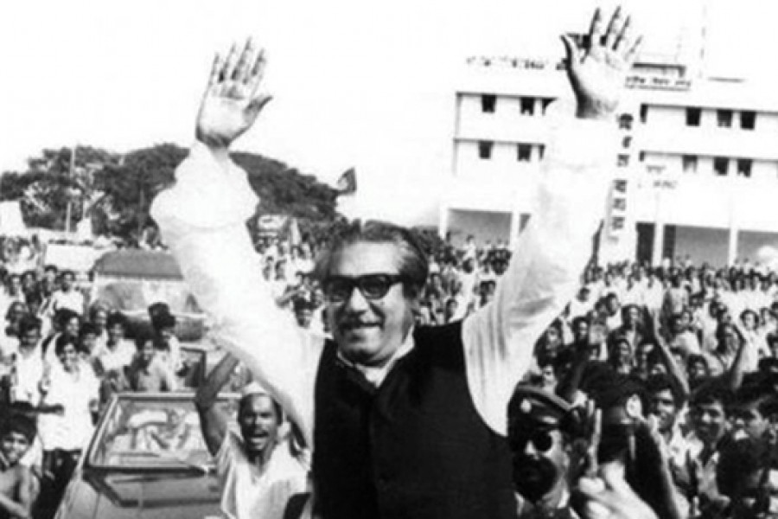
Thanks a lot !

