Slide 1
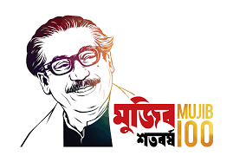
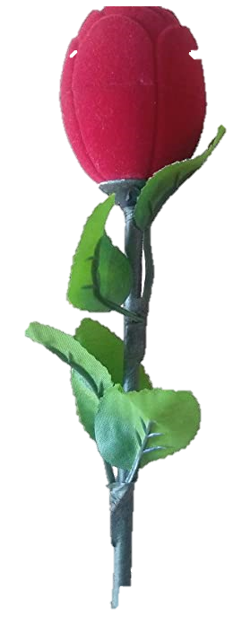

Slide 2
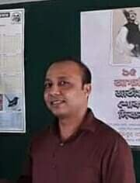
Teacher’s Identity
Satyajit goswami
Head Teacher
Betory GPS
Sadar,Moulvibazar.

Slide 3
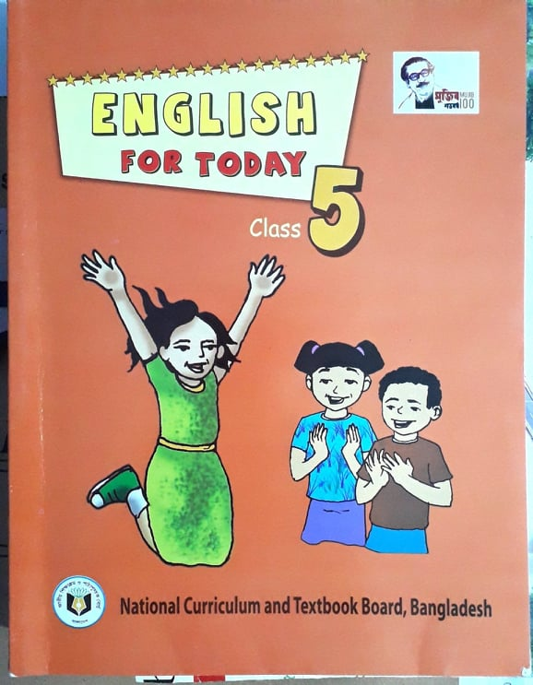
Lesson Identity
Subject: English
Class : Five
Unit:10
Date:19.07.2021

Slide 4
Let`s enjoy a song

Slide 5
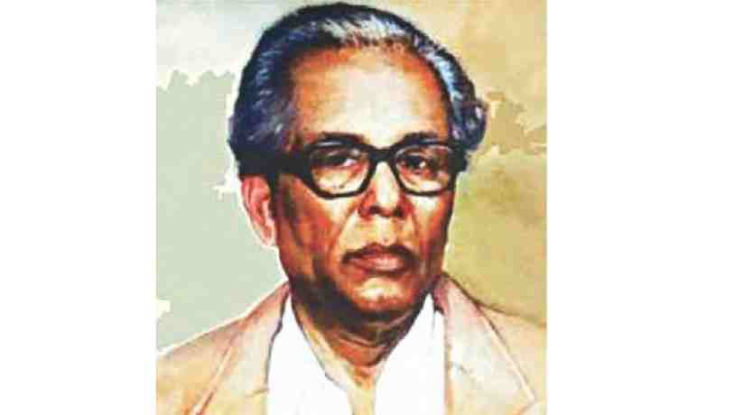
Who is this person?
Where does he come from?
Zainul Abedin
Kishoreganj

Slide 6
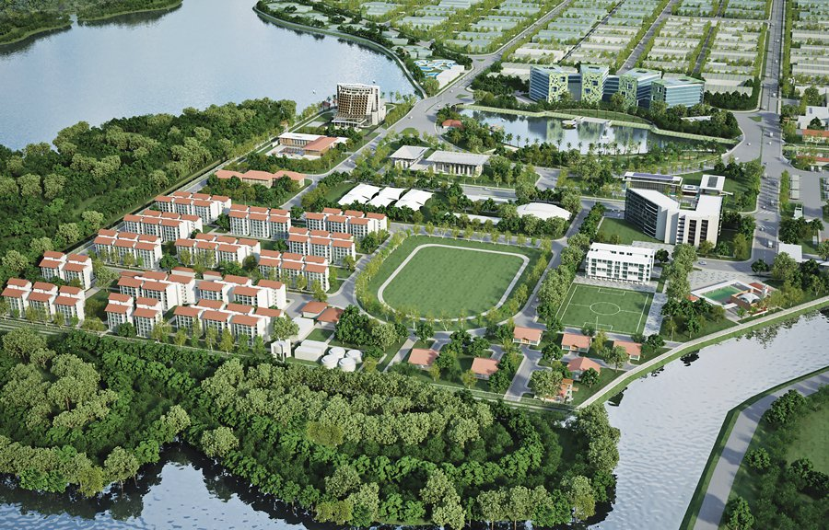
Our Today’s topic
is
My Home District
(People from many district …………………… I love my home district)

Slide 7
Learning outcomes
By the end of the lesson students will be able to……………….
Listening:4.2.1 understand and enjoy simple stories.
Speaking: 1.1.1 say words, phrases and sentences with proper sounds ,stress and intonation.
Reading: 1.5 read words, phrases and sentences in the text with proper pronunciation, stress and intonation.
Writing: 3.1 write sentences using non-cursive and cursive capital and small letters.

Slide 8
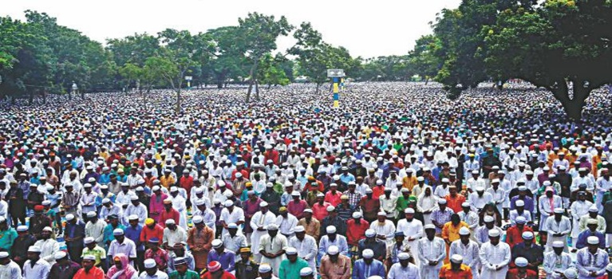
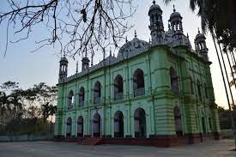
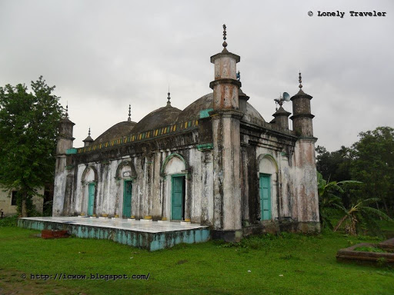
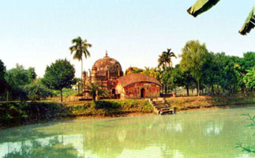
People from many districts come to this place to celebrate Eid.
The Pagla Mosque is also in my home district.
Outside the town, you can visit the fort of Isah Khan at Jangal Bari.
You can also see Shah Muhammad Mosque at Egaroshindhur.

Slide 9
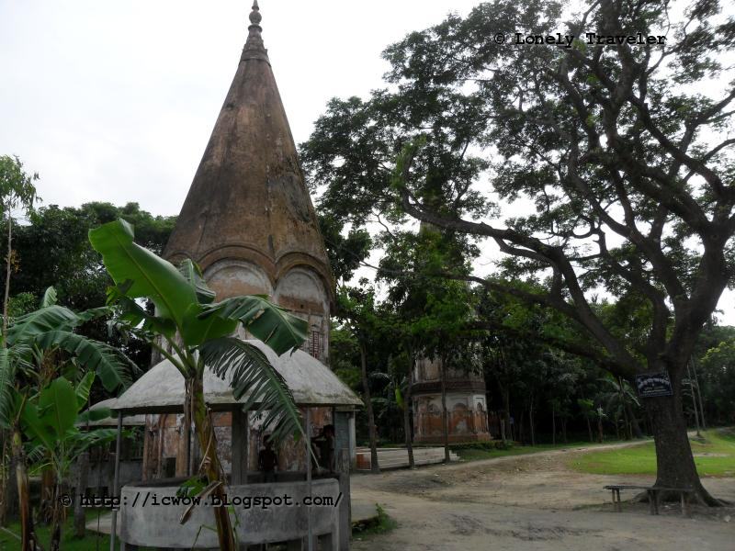
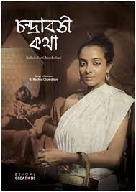
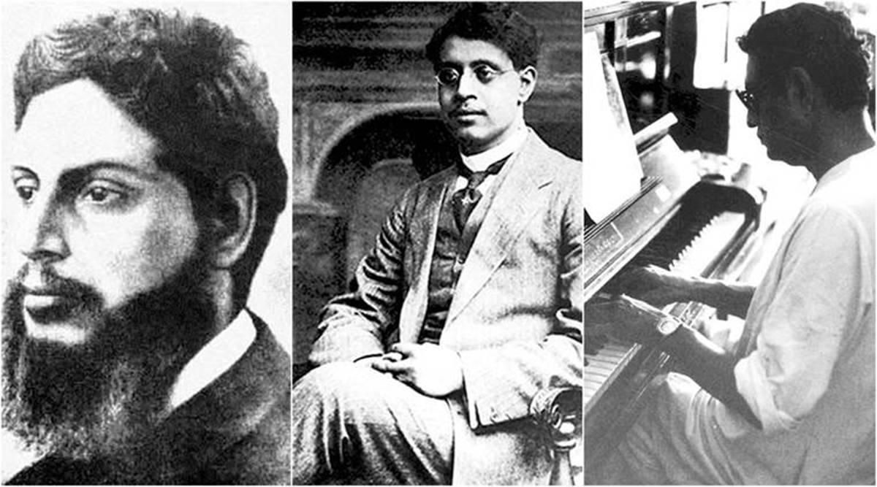
Near the Fuleshwari River, you can see the Shiva temple of Chandrabati.
Kishoreganj is also the home district of some famous people.
Chandrabati, the first woman poet of Bangla literature , was born here.
Two writers of children’s literature, Upendrakishore Roy Chowdhury and Sukumar Roy are also from here.

Slide 10
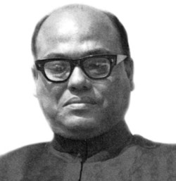
The great painter Zainul Abedin comes from Kishoreganj too.
Syed Nazrul Islam, the first acting president of Bangladesh, is also from here. I love my home district.

Slide 11
New Words
Well-known
Temple
Famous
Acting
Painter
literature
সুপরিচিত
মন্দির
বিখ্যাত
ভারপ্রাপ্ত
চিত্রকর
সাহিত্য

Slide 12
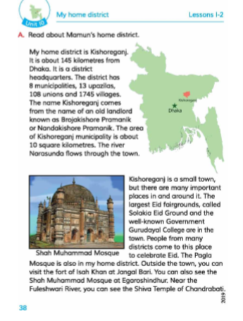
Open your book at page no 38 and read the text silently

Slide 13
Now read the text loudly one by one

Slide 14
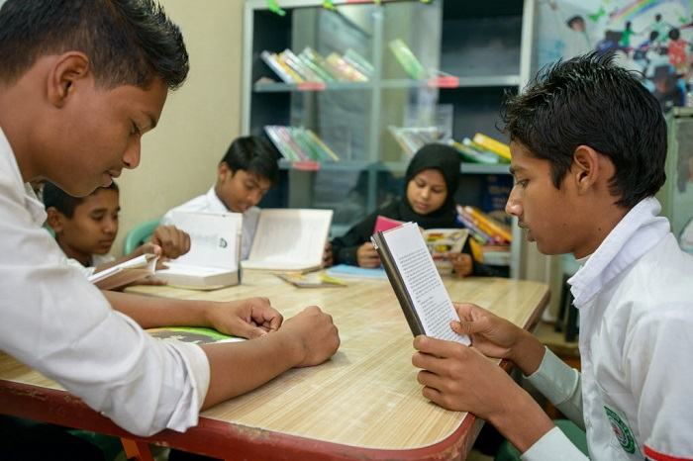
Group Work
Answer the following questions;
1.Who was Syed Nazrul Islam?
Ans. Syed Nazrul Islam was the first acting president of Bangladesh.
2.How many rivers are mentioned in this passage? What are they?
Ans.Two rivers are mentioned in this passage; The river Narasunda and the river Fuleshwari.
.

Slide 15
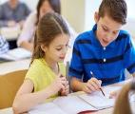
Pair Work
Match the words.
Literature
Important
Famous
Temple
Fairground
Well-known
A place of warship
Written works with artistic value.
Having vitality.
An open area
a+ iii, b+ iv, c+ i, d+ ii, e +v

Slide 16
Evaluation
Answer the following questions;
1.Write the name of three important personalities of kishoreganj.
Ans. Syed Nazrul Islam, UpendraKishore Roy Chowdhury and Zainul Abedin.
2.Who are the popular writers of children’s literature?
Ans.Two writers of children’s literature are Upendrakishore Roy Chowdhury and Sukumar Roy.

Slide 17
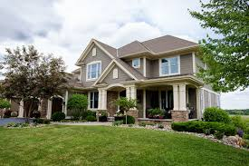
Home Work
Write the name of some important personalities of your home district.

Slide 18
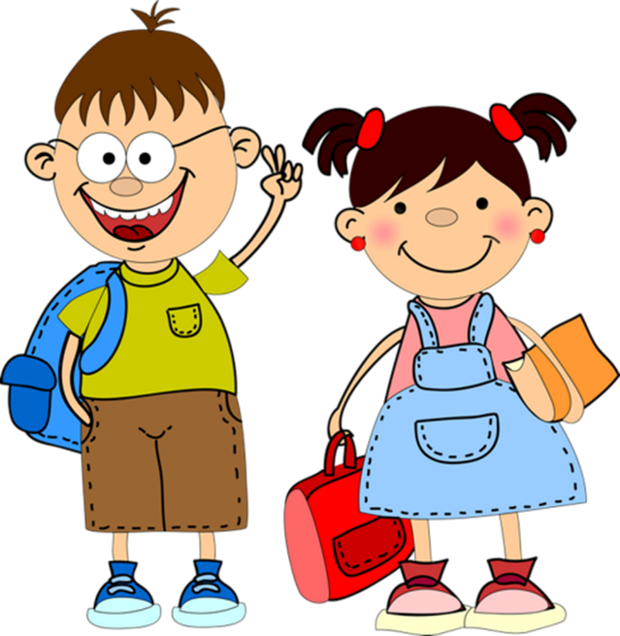
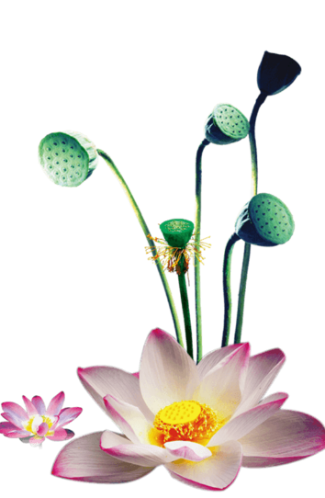
Thank you

