Slide 2
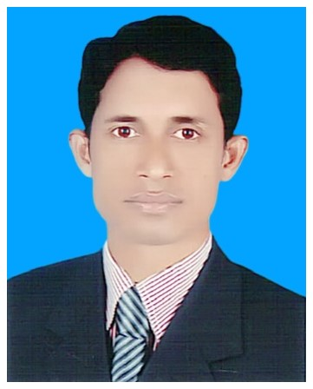
Identity
Class: Five
Sub- English, Unit: 8
Lesson: 1 & 2
Lesson title: Write to me soon.
Today’s lesson: Sima is at home……….these things.
Time : 30 minute
Date:
Mohammod Abdul Hannan
Assistant teacher
Chunghor Govt. Primary School
Kulaura, Moulvibazar.

Slide 3
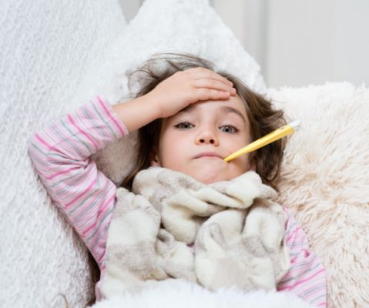
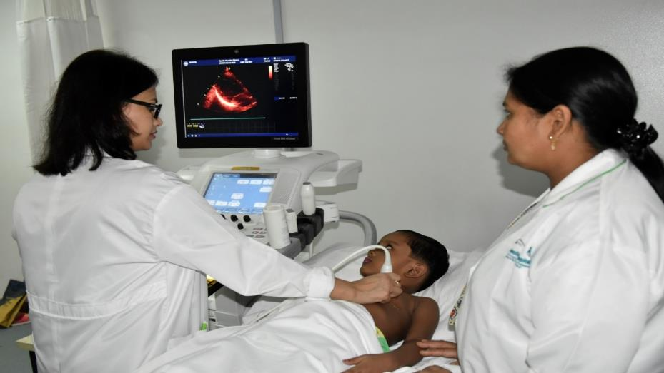
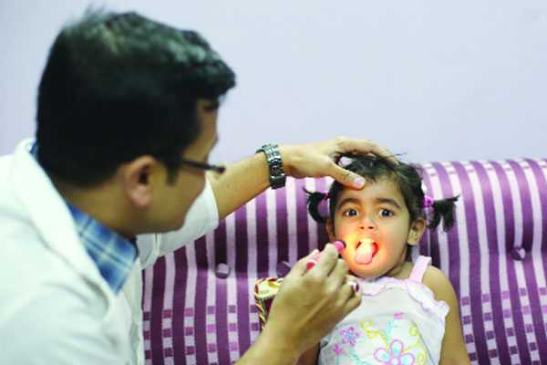
What can you see in these pictures?

Slide 4
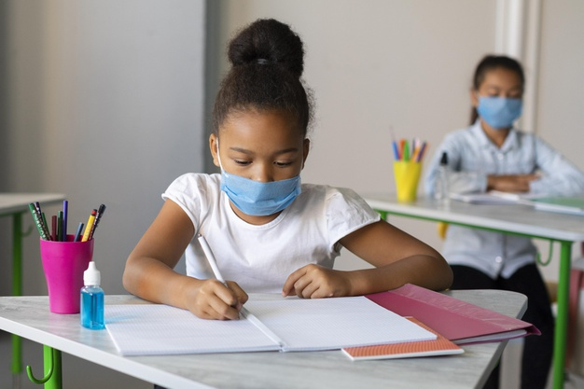
We are going to talk about
Unit: 8, Lesson 1 – 2, Section - A

Slide 5
Students will be able
to know about the importance of healthy food.
Learning outcomes
to tell what to do if they catch in flu.
to learn about cleaning.
to read the story with correct pronunciation.
to learn to use their own glass, plate and cup if they catch in flu.

Slide 6
Word meaning
fever
জ্বর
Visit
পরিদর্শন
Sore throat
ভঙ্গ স্বর
Medicine
ঔষধ
Cough
কাশি

Slide 7
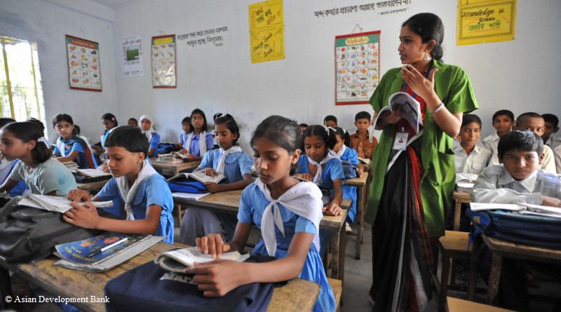
Reading
Open your textbook page at 30

Slide 8
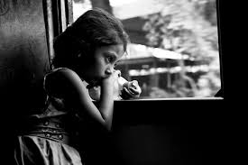
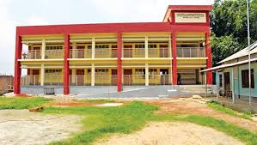
Sima is at home today.
She didn’t go to school because she is ill.

Slide 9
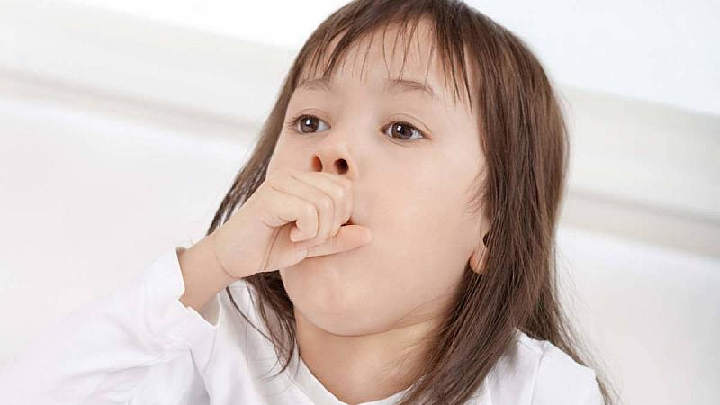
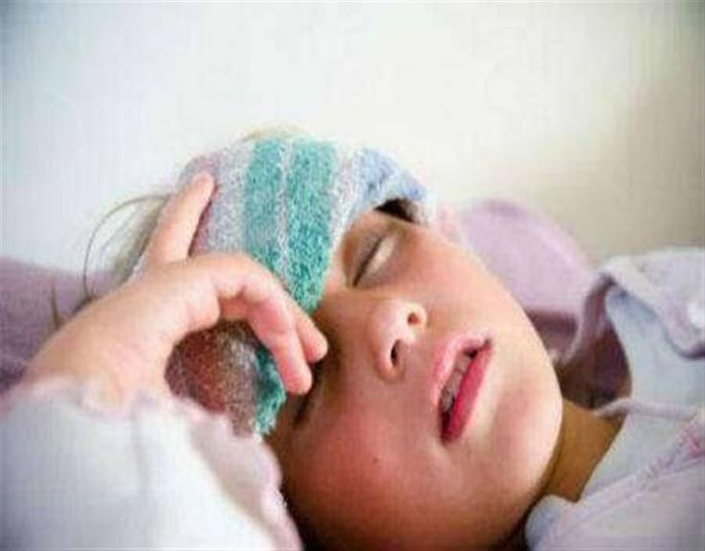
She has a cough and a
sore throat.
She also feels very warm because she has a fever. She has the flu.

Slide 10
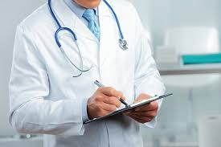
The doctor visited sima last night. She needs some medicine.
He also told her what to do in order to get well soon.

Slide 11
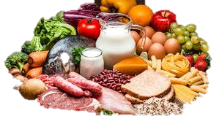
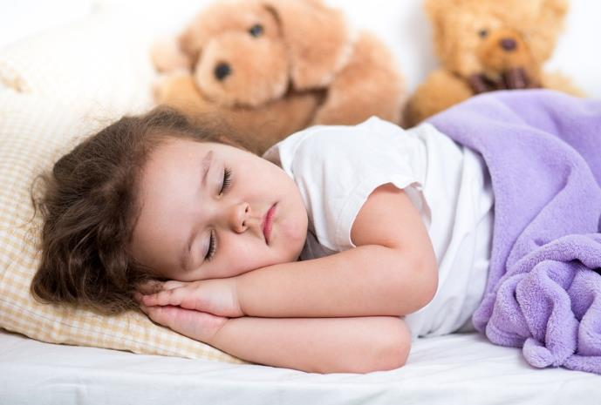
The doctor’s advice
Eat food that gives your body energy. Try to eat even if you aren’t hungry. You need to be strong.
Rest, Stay at home. Don’t go to school or work.

Slide 12
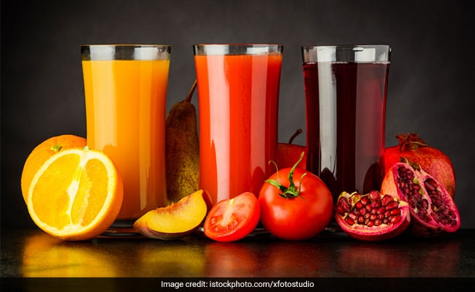
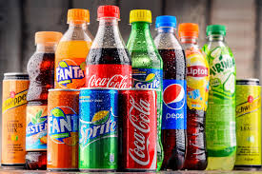
Drink a lot of water or juice..
They are better than soft drinks.

Slide 13
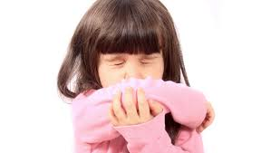
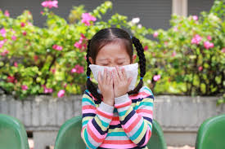
Are you coughing or sneezing? Cover your mouth and nose
Use a tissue, not your hand.

Slide 14
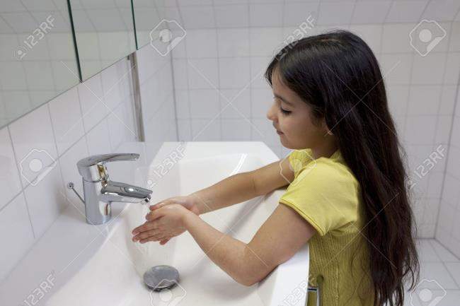
Wash your hands regularly.
Use your own plate, glass and cup.other people can catch your illness from these things.

Slide 15
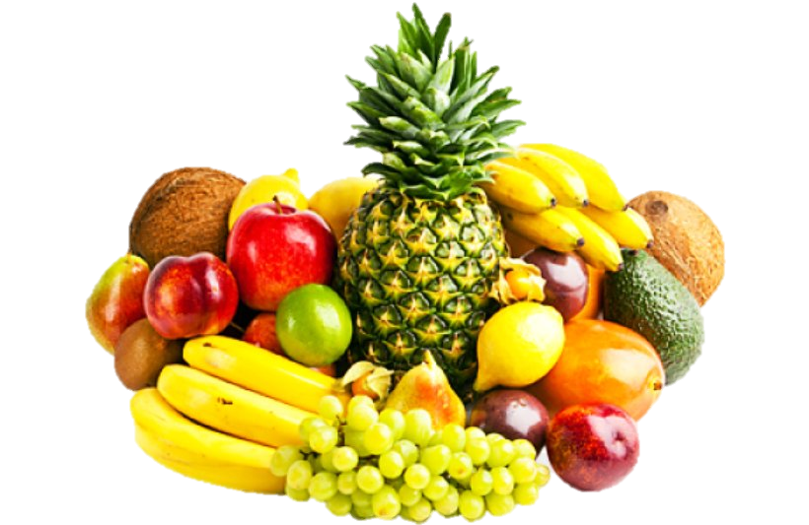
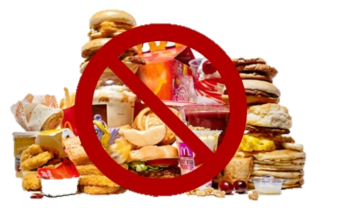
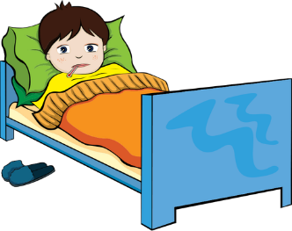
Matching
Unhealthy food
Ill
Juice
Healthy food

Slide 16
ASSESSMENT
1.
Why Sima is at home?
2.
What kinds of food we should eat?
3.
What you do if you are sneezing?
4.
What kinds of drink we should take?
5.
What do you do if you are catch in fever?

Slide 17
Homework
Suppose, You Caught cold a few days ago. Now,
Write a short composition about your illness in eight sentences.

