Slide 1
WELCOME
Notes:
Welcome slide.

Slide 2
IDENTITY
Md. Afsar Ali
Asst. Teacher
Majhira Model High School
Shajahanpur, Bogura
ENGLISH FOR TODAY
CLASS: NINE-TEN
Notes:
Identity of teacher & class

Slide 3
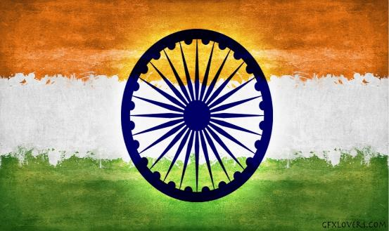
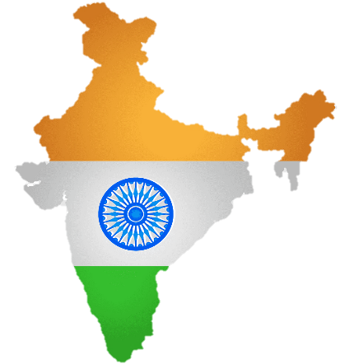
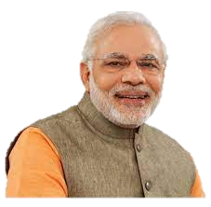
Which country do we remember when we see the pictures below?

Slide 4
Today we will discuss about
India: Unity in Diversity
Unit: 6 Lesson: 4

Slide 5
Learning Outcomes
By the end of the lesson students will be able to:
introduce with some key words
read, comprehend and summarise texts
ask and answer questions
choose the best answer
complete a flow chart
write a dialogue
describe the history India
write a paragraph about diversity of India history

Slide 6
B. Discuss the following questions in pairs
What do you know about the population and geographical area of India?
When did Buddhism spread in India?
What happened to India during Mughal Empire?
What are some of the tourist attractions in India?

Slide 7
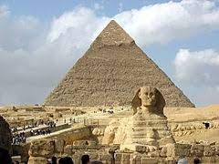
Let's introduce with some key words
Synonym
Word
Progress
Civilization
Refinement
Advancement
Development
Meaning: the stage of human social and cultural development and organization that is considered most advanced.
Sentence: He went to study the civilization of the Arab world.

Slide 8
Let's introduce with some key words
Synonym
Word
Variety
Diversity
Assortment
Multiplicity
Miscellany
Sentence: There was considerable diversity in the style of the reports.
Meaning: the state of being diverse; variety.

Slide 9
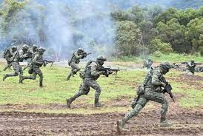
Let's introduce with some key words
Synonym
Word
Attack
Invasion
Assault
in 1546 England had to be defended from invasion
Raid
Offensive
Meaning: an instance of invading a country or region with an armed force.
Sentence: Napoleon could not have commanded an invasion of Russia and never did so.

Slide 10
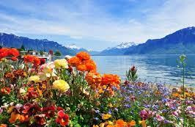
Let's introduce with some key words
Synonym
Word
Thrive
Flourish
Develop
Increase
Grow
Meaning: grow or develop in a healthy or vigorous way, especially as the result of a particularly favorable environment.
Sentence: Wild plants flourish on the banks of the lake.

Slide 11
Let's introduce with some key words
Synonym
Word
Amalgamation
Unification
Union
Amalgamation
Merger
Meaning: the process of being united or made into a whole.
Sentence: The unification of the railways caused greater difficulties.

Slide 12
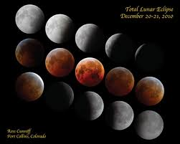
Let's introduce with some key words
Synonym
Word
Accord
Coincide
Concur
Overlap
Match
Sentence: The loading and unloading curves do not exactly coincide..
Meaning: occur at or during the same time.

Slide 13
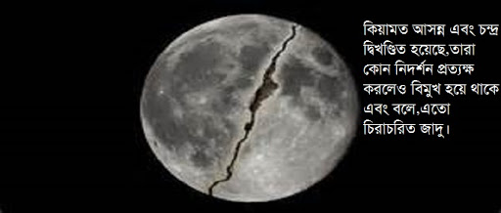
Let's introduce with some key words
Synonym
Word
Breakdown
Disintegration
Breakup
Collapse
Fragmentation
Meaning: The process of losing cohesion or strength.
Sentence: In the disintegration of parties the Liberals suffered most..

Slide 14
Let's introduce with some key words
Synonym
Word
triumph
Vying
Contending
Contesting
competition
Sentence: They are vying with each others to control of India.
Meaning: to win

Slide 15
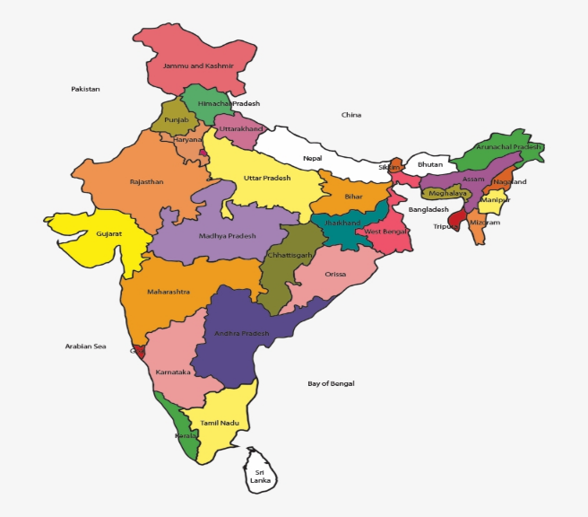
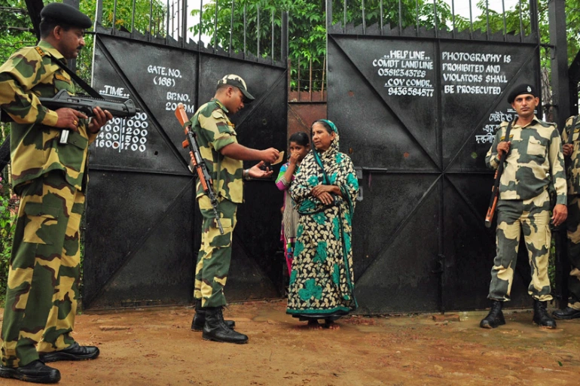
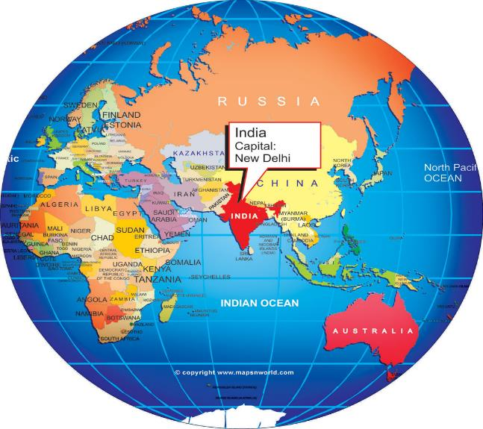
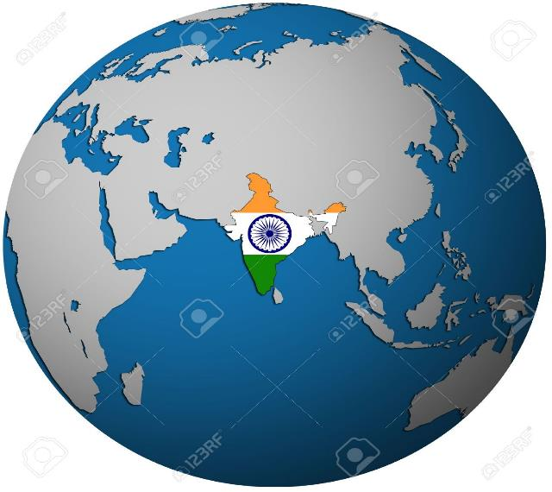
Area of India
India is seventh largest country in the world.
India is our closest neighbour.
It’s land of India is area is 3,287,590 square kilometers.
It is the largest among South Asian Countries.

Slide 16
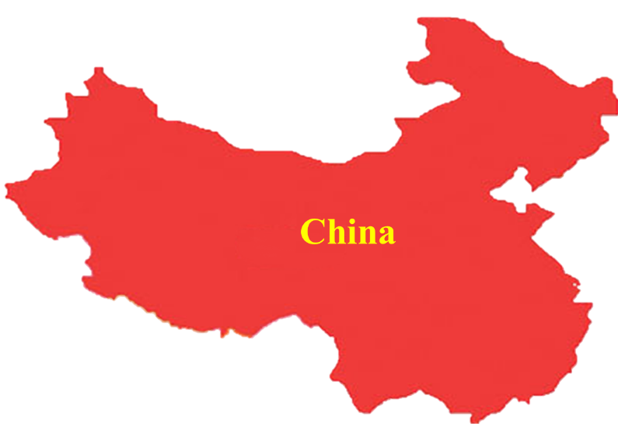
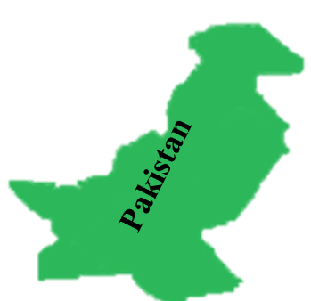
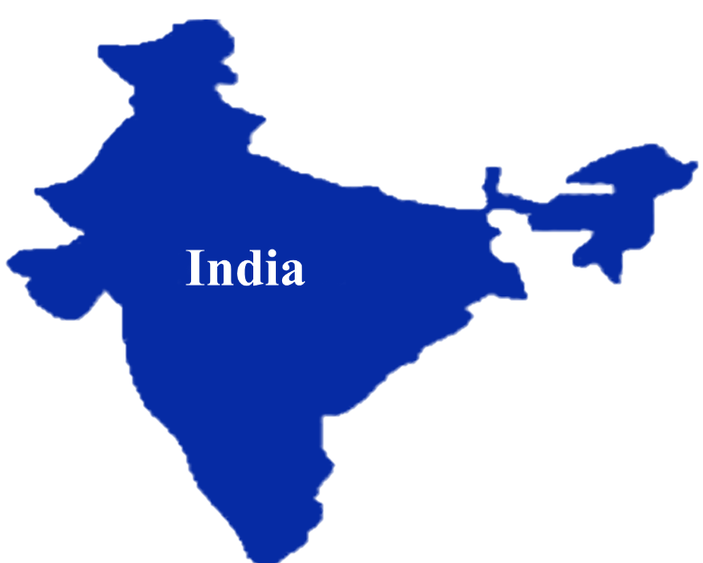
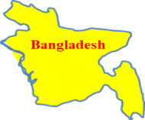
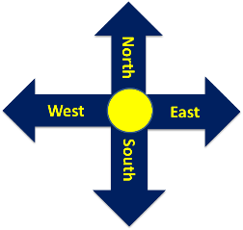
Bhutan
Arabian Sea
Bay of Bangle
Indian Ocean
Nepal

Slide 17
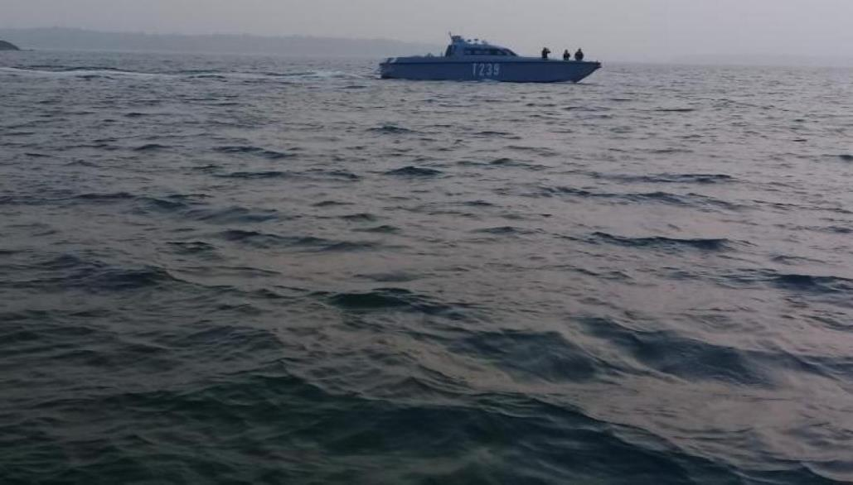
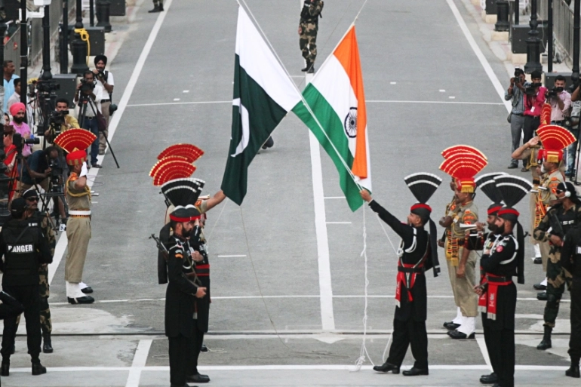
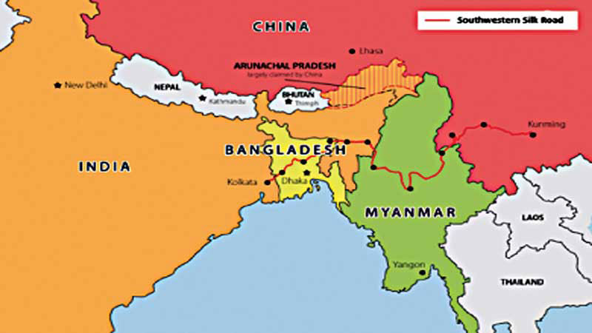
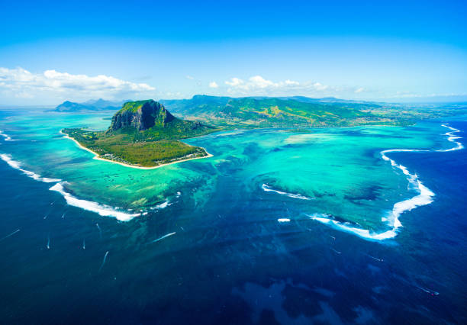
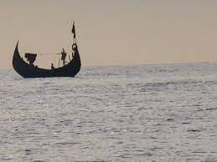
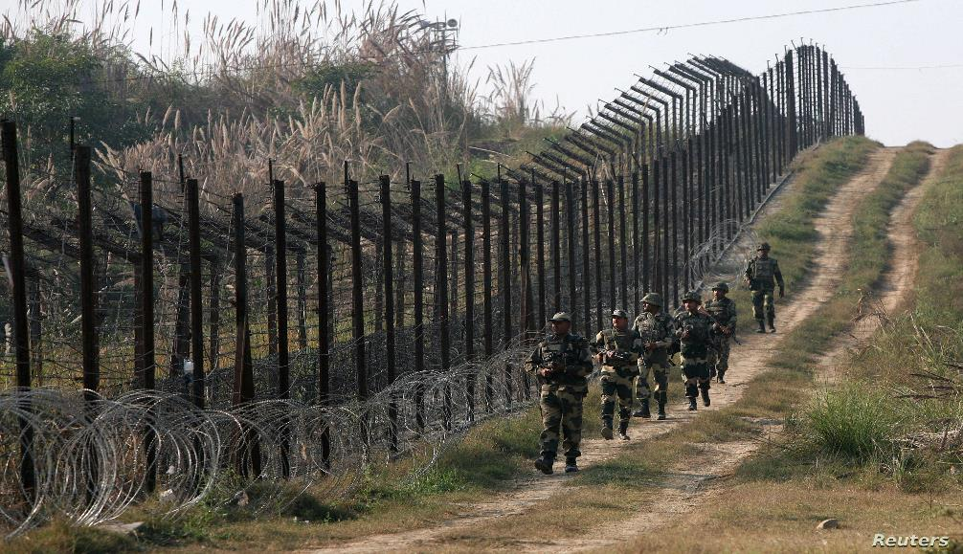
The border of India
India is bounded by the Indian Ocean on the South
China, Nepal and Bhutan to the North
Bangladesh and Myanmar to the East.
It is bordered by Pakistan to the West.
The Arabian Sea on the West.

Slide 18
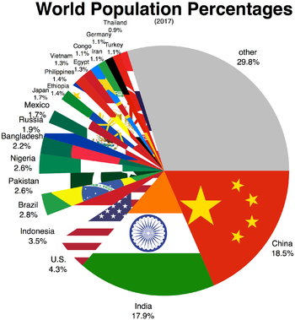
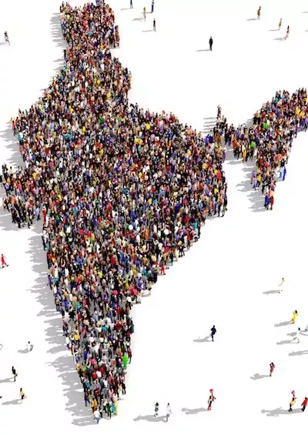
Population of India
India is the world second most populous country after china.Its current
population is around 1.5 bilion. .About 13 million people live in capital,New Delhi.
Its current population is around 1.5 billion.
India is the world second most populous country after China

Slide 19
The Capital of India
The Capital of India is New Delhi.

Slide 20
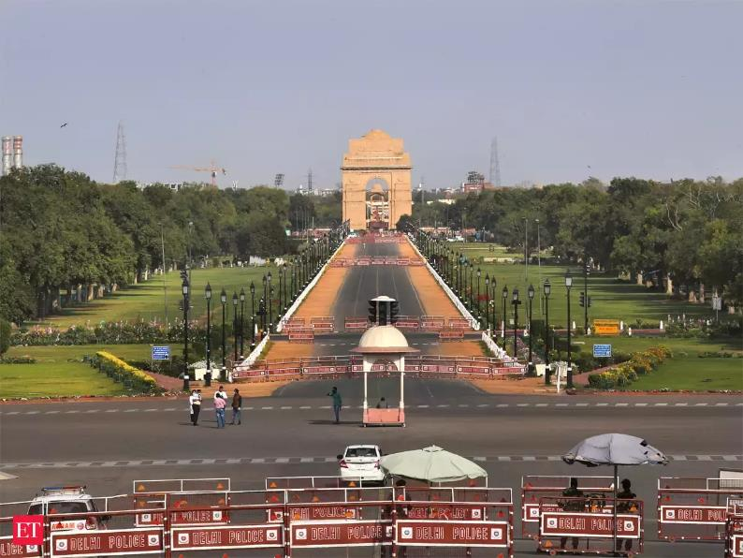
Population of the capital of India
The population of New Delhi is About 13 million.

Slide 21
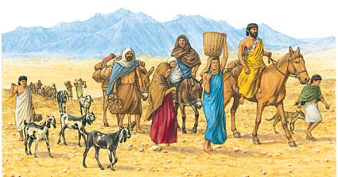
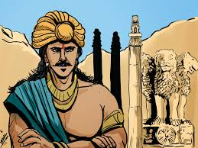
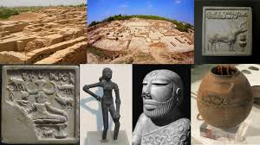
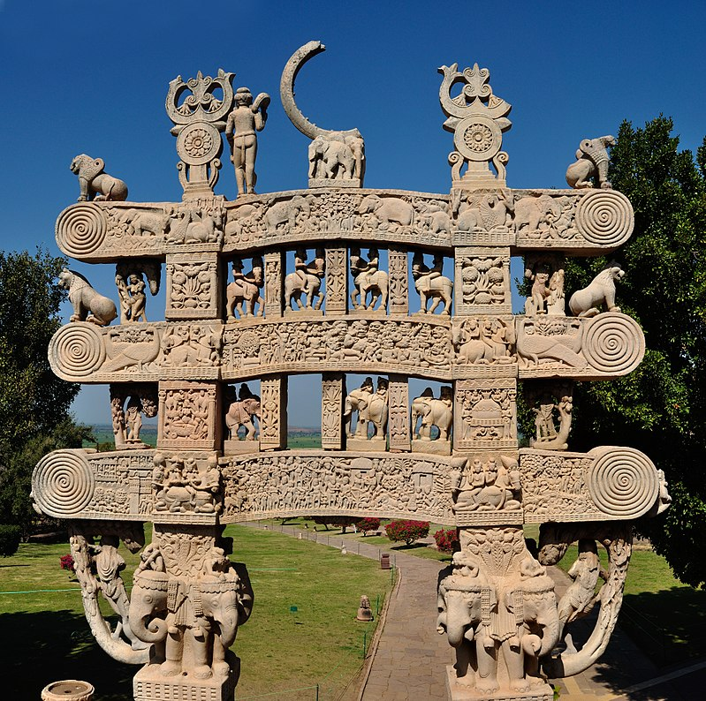
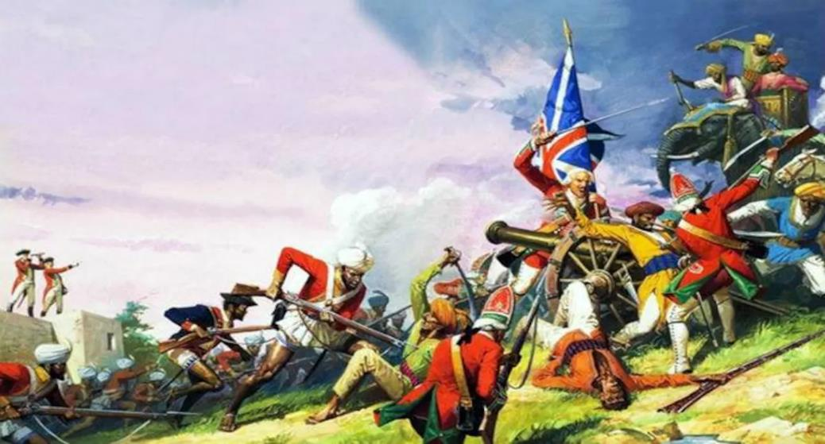
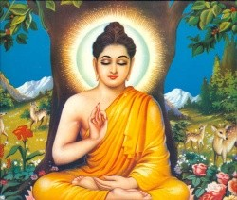
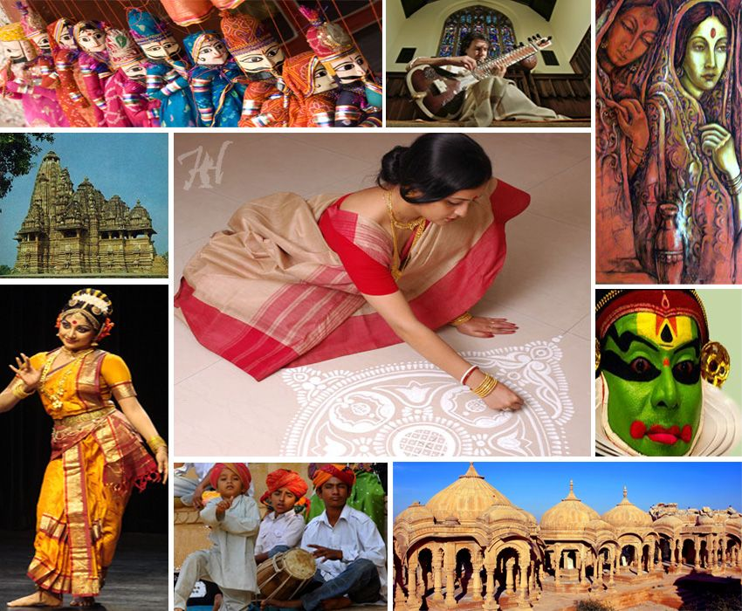
History of India
Indian history begins with the birth of the Indus Valley Civilization and coming of the Aryans.
During this period Aryan culture flourished in this part of the world.
The vast country is the result of invasions by different races in the process of history.
It is in his time that Buddhism spread in many parts of Asia.
The fifth century saw the unification of India under Ashoka.
It has a social, economic and cultural diversity.
India is a land of ancient civilization.

Slide 22
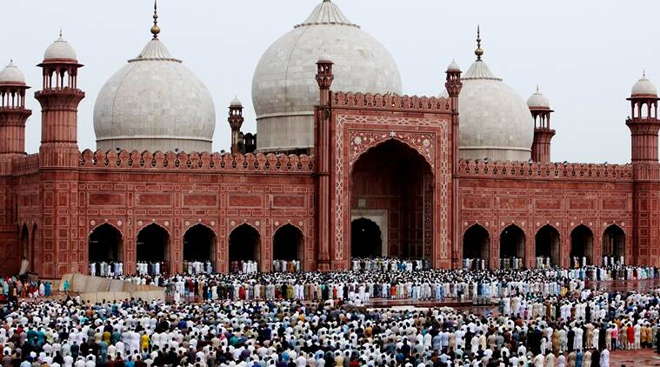
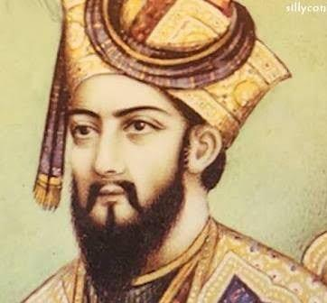
Islam came to India
In the eighth Century, Islam came to India for the first time and by the eleventh century it had firmly established.
It resulted into the formation of the Delhi Sultanate in 1206 by Qutb ud din Aybek.and finally succeeded by the Mughal Empire In 1526.

Slide 23
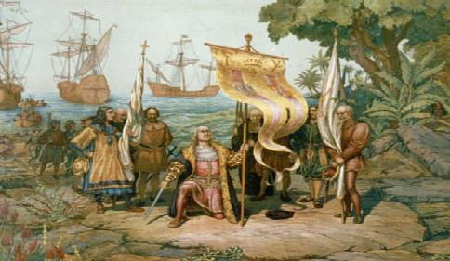
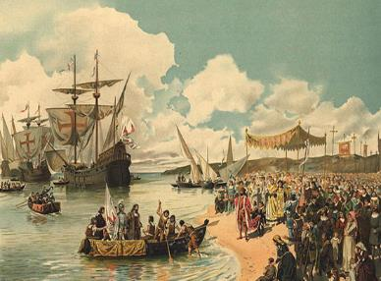
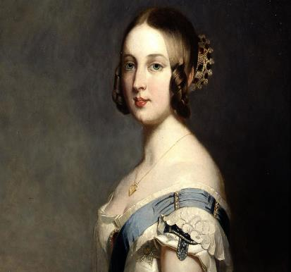
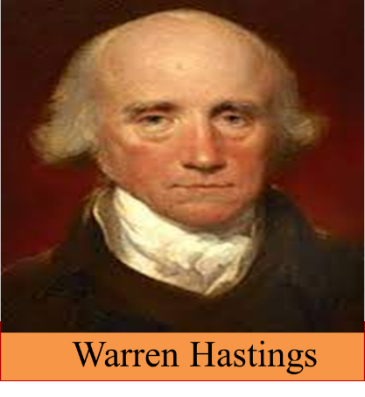
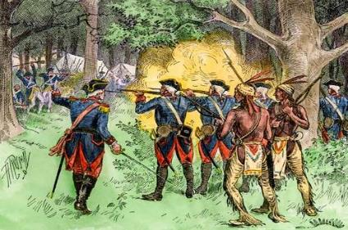
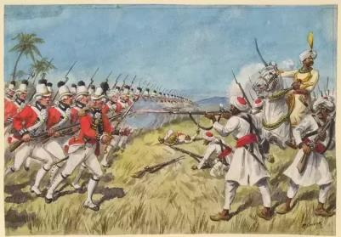
Advent of Foreigners in India
In1876 Queen Victoria was given the title empress of India by the British Parliament and India came under the British rule for 200 years. This period was marked by India’s struggle for independence. Through a series of heroic and patriotic movements India restore freedom in 1947.
This coincided with the disintegration of the Mughal Empire, paved the way for supremacy of the English, the French, the Dutch and the Portuguese who were vying with each other to gain control of India.
In the contest for supremacy, the English as Victors. In 1774 Warren Hastings was appointed the first Governor General of India by the East India Company
In the 17th century the European came to India.

Slide 24
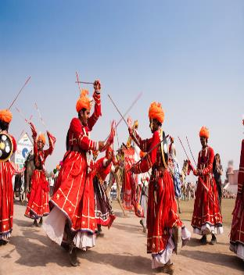
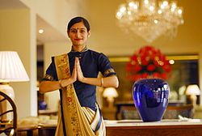
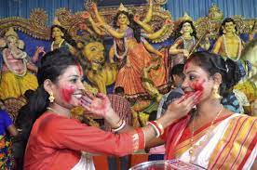
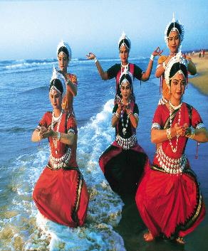
The culture of India
The culture of India is one of the and the most unique in the world. There is amazing cultural diversity through out the country. The South North, and Northeast have their own distinct cultures and almost every state has carved out its own cultural distinction. There are 17 major languages and 844dialects used by people.

Slide 25
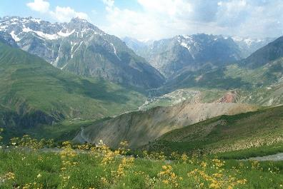
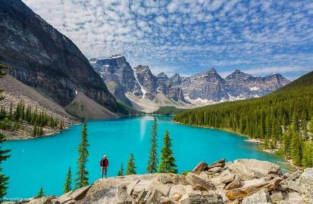
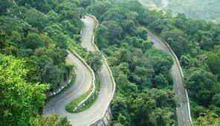
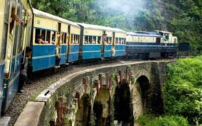
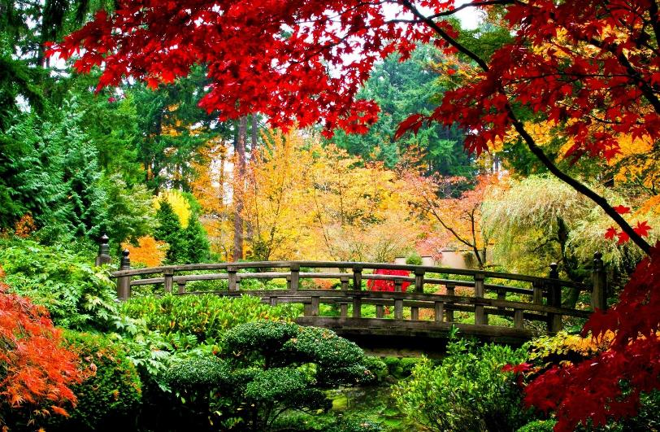
The Tourist Attractions of India
The Nilgiri mountains, hill stations like Ooty and Dardeeling and the temples of South India, Ajanta and Ellora caves are the places one can explore in India.
The country of mountains, valleys, deserts, rivers and lakes offer the richness of a mini world within a single country.
The Taj Mahal, Fatehpur Sikri, The Qutub Minar and the Red Fort are a few of the many wonders which attract people from all over the world.
India is the tourist delight.
Kasmir has been described as a paradise on earth.

Slide 26
Choose the best answer
1. When Queen Victoria got the title ‘Empress of India’.
India declared its freedom (ii) The British declared India free
(iii) The East India Company left India (iv) India lost its emancipation
2. The word ‘coincide’ stands for __.
(i) supreme (ii) concur (iii) explore (iv) freedom
3. The word ‘victor’ refers to __.
(i) hero (ii) conqueror (iii) peer (iv) medalist
4. By reading the passage, we came to know about.
People to India (ii) the heritage of India
(iii) India in general (iv) the ceremony of India
5. Which is the following is a tourist attraction of India?
The Taj Mahal (ii) East India Company
(iii) Mughal Empire (iv) victors

Slide 27
C. Complete the flow chare below to show the history of India. Use one word to fill in each gap.
Indus Valley Civilization and the coming of the Aryans.
8th Century..............came to India for the first time.
Islam
Qutbuddin Aybek
1206: Establishment of the Delhi Sultanate by.................
unification
15th Century: The .......................of India under Ashoka and spread of Buddhism.
Mughal
1526: Beginning of the.......................Dynasty.
appointed
1774: Warren Hestings was.................the first Governor General of India by the East India Company
Parliament
In 1876 Queen Victoria was given the title. ‘Empress of India, by the British........................
independence
1947: India achieved its.....................

Slide 28
Pair Work
Now, make a dialogue between you and your partner about history, culture and tourist attraction of India.

Slide 29
Evaluation
When did India gain its independence?
Who founded Qutb Minar?
How many years did the British rule India?
What are some of the tourist attractions in India?

Slide 30
Home work
Write a paragraph on about “Diversity of Indian history.

Slide 31
Thank you all for joining me

