Slide 1
WELCOME

Slide 2
TEACHER IDENTIFICATION
SHAMPA RANI DAS
ASSISTANT TEACHER
SATKORAKANDI GOVT. PRIMARY SCHOOL
BARLEKHA ,MOULVIBAZAR.

Slide 3
Lesson Identification
Subject: English
Class: Four
Unit: 08
Lesson unit: Traffic lights.
Time: 40 minutes
Date: 19.07.2021

Slide 4
Learning outcomes
Students will be able to………
1.1.1 Recognize sound differences in the contect of words.
2.1.1 To repeat after the teacher and say words,phrases sentences with proper sounds, stress and intonation.
1.4.1 Read words,phrases and sentences in the text.

Slide 5
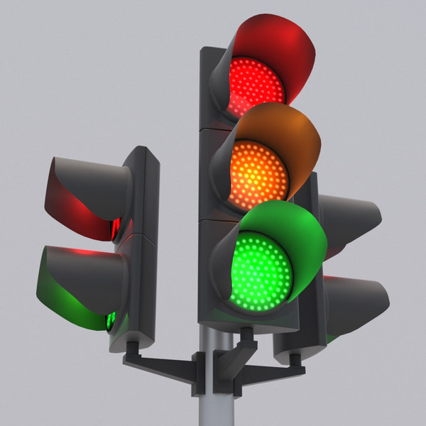
Lets see a picture

Slide 6
LETS WATCH A VIDEO

Slide 7
Lesson Declarations
Traffic lights

Slide 8
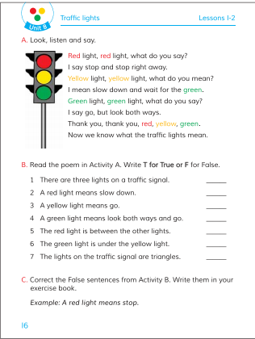
Open at page -16

Slide 9
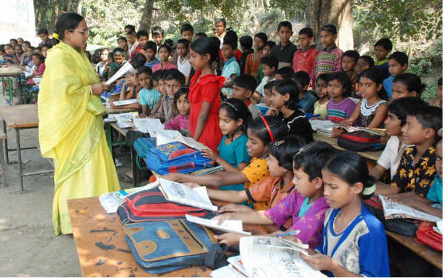
Teachers reading

Slide 10
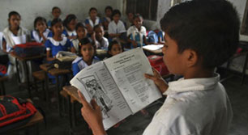
Students reading

Slide 11
Group work
Question and anwser
What light means slow down?
What light means go?
What light means stop?

Slide 12
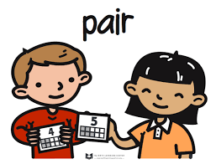
Pair work
Rearrange the word & sentences
1. anesgltri.
2. stop and/right/I/ stop.say/away.
3. you/what/say/do.

Slide 13
Home work
Write five sentences about traffic lights.

