Slide 1
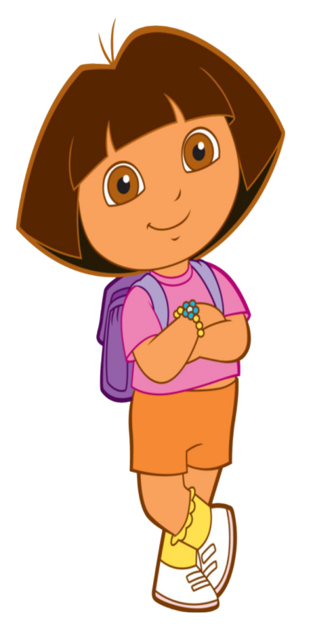

Slide 2
Introduction of the teacher
Md Abdul Kader
Assistant Teacher
Rustompur Govt. Primary School.
Faridgonj, Chandpur,
Mobile No- 01732-225593
Email – abdulkdr81@gmail.com

Slide 3
Introduction of the lesson
Class: Three
Unit: 28
Lesson:1-2
Lesson Title: Punctuation and capital letters.
Today’s Lesson: Maliha is…...in Bangladesh
Total Time: 35 minutes

Slide 4
Learning outcomes
By the end of the lesson the student will able to-
reading:
7.1.1- Recognize punctuation
marks and read accordingly.

Slide 5
Creating safety environment
Lets watch a video

Slide 6
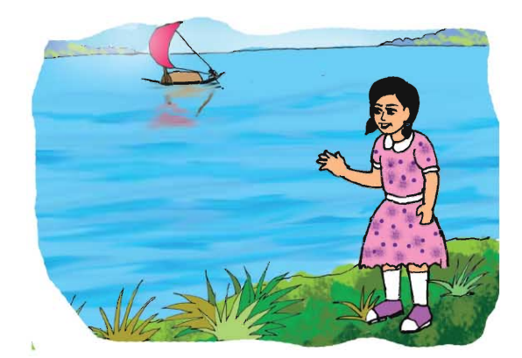
Look at the picture then thinks and discuss about picture.

Slide 7
Open at page - 64

Slide 8
Read and Say
Maliha is Bangladeshi. She comes from from Dhaka. Dhaka is the capital of Banglasdesh. Maliha lives near the Buriganga River. The river is very big. In June, July and August, there is a lot of rain in Bangladesh.

Slide 9
Group work
Maliha is Bangladeshi. She comes from from Dhaka. Dhaka is the capital of Banglasdesh. Maliha lives near the Buriganga River. The river is very big. In June, July and August, there is a lot of rain in Bangladesh.

Slide 10
Evaluation

