Slide 1
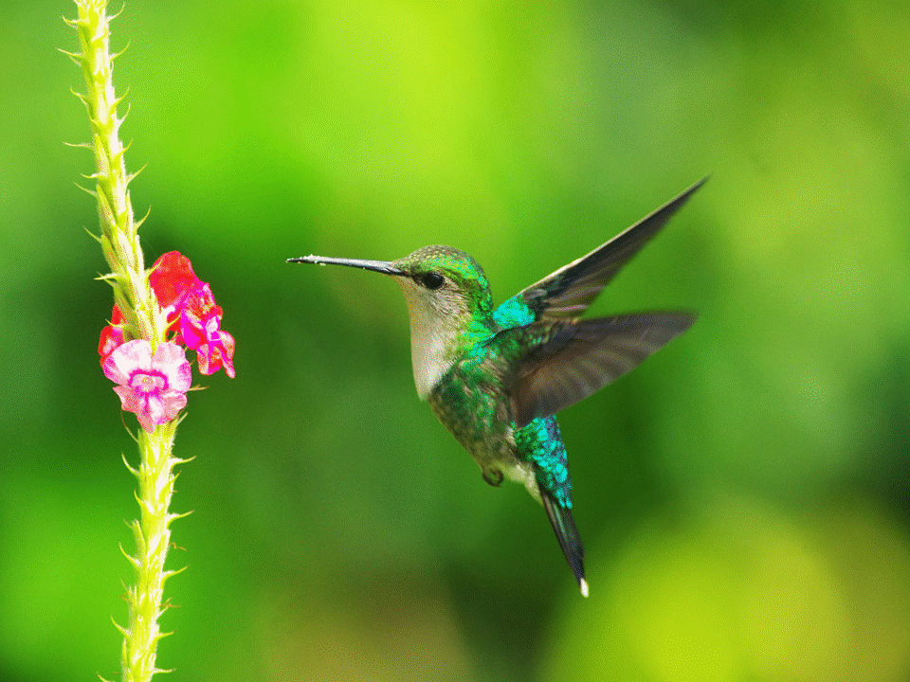
Welcome

Slide 2
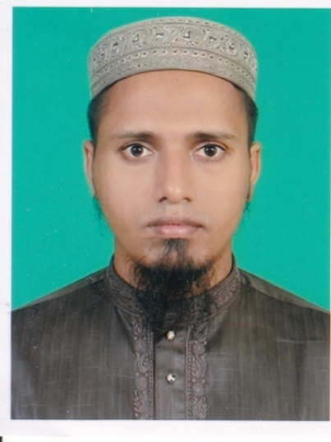
Introduction
Md.Mehedy Hasan
Lecturer in English
Bandar Islamia Fazil Madrasah
Bandar, Narayanganj.
Mob: 01745866460
Email:mehedypakdal@gmail.com
Class: xi-xii
Sub:English 1st Paper

Slide 3
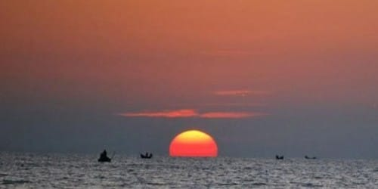
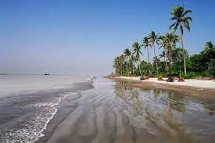
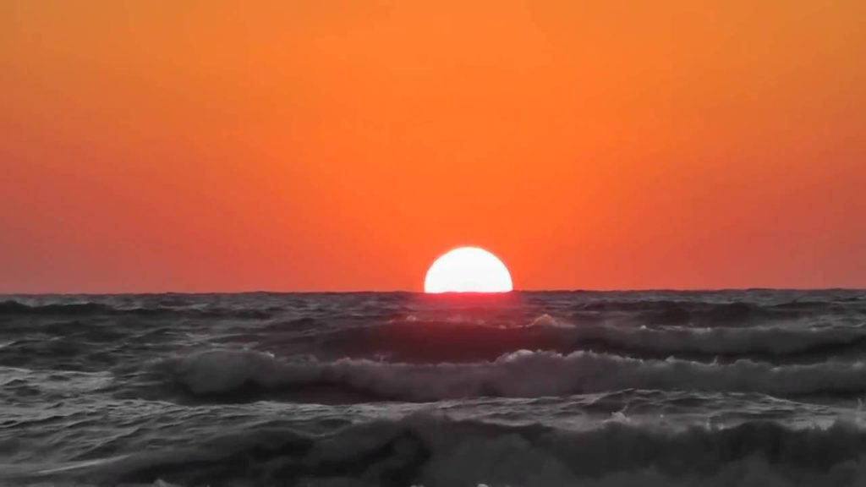
Look at the picture below? What do you see ?
Sun set
Sea beach
Sun rise
Can you say what it is ?
Where is it situated ?
Have you ever seen any sea beach?

Slide 4
Lets enjoy a short video of Kuakata sea beach.

Slide 5
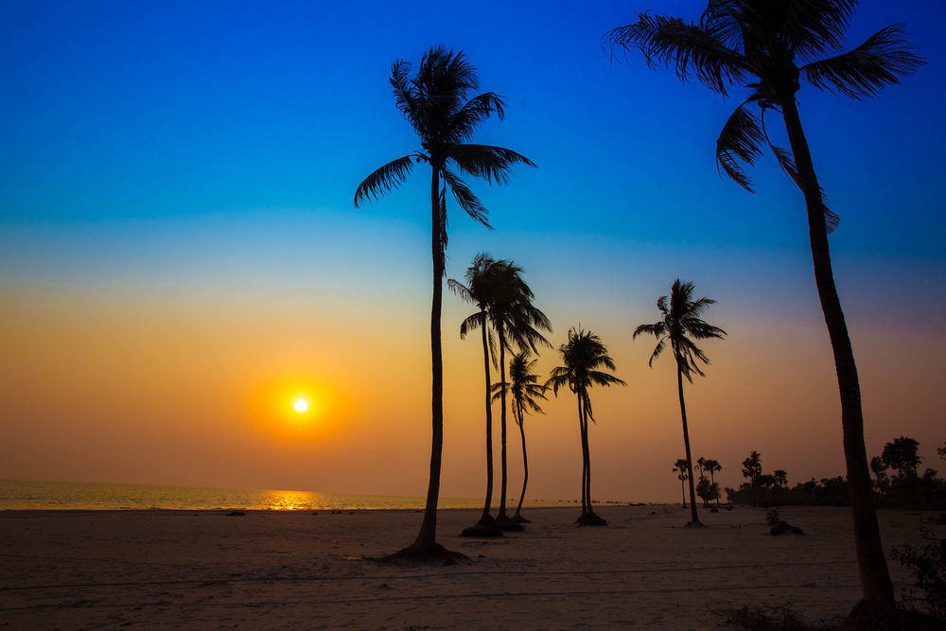
Our today’s lesson is
Kuakata: Daughter of the Sea
Unit : 8 Lesson : 5

Slide 6
Learning outcomes
By the end of the lesson the students will be able to..
. talk about pictures
. ask and answer questions
. infer the word meaning from the text
. change word from adjective to noun.
. choose the best answers
. write a letter.
Learning outcomes

Slide 7
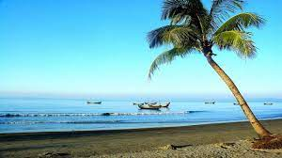
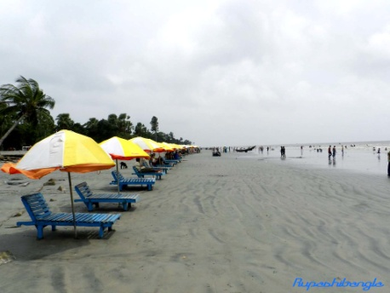
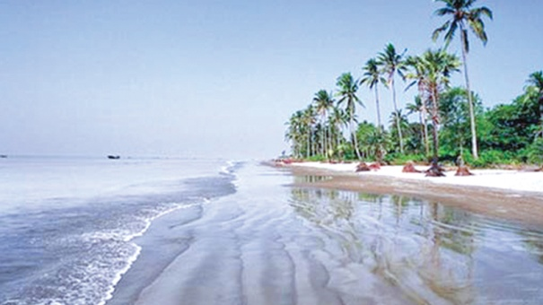
What do you see in the pictures below ?
Blue Sky
Shimmering expanse of water
Sandy Beaches
It has an excellent combination of the picturesque natural beauty that is why it is called the daughter of the sea.

Slide 8
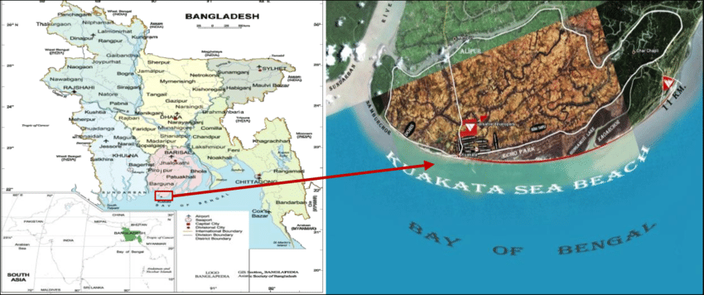
Can you say the location of Kuakata ?
Location of Kuakata
*Situated in Kalapara Police station of Patuakhali district.
*70 km from Patuakhali district
*320 km from Dhaka
*Length 30 km
*Breadth 6 km

Slide 9
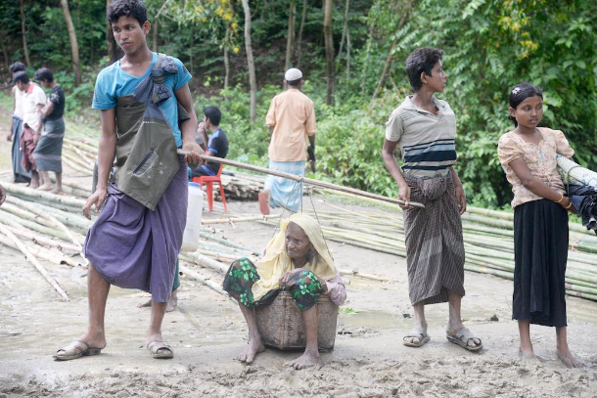
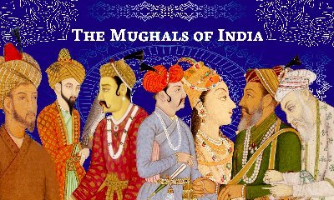
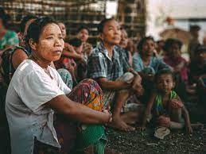
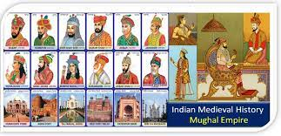
Do you know who came first in Kuakata ? Why ?
The Rakhine came first
They were expelled by the Mughals.

Slide 10
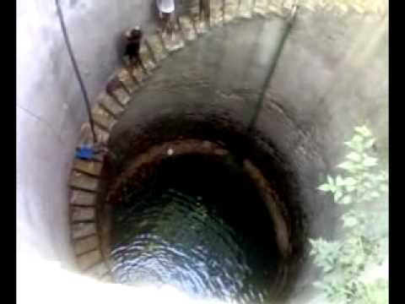
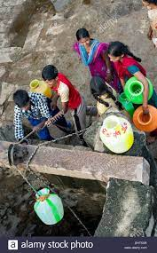
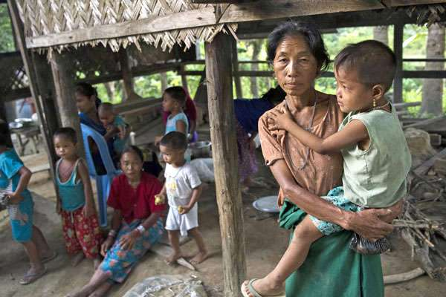
What do you mean by ” kuya” ? What is it significant ?
‘Kua’ means well
The Rakhine settelers dug it for fresh water
The name Kuakata is orginated from‘kua’ or well.

Slide 11
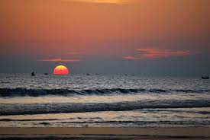
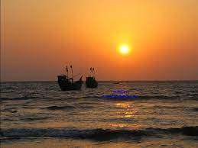
Kuakata is a unique sea beach ,why ?
Sun rise
Sun set
Both the sun rise and sun set can be enjoyed from here.This makes it one of the world most attractive sea beaches.

Slide 12
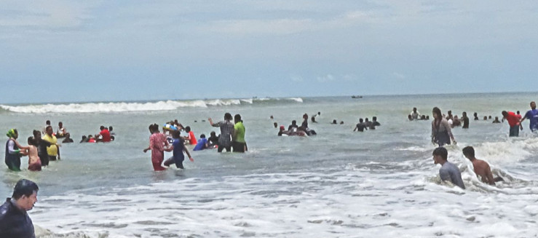
Why do the visitors come here ?
This sandy beach slopes into the Bay
Bathing,swimming and driving are pleasant.
The long and wide sea beach of it has a natural setting that attracacts the tourists.

Slide 13
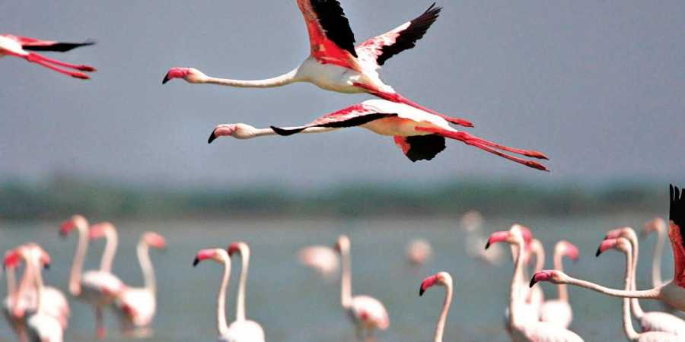
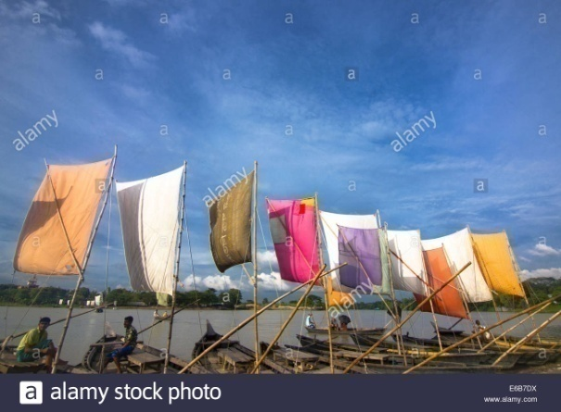
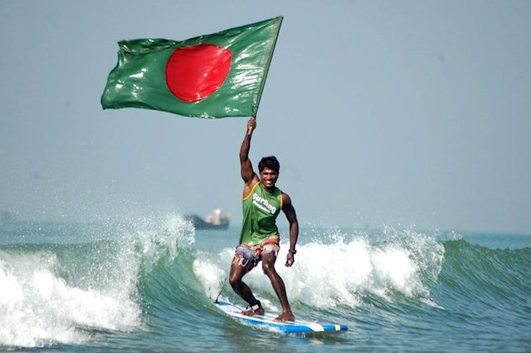
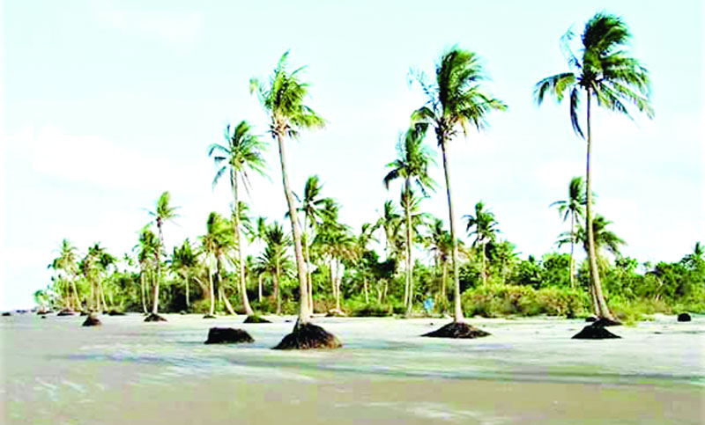
Do you know why Kuakata is called a virgin sea beach ?
Sanctuary for migratory birds
Colourful sails of boats
Surfing waves
Lines of coconut trees
These add to a vibrant colours of Kuakata and it is called a virgin sea beach.

Slide 14
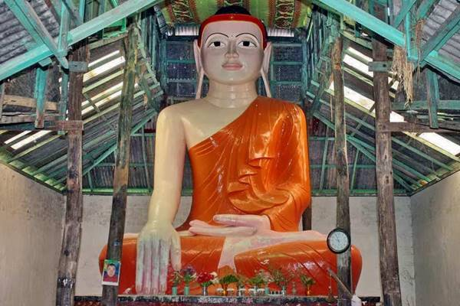
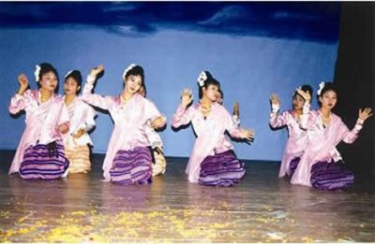
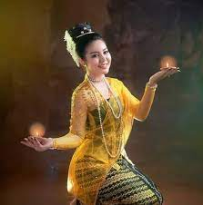
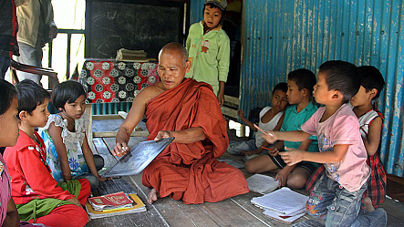
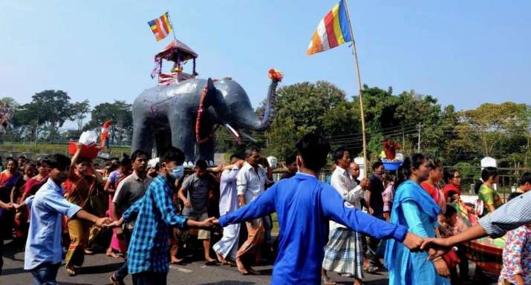
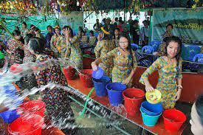
What do you see in the pictures below ?
Tradition and culture
Buddhist temple
These indicate age-old tradition and cultural heritage of this area .

Slide 15
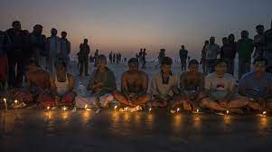
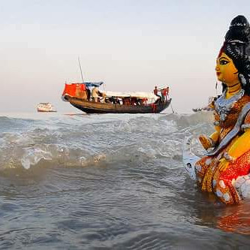
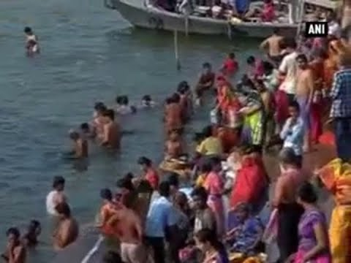
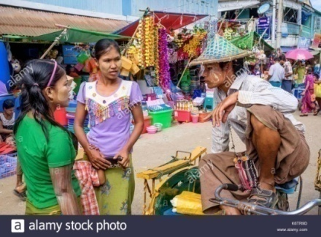
Why do hundred of devotees come here? What do you see ?
Mugi Purnima
Rush Purnima
Holy Bath
traditional Fair
Kuakata is a holy land for both the Hindus and the Buddists.

Slide 16
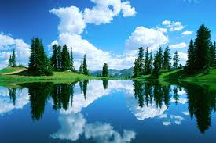
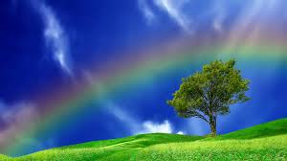
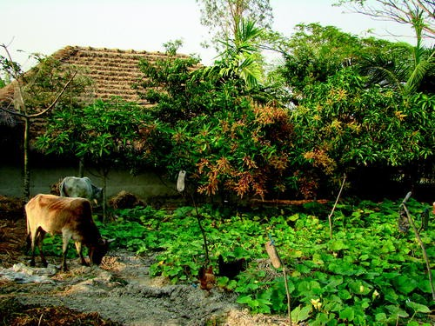
Word meaning
Scenic
Lovely
Picturesque
Prety
Homestead
Farmstead

Slide 17
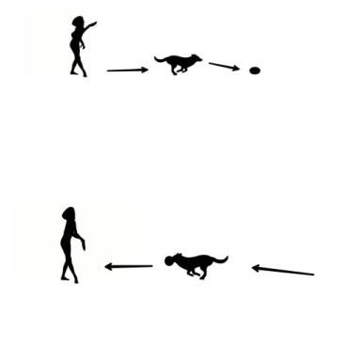
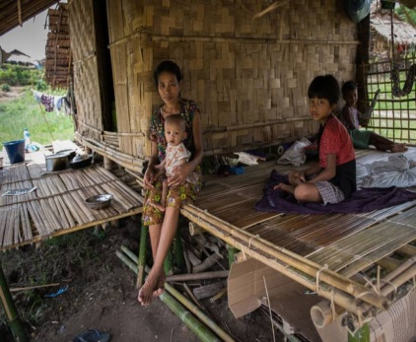
Word meaning
Fatch
Bring
Expanse
Area
Sanctuary
Shelter

Slide 18
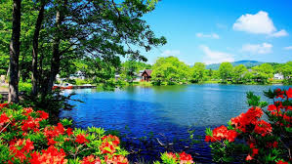
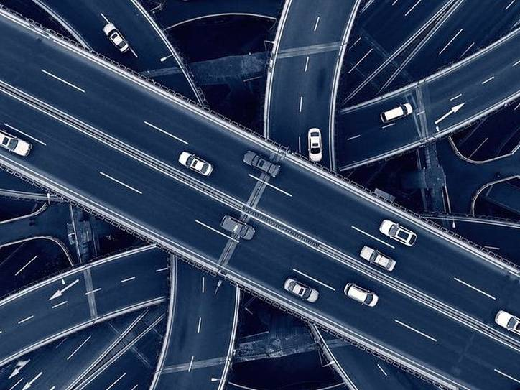
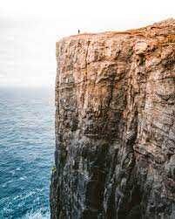
Word meaning
Panorama
Scene
Ply
Over a route
Cliff
Rock-face

Slide 19
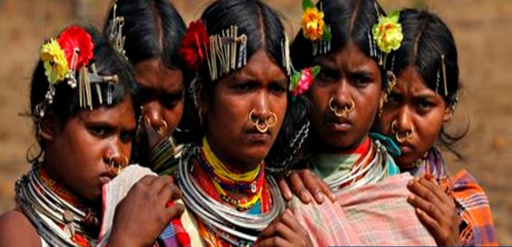
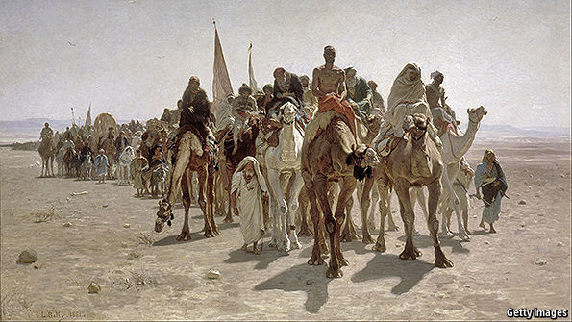
Word meaning
Vibrant
Dynamic
Indigenous
Native
Pilgrimage
Journey

Slide 20
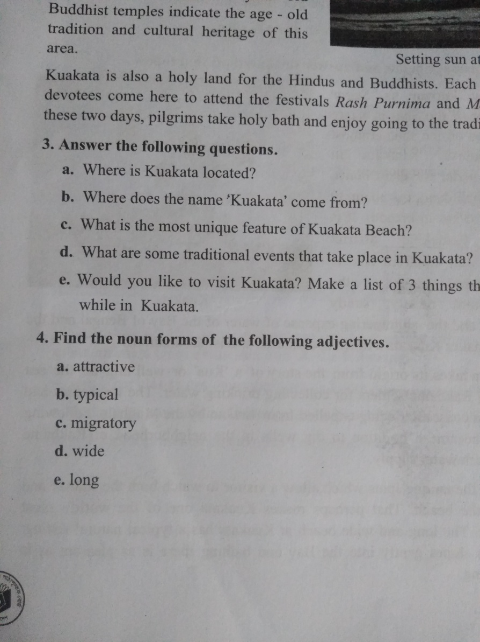
Individual Work [Reading and Speaking Test ]
Connection with main book
Open your textbook and answer the question no: 4
attraction
typically
migration
a b c d e
width
length

Slide 21
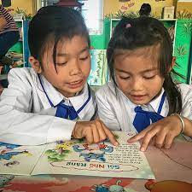
Pairwork[Reading& Writing Test]
( Read the text and answer the following question)
a) Where is Kuakata located ?
b) Who came first in Kuakata ?
c) Why did they dig kua ?

Slide 22
Evaluation ( Fill in the blanks) [Listening & Speaking Test]
a
b
c
d
e
a) Kuakata is ----km from Patuakhali district.
1) 50 2) 60 3) 70 4) 80
b) Its length is-----km.
1) 15 2) 20 3) 25 4) 30
“Kua” means------
1) well 2) field 3) beach 4) pond
The synonym of “cliff” is-----
1) road 2) park 3) middle 4) rock-face
Kuakata is a holy place for the-------
1) Christians 2) Muslims 3) Buddists and Hindus

Slide 23
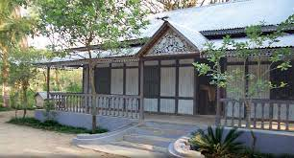
Homework [Writing Test]
Write a letter to your friend describing the natural beauties of Kuakata Sea Beach that you have visited recently.

Slide 24
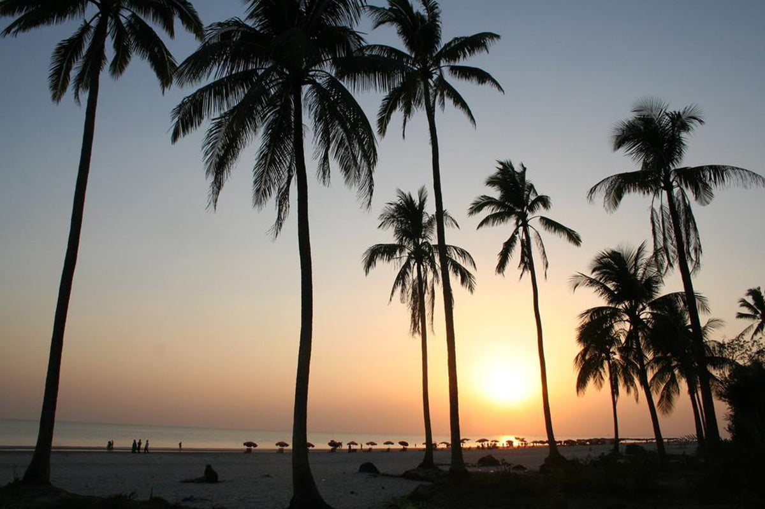
Thanks

