Slide 2
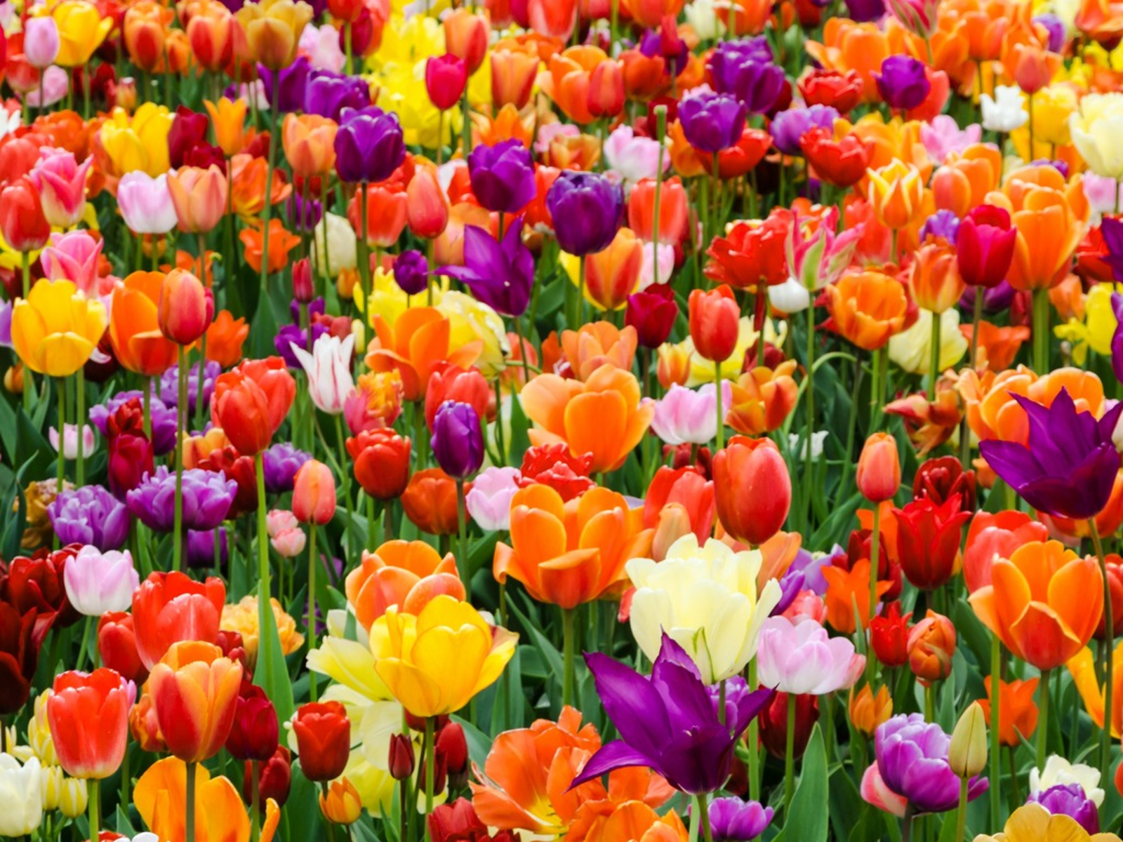
You are welcome

Slide 3
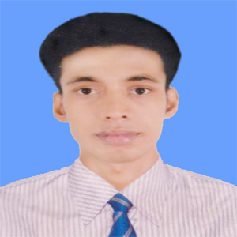
Introduction
Swandip Banerjee
Asst. Teacher (English)
Pallimangal Secondary School, Sonadanga, Khulna.
E-mail: swandipb1@gmail.com
Mobile: 01718503573

Slide 4
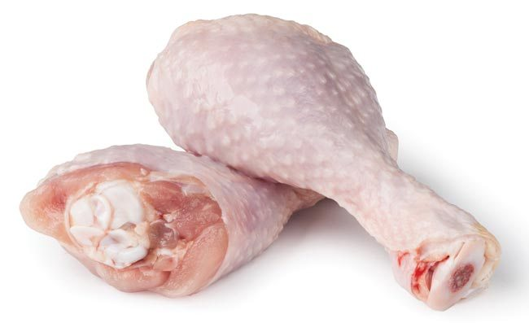
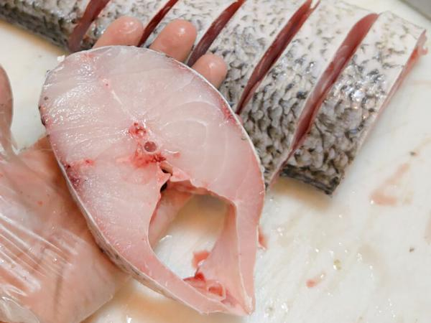
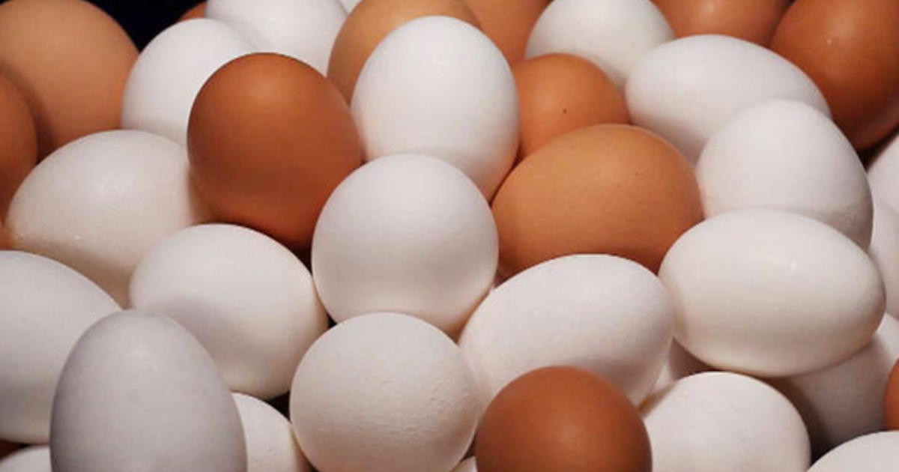
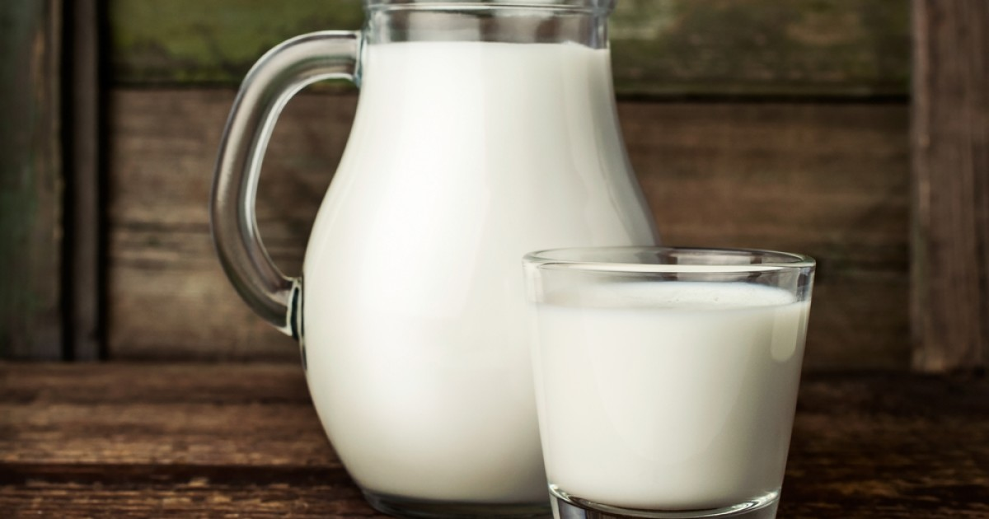
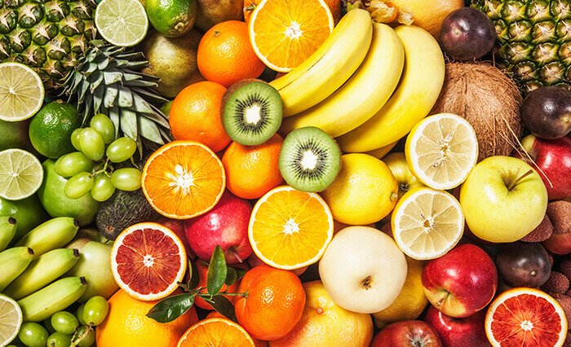
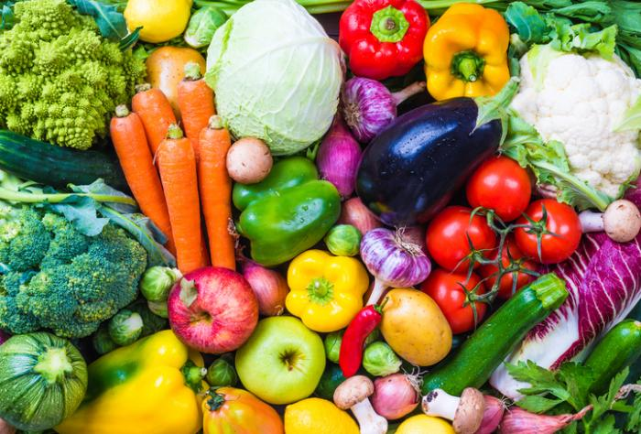
Let us enjoy some pictures.
What are these pictures about?

Slide 5
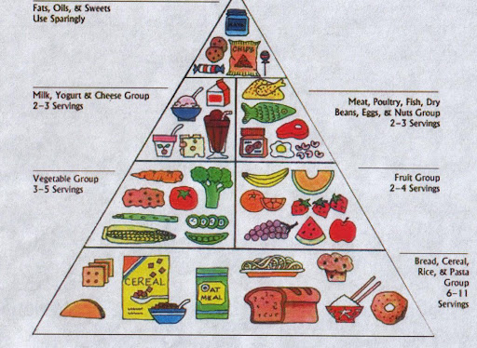
Our today’s lesson is…
Good Food
Unit: Two
Food and nutrition.
Lesson: 01

Slide 6
Learning outcomes
read and understand texts through silent reading.
ask and answer questions.
write answers to questions.

Slide 7
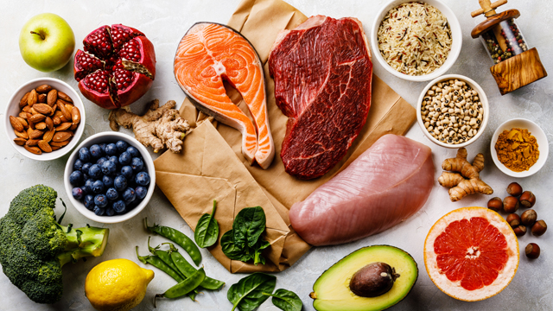
New word
Nutritious
(of food) very good for body; containing many of the substances which help the body to grow.
Synonym: Nourishing

Slide 8
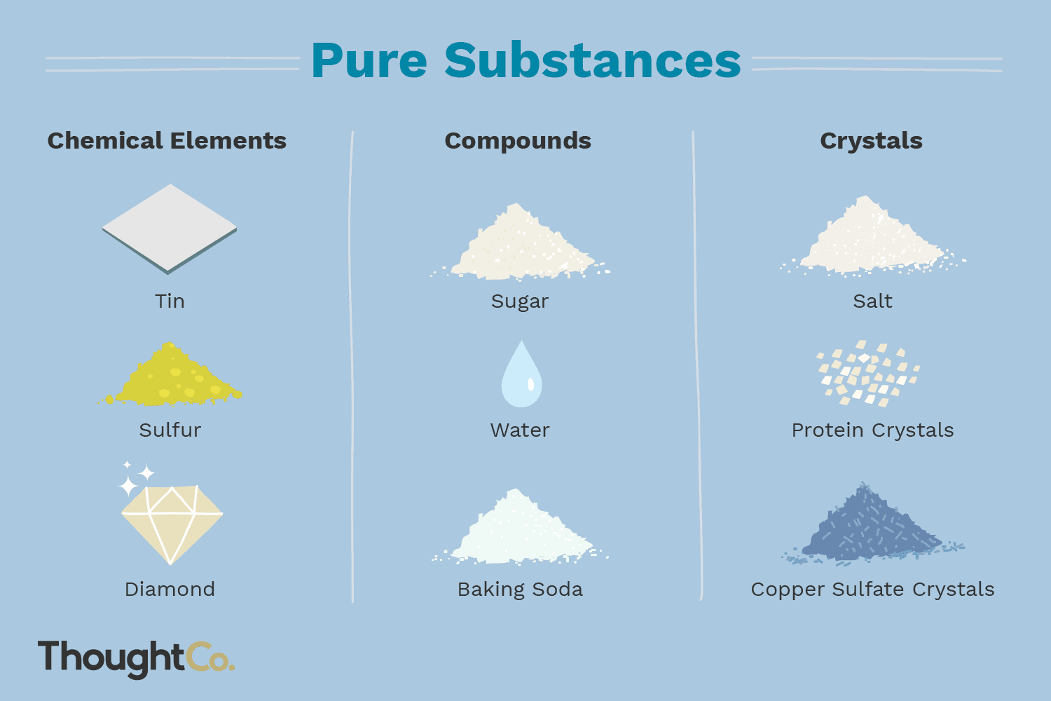
New word
Substances
a type of solid, liquid or gas that has particular qualities.
Synonym: Ingredients or articles

Slide 9
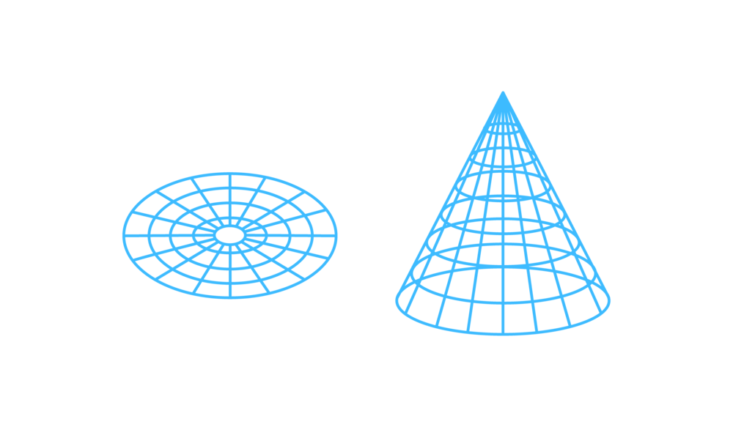
New word
Structure
the way in which the parts of something are connected together, arranged or organized;
(a particular arrangement of parts)
Synonym: Formation

Slide 10
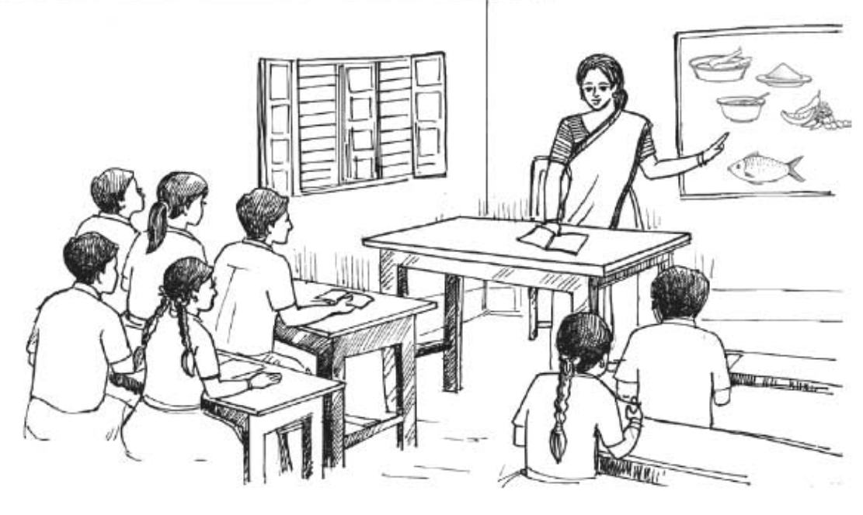
A. Talk about the picture and read the text.
Ms Rehana, the English teacher, is talking to the class about food. “Food is very important for our body,” she says. “We can’t live without it. So you must always have good food.” “What's good food, teacher?” asks a student. “Good food means the right kind of food for good health,'' says Ms Rehana. “It is nutritious. It must contain natural substances that our body needs to grow properly and stay healthy.
But remember, you must not eat too much though the food is good. Eating too much is bad for health. You have to eat only a certain amount of food that your body needs. So we do not need the same kind of food in the same quantity. It depends on your growth and physical structure”.

Slide 11
B. Answer the following questions.
What is Ms Rehana talking about?
Why do we eat food?
What is meant by ‘nutritious food’?
How much food does a man need to eat a day?
Does everyone need the same amount of food? Why?

Slide 12
C. Complete the sentences in pairs.
We should eat good food to……………………………………
We should not eat more than …………………………………
Eating too much food is not ………………………………......
Good food means ……………………………………………....
Probable answers.
We should eat good food to grow properly and stay healthy.
We should not eat more than our body needs.
Eating too much food is not good for health.
Good food means the right kind of food for good health.

Slide 13
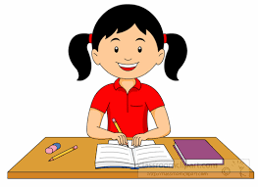
Home work.
Write a dialogue between you and your friend about the importance of good food for our staying healthy.

