Slide 1
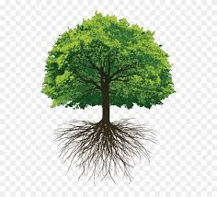
WELCOME

Slide 2
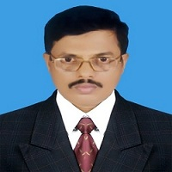
IDENTITY
Md. Saiful Islam Chowdhury
Senior Teacher
C. J. M High School,
Mohara, Chandgaon, Chittagong..
saifulcjm@gmail.com Mob: 01991945882
ENGLISH FOR TODAY
Class : Nine-Ten
Unit- Twelve Lesson – One

Slide 3
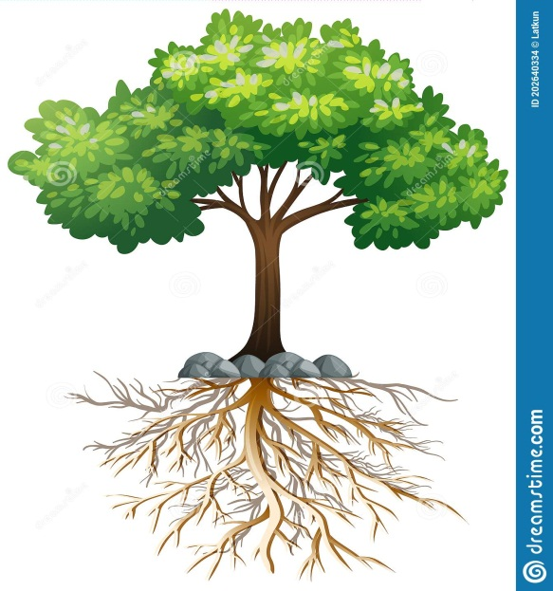
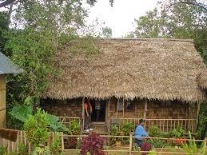
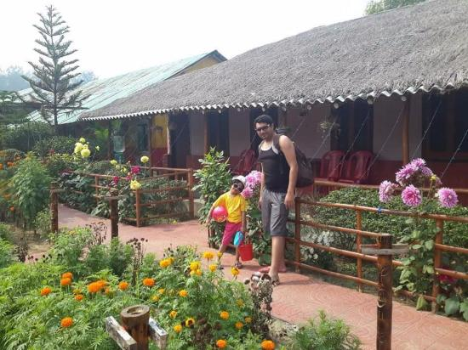
Look at the picture
What do you see in the picture?
This is roots of a tree.
Do you know that we have roots like trees?
Yes , we have invisible roots , they lie in our minds.

Slide 4
Today our lesson is
My roots
Unit- Twelve ; Lesson – One

Slide 5
Learning outcomes
After we have studied the lesson we will be able to ..
1. Participate in conversations and debates ;
2. Exchange personal information.
3. Narrate incidents and events in a logical sequence;
4. Present own ideas , give and ask for information;
5. Present information in a chart.

Slide 6
Read the text silently
Eid is the main religious festival of the Muslims in Bangladesh. Eid means happiness. Everyone wants to share this happiness with near and dear ones. So most of the people, who are living outside their homes for different reasons have a strong desire to get back home during the Eid vacation. As a result, there is a mad rash to board buses, trains, or launches for going home. This often causes trans pest accidents that take away many lives.
However, these cannot stop people from going home to meet their family, in-laws, or friends. What makes people rush for their homes in spite of serious hazards? This is nothing but people's desire to return to the roots. Do human beings have mots like the trees? The answer is ‘yes' but unlike the roots of the trees they are invisible, they lie in our minds. Ifs these roots that make a bond between us and family members, in-laws, friends, neighbours or even between us and the land where we were born and grew up.
In that sense our families, our land of birth, relatives, our culture, traditions, or surroundings are our roots. And wherever we stay, we feel the power of our roots. It's our roots that develop our identity making us what we are. When we lose that bond, we become rootless. Human beings who do not have any roots are a non-entity. In other words, they do not have an identity. They don't know where they are from, and/or where they are heading to. This often makes them feel empty and lost.

Slide 7
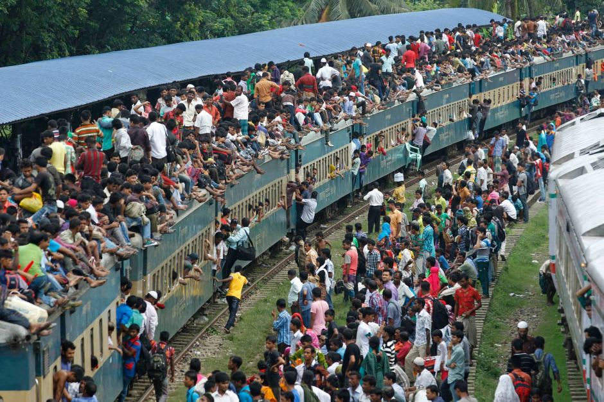
Key word
Caption
Meaning:
Words that are printed underneath a picture.
Most Packed Eid Festival Special Train of Bangladesh Railway
Look at the picture and the caption below.

Slide 8
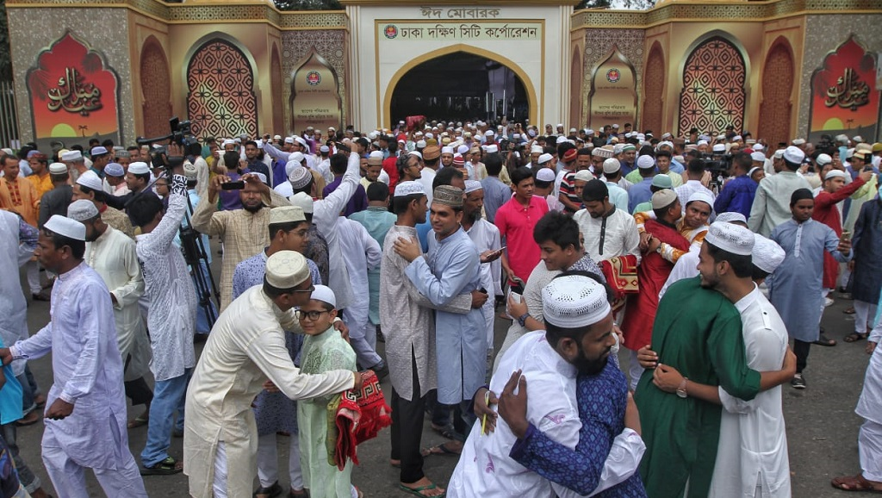
Key word
Festival
Meaning:
A day or period of celebration.
Eid is the main religious festival of the Muslims in Bangladesh .

Slide 9
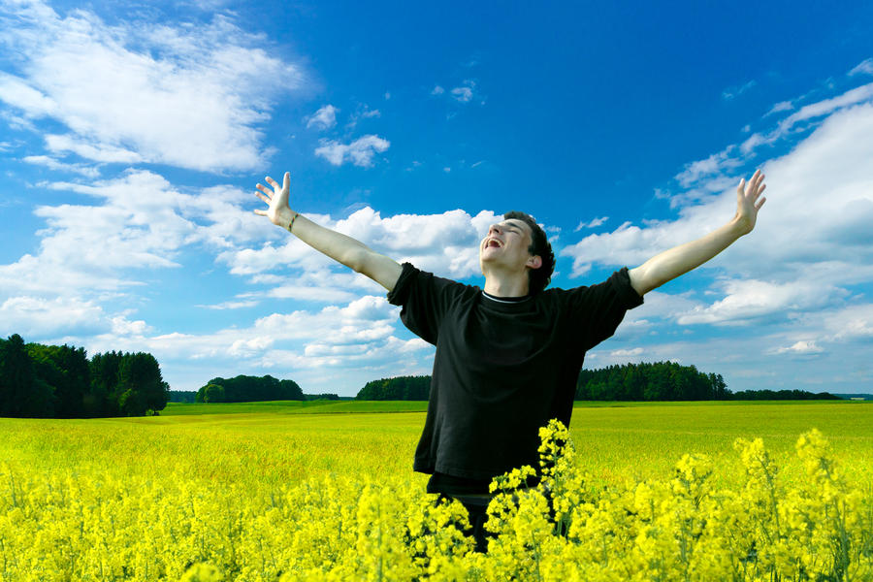
Key word
Desire
Meaning:
A strong feeling of wanting to have something.
We all desire happiness and health .

Slide 10
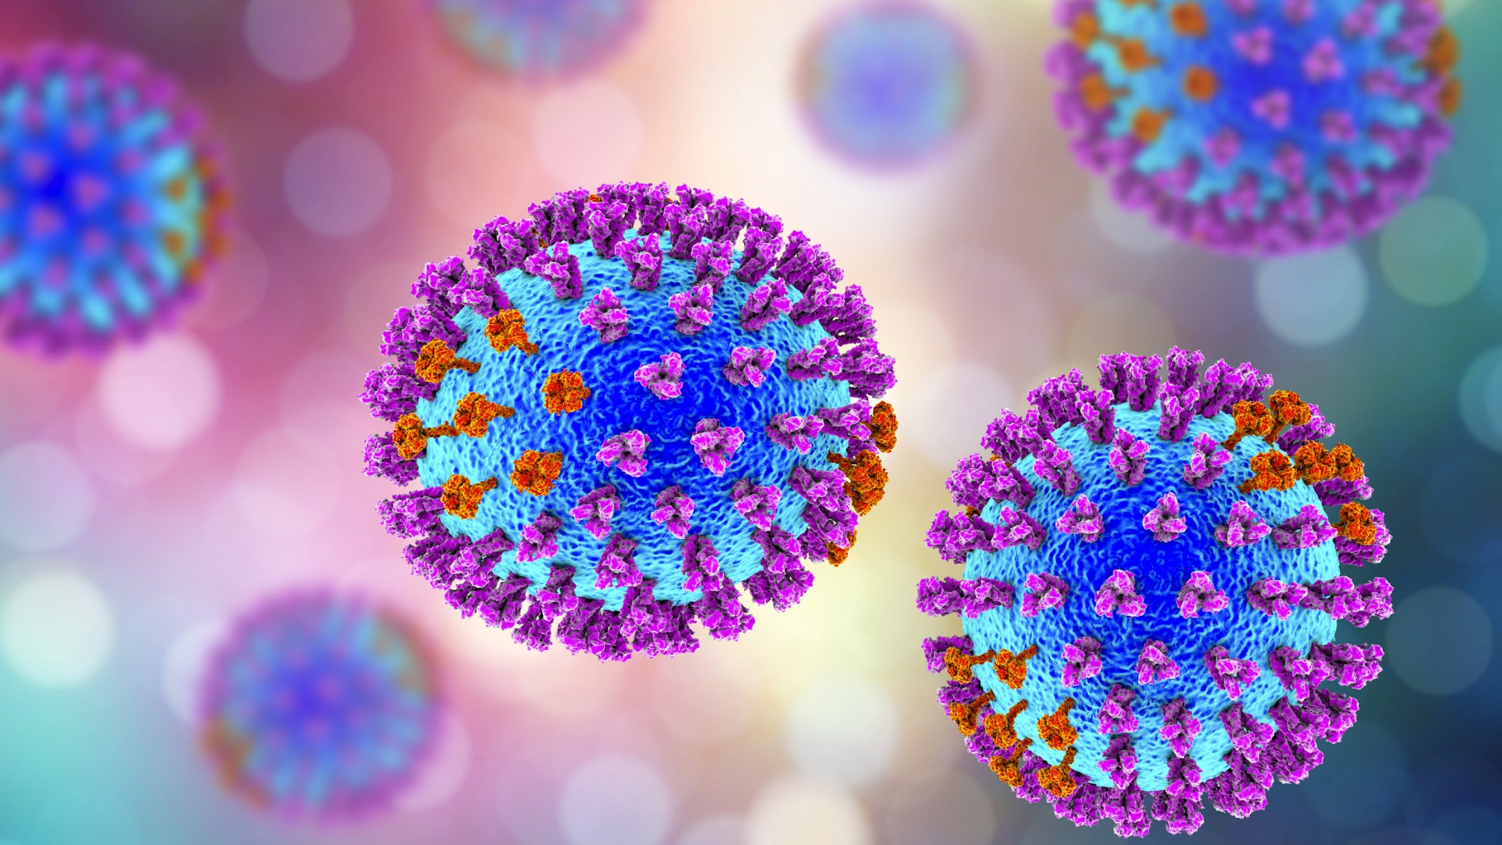
Key word
Invisible
Meaning:
Unable to be seen
Virus is something invisible to the eye.

Slide 11
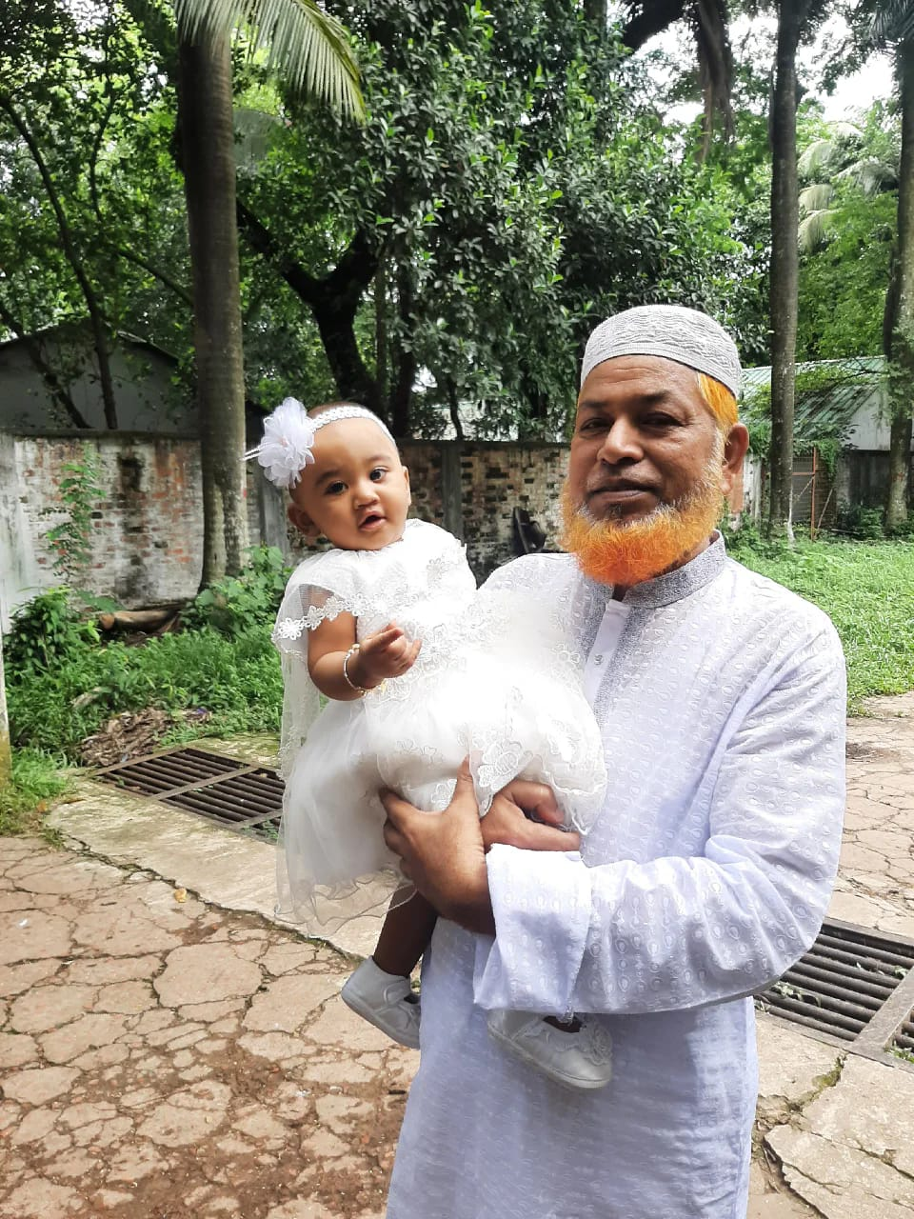
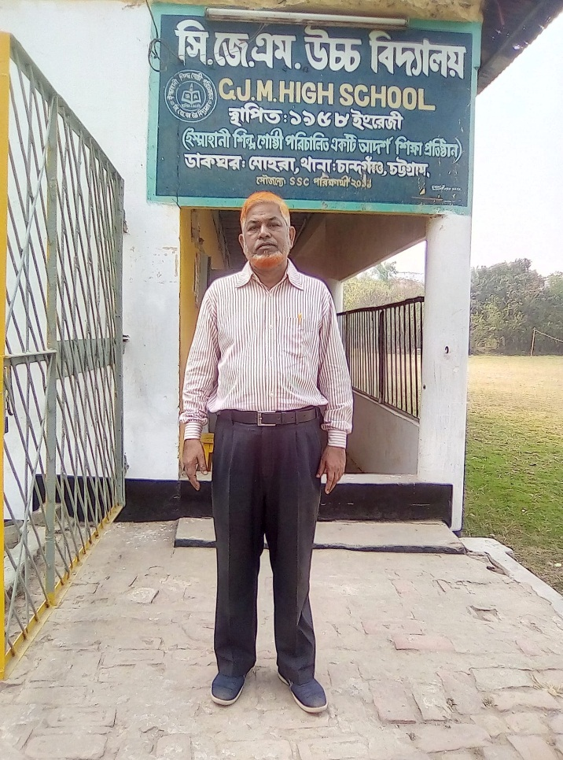
Key word
Neighbour
Meaning:
A person who lives next to you or near you .
Mr, Jahangir is my next-door neighbour .

Slide 12
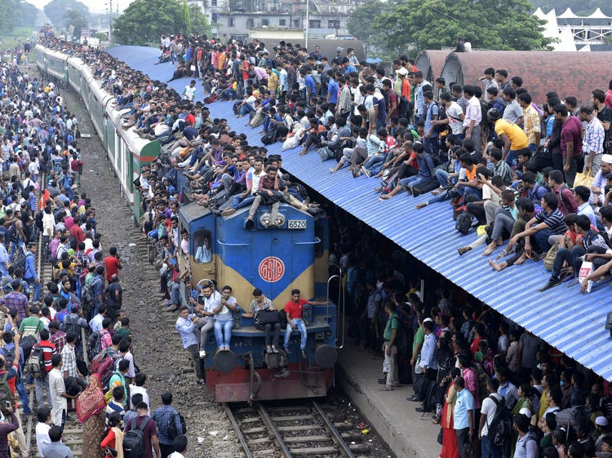
Look at the picture and the caption below.
How do you feel looking at the photo?
I am afraid of seeing this photo.
Why do you think people take such risks to go home to celebrate Eid ?
People take such risks because of the pull of their roots meaning their family behind. It expresses their passion for going home on Eid occasion.
Most Packed Eid Festival Special Train of Bangladesh Railway

Slide 13
Read the text in the speech bubbles. Make questions based on the bubbles .
Eid is the main religious festival of the Muslims in Bangladesh.
Eid means happiness.
What is the main religious festival of the Muslims in Bangladesh?
What does Eid means ?

Slide 14
Read the text in the speech bubbles. Make questions based on the bubbles .
In that sense our families, our land of birth, relatives, our culture, traditions, or surroundings are our roots.
It's our roots that develop our identity making us what we are.
What are our roots ?
What do our roots do to us?

Slide 15
Fill in the grid with appropriate information from the text above.
Family
In-laws
Friends
Neighbors
Our birth and growing land
No identity
No address
No destiny
Feeling of emptiness and loss Is created
That makes our roots | The problems of a rootless person
1 | 1
2 | 2
3 | 3
4 | 4
5

Slide 16
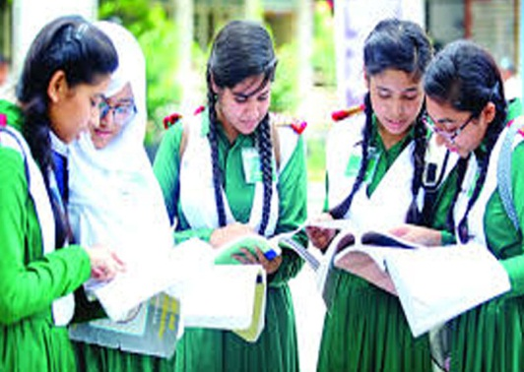
Participate in conversations
A: Do you have any root other than the place where you are living now? If yes, where is it and who live there? If not, why not?
B: Yes, I have. It is my village in Noakhali. My grandmother and uncles live there.
A: How do you label your roots?
B: I have my roots in a village.
A: Do you feel any attraction for your roots? Any pull in your heart?
B: Yes, I feel a pull of my roots in my heart.
A: How do you nourish your roots?
B: I always feel my childhood, my village, the relatives, neighbors of my village. I try my best to look after my relatives at my village. Thus I nourish my root.
A. What, according to you, are the reasons why people become rootless?
B: Disintegration of joint family, moving of people to the city for job and business, poverty etc. are the reasons of being rootless.

Slide 17
Choose the correct answer from the alternative.
1. What does the phrase ‘strong desire’ mean?
a) willing
b) wish
c) strong wish to have something
d) opinion

Slide 18
Choose the correct answer from the alternative.
2. What is the meaning of Eid?
a) A feeling of joy
b) Enrichment
c) Enhancement
d) Enchantment

Slide 19
Choose the correct answer from the alternative.
3. What does the phrase ‘near and dear ones’ mean?
a) neighbour
b) known person
c) well-known person
d) close relatives

Slide 20
Choose the correct answer from the alternative.
4. The roots of human beings lie in their ____.
a) home
b) minds
c) society
d) country

Slide 21
Choose the correct answer from the alternative.
5. The rootless are ____.
a) entity
b) identical
c) non-entity
d) relatives

Slide 22
Choose the correct answer from the alternative.
6. Which one develops our identity?
a) our culture
b) our roots
c) our religion
d) our environment

Slide 23
Choose the correct answer from the alternative.
7. What is pull of roots?
a) Affection of roots
b) Addiction of roots
c) Assistance of roots
d) Attraction of roots

Slide 24
Evaluation
Answer the following questions in your own words:
What do most of the people living outside home desire during the Eid vacations ?
(b) What happens to transport during Eid vacation ?
(c) What makes people rush for their homes in spite of serious hazards ?
(d) What are the roots of human beings ?
(e) How do human beings become rootless ?

Slide 25
Compare with your answer
During the Eid vacations, most of the people living outside home desire to go back home to observe the Eid.
(b) There is a mad rush in the transport during Eid vacations, consequently transport accident takes place.
(c) The attraction of roots makes people rush for their homes in spite of serious hazards.
(d) Families, birth land, relatives, cultures. Traditions and surroundings are the roots of human beings.
(e) Human beings become rootless by losing the bond between them and others.

Slide 26
Home Work
Make a classroom survey and present in a chart the types of roots your classmates have.

Slide 27
Patriotism is a thing of the heart.
A man is a patriot if his heart beats true to his country
Charles Edward Jefferson
Thank you all

