Slide 1
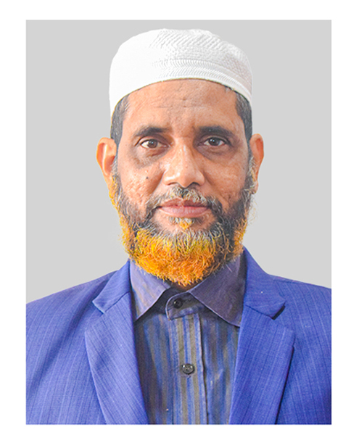
Welcome to my Multimedia Presentation
A.K.M. Noor-e-Alam
Senior Teacher(English)
M.A. in English
Ikrashi Adarsha High School
Dohar, Dhaka-1331
Presentation made for class
VI-X
English 2nd paper
Paragraph
Notes:
Welcome and identity of the content builder and class with subject in one slide.

Slide 2
Notes:
The main aim of this lesson is to make the students able writing a composition on hobby.

Slide 3
Learning outcomes
At the end of the lesson we will be able to-
define COVID-19
Differentiate between the general flu and corona disease.
write a paragraph on ‘COVID-19’.
Notes:
The main aim of this lesson is to make the students able writing a composition on hobby.

Slide 4
It is a paragraph.
Notes:
The main aim of this lesson is to make the students able writing a composition on hobby.

Slide 5
Coronavirus disease (COVID-19) is an infectious disease caused by a newly discovered coronavirus.
Notes:
The main aim of this lesson is to make the students able writing a composition on hobby.

Slide 6
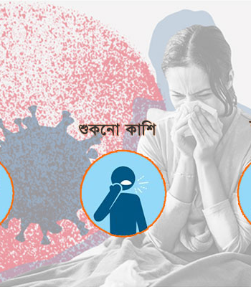
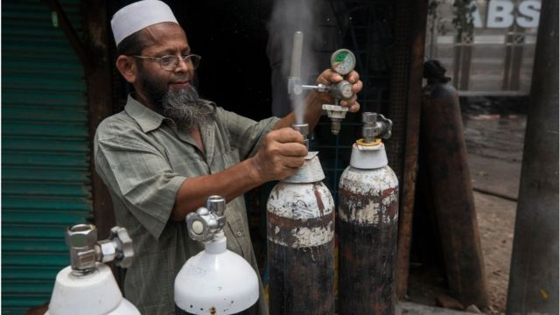
Most people infected with the COVID-19 virus will experience mild to moderate respiratory illness and recover without requiring special treatment. Older people, and those with underlying medical problems like cardiovascular disease, diabetes, chronic respiratory disease, and cancer are more likely to develop serious illness.
Notes:
Suspension to lead the lesson.

Slide 7
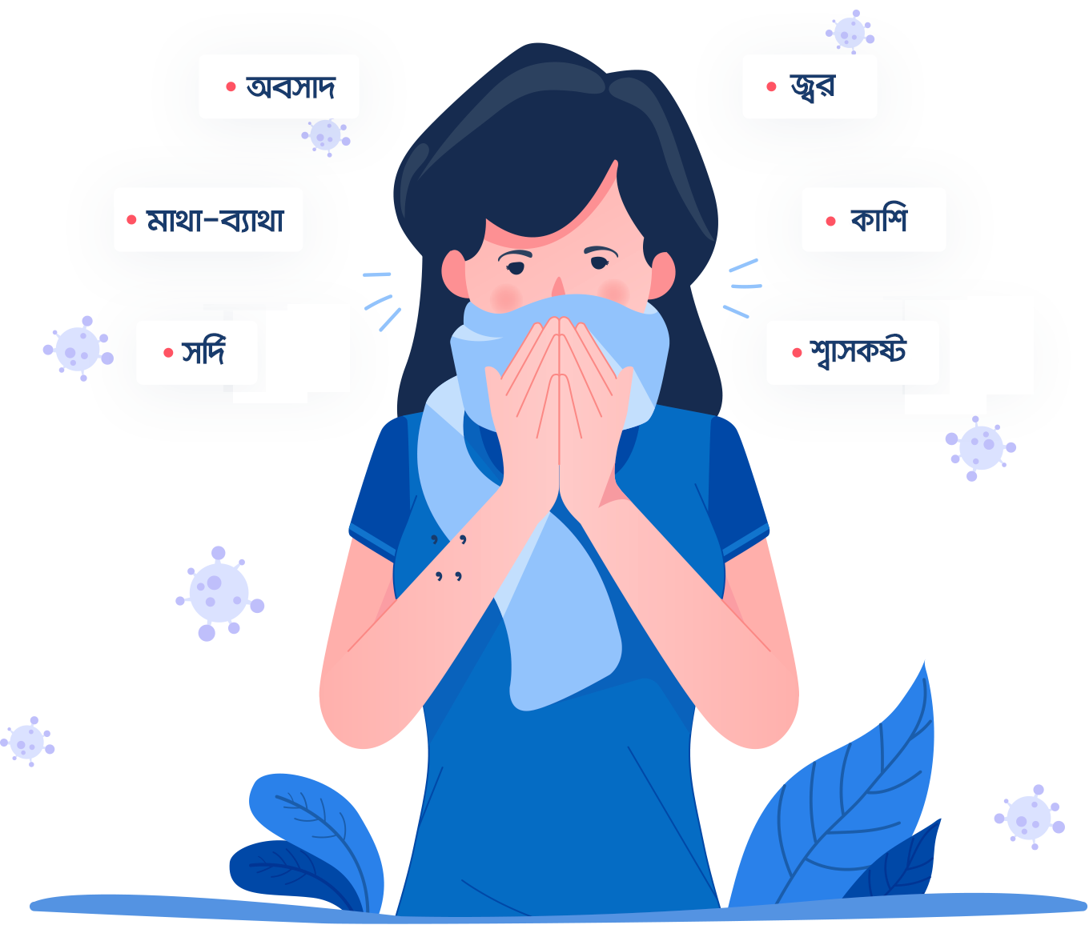
Coronaviruses are a large family of viruses which may cause illness in animals or humans. In humans, several coronaviruses are known to
cause respiratory infections ranging from the common cold to more severe diseases such as fever, runny nose, headache, fatigue, shortness of breath, cough etc.
Notes:
Learning outcomes No 1 & 2 will be effective from this slide.

Slide 8
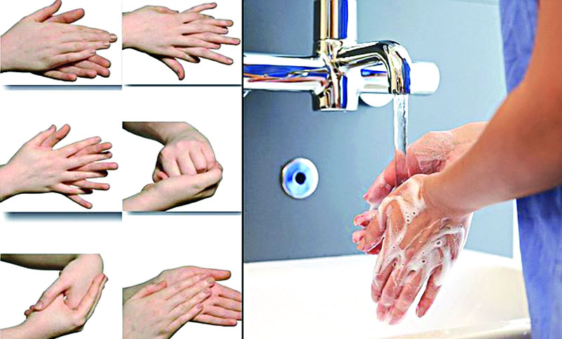
The way of remaining safe
from Corona virus disease.
|
We have to clean our hands regularly and thoroughly with an alcohol based hand rub or wash them with soap and water, because these actions kill viruses that may be on our hands.
|
Notes:
The main aim of this lesson is to make the students able writing a composition on hobby.

Slide 9
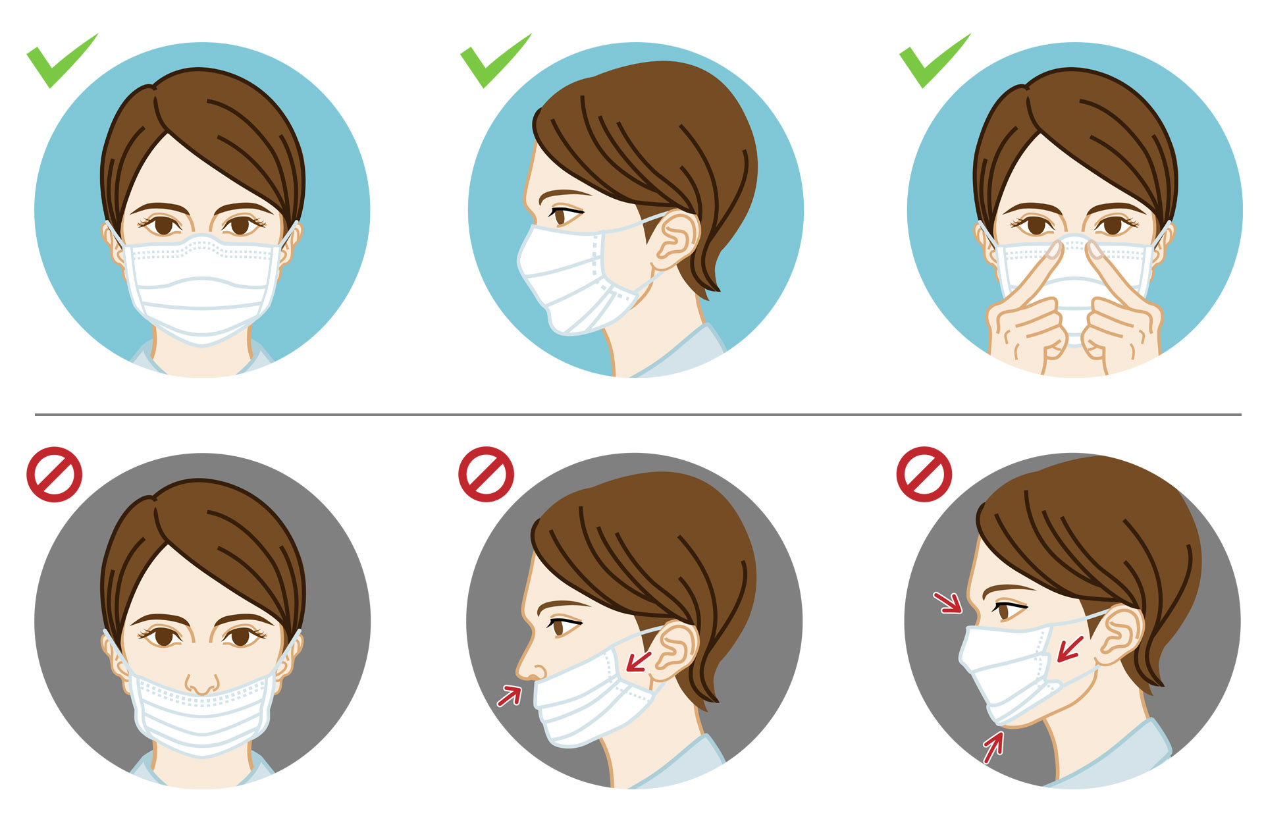
We should wear mask properly when we meet
with each other.
|
Notes:
The main aim of this lesson is to make the students able writing a composition on hobby.

Slide 10
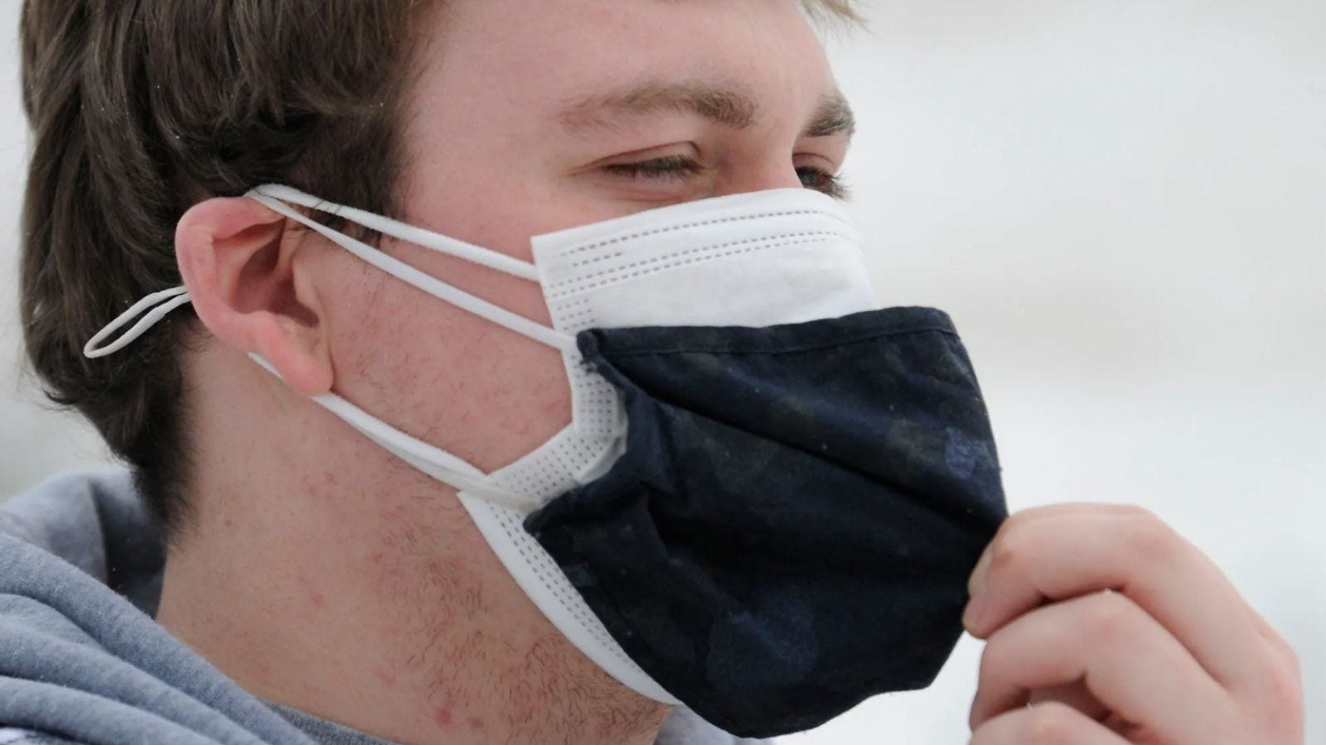
We may wear double mask when we
go out for getting more safety.
|
Notes:
The main aim of this lesson is to make the students able writing a composition on hobby.

Slide 11
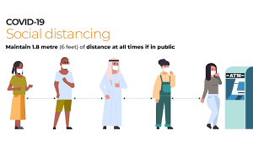
We should keep a safe distance of at least 1 metre (3 feet) from people. The virus is contained in saliva droplets and can be transmitted by breathing at close range, particularly when they cough, sneeze or have a fever.
|
Notes:
The main aim of this lesson is to make the students able writing a composition on hobby.

Slide 12
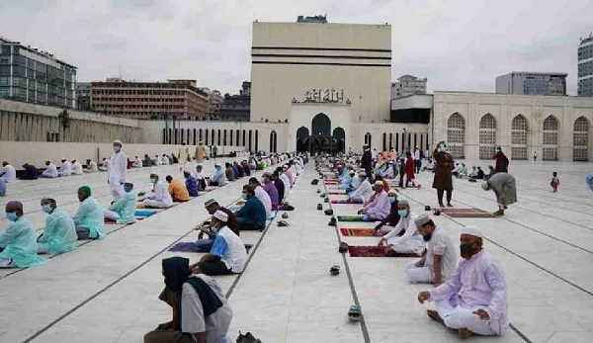
We have to say our prayer maintaining social distance
|
Notes:
The main aim of this lesson is to make the students able writing a composition on hobby.

Slide 13
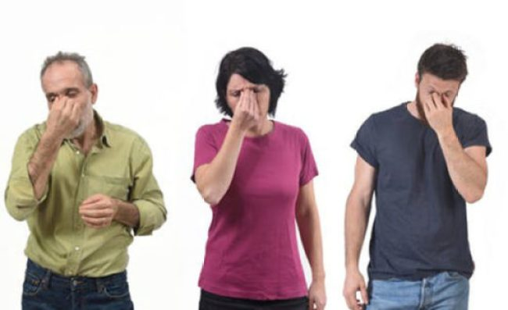
We should avoid touching eyes, nose and mouth because hands touch many surfaces and can pick up viruses. Once contaminated hands can transfer the virus to our eyes, nose or mouth. From there, the virus can enter our body and can make us sick. |
Notes:
The main aim of this lesson is to make the students able writing a composition on hobby.

Slide 14
If we follow these rules and maintain them, we can remain safe from
this Coronavirus. Besides, we may take vaccination if it is available.
Notes:
Heavenly enjoyment.

Slide 15
Notes:
Ending slide.

