Slide 1
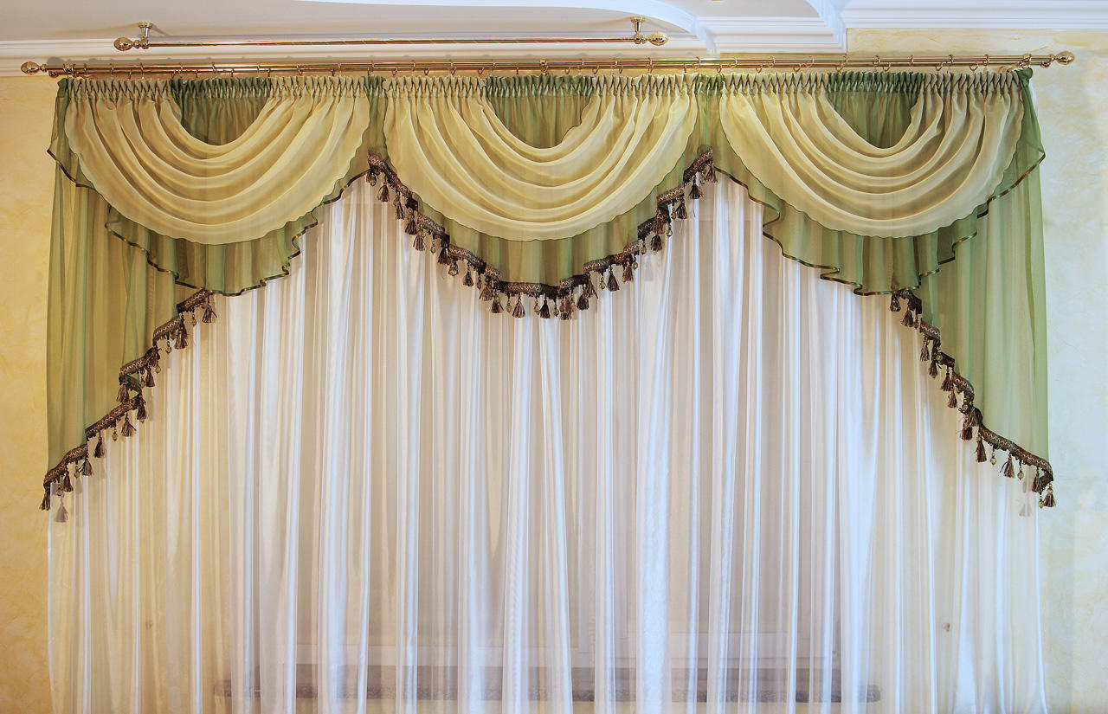

Slide 2
Teacher’s Identity
Sabina Akter Talukder
Assistant Teacher
Chuta Vakoir GPS
Nabigonj, Habiganj
Sylhet.

Slide 3
Lesson Identity.
Class: Five
Subject: English
Unit: 9
Lesson: 1-2
Occupations

Slide 4
Learning Outcomes
1.3.1. Recognize which words in a sentence are stressed.
3.3.1. Understand questions about objects around them.
3.4.1. Understand statements made by the teacher and students.
1.1.1. Say words , phrases and sentence with proper sounds and stress.
1.1.2. Say sentence with proper intonation.
1.5.1. Read words , phrases and sentences in the text with proper pronunciation, stress and intonation.
1.6.1. Recognize and read statements commands , greetings , questions and answers.

Slide 5
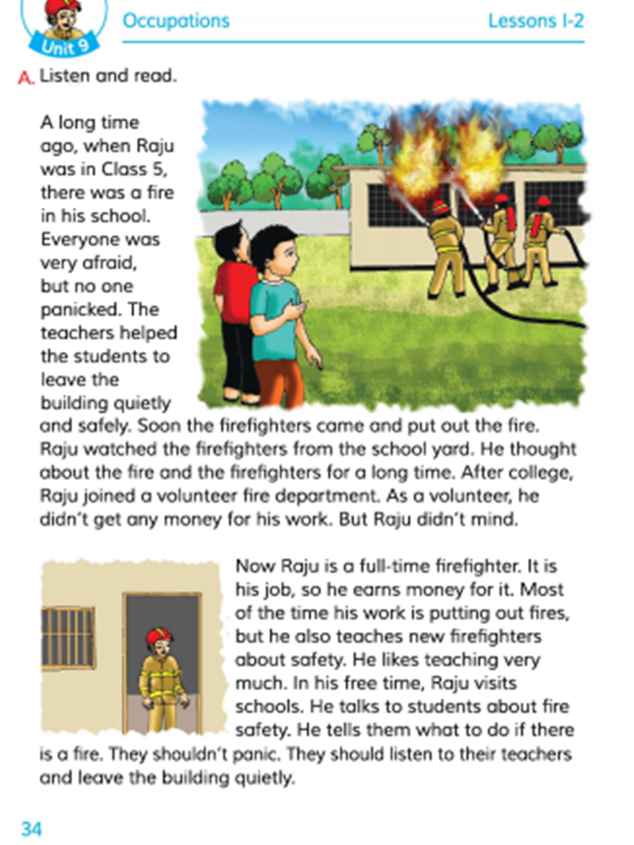
TODAY’S TOPIC
Occupations

Slide 6
Which occupation would you like to take up?

Slide 7
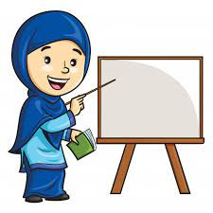
Teachers loud reading
Occupations

Slide 8
Look at these pictures and think about them
Nurse
A woman who takes care of sick people.
A person who grows crops.
Farmer
A person who teaches students.
Teacher
Firefighter
A person who puts out fire.

Slide 9
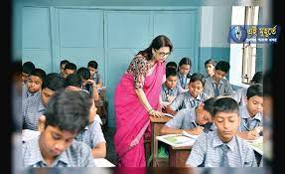
Students silent reading

Slide 10
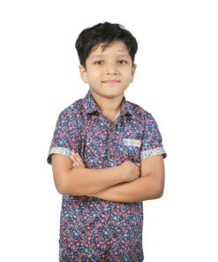
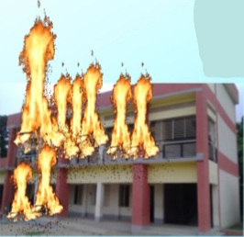
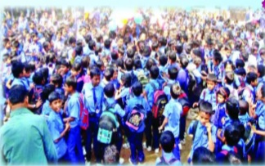
Look at the picture
A long time ago, when Raju was in class 5, there was a fire in school. Everyone was very afraid but no one panicked.

Slide 11
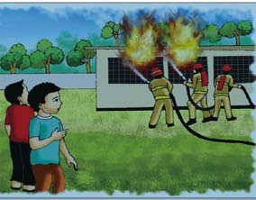
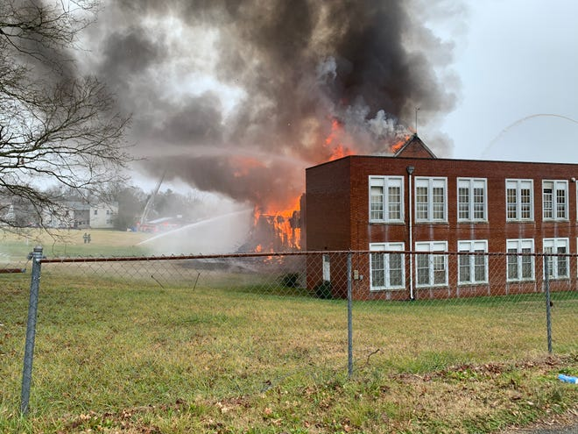
Look at the picture
The teachers help the students to leave the building safely and quietly. Soon the firefighter came and put out the fire.

Slide 12
Look at the picture
Raju watched the firefighter from the school yard. He thought about the fire and the firefighters for a long time.

Slide 13
Look at the picture
After college, Raju joined a volunteer fire department. As a volunteer he didn’t get any money for his work. But Raju didn’t mind.

Slide 14
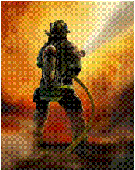
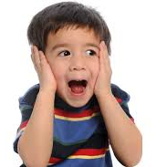
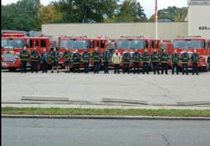
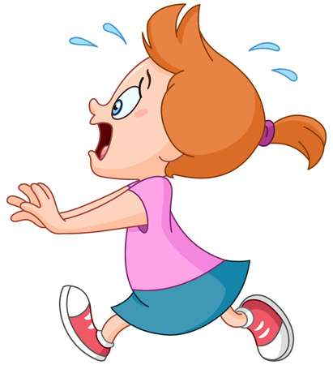
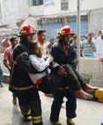
New words
Fire fighter
Help
Afraid
Volunteer
Panicked
Safe and quit

Slide 15
Individual work
Match the words in column A with their meaning in B
Column A
Column B
a) Afraid
i. A preson whose job is put out fire
e) Firefighter
ii. Affected with fear
b) Brave
iii. Feeling fear and frightened
d) Panicked
iv. division
c) Visit
v. A fearless person
vi. Go or come to see anything
vii. free from danger

Slide 16
Answer the questions
(a) Raju is a firefighter.
(a) What is Raju?
(b) The students were very afraid because there was a fire in the school.
(b) Why were the student very afraid?
(c) When Raju was in class 5, there was afire in their school.
(c) What happened when Raju was in class-5?
(d) In his free time he visits schools and talks to students about fire safety.
(d) What dose Raju do in his free time?
(e) Where dose Raju work?
(e) Raju works under the Fire Department.

Slide 17
True or false
(a) Everyone was panicked.
False
(b) The students left the building quietly.
True
(b) The students were afraid to see the firefighters .
False
(c) Raju joined a volunteer fire department after school.
False
(d) Now Raju earns money as a full- time firefighter.
True

Slide 18
Pairwork
Group
Write two qualities of a firefighter.
Group
If there is a fire in your house what should you do at first?

Slide 19
Homework
Write a short composition about a job you like.

Slide 20
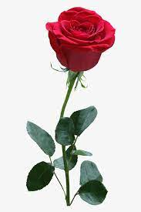
See you again

