Slide 1
Good Morning

Slide 2
Presented by
Lesson Identity
Class : One
Subject : English
Unit:12
Lesson:Numbers1-3
Page:24
Time: 40 minutes
Masuma
Assistant Teacher
Kishor Mojlish Govt. Primary School
Barishal sador.
.

Slide 3
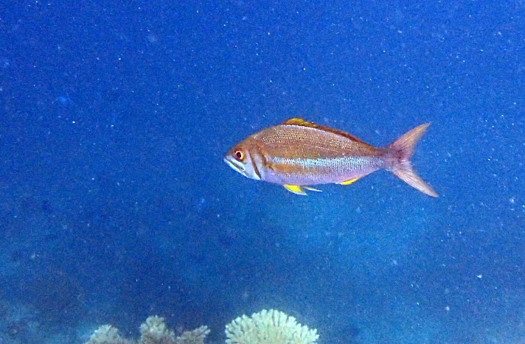
Let’s see a picture
What can you see in the picture?
A fish
1) How many fish?
Ans: 1
2) What is 1?
Ans: 1 is a number.
Our lesson is about ‘numbers’

Slide 4
Today’s Lesson
Numbers
1-5
Page no: 24

Slide 5
Learning Outcomes
Students will be able to……………
Reading:
2.1.1= recognize and read cardinal numbers up to 10.
Writing:
2.1.1= write cardinal numbers up to 10 in figures.

Slide 6
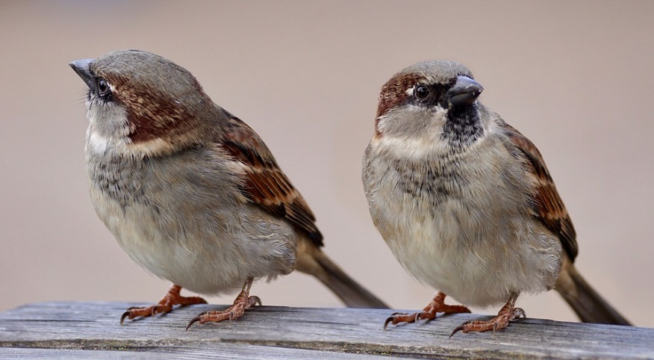
Now count the pictures with the numbers
How many birds are there in the pictures?
Ans: 2 birds.

Slide 7
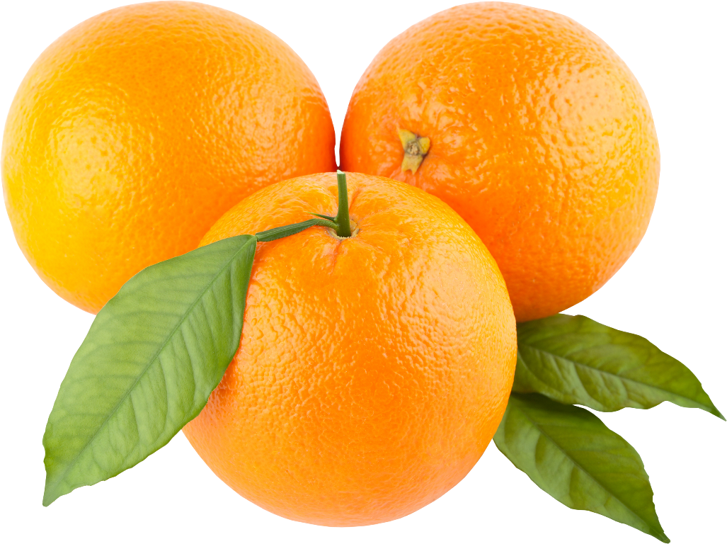
Now count the pictures with the numbers
How many oranges are there in the picture?
Ans: 3 oranges.

Slide 8
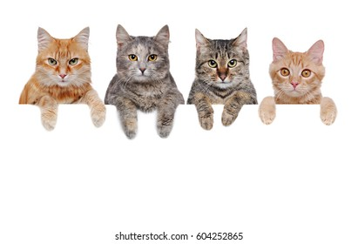
Now count the pictures with the numbers
How many cats are there in the picture?
Ans: 4 cats.

Slide 9
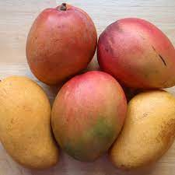
Now count the pictures with the numbers
How many mangos are there in the picture?
Ans: 5 mangos.

Slide 10
Now open your book, page no 24 and look at activity a.

Slide 11
Match the numbers with the pictures
WCW

Slide 12
Fill in the gaps with numbers after count the pictures
5
4
2
3
1
PW

Slide 13
Read loudly the numbers below
IW

Slide 14
Evaluation
Read the cardinal numbers from 1-5

Slide 15
Evaluation
Write the numbers in your exercise book from 1-5

Slide 16
Home Task
Write the numbers at home as your home task from 1-5

