Slide 2
Welcome

Slide 3
Presented by
Md. Kamal Uddin
Assistant Teacher
Kuliarchar Bazar Model Govt. Primary School
Kuliarchar , Kishoregonj

Slide 4
Introduction of the lesson
Subject: English
Class : 4
Unit : 6
Lesson : 1-2

Slide 5
Learning outcomes:
Students will be able to
Listening:
1.1.1 recognize sound differences in the context of words.
1.2.1 recognize which syllable in a word is stressed.
1.3.1 recognize which words in a sentences are stressed.
3.3.1 understand questions about objects around them.
Speaking:
1.1.1 repeat after the teacher and say words , phrases and sentences with proper sound , stress and intonation.
6.2.1 talk about people , objects , events etc.
Reading:
1.4.1 read words , phrases , and sentences in the text.
1.5.1 read words , phrases , and sentences in the text with proper pronunciation , stress and intonation.
2.1.1 recognize and read cardinal numbers up to 100.

Slide 6
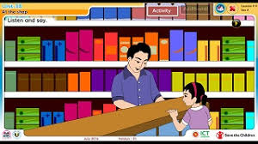
Now we see some pictures

Slide 7
Today our lesson is At the shop

Slide 8
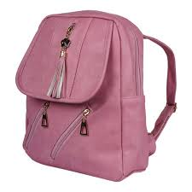
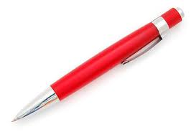
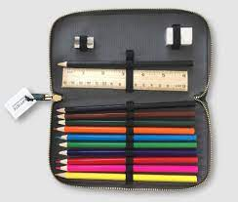
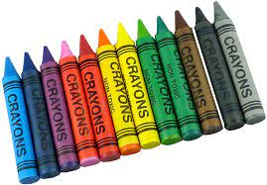
Can you say the name of the pictures ?

Slide 9
pen
pencil
eraser
bag
crayons
Pencil case
paper
sharpener

Slide 10
paper
pencil
eraser
pen
Let us play a game
crayons
bag
sharpener
Pencil case

Slide 11
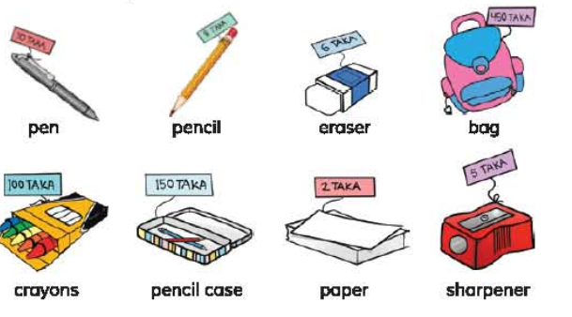
Look and say

Slide 12
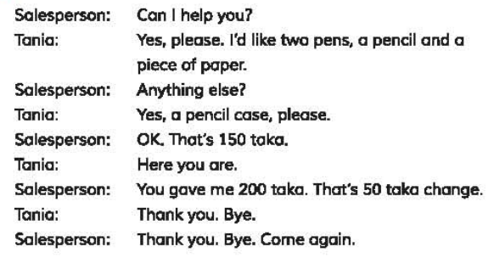
Now we listen a dialogue between the salesperson and Tania

Slide 13
Indivisual Work
Indivisually read the lesson in silent

Slide 14
Home Work
Write a dialogue between you and salesperson.

Slide 15
Thanks to all

