Slide 1
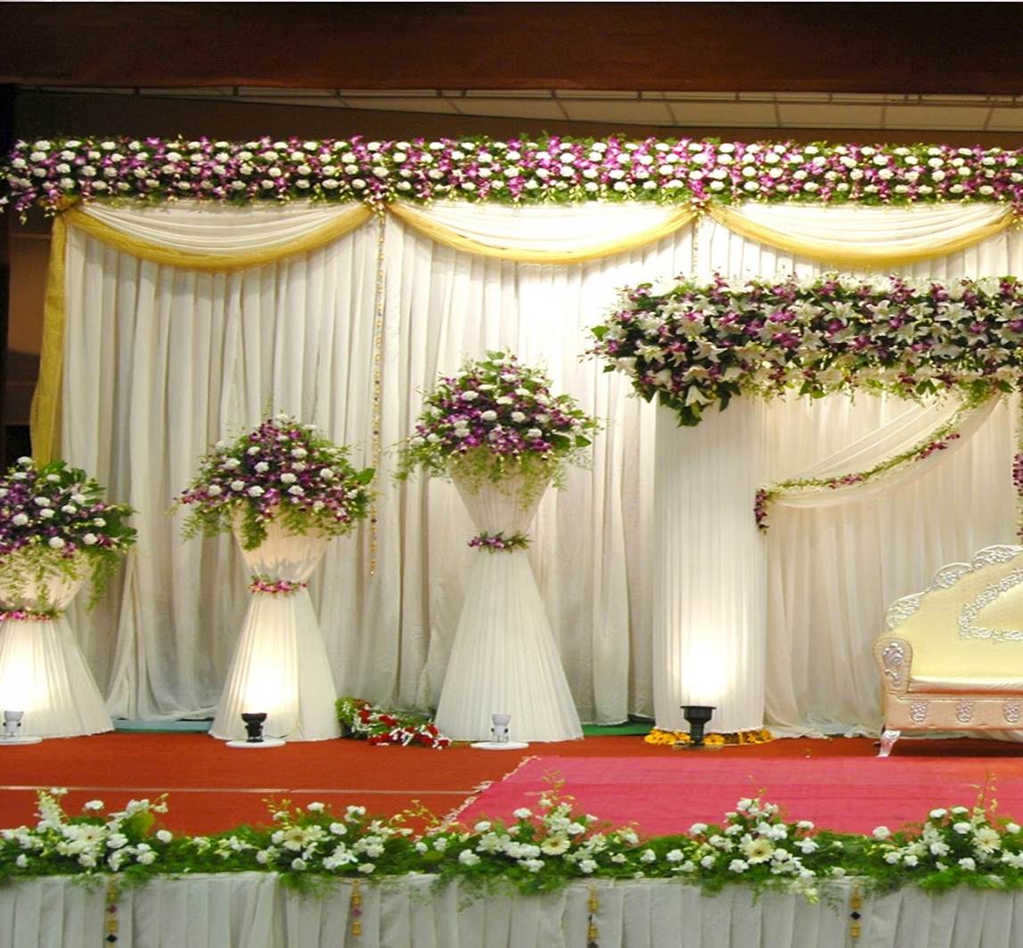
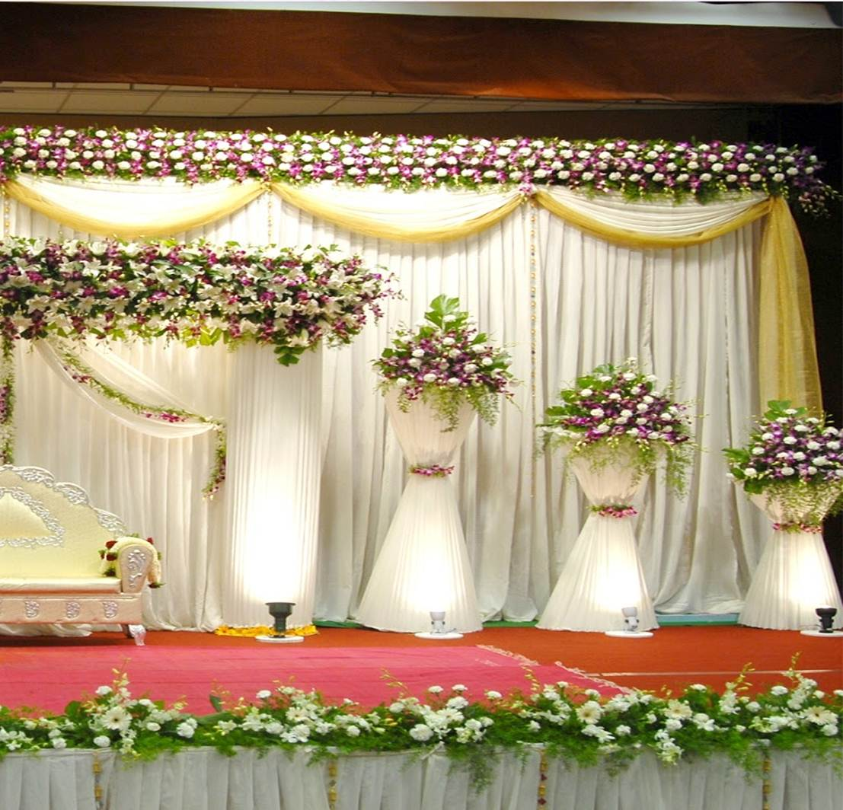
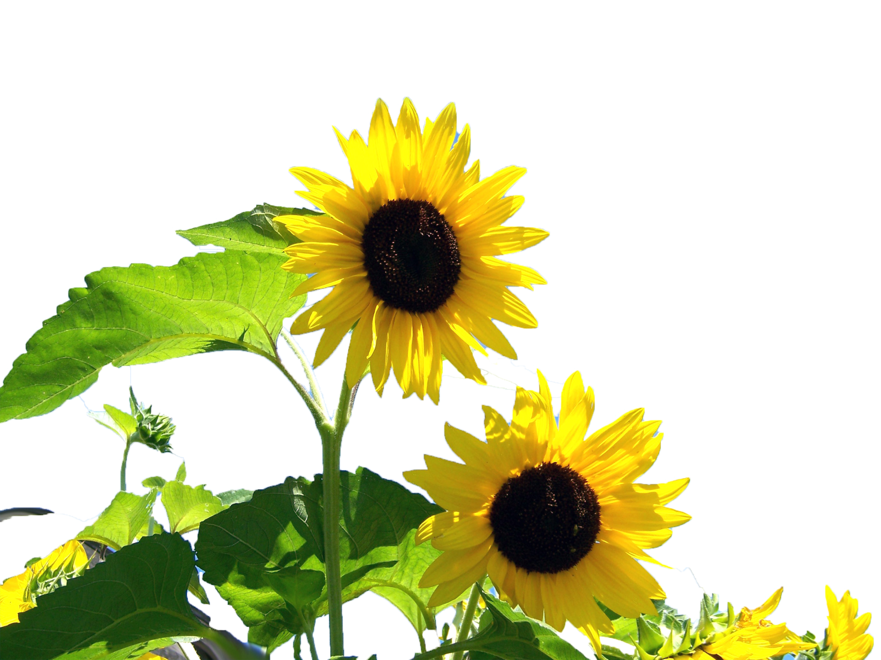
Welcome to my Multimedia Presentation
A.K.M. Noor-e-Alam
Senior Teacher(English)
M.A. in English
Ikrashi Adarsha High School
Dohar, Dhaka-1331
Presentation made for class
VI-X
English 2nd paper
Paragraph
Notes:
Welcome and identity of the content builder and class with subject in one slide.

Slide 2
Notes:
The main aim of this lesson is to make the students able writing a composition on hobby.

Slide 3
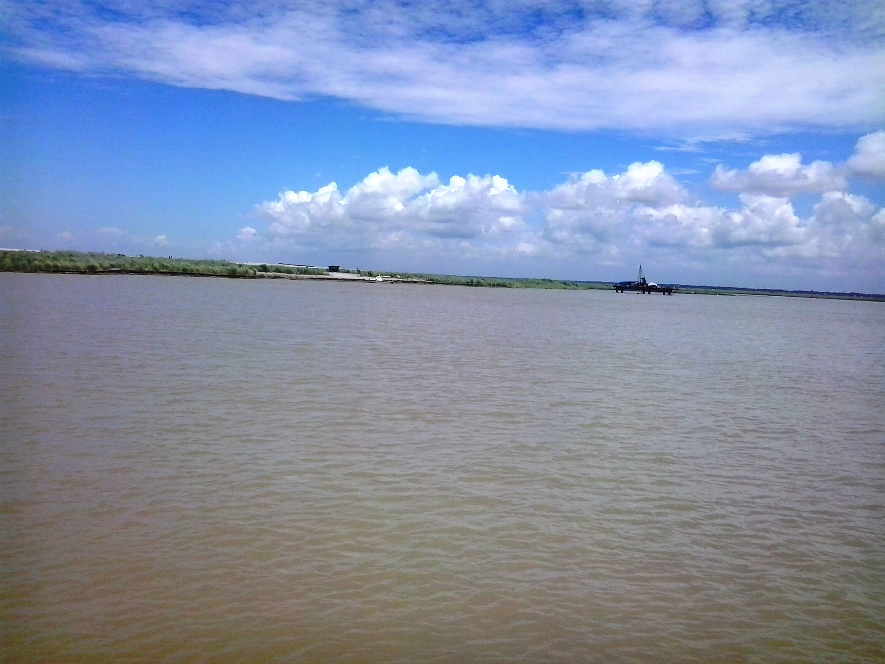
Learning outcomes
At the end of the lesson we will be able to-
define the national flag.
able to practice freehand writing.
help to become creative mind.
can write a paragraph on ‘ The National Flag’.
Notes:
The main aim of this lesson is to make the students able writing a composition on hobby.

Slide 4
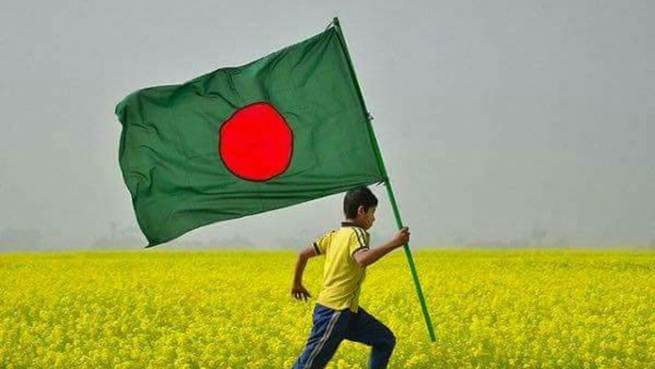
Our National Flag
It is a paragraph.
Notes:
The main aim of this lesson is to make the students able writing a composition on hobby.

Slide 5
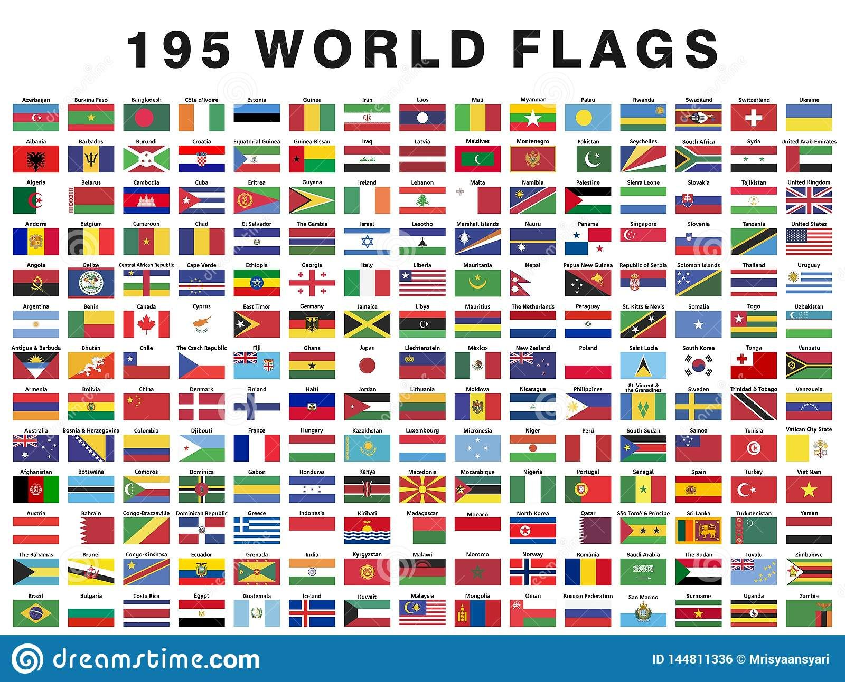
Every nation of the world has a national flag. The flag indicates the freedom and sovereignty of a country.
Notes:
The main aim of this lesson is to make the students able writing a composition on hobby.

Slide 6
We are citizens of a freedom country. So, we have also a national flag. Our national flag symbolizes the liberty
and sovereignty of our country.
Notes:
The main aim of this lesson is to make the students able writing a composition on hobby.

Slide 7
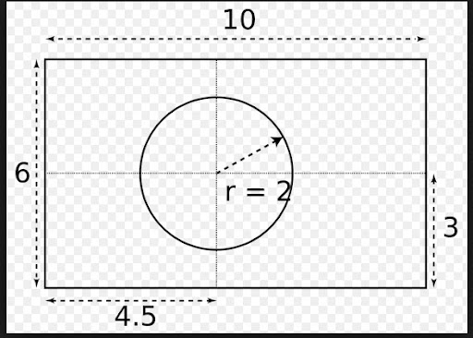
Its size is confined to 10:6.
Notes:
The main aim of this lesson is to make the students able writing a composition on hobby.

Slide 8
The flag is green with a red circle in the middle of it. The green colour symbolizes the evergreen nature of the country. The red circle represents the fresh red blood of the martyrs in the liberation war of 1971.
Notes:
The main aim of this lesson is to make the students able writing a composition on hobby.

Slide 9
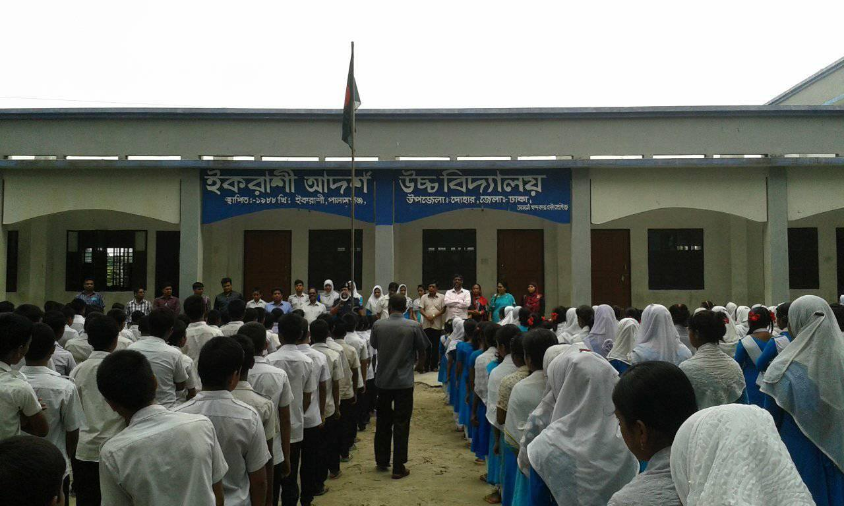
Our National Flag is hoisted at govt. offices, educational institutions, etc.
Notes:
The main aim of this lesson is to make the students able writing a composition on hobby.

Slide 10
On the 14 December, 21 February and on the other national mourning day our national flag keeps half-mast.
Notes:
The main aim of this lesson is to make the students able writing a composition on hobby.

Slide 11
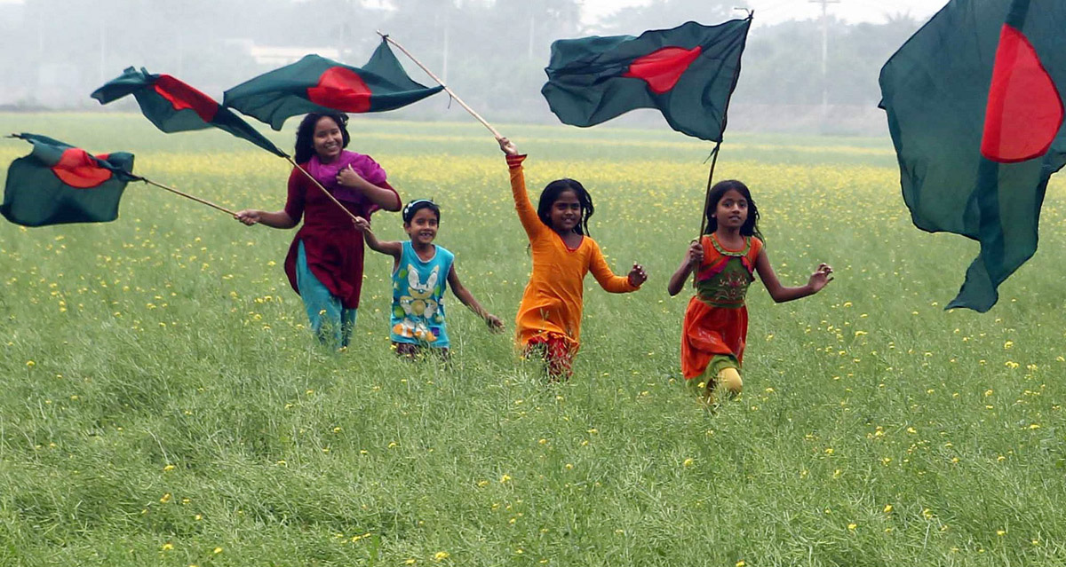
Our feelings about the flag are very sensational and respectful. When we see our national flag, our heart is fulfilled with joy and respect.
Notes:
The main aim of this lesson is to make the students able writing a composition on hobby.

Slide 12
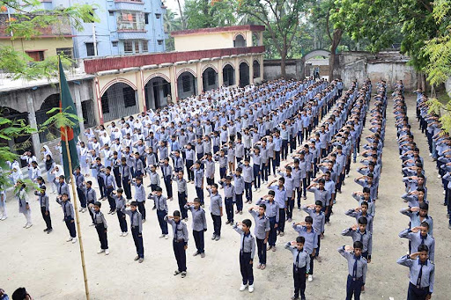
We bow down our heads towards it. We have to save the honour and dignity of this flag even instead of our lives when it will be essential.
Notes:
The main aim of this lesson is to make the students able writing a composition on hobby.

Slide 13
Evaluation
Answer the following questions
1.What does it symbolize?
2.Where is it hosted?
3.When is the national flag kept half-mast?
4.Which memory does the blood-red colour bear?
5.How do you feel for your national flag?
6.How can you uphold its honour?

Slide 14
Homework
Write a paragraph about ‘My country’.
Notes:
Personal information of hobby.

Slide 15
Notes:
Ending slide.

