Slide 1

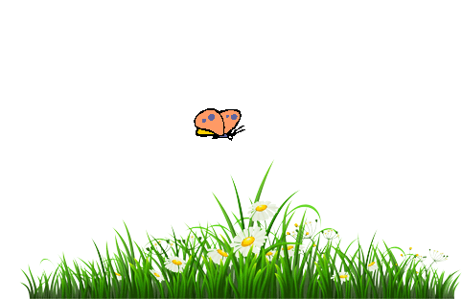
Welcome to English Class

Slide 2

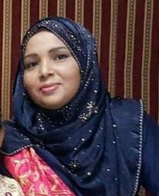


Identity
Achia Begum
Head teacher
Uttarsur K.C Govt. Primary school
Sreemangal,
Moulvibazar.
Class : Five
Subject : English

Slide 3
Learning Outcomes
Student’s will be able to-
Listening:1.3.1- to recognize which words in a sentence are stressed.
Speaking:1.1.1-to say words and phrases and sentences with proper sounds and stress.
Reading:1.5.1-to read words , phrases and sentences with proper pronunciation , stress and intonation.
Writing:5.1.3-to make sentences using words and phrases ,following instructions.

Slide 4

Let’s enjoy a song…..

Slide 5
Let’s see a picture….
Do you mind if I ask you some questions?
Who are in the picture?
They are Tamal ,Sima ,Nasrin and Biju.
What are they doing?
They are talking and writing .

Slide 6
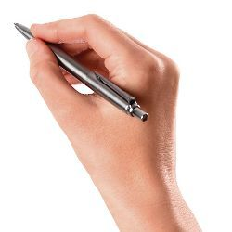
Can you guess what is our today’s topic?
Our today’s topic is -
Unit-Four, Lesson 1-2
Leisure time

Slide 7
New/difficult words
connected
join
যুক্ত থাকা
swimming
floatingg
ভাসমান
fit
healthy
স্বাস্হ্যবান
painting
drawing
চিত্রিত করা
especially
mainly
বিশেষভাবে

Slide 8
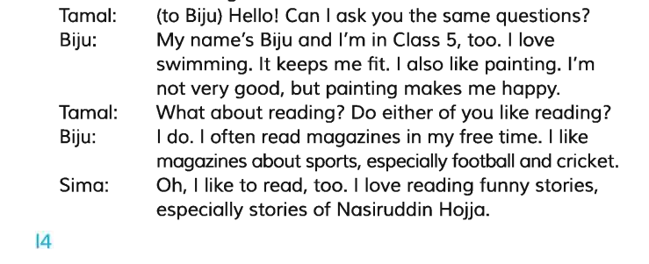
Open at page 14.
Now listen to me carefully.
Open your book and Put your finger under the line.

Slide 9
Individual work
1.What does Biju do in his leisure time?
Biju swims and paints in his free time.
2.What kind of magazines does Biju like?
Biju likes magazines about sports.
3.What keeps Biju fit?
Swimming keeps Biju fit.
4.Who was Nasiruddin Hojja?
Nasiruddin Hojja was famous for his funny stories.

Slide 10
Small group work
Four students will make group. Every group will read. Teacher will try to see the reading of each pair. Everyone has to make sure to read.

Slide 11
Pair work
5
1.Biju is in class………
Swimming
2. ………………..keeps Biju fit.
Painting
3. ……………. makes Biju happy.
sports
4.Biju likes to read magazine about …………
stories
5.Sima loves reading funny…………..

Slide 12
Role play
Every four students will perform the lesson together. They will play the role of Tamal, Sima, Nasrin, Biju.

Slide 13
Evaluation
Each student will say, How do they spend their leisure time?

Slide 14

What do you do in your free time? Write within five sentences.

Slide 15



