Slide 1
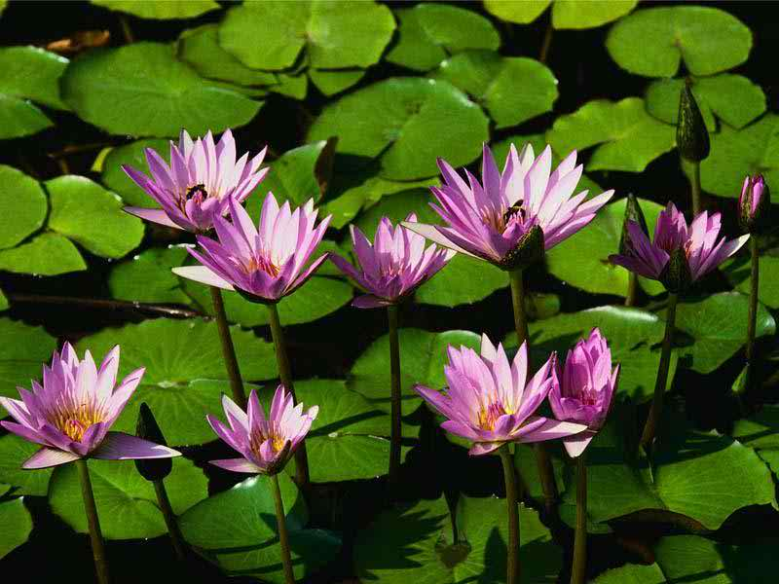
WELCOME
WELCOME

Slide 2
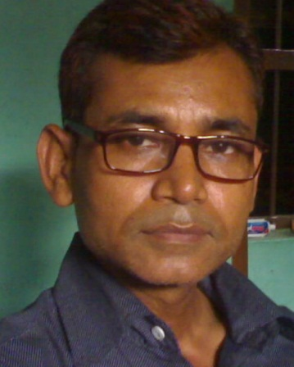
Teacher identity
Md . Lalmia
M.A (English)
HEADTEACHER (ACTING)
MATIDALI HIGH SCHOOL
BOGRA SADAR ,BOGRA.
C.ph:01716852454
lalmiya33@gmail.com

Slide 3
Lesson introduction
Class – Eight
Subject- English 2nd paper
Unit-2
Lesson-8
Time:45 Date:2/4/2014

Slide 4
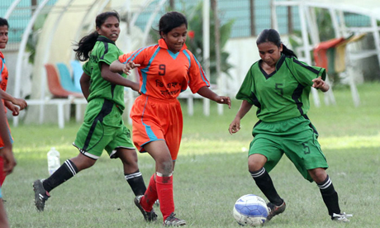
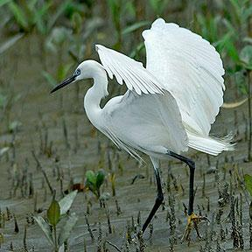
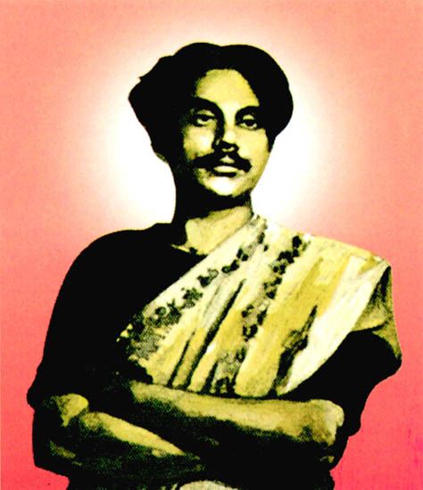
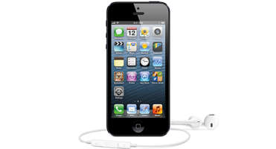
VERIFICATION OF PRIMARY KNOWLEDGE
Look into the following pictures and tell about them.
1.playing girls.
2.A bird about to fly
4. attractive, costly cell phone.
3. thinking and looking at.
..

Slide 5
Our today’s lesson
construction or formation of sentence

Slide 6
LEARNING OUTCOMES
By the end of the lesson the students will have learnt about -
1.Defination of the formation of simple sentence.
2.Making simple sentence.
3.Using in real life situation.

Slide 7
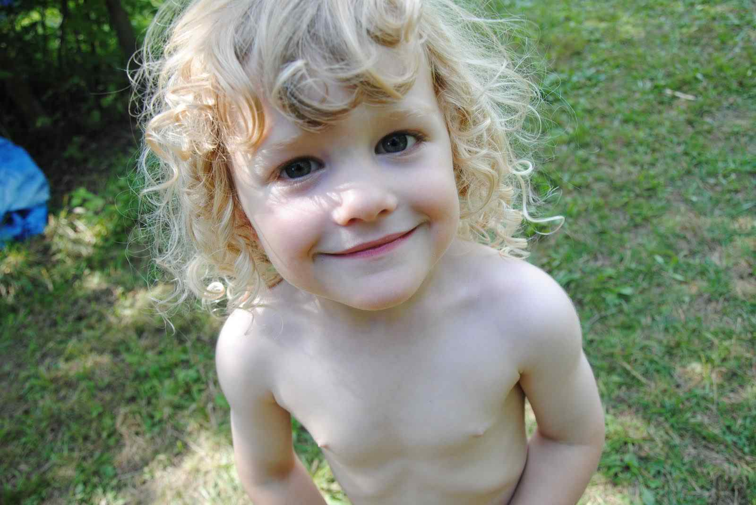
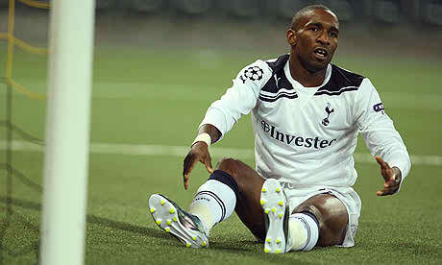
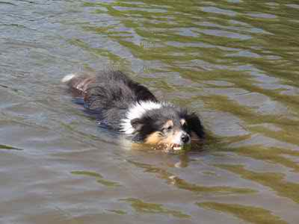
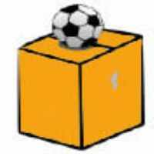
construction of simple sentence
1.Laughing baby
3.Doing exercise.
4.A ball on the box.
2.Dog in the pond.
A baby is laughing.
sub
f.verb
simple sentence=it has one sub and one f. verb

Slide 8
Individual work
1.What is called simple sentence?
Ans:
The sentence that has one sub and one f. verb is called ss.
2.What do you mean by finite verb?
Ans:
The verb that completes a sentence is called fv.
3.How many subjects has a simple sentence?
Ans:
It has one sub.
Well-done!

Slide 9

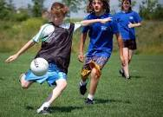


Pair work
A horse with a man jumping
Playing football
A running dog.
A girl in the rain.
Look into the above pictures and make 5 s s

Slide 10
Self - check
1.Does each sentence have a subject ? Box it.
2.Does each sentence have a finite verb? Underline the verb.
3.Does each sentence start with a capital letter?
4. Does each sentence end with punctuation?
Good job!

Slide 11
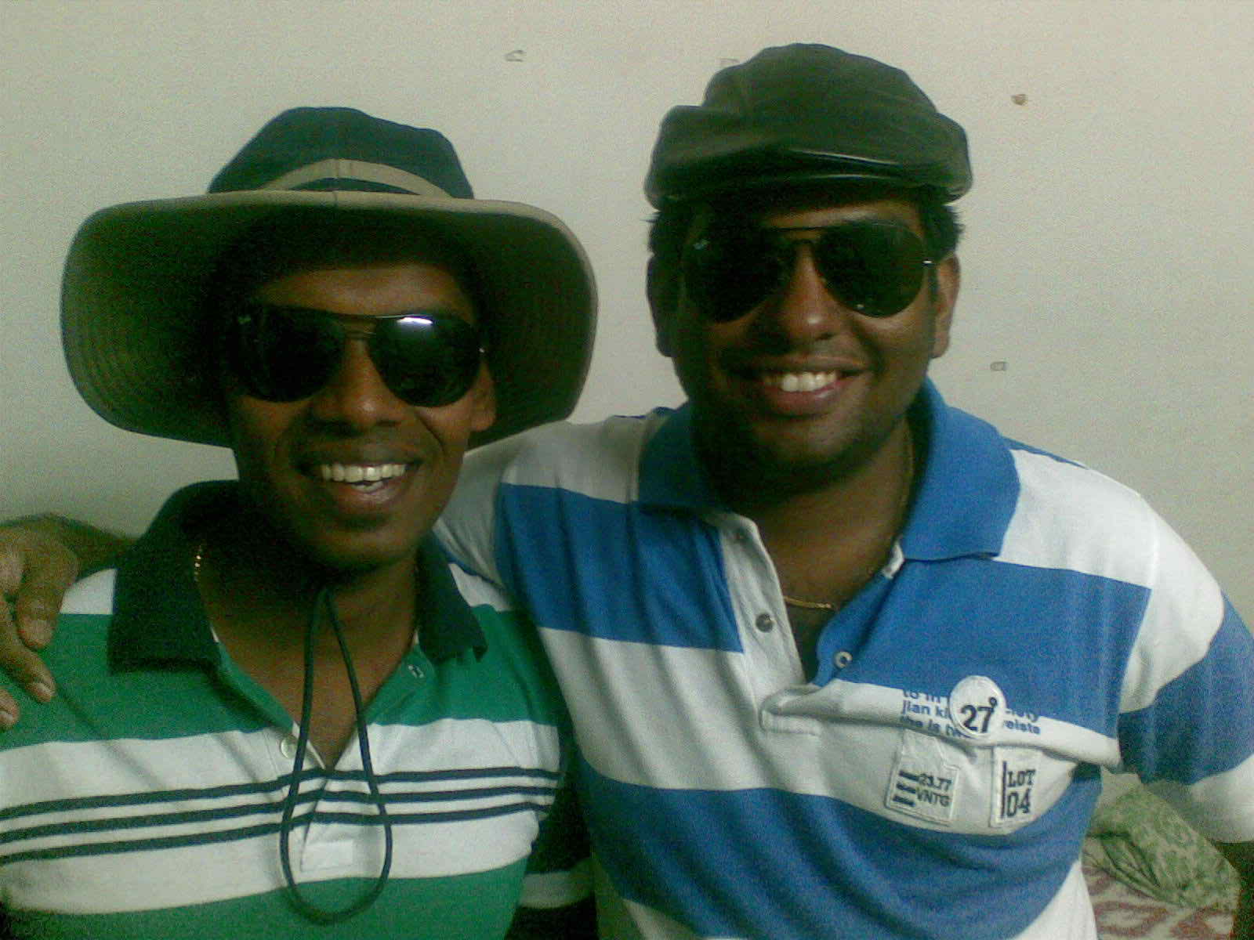

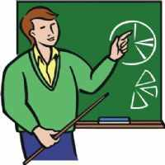
Group works
Two brothers
A computer on the desk.
A teacher
Use the above pictures and make 5 sentences that are essential in our real life situation.

Slide 12
solution
Hasan and karim are two brothers .they have a computer. The computer is on the desk. They are very happy. A teacher teaches them computer.
Well-done!

Slide 13
EVALUATION (Orally)
Find out simple sentence.
1.Sabina works in a factory.
2.The place where he works is a large building.
3.She learnt a good lesson .
4.Mina is a worker but she earns little.
5.Do or die.
6.Eating rice the boy went to school.
simple
simple
simple

Slide 14
Home work
Make 10 sentences using one subject and one finite verb.

Slide 15

THANK YOU

