Slide 3
Introducing
Masuma
Assistant Teacher
Kishor Mojlish Govt Primary School
Barishal Sador
Class-One
Subject- English
Lesson- 1-3
Unit-11
Commands B,C

Slide 4
Learning Outcomes

Slide 5
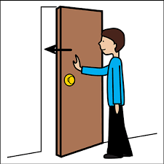
What do you see in the picture?

Slide 6
Todays lesson is Commands

Slide 7
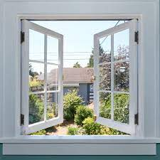
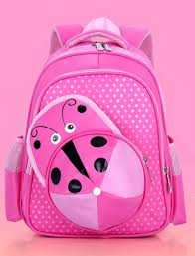
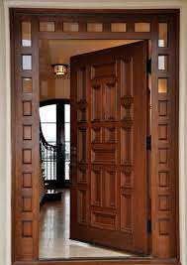
What do you see in the picture?
Window
bag
door

Slide 8
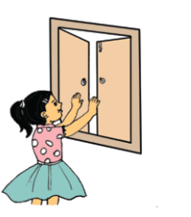
What do you see in the picture?
Open the window

Slide 9
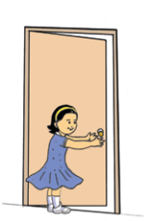
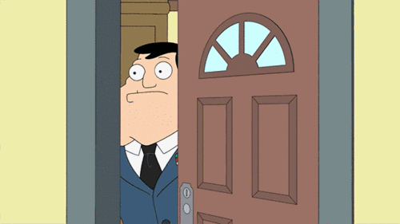
What do you see in the picture?
Close the door

Slide 10
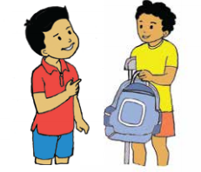
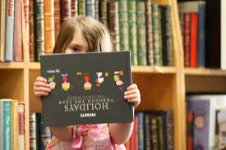
What do you see in the picture?
Show me your bag

Slide 11
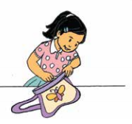
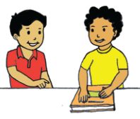
Say and match
Show me your book
Open your bag

Slide 12
New words.
Open - খোলা
Close – বন্ধ করা
Door– দরজা
Show- দেখানো.
Book-বই.
Window – জানালা

Slide 13
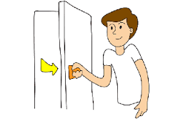
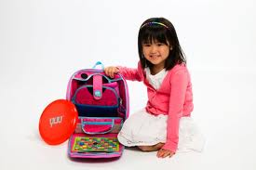
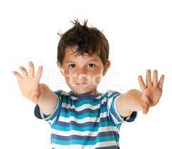
Evalution:
*Say the following commands by using the pictures.
Open the
window.
Close the
door.
Show me
your pencil.
Show me
your bag.
Show me
your hand

Slide 14
ধন্যবাদ

