Slide 1
Welcome

Slide 2
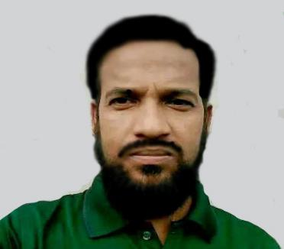
Teacher’s Introduction
Md Amir Hossain (M.A.B.Ed)
Head Teacher
Hossainpur Girls High School 79hossainamir@gmail.com
Phone: 01714-315772

Slide 3
English First paper
Class – Nine
Unit – 8
Lesson – Two
03/07/2021

Slide 4
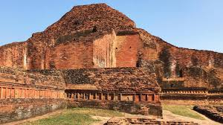
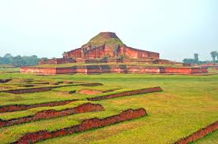
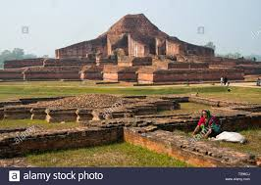
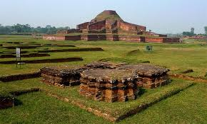
Look at the pictures and discuss

Slide 5
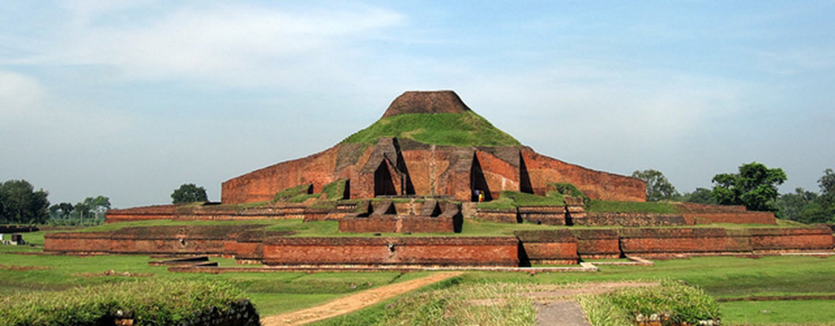
Have you ever visited this place?
Where is it situated?
What is it called?

Slide 6
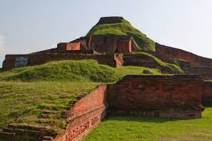
Today’s topics is
The Somapura Mahavihara

Slide 7
Click in video

Slide 8
Learning outcomes
After finishing the lesson ss will be able to----------
read and understand a text.
match words with their meaning.
choose the correct answer.
ask and answer questions.

Slide 9
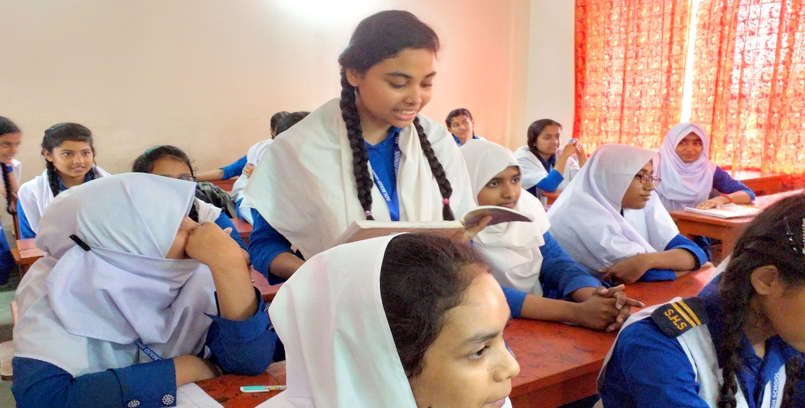
Silent Reading

Slide 10
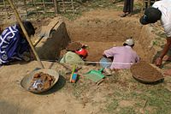
Vocabulary
Excavate (v):
Meaning:
to make hollow by removing the inner part Similar: dig, cut out
People excavate to bring out the things inside the earth.

Slide 11
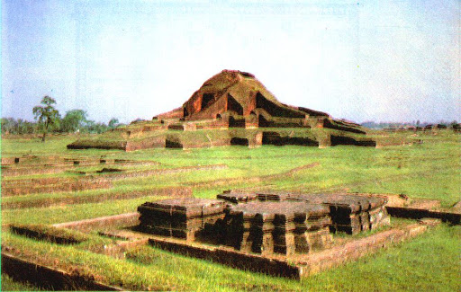
Emerge (v):
Meaning:
move out of or away from something and become visible.
Similar: come out, appear
This temple was emerged after the excavation in Paharpur.

Slide 12
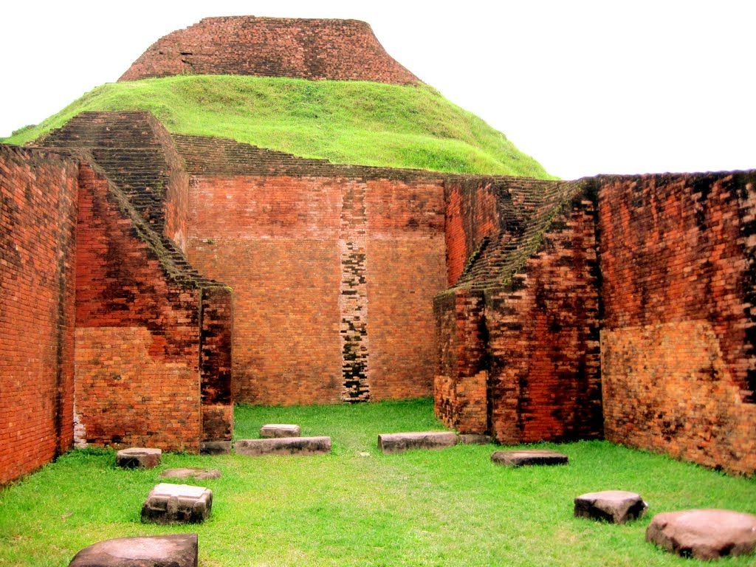
Extensive (adj):
Meaning:
large in amount or scale.
Similar : thorough, complete
An extensive excavation was needed to find out the temple.

Slide 13
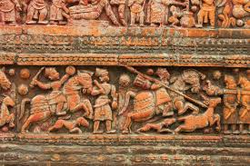
Archeology (adj):
Meaning:
the study of human history and prehistory through the excavation of sites and the analysis of artefacts and other physical remains.
I want to visit the renowned archeology of Bangladesh.

Slide 14
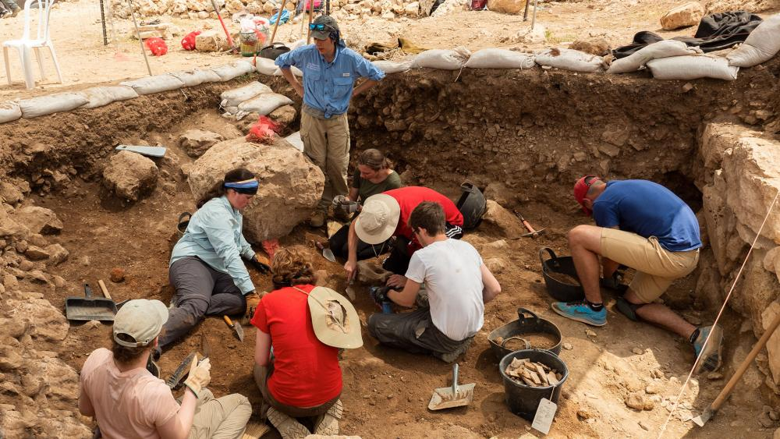
Expedition (n):
Meaning:
a journey undertaken by a group of people with a particular purpose, especially that of exploration, research, or war.
A group of archeologists made an expedition to reveal the monastery.

Slide 15
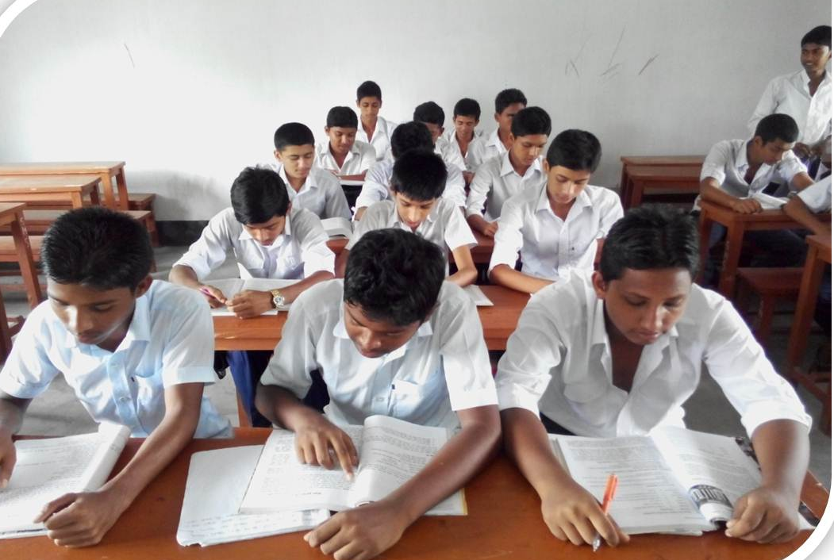
Individual Work
Word‘s & Meanings :Plain,Cover,Clear,Permit,Build.
Notes:
Teacher will monitor the class and can help them.

Slide 16
Pair Work
B. Match the words with their meanings.
Words | Meanings
Archeological Excavate Lofty Extensive Systematic Debris Debout | Rubbles/wreckage Widespread Ancient cultural remains Pious Uncover something with difficulty Grand Done methodically

Slide 17
C.Read the text in A again and choose the correct answer.
Paharpur is a ----
a) typical Bangladeshi village. c) a very small village.
b) an extraordinary village. d) a village on top of a mountain.

2. After excavating, the archaeologists discovered a huge----
a) king’s palace. b) emperor’s courtyard
c) Buddhist monastery. d) Hindu temlpe.

3. How many phases of excavation of Paharpur have been mentioned in the text?
a) four b) five c) six d) seven


Slide 18
4. What objects indicate that the site was built by the second Pala king?
a. earthen seals. b. ceramic seals.
c. stone seals. d. iron seals.

5. The word “benefactors” in the text means?
a) banks. b) famous businessmen.
c) people with money. d) financial supporters.


Slide 19
Group Work
D.Read the text again and work in pairs. Ask and answer the following question.
1.Why is the village named Paharpur?
2.Where is it located?
3.What is it famous for?
4.What did Cunningham find when he was digging the Paharpur site?
5.Why was the site officially stated to be preserved?

Slide 20
Answers to the questions -----------
1.The village was named Paharpur as there was a hill covered with jungle. And in Bangla ‘hill’ means ‘Pahar’. In reference to this word, the village is called so.
2. It is located in Naogaon district of Northern Bangladesh.
3. It is famous for its ancient history of the Pala rulers.
4. While digging the Paharpur site Cunningham found a vast Buddhist monastery.
5. The site was declared to be officially protected because of its ancient history of Bengal and Southern Asia.

Slide 21
Evaluation
Paharpur is an ---- site
2. Paharpur is in ----Bangladesh
3.The word” excavate”means ----.
4. What is Paharpur ?
5.The word “benefactors” in the text means?

Slide 22
Homework
Do you have any old relics in your village/town/city? Write about it with the help of the following questions:
When was it established? Who built it? How does it look like? How big is it? What was it for? What was its present condition?Why do you like it?

Slide 23
Thanks

