Slide 1


Welcome

Slide 2




Conducted by-
Md. Monirul Islam.Assistant Teacher.
email- monir19077@gmail.com. 0176171482.
Subject :
English 2nd paper.
Class – Ten
Time- 45 mins
Azimnagor Computer Technical School & Commercial College .

Slide 3
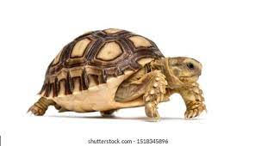
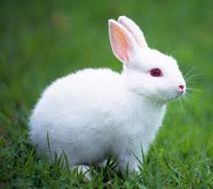
Look at the pictures.
What do you see in the pictures ?

Slide 4

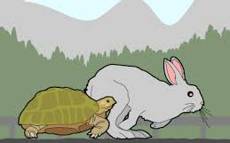

So , Today we will read about.
The Hare and the Tortoise .

Slide 5
Learning outcomes .
At the end of the lesson, students will be able to –
define about story;
write a story about The Hare and the Tortoise;
ask and answer question .

Slide 6
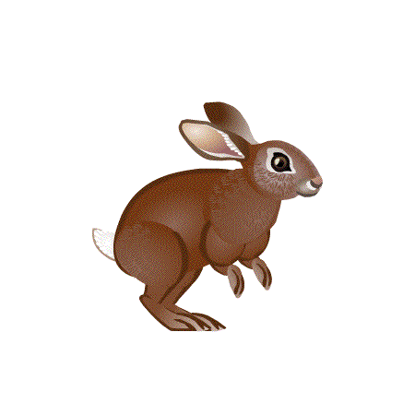
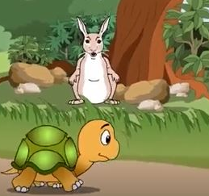
A hare was very proud of her speed.
She said to the tortoise, “I am pity for your speed”.

Slide 7
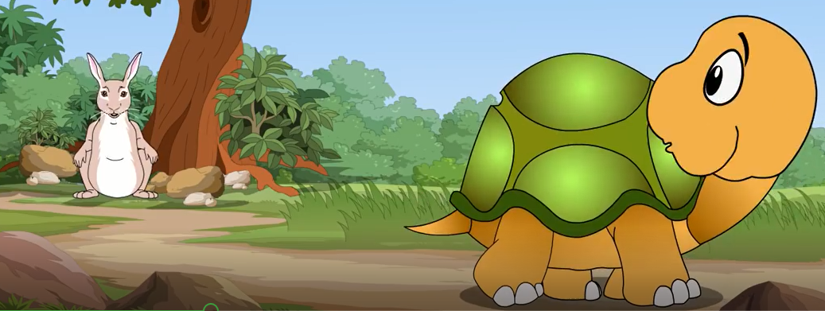
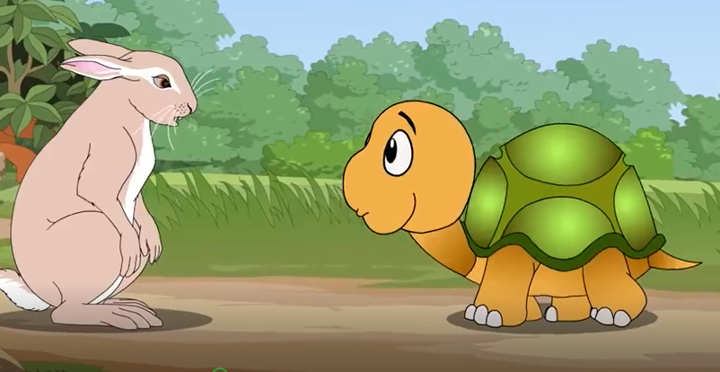
You need not worry friend hare, “said the tortoise”.
If you like I can run a race with you. “said the tortoise”.

Slide 8
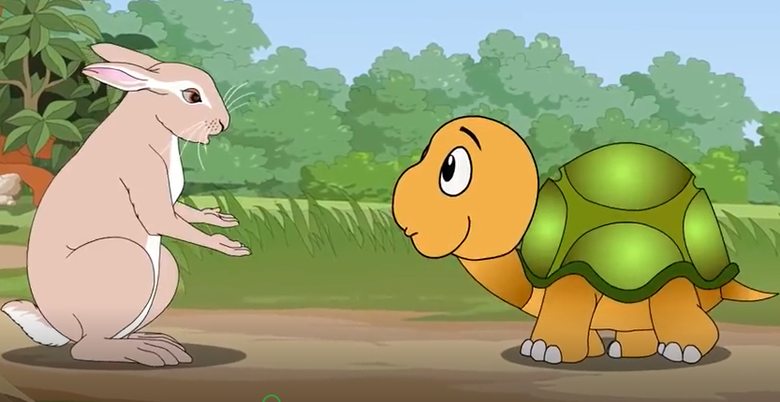
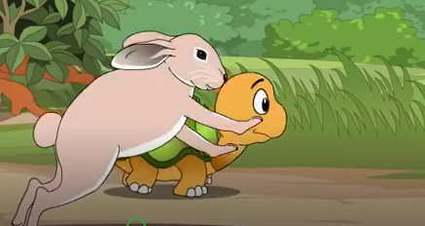
Very well, I accept your challenge, “said the hare”.
At once both of them started to run.

Slide 9
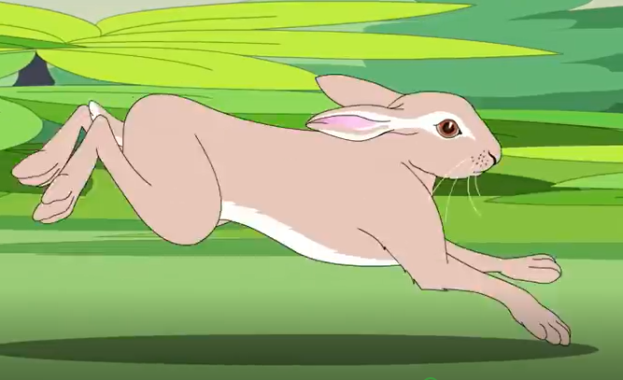
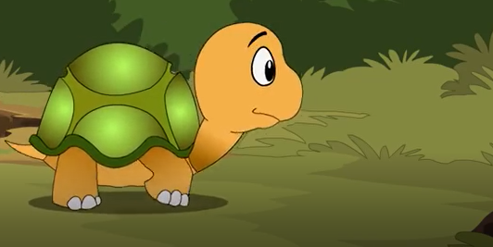
In a moment the hare got ahead of the tortoise.
The tortoise is moving very slowly with his heavy shell on his back.

Slide 10
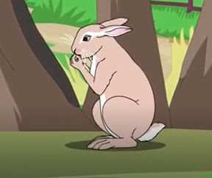
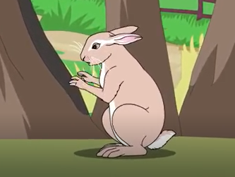
The hare stopped half way and looked back.
“Ha! Ha!” laughed the hare, “You are creeping on far behind.

Slide 11
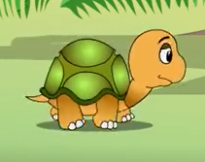
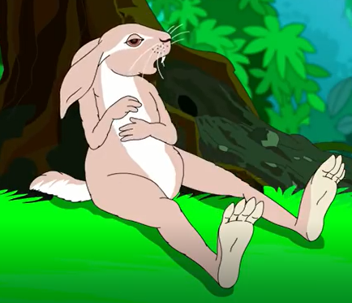
The tortoise toiled and toiled..
The hare said to herself, “ I may easily take a short nap and then overtake him.

Slide 12
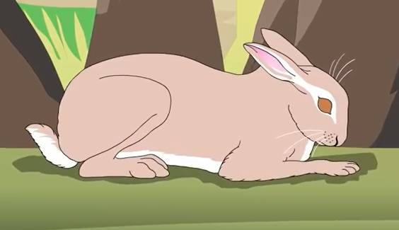
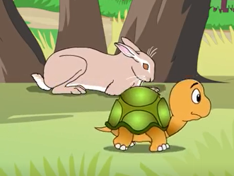
The hare lay down on the grass and fell fast asleep.
The tortoise continued unabated and passed the hare.

Slide 13
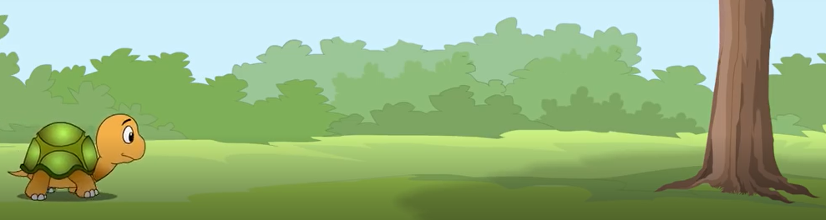

When the hare woke up the tortoise almost reached its destination.
The hare sprang up and began to run like the wind.

Slide 14
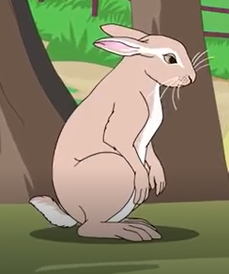
Finishh
When the hare woke up the tortoise almost reached its destination.
The hare sprang up and began to run like the wind.

Slide 15
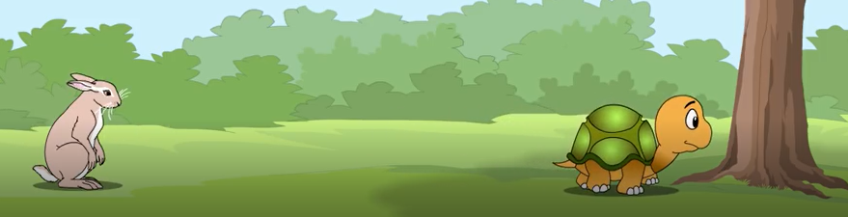
But the tortoise won the competition before the hare approached the tree.
Finish

Slide 16
Let’s enjoy a video.

Slide 17


Evaluation
1. Why the hare lost the competition ?
2. What made the hare proud ?
3. What is the moral of the story ?

Slide 18
Home work.
The following sentences are the beginning of an incomplete story. Read them carefully and complete the story in your own way and give a suitable title..
A hare was very proud of her speed. One day she said to a tortoise “I pity for your speed”. ‘ How can you walk with such a heavy shell on your back “? “ You need not worry friend hare”, said the tortoise. “ If you like I can run a race with you”. The hare sneered. “What”! Do you want to run a race ? Very well I am ready. At once both of them started to run. In a moment the hare got ahead of the tortoise…………………………………………. ……. …..

Slide 19


Thank you.

