Slide 1
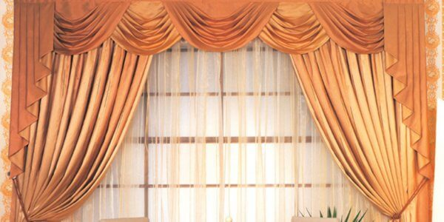

Slide 2
Welcome to all

Slide 3
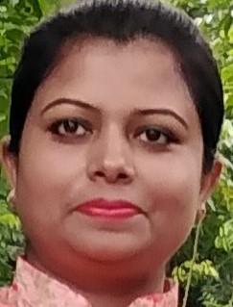
Teacher’s Identity
Nahida Akhter
Assistant Teacher
Kalikaccha North Govt. Primary School
Sarail , Brahmanbaria
Email : nahidaakhter99@gmail.com

Slide 4
Lesson
Class:Three
Unit :8
Lessons :1-2
Lessons Tittle:Numbers
Today’s Lesson:A

Slide 5
LEARNING OUTCOMES
Listening
1.1.2 say words ,phrases and sentences with proper sound and stress.
Reading
1.1.1 recognize and read cardinal numbers up to 100.
Writing
4.1.2 Write cardinal numbers up to 100 in figures .

Slide 6
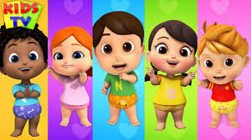
Dear Superlearners , lets watch a video.
https://www.youtube.com/watch?v=voCrQ1ebEdU

Slide 7
Today’s lessons
Numbers
Unit: 8
Page:16

Slide 8
Dear superlearners what’s this?

Slide 9
How many pencils are here?
15

Slide 10
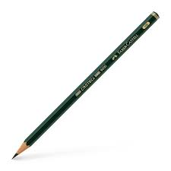
How many pencils are here?
13

Slide 11
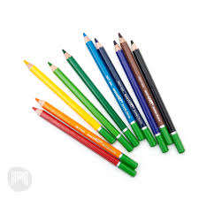
How many pencils are here?
11

Slide 12
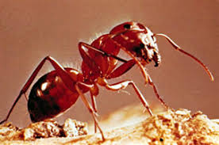
Dear frends whats this ?

Slide 13
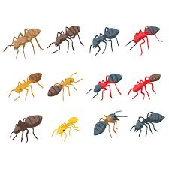
How many ants are here?
20

Slide 14
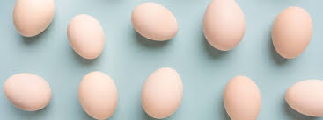
How many eggs are here?
14

Slide 15
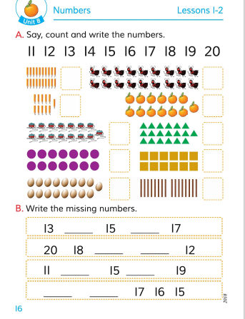
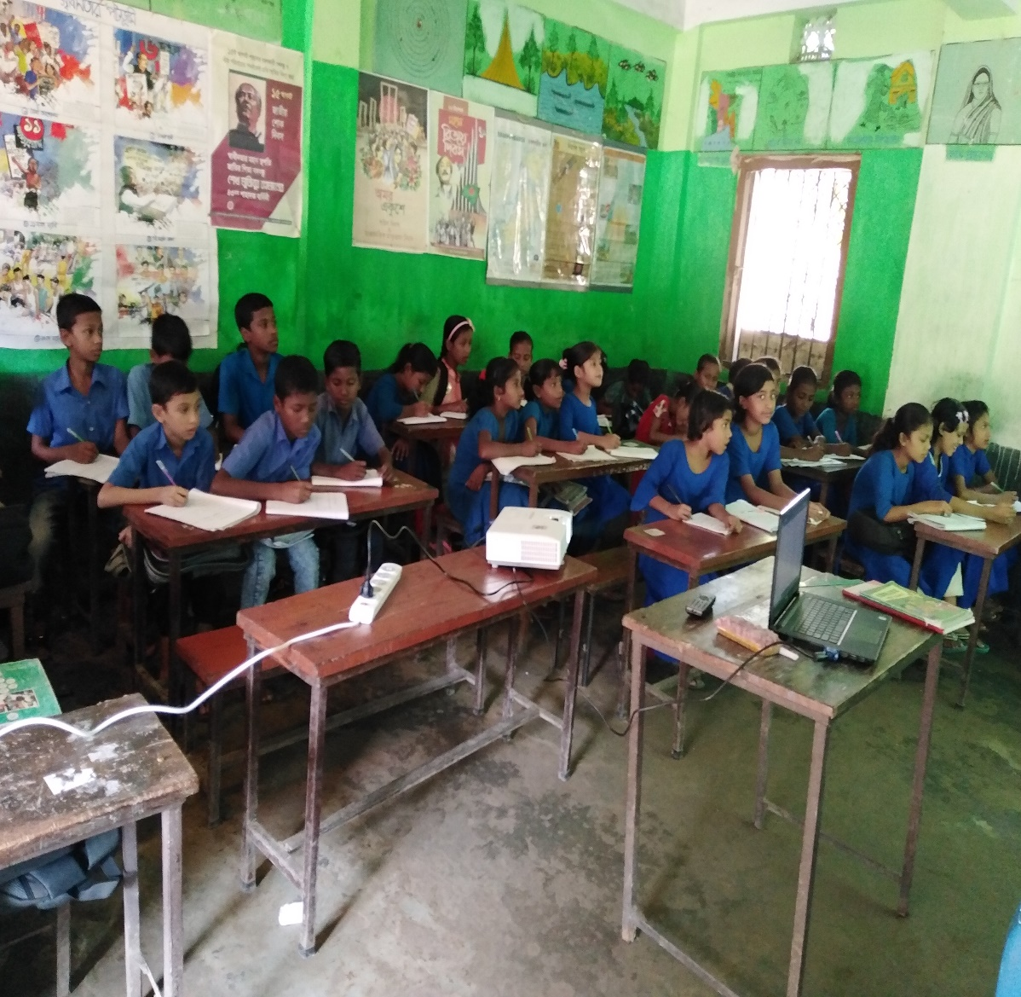
Student reading
Open the book ,page no-16

Slide 17
Say, count and write
15
17

Slide 18
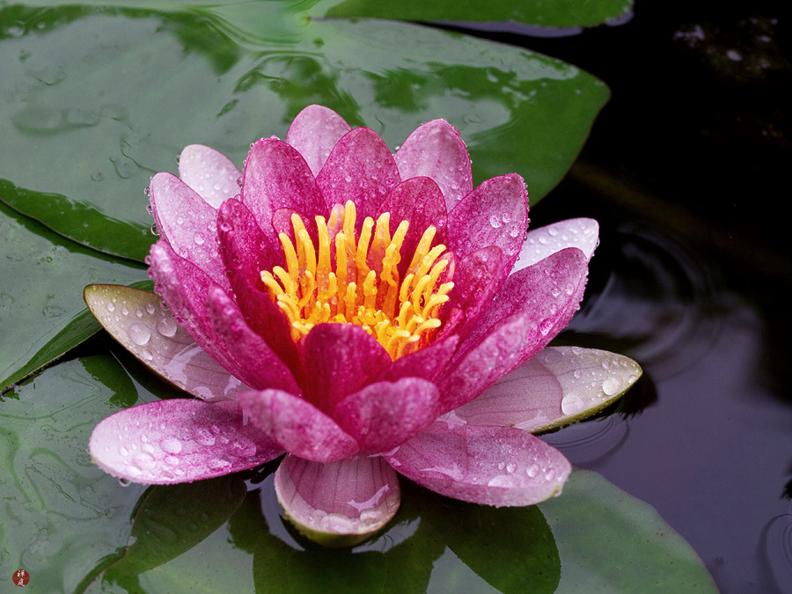
Match the numbers with their objects.
12
11
17

Slide 19
Homework
Suppose you are Ruhi/ Rehan, Now write cardinal numbers 1 to 20 .

Slide 20
Good bye

