Slide 1
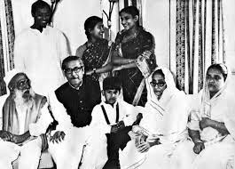
Welcome

Slide 2
Identity
Mst. Arifa Khatun
Assistant Teacher ( English)
Chand Sultana Secondary Girls’ School, Kushtia Sadar, Kushtia
Mobile: 01963601076
Email: arifakch87@gmail.com
Class:9-10
Unit: One
Lesson: One

Slide 3
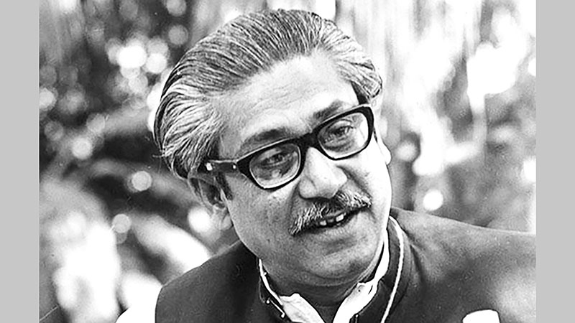
Who can you see in the picture?

Slide 4
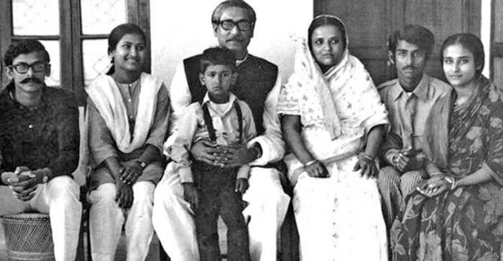
Our Today’s Lesson is----
Bangabandhu’s Family in 1971

Slide 5
Learning outcomes----
Ask and answer the questions,
Write True/False and
Write a short paragraph.

Slide 6
Lesson 1:Bangabandhu’s Family in 1971
A.
Look at the pictures below and discuss the following questions in pair.
Who can you see in the pictures?
What do you know about them?
Where were those people during the Liberation War?
Picture 1
Picture 2

Slide 7
Probable answer to the question no -1,2 and 3.
I can see in the both pictures the family of Bangabandhu. In picture 1, I can see Bangabandhu is sitting with his children, wife and parents, and in picture 2, Bangabandhu and his family members are taking photograph.
I know about them that Bangabandhu is not only a famous leader in our country but also all over the world and his family members made an important role to reach him that position.
During the Liberation War those people were moving one place to another in search of a safer place and they suffer a lot.

Slide 8
B. List the five ways how the Pakistan Army tortured Bangabandhu’s family.
Probable Answer-
The Pakistani Army arrested Bangabandhu.
They set fire in Bangabandhu’s Tungipara home.
They threatened other family members of Bangabandhu.
They also kept under house arrest of the family of Bangabandhu.
They did not allow Begum Mujib to stay her daughter Sheikh Hasina, when she was admitted to hospital.

Slide 9
C. Divide into pairs and tell the sufferings of Bangabandhu’s family during Liberation War in your own words (Do not look at book).
Probable Answer-
The sufferings of Bangabandhu ‘s family during Liberation War was very pathetic. They lead a very risky life during those days. The Pakistani Army arrested Bangabandhu. They threatened the family members of Bangabandhu. They kept under house arrest of Bangabnadhu’s family. They made Bangabnadhu’s family homeless and they did many things till the victory of the Liberation War.

Slide 10
D. Answer the following questions. First discuss in groups of four, then write the answers individually.
Why was the family anxious on the 25 March night in 1971?
Where did Bangabandhu send the girls on that night?
How would the family communicate with people or freedom fighters while they were under house arrest?
How did the Pakistan Army scare Sheikh Jamal? How did Sheikh Jamal manage to flee from captivity?
How do you explain Bangabandhu’s family’s contribution to Liberation War?

Slide 11
Probable Answer---
The family was very anxious on the 25 March night in 1971 because they understood that something tragic was going to happen. The Pakistani Army had been killing people indiscriminately.
2. Bangabandhu sent the girls on that night, a safer place which was situated Dhanmondi, a house at Road no. 15.
3. People or freedom fighters would communicate with the family in disguise of vendors and sometimes they would throw a written waste paper with an important information to the house while they were under house arrest.

Slide 12
4. The Pakistani Army used to scare Sheikh Jamal that they would hang him upside down. So, he found a chance ,fled and joined the freedom fighters.
5. I can not describe Bangabandhu’s family’s contribution to the Liberation War in a word. During the Liberation War, Bangabandhu’s family suffers a lot. They made a great role to the Liberation War to liberate our country. Bangabanghu’s sons joined the Liberation War to make our country free.

Slide 13
E. Discuss if the sentences are True/False. Give correct information if a statement is false.
Begum Mujib went to a safer place at Dhanmondi at night on 25 March, 1971.
Bangabandhu had declared the independence of Bangladesh before he was arrested by Pakistan Army.
Nobody stood beside the family of Bangbandhu during Liberation War.
Bangabandhu’s parents became very sick soon after the Pakistan Army had set fire to their home at Tungipara.
After Liberation War was over, Sheikh Kamal and Sheikh Jamal both returned home on the same day.

Slide 14
Answer--
False
Correct Information : Begum Mujib did not go to a safer place, instead of staying with her husband Bangabandhu at the night on 25 March, 1971.
2. True.
3. False
Correct Information: Some close people stood beside the family of Bangabandhu during Liberation War.
4. True.
5. False
Correct Information : After Liberation War was over, Sheikh Jamal returned home in the afternoon while Sheikh Kamal returned home the next day.

Slide 15
Find out the sentences which include the word ‘however’ in the text. Write down these sentences along with their previous sentences on your exercise book. Try to observe for which purpose they are used. ‘However’ is used to show contrast and contradictions and it is accompanied by a comma. Look at the following example from the text.
Example: The sofa is very eye-catching. However, it does not go with the simple look of the room.
Write five more pairs of sentences using ‘however’.

Slide 16
Answer----
The house is very nice. However, the owner of this house is very ugly.
This laptop is very good. However, it works very slowly.
He is good at English. However, he can not speak English fluently.
The Liberation War was over. However, Bangabandhu’s family was very worried about Bangabnadhu’s return to home.
He is honest. However, he is very poor.

Slide 17
G. Group work: Discuss the sufferings of people during Liberation War. Write a short paragraph on ‘ the sufferings of people during ‘Liberation War’ in group.
Answer---
The sufferings of people during Liberation War
The sufferings of people during Liberation War is out of description. Bangladesh got independent in 1971 through much struggle and sacrifices. The Pakistani Army made a dangerous operation searchlight over the people of Bangladesh on the darkest night on 25 March1971.They started killing our innocent people indiscriminately .

Slide 18
They arrested our great leader Bangabnadhu before that he declared that our country is independent. About three million people were killed on this nine months supreme war. Many lost their sister, parents, husband, brother, wife, children, relatives and neighbours. Before two days, their certain defeat , they brutally killing our intellectual people who were the torch bearer of our country. But, at last we got our victory through this long struggle.

Slide 19
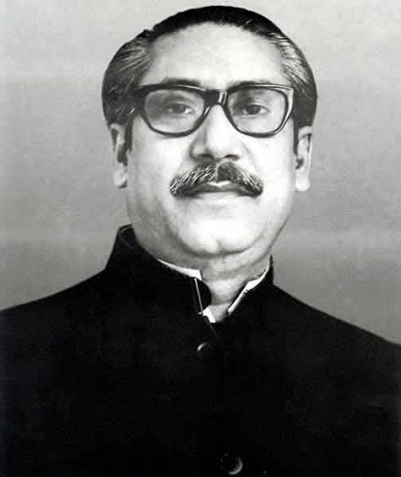
Thanks!

