Slide 1
Good Morning

Slide 2


Lesson Identity
Class:two
Subject: English
Lesson:4-6
Unit:Four ( A )
Md. Inam Ulla Khan
Assistant Teacher
Sharergoj Govt.Primary school.
Sreemangal, Moulvibazar

Slide 3
Creat Emotion
Let,s see the video
Discuse about the video

Slide 4


Today’s Lesson
Alphabet
(Pp-Tt)

Slide 5






Learning Outcomes
By the end of the lesson the students will be able to----------------
1 .Become familiar with English sounds by listening to common English words.
2 .Repeat after the teacher simple words and phrases with proper sounds and stress.
3.Recognize and read the alphabet both small and capital ( non –cursive)

Slide 6
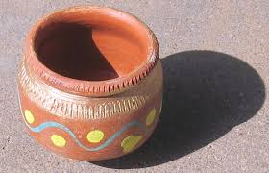
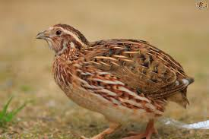


Now look at the picture.Say loudly
What is this?
What is this?
pot
quail

Slide 7

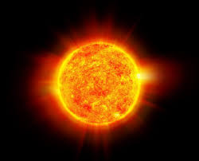
Now look at the picture.Say loudly
What is this?
What is this?
rose
sun

Slide 8
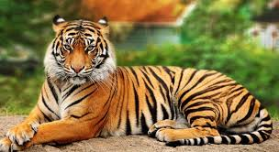
Now look at the picture.Say loudly
What is this?
tiger

Slide 9


Dear students,open at page 9 of your book and look activity A.

Slide 10
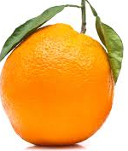

Loud reading by the teacher
P
s
pot
sun
Q
quail
T
tiger
R
rose

Slide 11
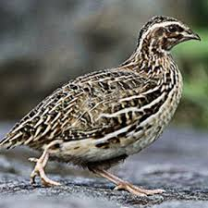
I W
Look at the picture and fill in the gaps.
quail
tiger
sun
pot
rose

Slide 12


wcw
What can you see?
pot
What is the letter name?
Pp
Capital letter
Small letter

Slide 13
wcw
What can you see?
Quail
What is the letter name?
Qq
Capital letter
Small letter

Slide 14
wcw
What can you see?
Rose
What is the letter name?
Rr
Capital letter
Small letter

Slide 15
wcw
What can you see?
Sun
What is the letter name?
Ss
Capital letter
Small letter

Slide 16
wcw
What can you see?
Tiger
What is the letter name?
Tt
Capital letter
Small letter

Slide 17

Match the words with the letter
Pair Work
Pp
quail
Qq
sun
Rr
pot
Ss
tiger
Tt
rose

Slide 18
Evaluation
What is this?
What is this?
What is this?

Slide 19


Evaluation
Fill in the blanks by small letter.
,Q
P
,R
,S
,T

Slide 20
Good bye students.

