Slide 1
Welcome

Slide 2
IDENTITY
Teacher
Lesson
Abdul Aziz
B.A(Hon’s), M.A(English)
Madhaia Bazar Sadim
High School,
Chandina, Cumilla
E-mail: azizabidpur@gmail.com
Mobile : 01921767310
Phrase & its classifications
Class : Nine –Ten

Slide 3
Look at the sentence
Reading books
is a good habit
How many parts of this sentence?
two parts
What are they called ?
They are called subject and predicate

Slide 4
Our today’s topic is
Phrases & its classifications

Slide 5
Learning Outcome
After the end of the lesson, Stduents will be able to
Define Phrase
Differentiate between phrases and clause
Talk about classification of clause.

Slide 6
Phrase and clause are the most important elements of English grammar. Phrase and clause cover everything a sentence has. Clauses are the center of sentences and phrases strengthen the sentences to become meaningful. If the clauses are the pillars of a building, the phrases are the bricks. A phrase usually is always present within a clause, but a phrase cannot have a clause in it.

Slide 7
A phrase is a small group of words that form a meaningful unit within a clause.
The basic difference between a clause and a phrase is that a clause must have a finite verb and a phrase must not.

Slide 8
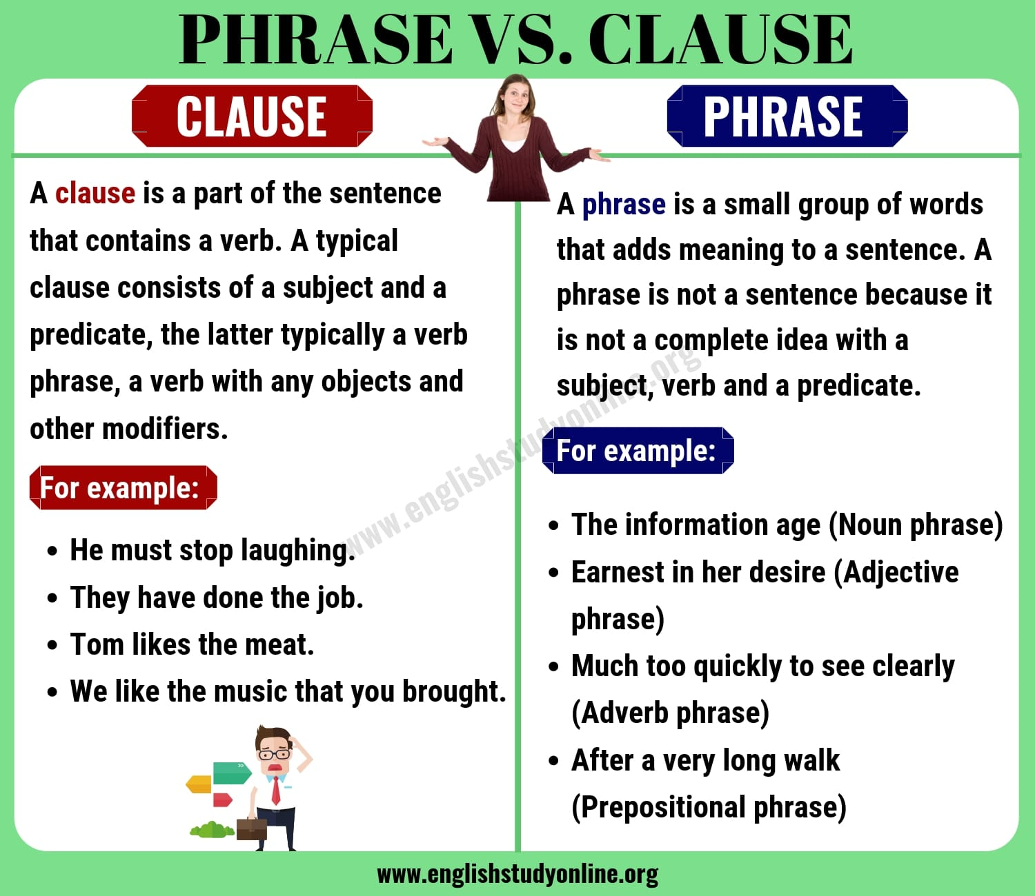

Slide 9
Types of Phrases
The phrases are generally of six types.
1. Noun Phrase
2. Adjective Phrase
3. Adverbial Phrase
4. Prepositional Phrase
5. Conjunctional Phrase
6. Interjectional Phrase

Slide 10
Noun Clause
A noun phrase is usually assembled centering a single noun and works as a subject, an object or a complement in the sentence.
Example:
I like to swing the bat hard when I am at the crease. (An object)
Reading novels is a good habit. (A subject)
The probability of happening that match is not much. (A subject)
We are sorry for her departure.

Slide 11
An adjective phrase is comprised of an adjective and works as a single adjective in the sentence.
Example:
Alex is a well-behaved man.
He is a man of friendly nature.
Julie is a woman of gorgeous style.
She leads a very interesting life.
A lot of people do not sleep at night.

Slide 12
Adverbial Phrase
An adverbial phrase modifies the verb or the adjective and works as an adverb in the sentence.
Example:
The horse runs at a good speed.
I was in a hurry then.
I ran as fast as possible.
He works very slowly.

Slide 13
Prepositional Phrase
A prepositional phrase always begins with a preposition and connects nouns.
Example:
He sacrificed his life for the sake of his country.
In the end, we all have to die.
He is on the way.
By working aimlessly, you will not get success.
In spite of working hard, he was insulted by his boss.
Note: Prepositional phrases include all other types of phrases.

Slide 14
Conjunctional Phrase
A conjunctional phrase works as a conjunction in the sentence.
Example:
As soon as you got in, he went out.
We have to work hard so that we can win the next match.
I will attend the ceremony provided that you come.
John started working early in order that he could finish early.

Slide 15
Interjectional Phrase
Interjections that have more than one words are called the interjectional phrases.
Example:
What a pity! He is dead.
What a pleasure! I won the first prize.
Oh please! Don’t say that again.

Slide 16
Thanks for watching

