Slide 1
I hope we are all fine by the grace of God.
Welcome

Slide 2
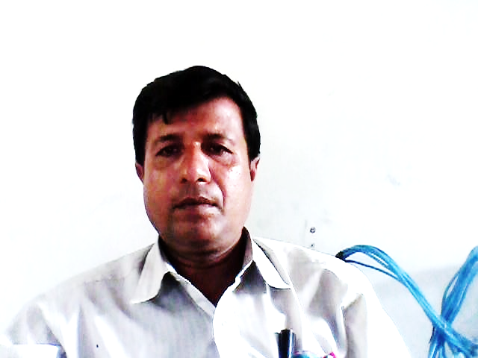
INTRODUCTION
Debnarayan Roy
Assistant Teacher ( ICT)
Kagmari Secondary School
Kotchandpur, Jhenaidah.
E-Mail- debnarayan1975@gmail.com
Mobile NO-01752-049147
ENGLISH FOR TODAY
Class-Six
Lesson-Eight
Section-A
Time- 50 Minute

Slide 3
See The pictures
And Think ..

Slide 4
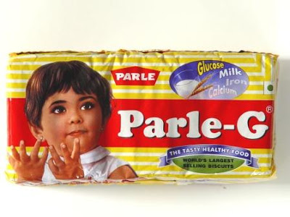
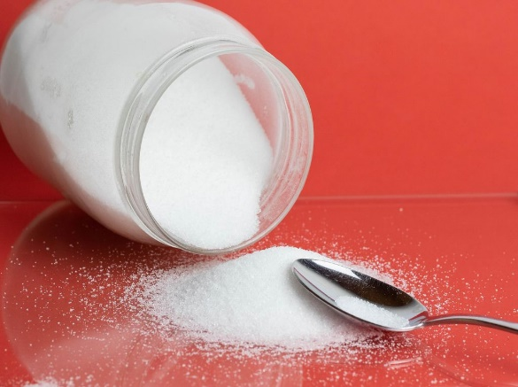
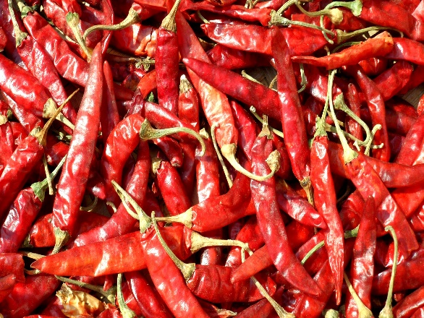
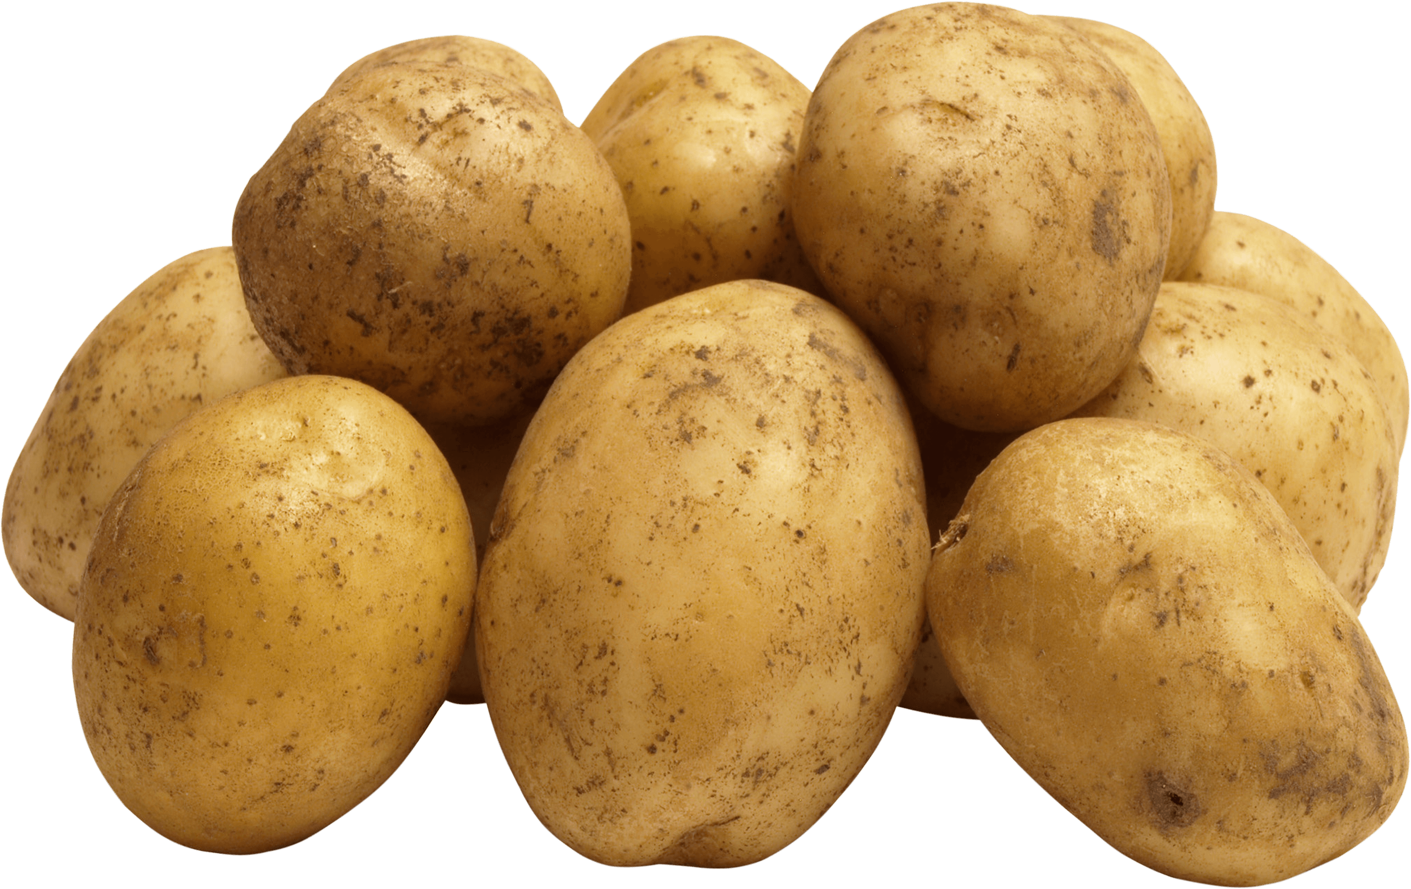
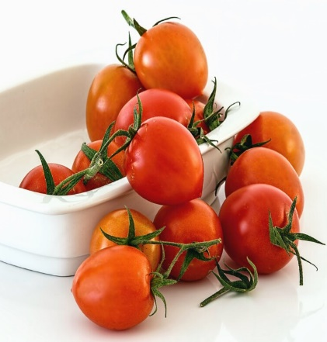
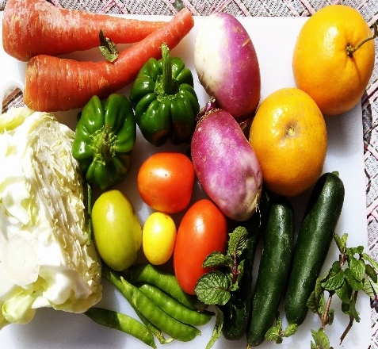
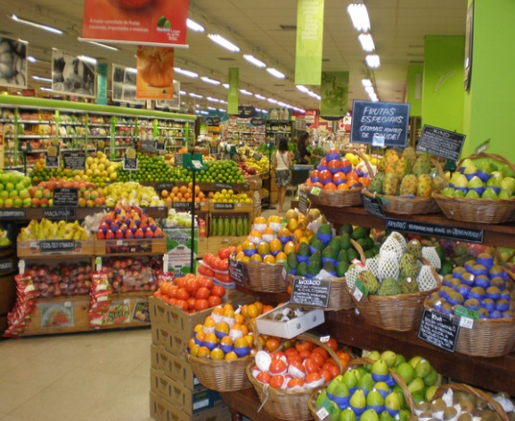
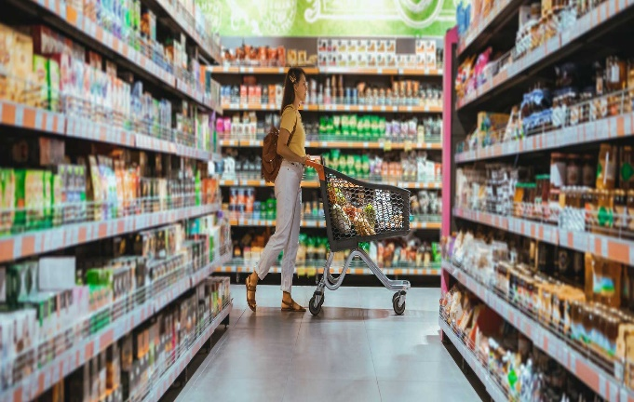
Take a idea and try to say your today`s Lesson
BISCUIT
SUGER
DRY CHILI
OIL
POTATO
TOMATO
VEGETABLES
VEGETABLES SHOP
GROCER SHOP

Slide 5
Today`s lesson is
“Grocery Shopping”

Slide 6
LEARNING OUTCOMES
After this lesson the students will be able to ………………
1. Read and understand text.
2. Ask and answer.
3. Can read and translate into bangla.
4. Write short comprehension.

Slide 7
Read the passage below and do not sound :
Imran: Mom, what do I need to buy?
Mom: Well, see if we have enough potatoes?
Imran: We have some potatoes but i don`t think it`s enough.
Mom: Then get half kg of potatoes . How about tomatoes?
Imran: I don`t see any tomatoes.
Mom: Are there any other vegetables?
Imran: Yes, there are some beans, carrots,cucumber and eggplants. That`s all.
Mom: Well. I`ll need one kg of tomatoes. Half kg of beans and two cauliflowers…. Are there any eggs ,dear?
Imran: There are only three eggs. Maybe I`ll buy a dozen more?

Slide 8
Mom: Humm….oh, yes ….get some suger , and milk and one litre of oil too.
Imran: OK. one litre of milk and one kg of suger.
Mom: One more thing, dear. You are forgetting your list! Here it is.
Imran: Oh! Thanks, Mom.

Slide 9
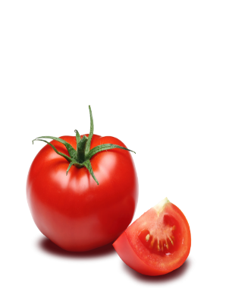
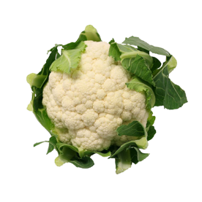
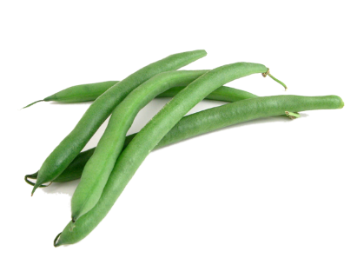
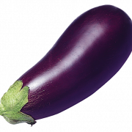
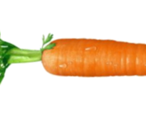
মুখে মুখে বল
ছবি | ইংরাজিতে নাম | বাংলায় অর্থ
Tomato
টমেটো
Cauliflower
ফুলকপি
Bean
সিম
Eggplant
বেগুন
Milk
দুধ
Carrot
মুলা বা গাজর

Slide 10
Discuss in pair and write down in your notebook.
SL | A COLOUM | SL | B COLOUM
1 | A can of | a | Poster paper
2 | A loaf of | b | Bread
3 | A packet of | c | Paint
4 | A tube of | d | Facial tissue
5 | Half a kilo of | e | Cake
6 | A dozen | f | Honey
7 | A box of | g | Eggs
8 | A roll of | h | Chocolates
9 | A …………… | i | Toothpaste
10 | A jar of | j | Note book
11 | A sheet of | k | pencils
 |  | l | Coke
ANSWER
(1+a) A can of coke
(2+b) A loaf of bread
(3+d) A packet of facial tissue
(4+i) A tube of toothpaste
(5+f) Half a kilo of honey
(6+g) A dozen of eggs
(7+h) A box of chocolates
(8+a) A roll of poster paper
(9+j) A note book
(10+c) A jar of paint
(11+c) A sheet of poster paper

Slide 11
Read the dialogue below:

Slide 12
Salesman: Hello, how can I help you?
Imran: Do you have any beans?
Salesman: Yes, we do. How much would you like?
Imran: I would like half kg. And I`ll also need one kg of tomatoes, two kg of potatoes, two cauliflowers, a dozen of eggs and some salt.
Salesman: Do you need oil, sir?
Imran: Yes, I need a litre of oil.
Salesman: Do you need anything else?
Imran: Umm….. Let me check . Oh, yes, could I have some suger and milk.
Salesman: Sure! We do not use plastic bag here. Here you go! I`ve put all the items here.
Imran: Thank you. How nuch is the total?
Salesman: The total comes on Taka Five hundred and thirty five .
Imran: Here is five hundred and fifty.
Salesman: Thank you. Here is the change fifteen taka. Have a good day.
Imran: Thanks,Bye.

Slide 13
Now write answers on your answer script:
1. Does Imran need oil?
2. How much is the total ammount?
3. How many items did Imran buy?

Slide 14
সঠিকভাবে উচ্চারণ করে পড়ঃ
Mom: Humm….oh, yes ….get some suger , and milk and one litre of oil too.
Imran: OK. one litre of milk and one kg of suger.
Mom: One more thing, dear. You are forgetting your list! Here it is.
Imran: Oh! Thanks, Mom.

Slide 15
Home Task
Write a paragraph about
“Grocer Shop”.

Slide 16
THANKYOU

