Slide 1
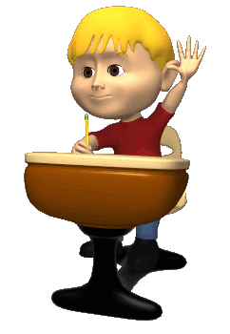
You’re Welcome

Slide 2
Presented by
Md Sultan Mahmud
Assistant Teacher
Tepirchar Government Primary School
Munshiganj Sadar, Munshiganj.

Slide 3
Subject Identity
Class:- Four
Unit :-22
Title:- Tune up !
Lesson: 1-2.
Activity:- A
Page:- 44

Slide 4
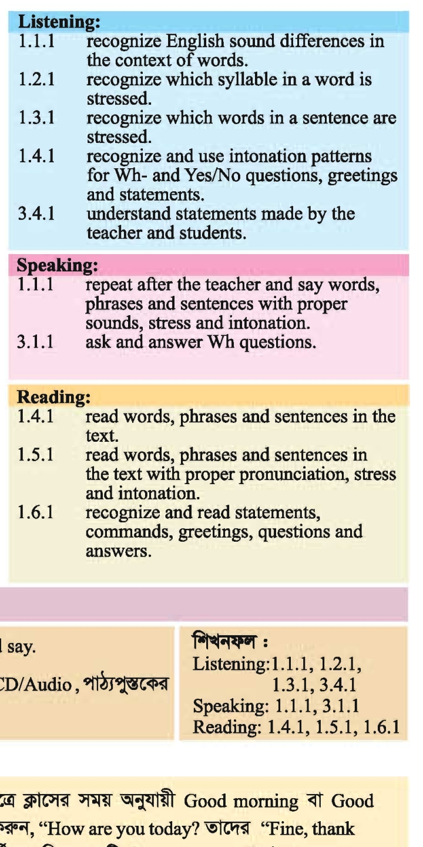
Learning Outcome
Students will be able to learn------

Slide 5
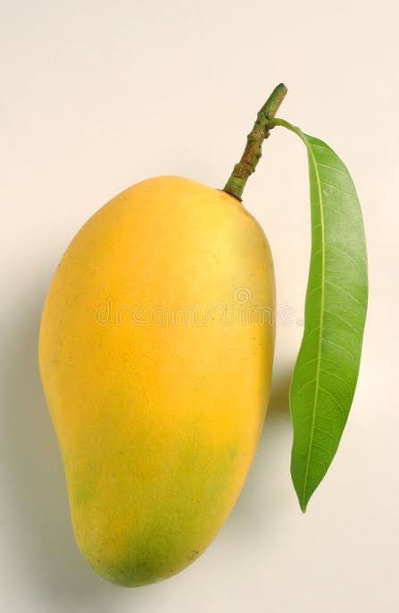
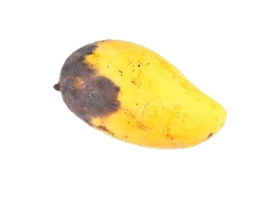
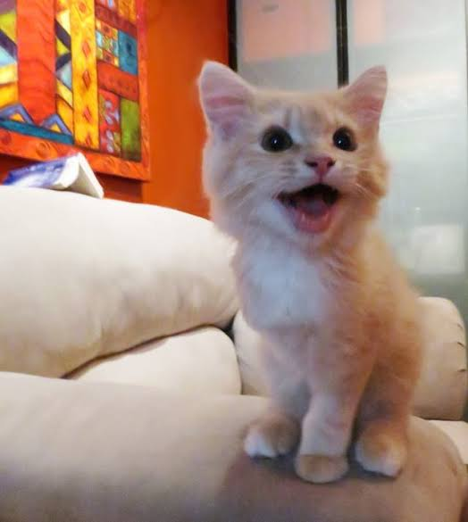
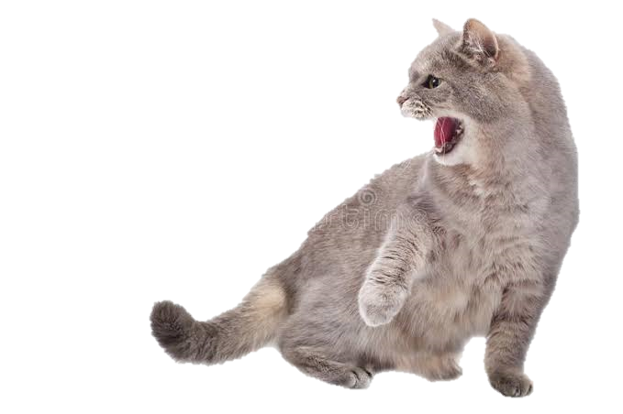
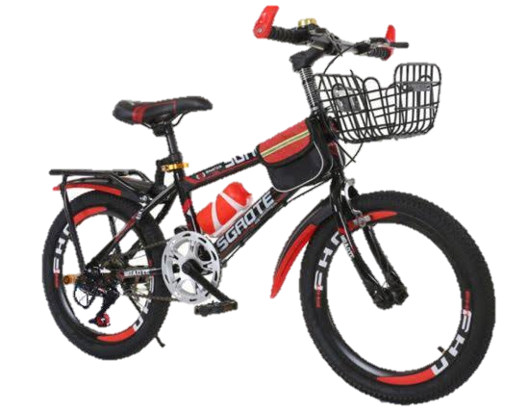
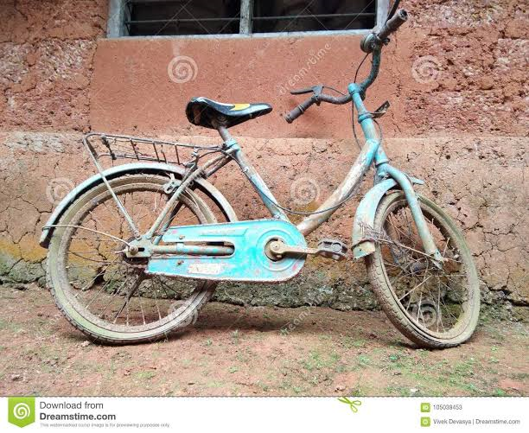
Look at the picture.
What can you see in the picture?

Slide 6
Today’s lesson
Food and meals-2

Slide 7
Let’s see some new words
Fresh
তাজা
Bad
খারাপ
Clean
পরিষ্কার
Dirty
ময়লাযুক্ত
New
নতুন
Old
পুরাতন
Happy
খুশি
Angry
রাগান্বিত

Slide 8
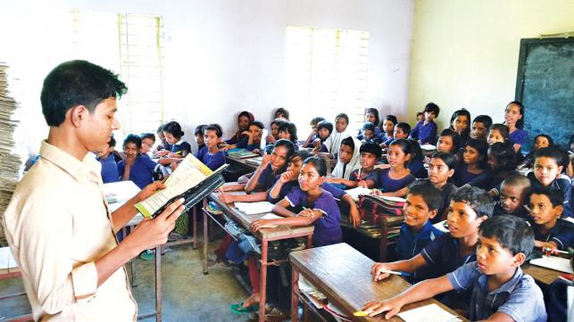
Page-44

Slide 9
A fresh mango.
A bad mango.

Slide 10
A clean shirt.
A dirty shirt.

Slide 11
A new bike.
An old bike.

Slide 12
A happy cat.
An angry cat.

Slide 13
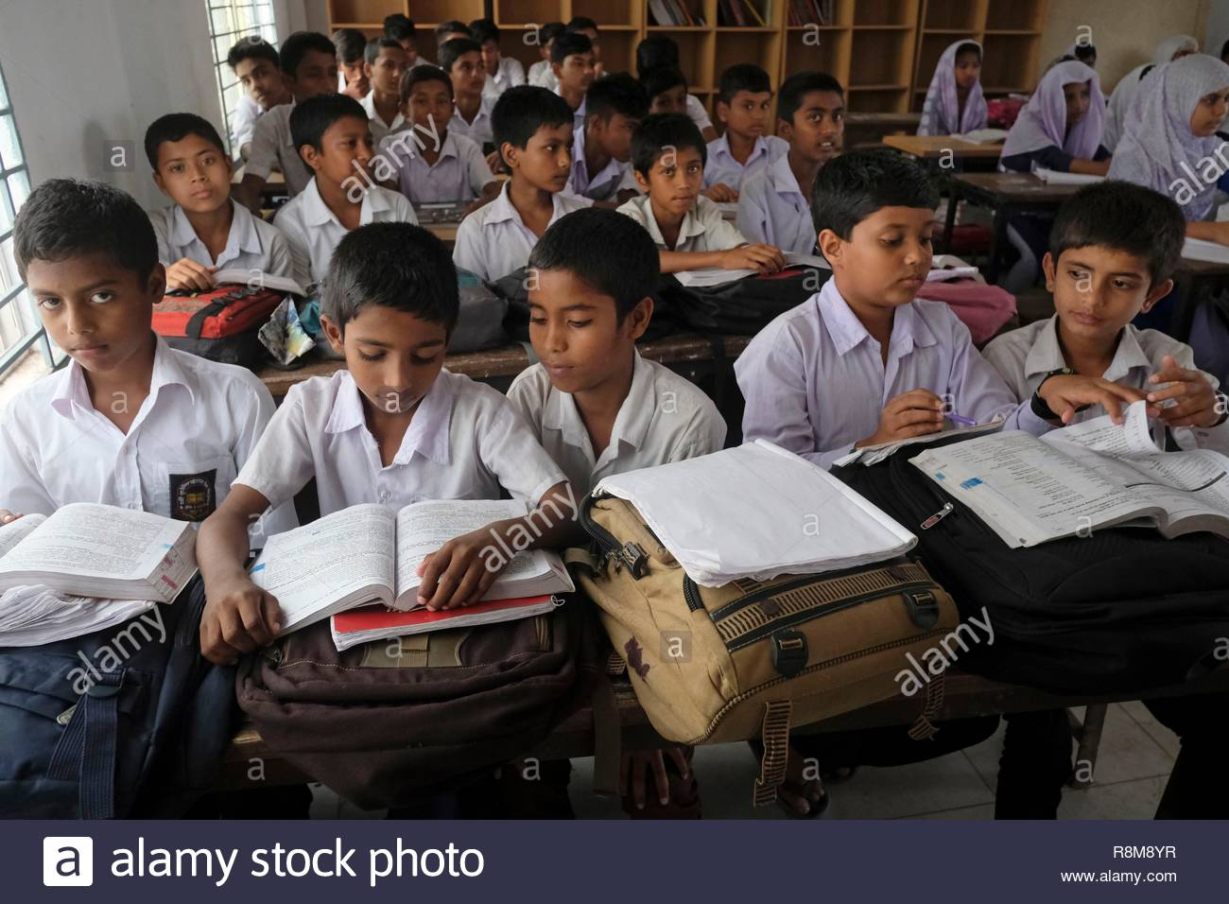
Page-44

Slide 14
Let’s match the sentences with the pictures
A fresh mango.
A dirty shirt.
A new bike.
An angry cat.
A clean shirt.

Slide 15
Say about the pictures
Evaluation
A happy cat.
An old bike.
A bad mango.

Slide 16
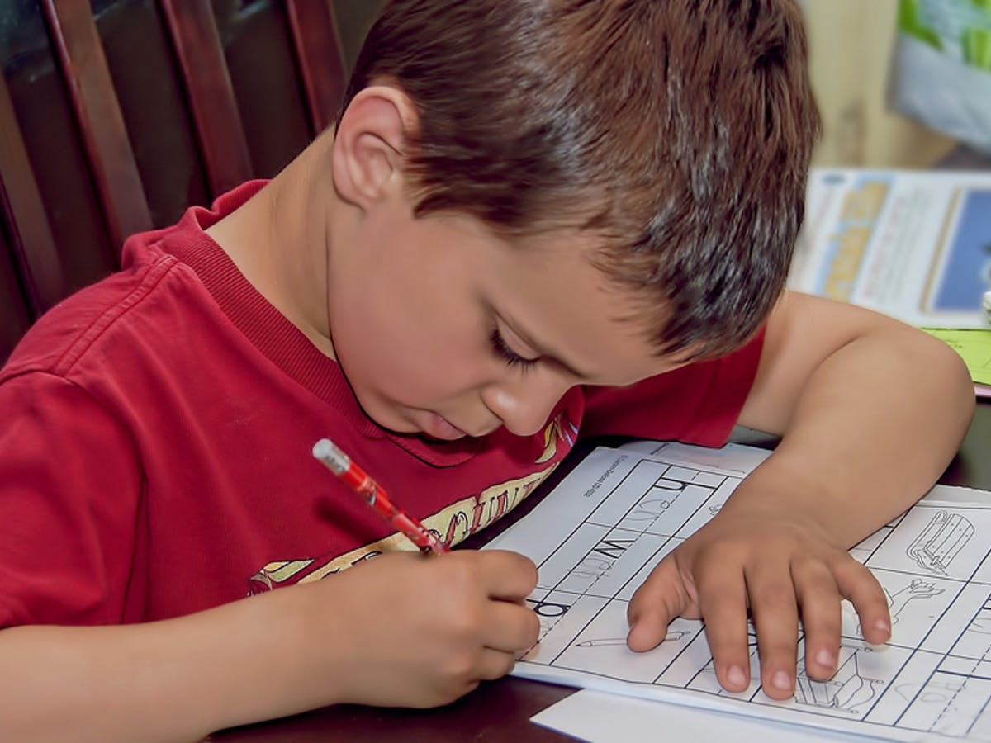
Homework
Write 3 sentences with any names of 3 objects
in your house.

Slide 17
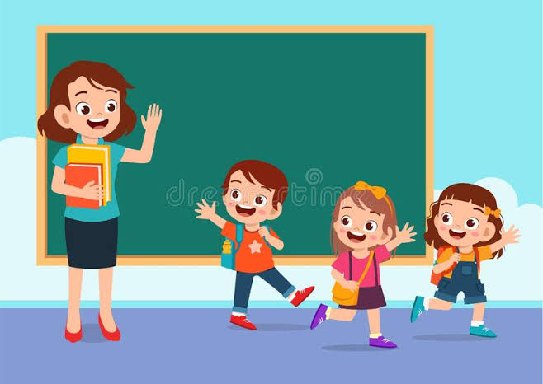
That’s all for today. Goodbye. See you again.
Thank you so much.

