Slide 1
You are welcome to my class.

Slide 2
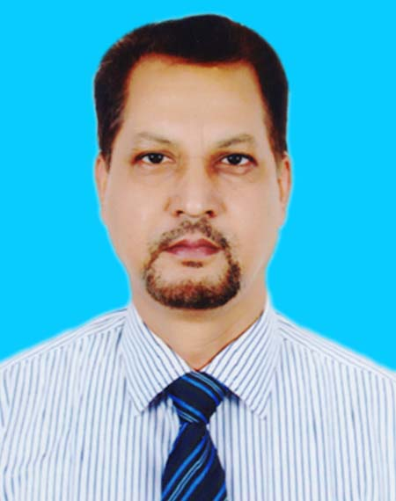
Identity
Md. Mokhlesur Rahman
Head Teacher
Kadam Mobarak City Corp.
High School, Chattogram.
English 2nd Paper
Grammar
Class VIII--X

Slide 3
Let us watch and
guess a video
How dangerous the sea is!
The sea is so dangerous.

Slide 4
Our today’s topic is-
Transformation of sentence
Part-3 (Assertive to Exclamatory)

Slide 5
Learning outcomes
After completing this lesson, we will be able to-
identify assertive sentence
identify exclamatory sentence and its classifications
change from assertive to exclamatory sentence

Slide 6
Please, Observe the Sentences
We enjoyed a very exciting show.
What an exciting show we enjoyed!

Slide 7
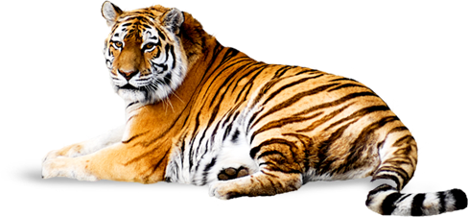
The tiger is a ferocious animal.
Assertive sentence
What a ferocious animal the tiger is!.
Exclamatory sentence

Slide 8
Structure of Assertive Sentence
(a) Subject + verb +a/an + adjective +noun
(‘very/so/too/great’ may have or not after verb)
(b)Subject +verb +adjective
(‘very/so/too/great’ may have or not after verb)
It is a very interesting story. / It is an interesting story.
It is very interesting./ It is interesting.

Slide 9
Structure of Exclamatory Sentence
(a) What + a/an + adjective +subject + verb +!
( adverb ‘very/so/too/great’ will be omitted)
(b) How +Adjective +Subject+ Verb +!
( adverb ‘very/so/too/great’ will be omitted)
Note: Assertive with a/an begins with ‘What’
Assertive without a/an begins with ‘How’
What an interesting story it is!
How interesting it is!

Slide 10
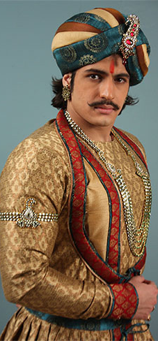
Class Activities
Change the sentences into Exclamatory
Akbar was a very powerful king of India.
He was very handsome.
There was an aristocratic throne for him.
It looked very gorgeous.
He was indeed a successful king.

Slide 11
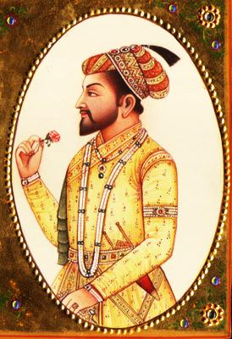
Had I the wings of a bird!
I wish I had the wings of a bird.
If I were a king!
I wish I were a king.
I wish< If/Had +subject +Extension +!

Slide 12
Activities at home
The Padma is a very big river.
It is so deep.
The river contains a vast water.
The water of the river is very useful for the people.
It is beneficial for cultivation.
The fishermen enjoy fishing in the river very cheerfully.
The fish of this river is really tasty.
I wish I had a boat.
I wish I were a fisher man.
I like the river very dearly.

Slide 13
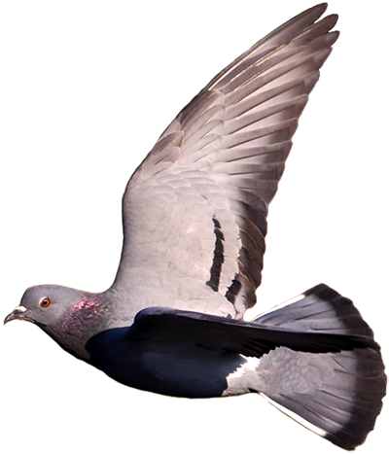
May Allah keep you safe and sound.
Notes:
I am greatful to Hasan Hafizur Rahman as I took different information from his model contents.

