Slide 1
English 2nd Paper Class
for
HSC/ Alim

Slide 2
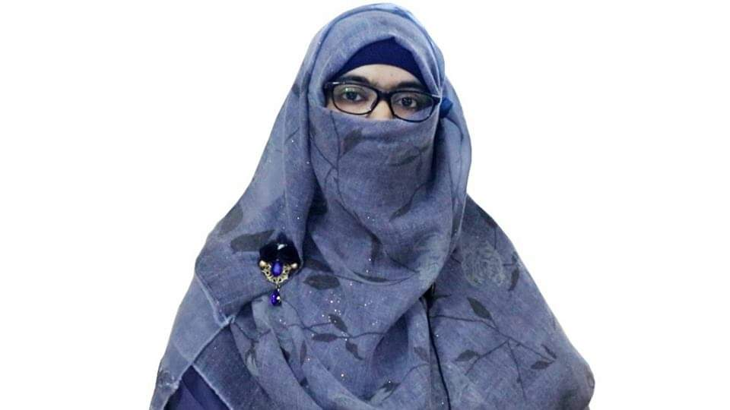
Identity
Sabina Yeasmin
Lecturer in English
Baridhara Nazmul Ulum Alim Madrasah
Badda, Dhaka

Slide 3
Narration Sylhet Board -2019

Slide 4
Indirect: Riyad asked the traffic sergeant why he had stopped him. He also wanted to know if he had done anything wrong.
Sylhet B- 2019
“Why did you stop me?” I did not do anything wrong, did I?” asked Riyad.

Slide 5
“You were driving too fast,” said the traffic sergeant, giving him a glare, “Now! Show me your driving license.”
Giving him a glare the traffic sergeant told him that he had been driving too fast and he also ordered him to show him his driving license then.

Slide 6
Thank you so much
For watching

