Slide 1
English 2nd Paper Class
for
HSC/ Alim

Slide 2
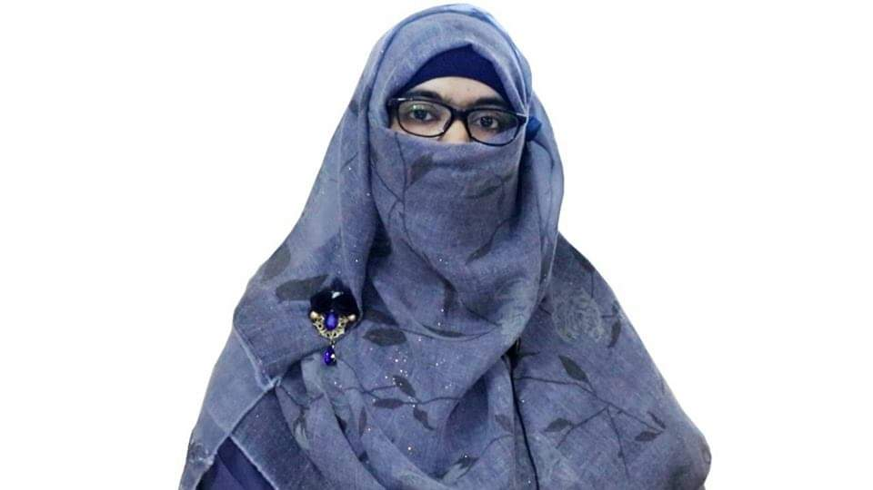
Identity
Sabina Yeasmin
Lecturer in English
Baridhara Nazmul Ulum Alim Madrasah
Badda, Dhaka

Slide 3
Narration Kha Set-2018

Slide 4
3. Kha Set-2018
“Will you buy my hair?” asked Della. “I buy hair,” said Madame. “Take your hat off and let’s have a sight at the looks of it.”
Della asked Madame if she (M) would buy her (D) hair. Madame replied that She (M) bought hair. She (M) requested her (D) to take her (D) hat off and also proposed her (D) that they should have a sight at the looks of it.

Slide 5
“Twenty dollars,” said Madame, lifting the mass with a practiced hand. “Give it to me quick,” said Della.
Madam again told her that she (M) would pay twenty dollars, lifting the mass with a practiced hand. Then Della requested her to give it to her (D) quick.

Slide 6
Thank you so much
For watching

